Slide 1
Pamela Prieto
Director

Slide 2
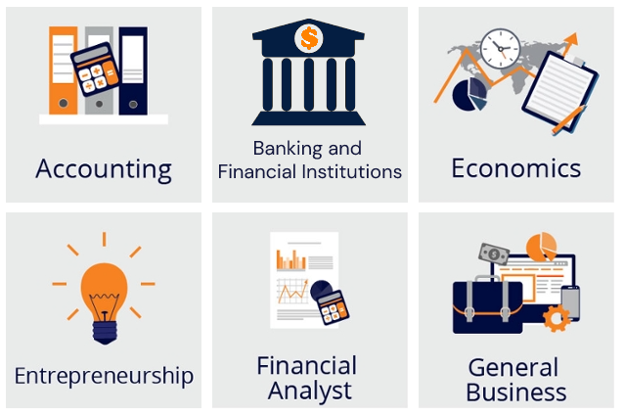
UTEP College of Business Administration

Slide 3
What is risk management?
The process by which to identify, assess and control threats to an organization's capital and earnings.
Risk Management asks: how can we keep our money (or our clients’ money) safe?

Slide 4
Careers in Risk Management
PATH 1 : Risk Analysts
Analyze and measure exposure to credit and market risk threatening the assets, earning capacity, or economic state of an organization.

Slide 5
Where do Risk Analysts work?
Commercial Banks
Investment Companies
Mortgage Firms
Retail & Consumer Companies
Entertainment Companies
Companies that manage large sums of money, investments, real estate, etc.

Slide 6
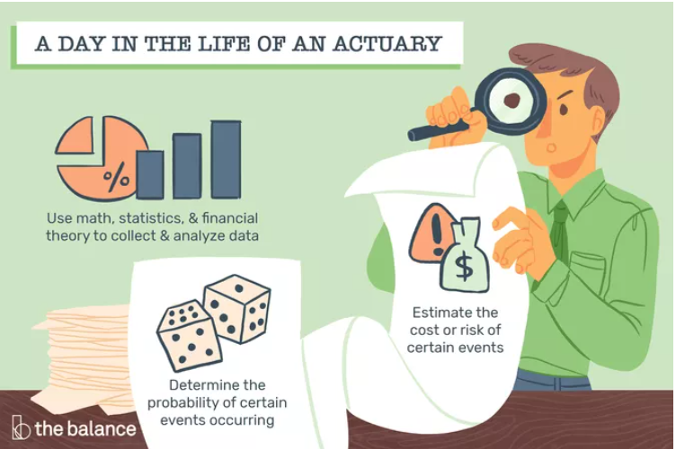
Careers in Risk Management
PATH 2 : Actuaries
Evaluate the probability of certain events happening and the potential costs associated with them.
Help their employers develop policies to help minimize those costs.

Slide 7
Where do Actuaries work?
Insurance Companies
Essential and everywhere
Stable, recession-proof jobs
Aging population
High salaries
Good work/life balance
Financial Services Firms
Consulting Firms
Government Agencies

Slide 8
Types of Actuaries & Actuarial Certifications
Life & Retirement
Property & Casualty
Surplus Lines
Life
Health
Retirement
Pensions
General Insurance (property and casualty)
Auto
Homes
Businesses
Non-standard, new or emerging lines of business like:
Start-ups
Art collections
Entertainers
Self-driving cars

Slide 9
Career Outlook
Risk Analysts
Actuaries
Annual Job Openings: 41,000
Salary
Entry level (lowest 10%): $48,740
Median: $81,410
Annual Job Openings: 2,400
Salary
Entry Level: (lowest 10%): $63,260
Median: $105,900
Average annual starting salary for UTEP RKMG graduates: $61,088
bls.gov/ooh/

Slide 10
Where do UTEP grads work?

Slide 11
UTEP Risk Management Program
Bachelor of Business Administration in Finance
Concentration in Risk Management
Courses built into the curriculum to help you pass the first two actuarial exams
Calculus I-III
Actuarial Quantitative Methods I & II (P Exam)
Actuarial Finance I & II (FM Exam)
Pass Rates
UTEP Students Exam Pass Rate = 50%
National Average Exam Pass Rate = 45%

Slide 12
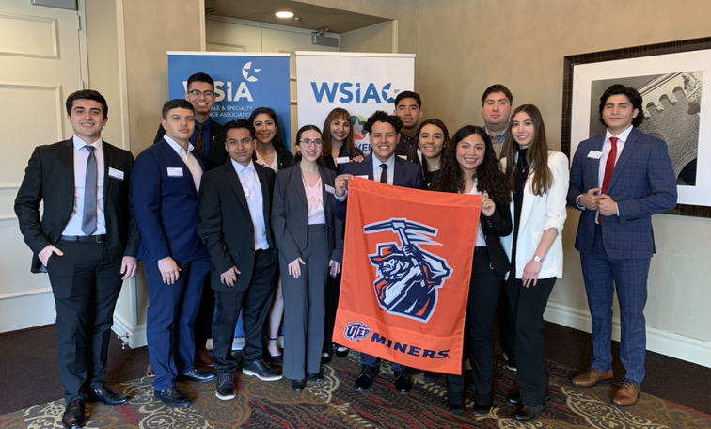
Prudential Risk Management Academy
Financial Support for the first Actuarial Exams
Academic Support through tutoring and test-prep materials
Professional Development Events
Mentorship Program
Travel Opportunities
Internship Opportunities

Slide 13
Gamma Iota Sigma
Mission Statement:
To diversify the insurance industry's student talent across all functional areas through innovative partnerships, industry support, campus engagement, and a professional network.

Slide 14
Is RKMG right for you?
Do you love math and business?
Do you consider yourself a problem solver?
Are you looking for networking, mentorship and travel opportunities?
Do you want to graduate with a highly marketable degree?
Are you ready for a challenge?

Slide 15
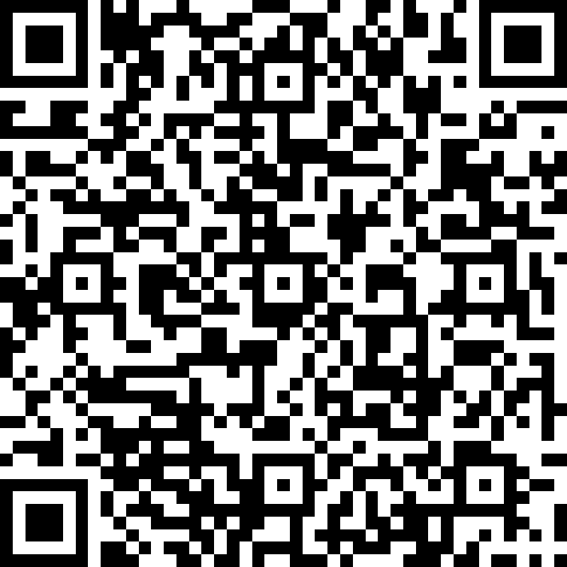
Diversity in Insurance Summer Bridge Program
When: July 11 and 12
Where: UTEP Campus
Who: High School Juniors & Seniors
What: Join us to learn more about careers in insurance and about life as a UTEP student!
How: Scan the QR Code and fill out the form to receive more information.

Slide 16
Let’s Play!
Insurance Trivia

Slide 17
Pamela Prieto
pprieto@utep.edu
utep.edu/riskmanagement

