Slide 1
Effects of Manual Resistance Training
By: Lizette Terrazas

Slide 2
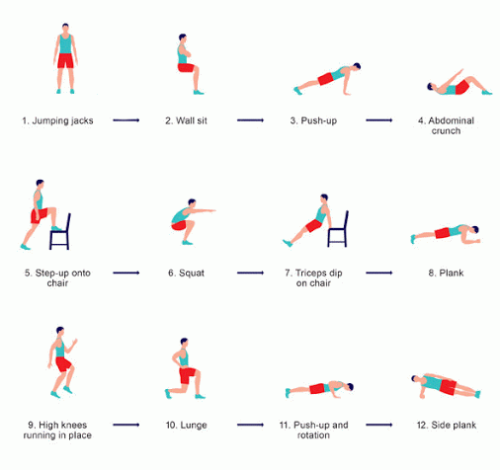
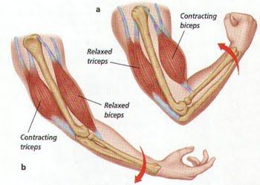
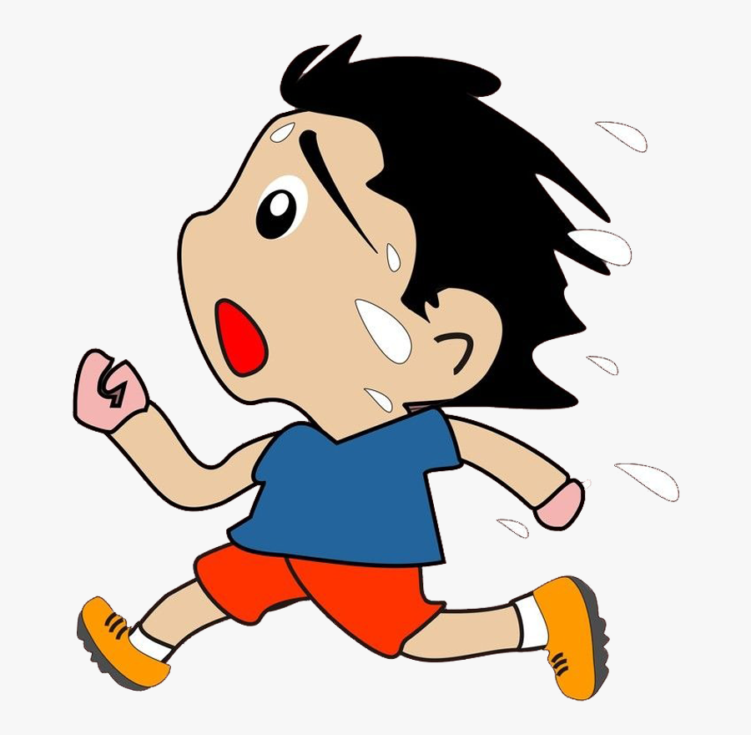
What is Exercise?
Physical activity that is planned or structured.
Resistance Exercise (Weights)
Exercises that cause muscles to contract against a
weight
Cardiovascular Exercise (Cardio)
Exercises that cause the heart rate
to go up and overall, your system to work hard

Slide 3
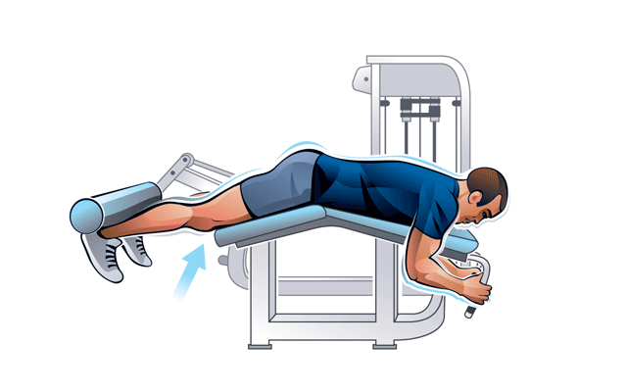
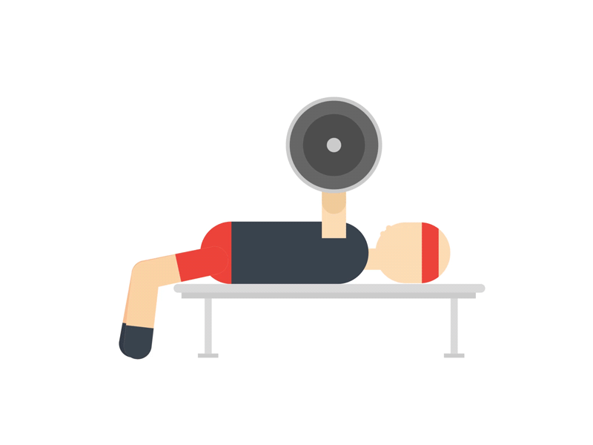
Manual Resistance Training
Example 2: Leg Curl
A type of Resistance Training
Exercises done with a partner
Requires minimum equipment
Example 1: Bench Press

Slide 4
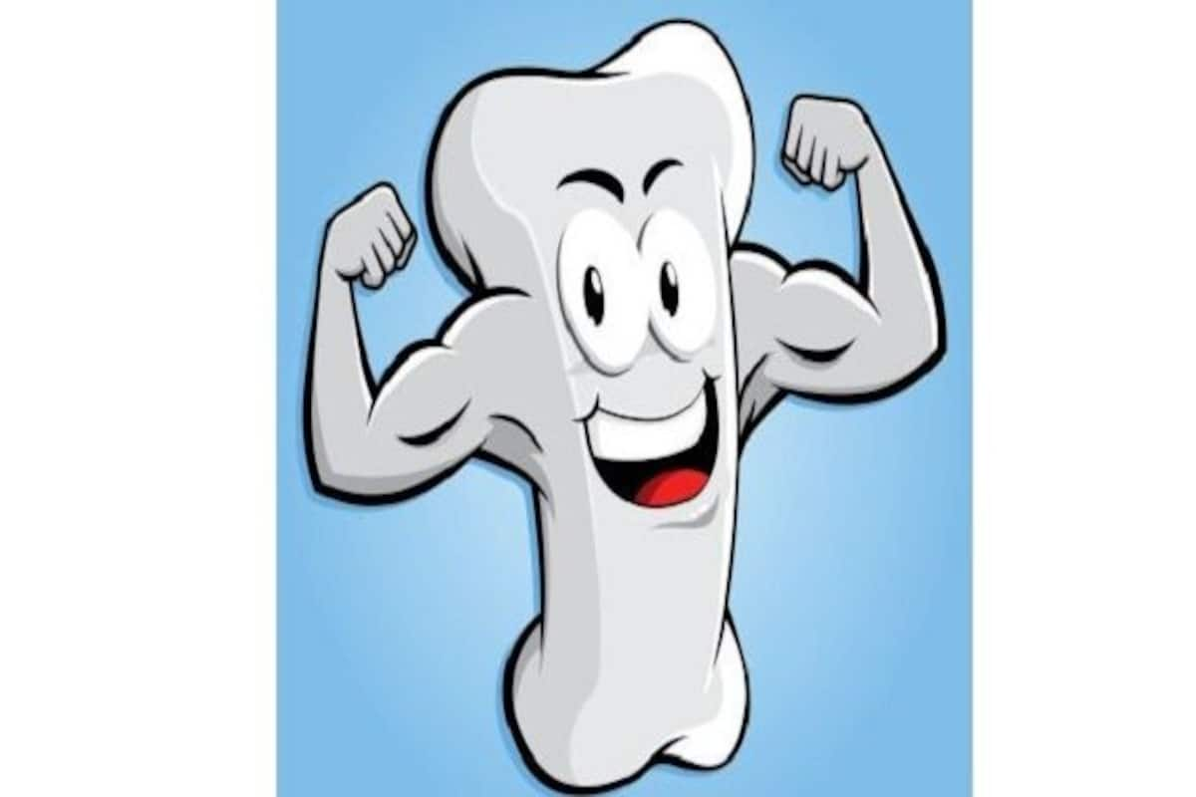
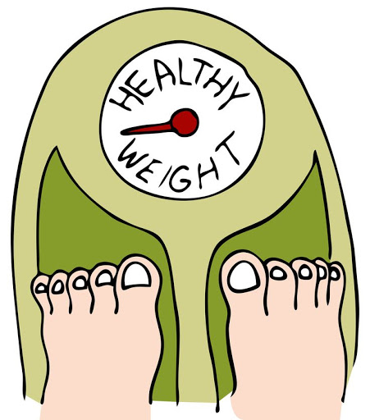
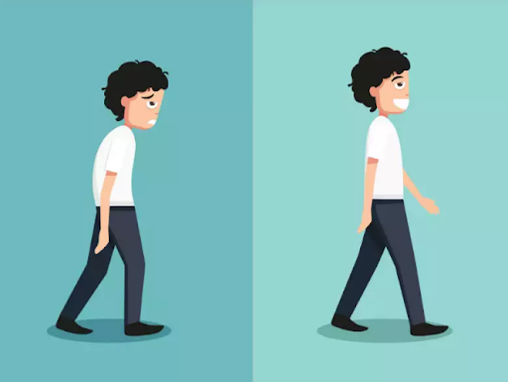
Benefits of Exercise
Improves and maintains posture, mobility, and balance
Creates stronger bones, tendons, ligaments
It controls weight
Improves mood and boosts energy

Slide 5
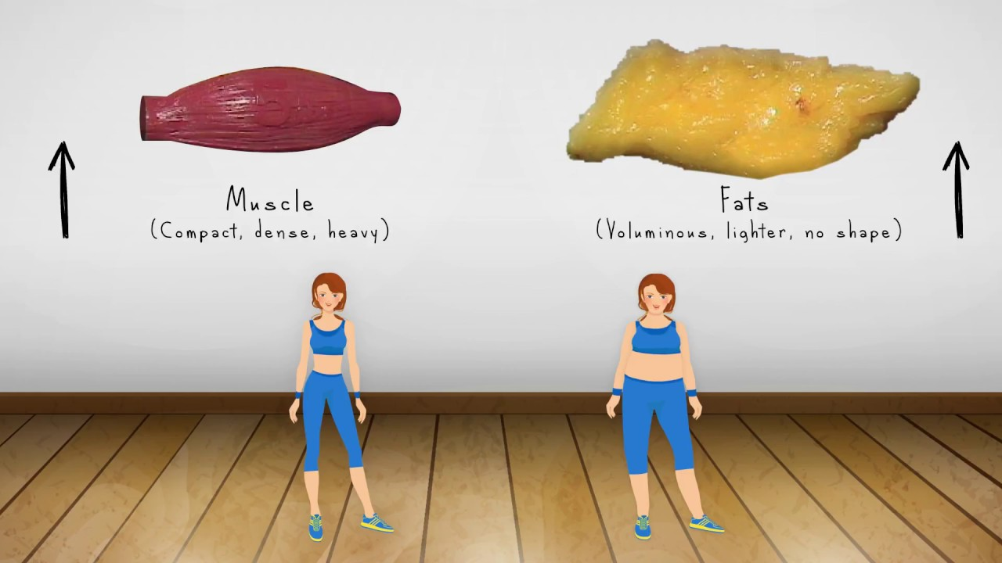
Why is exercise important?
Improves Health:
Lowers the risk of developing diseases:
Type 2 diabetes
Cancer
Cardiovascular diseases
Improve quality of life
Helps maintain weight

Slide 6
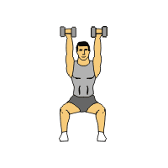
Research Study
Title: Effects of Manual Resistance Training on Body Composition in Young Adults
Purpose:
1. To view the difference in body composition and strength in 3 groups (Manual Resistance Training, Weight Resistance Training, and control groups) after an 8-week training
2. To compare the changes in all three groups

Slide 7
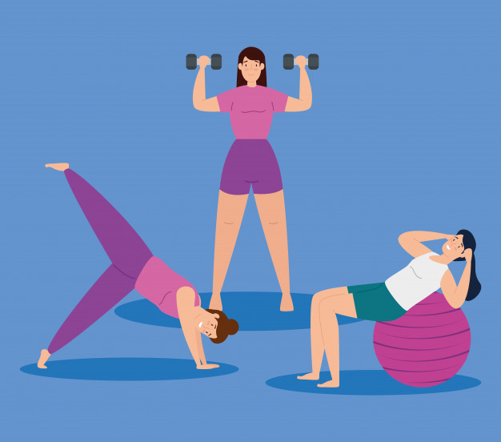
Research Study Cont.
Subjects: 30 young adults (18 females, 12 males)
Each group had 10 subjects (6 females, 4 males)
For the MRT and Weight Resistance Groups
Each Exercised 2x per week for 1 hour
Before the training started, the subjects had to do different tests

Slide 8
Dual-energy X-ray absorptiometry (DEXA) scan
Measures Body Composition:
Lean Mass
Fat Mass
Bone Mineral Density
A machine that scans the body for 10-15 minutes

Slide 9
Muscular Strength
Isometric Bench Press
- Tells us the strength of the upper body through force
Isometric Mid-thigh Pull
-Tells us the strength of the lower body through force

Slide 10
Muscular Strength
One Repetition Maximum:
Bench Press
Tells us the strength of the upper body by using weights
Unilateral Leg Press
Tells us the strength of the lower body by using weights

Slide 11
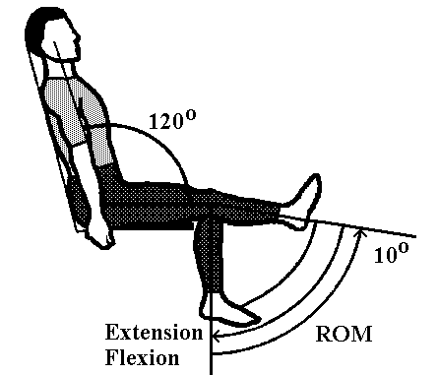
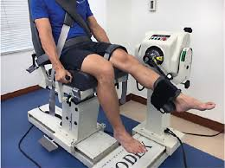
Muscular Strength
Isokinetic Knee flexion/extension (BIODEX)
- Tells us the strength of the lower body by force

Slide 13
Results
No statistical differences (p>0.05) were observed in body composition from pre to post testing

Slide 14
Results
Difference in 1RMBP in the WRT group only
Difference in 1RMLP in the WRT and MRT groups only

Slide 15
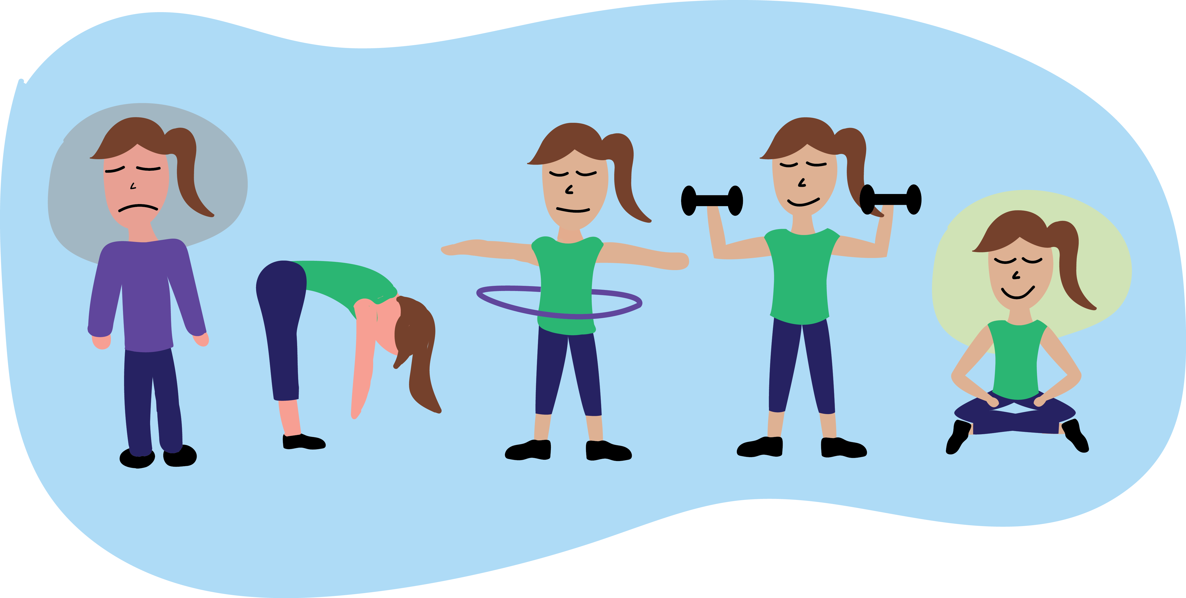
Conclusion
No changes were seen in body composition measurements in any groups
Increase in strength was shown in the MRT and WRT groups
Future Studies should investigate interventions with longer periods to know if there is a change in body composition

