Slide 1
Daltile Facility Analysis
Presenters
Dhari Alsaeedi |Mohammed Alqahtani |Smyer Ajhajri |Abdulaziz Alazemi

Slide 2
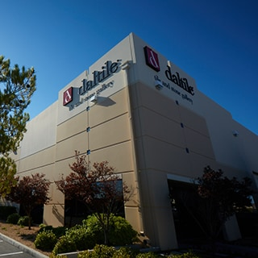
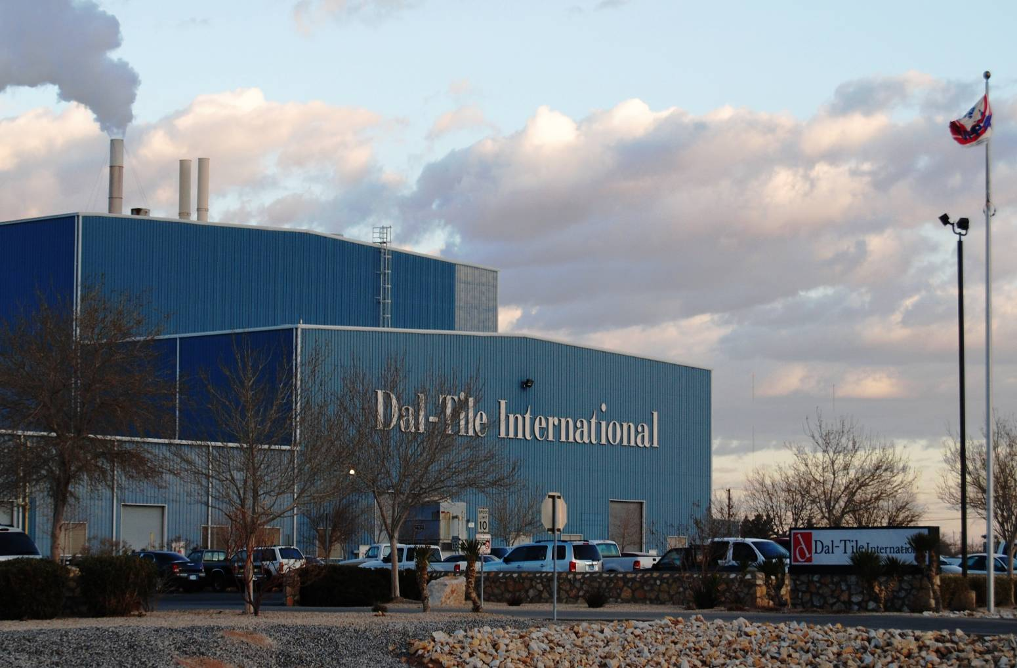
Daltile Facility
Daltile is America's leader in porcelain tile and natural stone and the world's leading manufacturer of ceramic tile.
Dal-Tile is a subsidiary of Mohawk Industries, the world's largest flooring company
Mohawk's integrated manufacturing and distribution processes provide advantages in production of carpet, ceramic tile, laminate, wood, stone and vinyl flooring.
The facility is located at El Paso, TX and is one of the biggest plant for Dal-tile in terms of production
Notes:
The test prep segment has the highest capital inflow and the greatest demand in Indi test preparation (from K-12 to entrance exams) and online certification. To put this into perspective, between 2014 to 2019, startups in test prep and online certification startups earned a whopping 88% ($1.6 Bn) of the total capital inflow in edtech. The skewness in funding and investor interest for test prep and online certification startups is in line with the prevalence of the grades-first mentality in the Indian market as well as the need for skilled tech labour.

Slide 3
Strong Management and Operations
Dal-Tile has more than 9,000 employees in North America and sells its products through a network of more than 300 company-owned sales service centers.
Effective Supply chain
Corporate relations
Dal-Tile Corporation is a subsidiary of the world’s largest flooring company, Mohawk Industries
Excellence since 1947
For over 70 years, Daltile has led the tile industry being a leader in ceramic, porcelain and mosaics
Visionary leadership
The management team consists of skilled professionals with deep industry experience

Slide 4
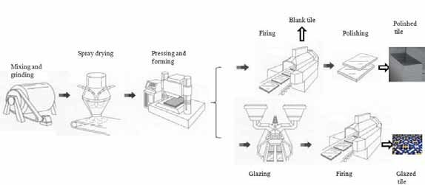
Tile Manufacturing Process
Once the raw materials are processed, a number of steps take place to obtain the finished product. These steps include batching, mixing and grinding, spray-drying, forming, drying, glazing, and firing. Many of these steps are now accomplished using automated equipment.
Batching
It is important to mix the right amounts together to achieve the desired properties. Batch calculations are thus required, which must take into consideration both physical properties and chemical compositions of the raw materials. Once the appropriate weight of each raw material is determined, the raw materials must be mixed together.

Slide 5
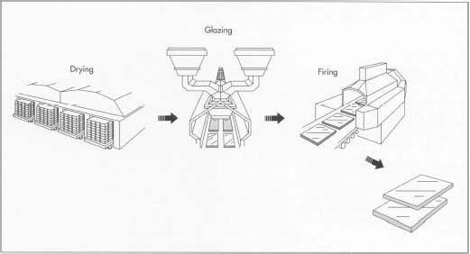
Tile Manufacturing Process
Mixing and grinding
Once the ingredients are weighed, they are added together into a shell mixer, ribbon mixer, or intensive mixer. A shell mixer consists of two cylinders joined into a V, which rotates to tumble and mix the material.
Spray drying
If wet milling is first used, the excess water is usually removed via spray drying. This involves pumping the slurry to an atomizer consisting of a rapidly rotating disk or nozzle.
Drying: Ceramic tile usually must be dried (at high relative humidity) after forming, especially if a wet method is used. Drying, which can take several days, removes the water at a slow enough rate to prevent shrinkage cracks.
Glazing: To prepare the glaze, similar methods are used as for the tile body. After a batch formulation is calculated, the raw materials are weighed, mixed and dry or wet milled. The milled glazes are then applied using one of the many methods available.
Firing: After glazing, the tile must be heated intensely to strengthen it and give it the desired porosity. In this process,
the tile goes through a low-temperature firing called bisque firing before glazing. This step removes the volatiles from the
material and most or all of the shrinkage. The body and glaze are then fired together in a process called glost firing.

Slide 6
Recent Developments in tile industry
PANEL PROLIFERATION Manufacturers are currently utilizing a new technology that is changing the industry dramatically with regard to large-format porcelain panel products.
WOOD FOR GOOD If you’re wondering whether the wood trend is fading yet, your first mistake is considering it a “trend” at all, say the experts with whom we spoke. By all accounts, wood looks are here to stay.
PRICING There is price pressure as the dollar has strengthened, and we can import for less. There is also pressure applied by other flooring categories-both sheet and vinyl tile. These are fairly hot products, and they add price pressure because they install for less money than porcelain. For the most part, because the market is good, Daltile is not under any undue pressure.
STIFF COMPETITON IN HARD SURFACE
Over the course of the last few years, there has been a great deal of discussion about competition both within the ceramic tile category, as a result of the increase in U.S. manufacturing, and from outside the category, with multiplying hard surface options, especially in the resilient market.

Slide 7
Complication Analysis
STEP 1 Identification of problem
STEP 2 Requirement to improve
STEP 3
Current Scenario
STEP 4 Analysis

Slide 8
Complication Analysis
STEP 1 Identification of problem

Slide 9
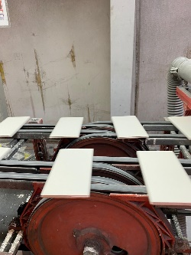
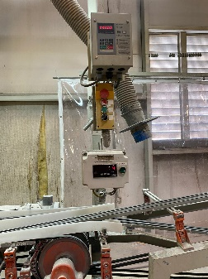
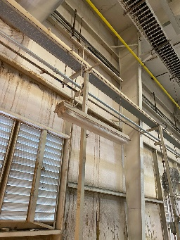
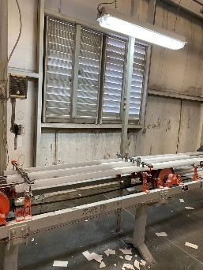
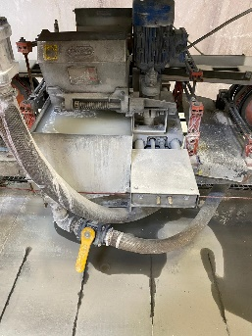
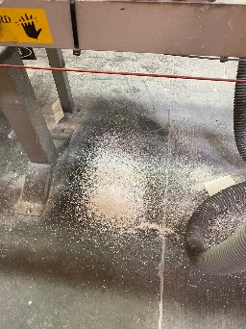
Identification of Problem
Paint inside the facility has not been maintained properly
There have been complaints of wear and tear inside the facility
Interior Designing
Illumination
There are corners in the facility which are not illuminated
It decreases the operational area in the facility
Machinery Efficiency
The machines at the facility are not maintained regularly
It decreases the operational efficiency of the facility

Slide 10
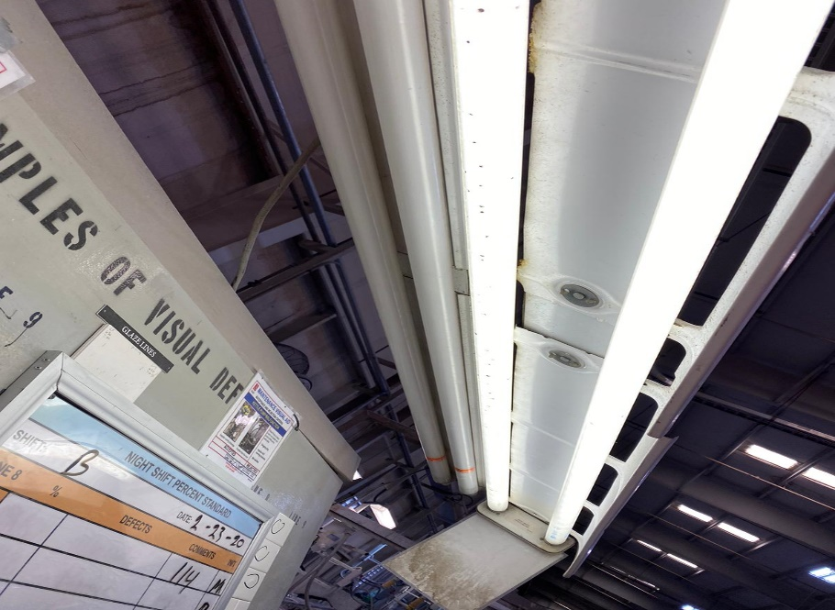
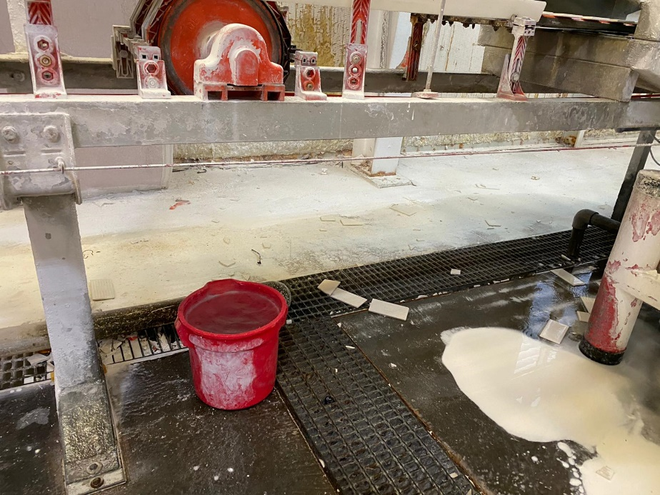
Interior Designing
Plant’s interior structure has been in poor shape
Paint has been wearing off in the facility
It impacts the facility’s productivity
It impacts the overall moral of the workers

Slide 11
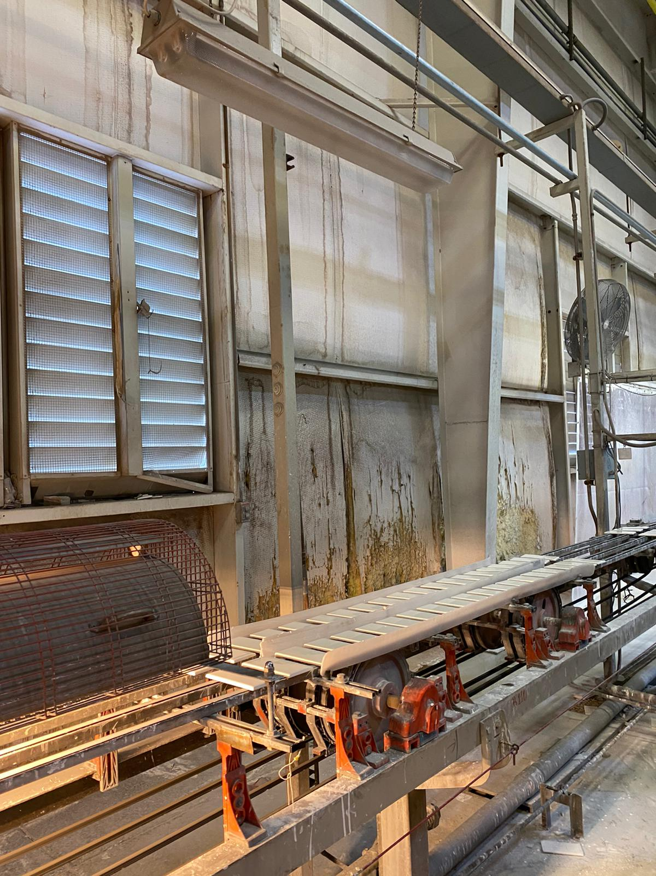
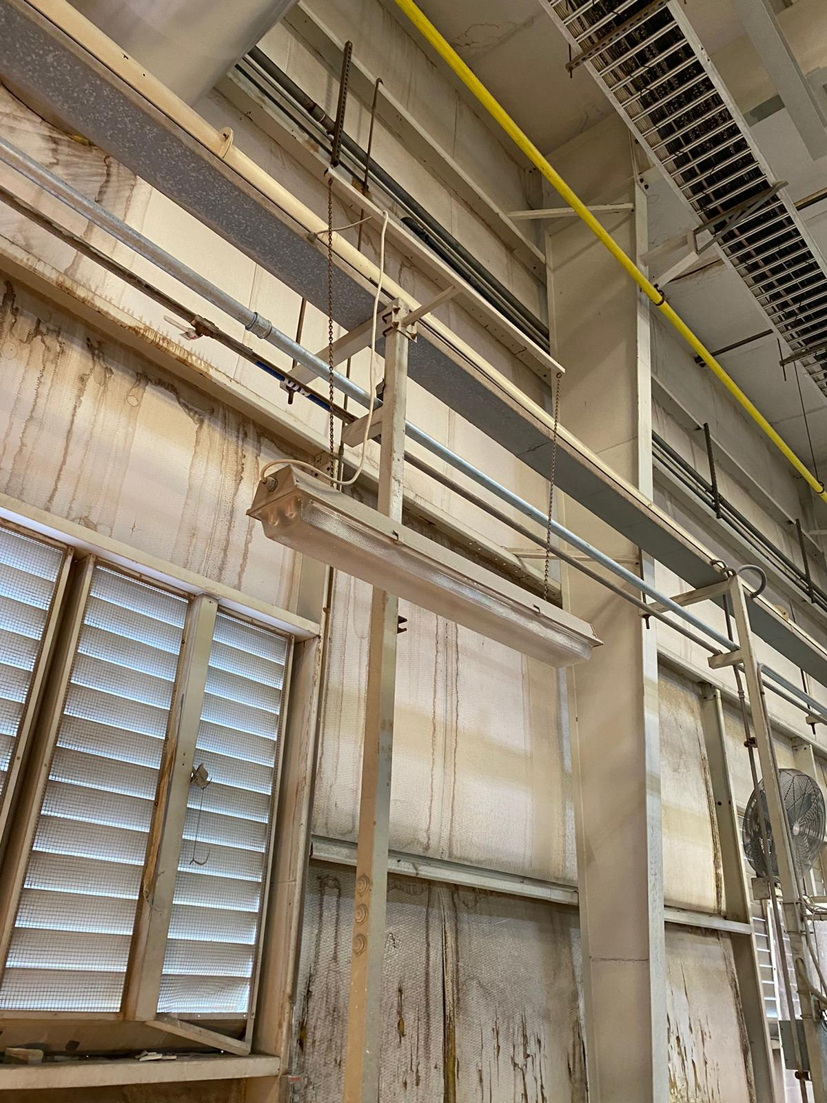
Illumination
Improper illumination has impacted facility’s productivity
The facility is not properly illuminated
Lack of illumination has been impacting labourer’s access to facility area
The facility doesn’t have direct access to sunlight which impacts workers health

Slide 12
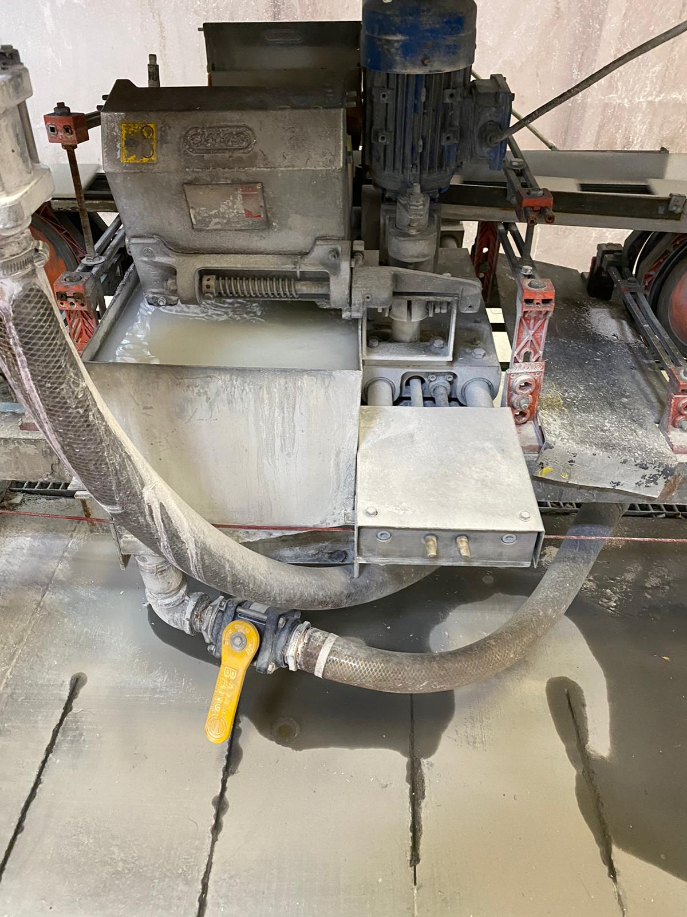
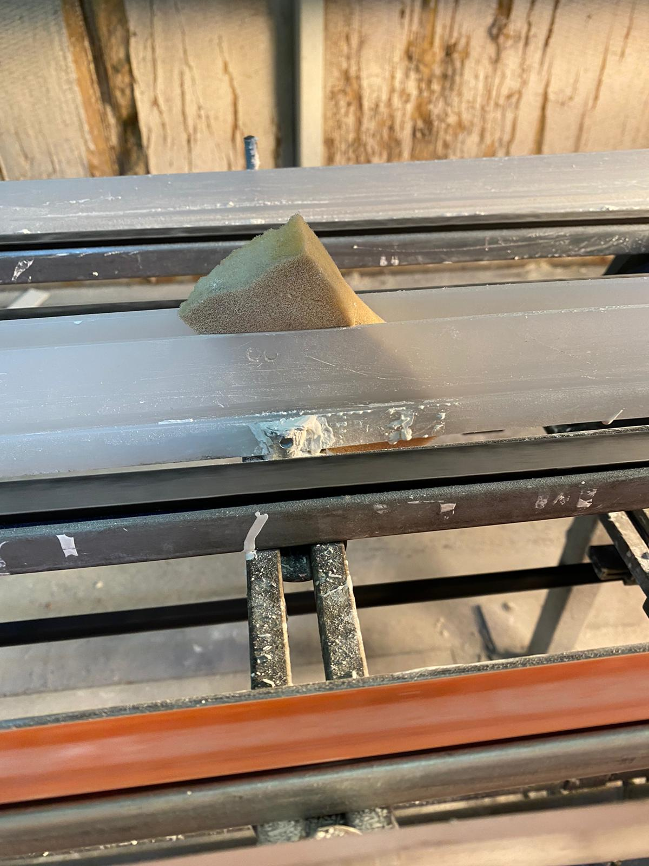
Machinery Efficiency
Lack of maintenance in company’s operations
Machinery is worn down and depreciating
It has led to loss of raw materials and production
Lack of machinery maintenance is also risky for workers in the facility

Slide 13
Complication Analysis
STEP 2 Requirement to improve

Slide 14
Requirement to improve
There are primarily two reasons why the existing complications in the facility need to be worked upon and improved to the latest standards:
Operational Concerns 2. Facility’s Profitability Concerns
To achieve minimum breakdown
To keep the plant in good working condition at the lowest cost
To reduce raw materials waste
To reduce downtime
To increase production quantity
Equipment breakdown leads to loss of production
It also affects production management
To increase production quality
To increase facility’s productivity
To improve facility’s area usability

Slide 15
Complication Analysis
STEP 3
Current Scenario

Slide 16
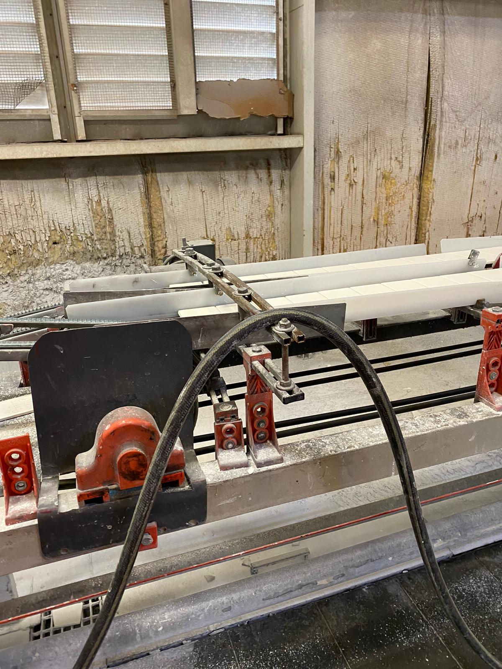
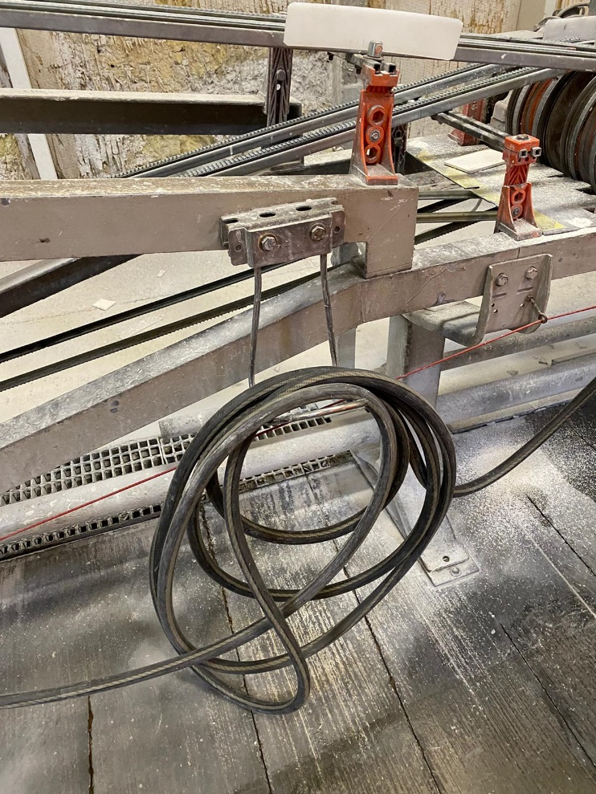
Current Scenario
Just when you think operations are running smoothly, the market changes—and then changes again. To cope with the markets, Daltile has been managing the supply levels accordingly and operating effectively. But with ongoing operations, the facility has been lagging on multiple fronts when it comes to efficient production:
Lack of maintenance Loss of inventory

Slide 17
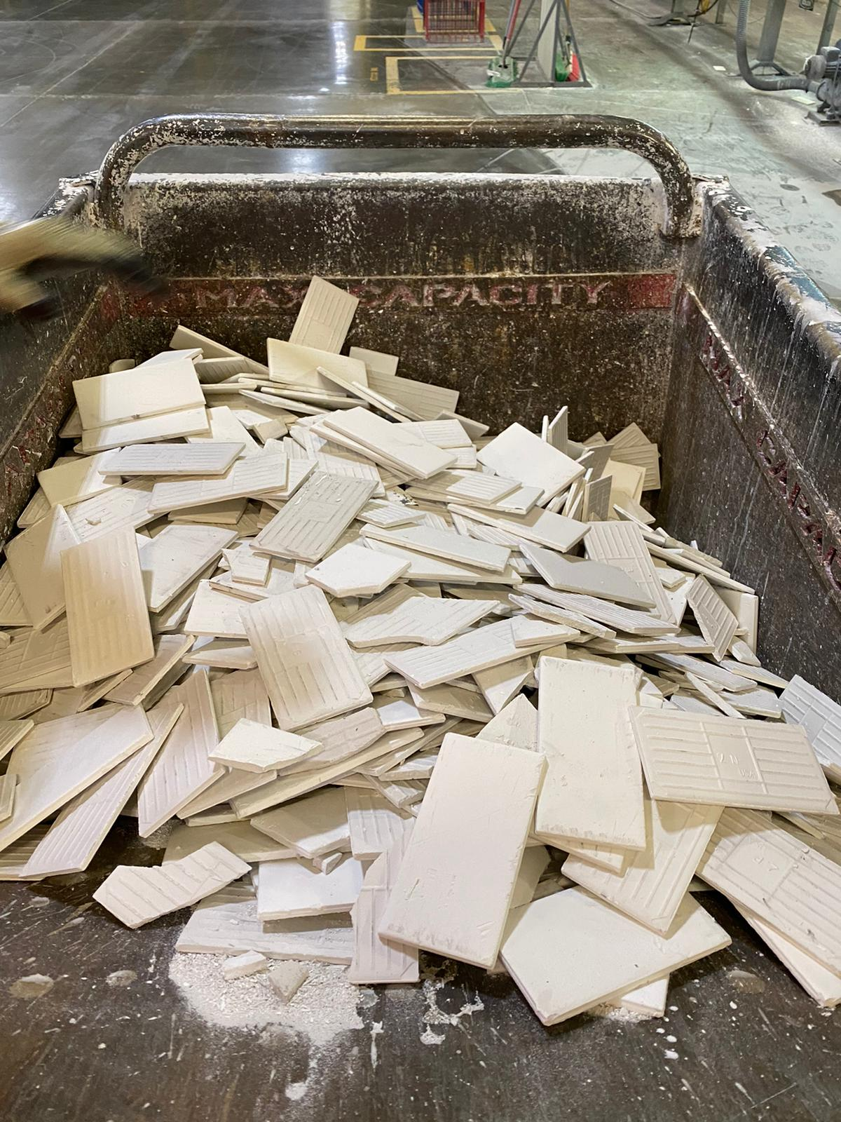
Current Scenario
Just when you think operations are running smoothly, the market changes—and then changes again. To cope with the markets, Daltile has been managing the supply levels accordingly and operating effectively. But with ongoing operations, the facility has been lagging on multiple fronts when it comes to efficient production:
Improper Production Increased Downtime

Slide 18
Complication Analysis
STEP 4 Analysis

Slide 19
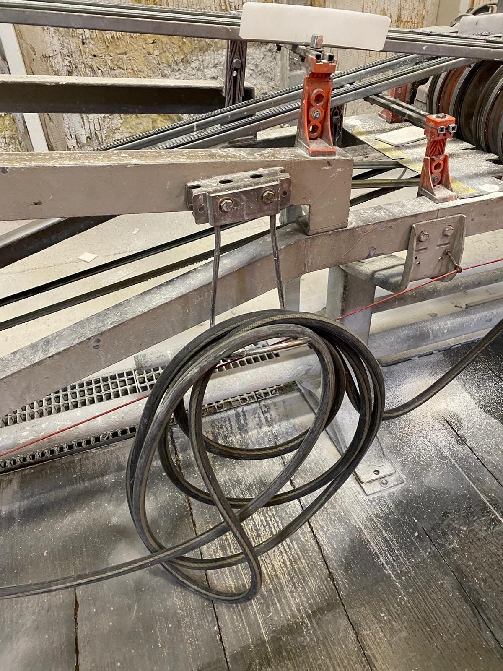
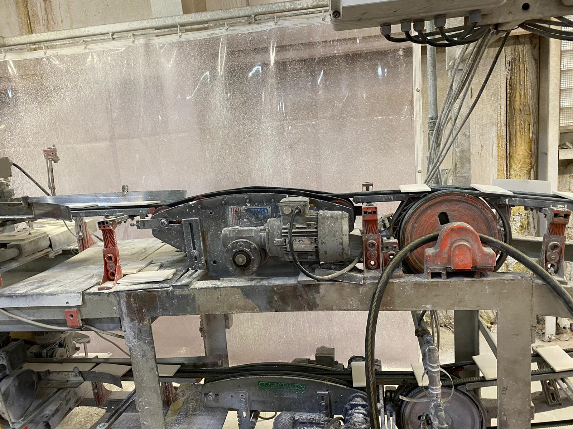
Current status
The plant facility is not up to the mark when it comes to interior and machinery maintenance. Due care needs to be taken else poor maintenance will impact the facility’s efficiency and bottom line.

Slide 20
Insights with Impact
Avenues Methodology
Key findings
Proprietary methodologies
Key problems
Evidence-based approach
Potential solutions
Leading edge analytical tools
Execution
Superior analytical capabilities

Slide 21
Insights with Impact
Insights with Impact
Key Findings
Key Problems
Potential Solutions
Execution
Worn out machinery
Lack of maintenance
Ill-maintained operations
Improper alignment of glides
Poor maintenance
Old machinery, highly depreciating
Poor Illumination in the facility
Impact on production quality
Impact on plant’s productivity
Introduction of new machinery
Regular maintenance of machinery
Periodic maintenance of facility
Introduction of cost effective illumination
Instant maintenance of machinery
Acquisition of machinery parts, cost amortized
Outsourcing facility (non machinery) maintenance
Implementation of biweekly maintenance of machinery parts

Slide 22
Ishikawa Diagram
Ishikawa diagrams are causal diagrams created by Kaoru Ishikawa that show the causes of a specific event. Common uses of the Ishikawa diagram are product design and quality defect prevention to identify potential factors causing an overall effect.
Advantages
Highly visual brainstorming tool which can spark further examples of root causes
Quickly identify if the root cause is found multiple times in the same or different causal tree
Allows one to see all causes simultaneously
Good visualization for presenting issues to stakeholders
Disadvantages
Complex defects might yield a lot of causes which might become visually cluttering
Interrelationships between causes are not easily identifiable

Slide 23
Ishikawa Diagram
The 5 Ms (used in manufacturing)
Originating with lean manufacturing and the Toyota Production System, the 5 Ms is one of the most common frameworks for root-cause analysis:
Man / mind power (physical or knowledge work, includes: Kaizens, suggestions)
Machine (equipment, technology)
Material (includes raw material, consumables, and information)
Method (process)
Measurement / medium (inspection, environment)

Slide 24
Solution to improve productivity
Updated Methods
Depreciating Machinery
Methods
Machine
Latest technologies
Ill maintained machinery
Optimum Manpower
Loss in Productivity
5M’s
Manpower
Low average age
Leader in Ceramics
Optimum measurement
Materials
Measurement
Usage of latest materials
New age instruments
The diagram shows the changes that are required to stop the loss of productivity in the plant

Slide 25
Solution to improve productivity
MANPOWER: With quality manpower of low average age, plant can be made more efficient.
MACHINERY: Updation of depreciating and ill maintained machinery with new age technology can improve plant’s productivity.
MEASUREMENT: With usage of perfect and new age tech measurement devices, loss in raw materials and degrading quality of output can be avoided.
METHODS: Implementation of new age technology methods in the plant’s production will lead to improved quality of tile produce and hence improve company’s profitability.
MATERIALS: Usage of latest and optimum raw materials in production will help Daltile in maintaining their leading position in ceramic based tile production.

Slide 26
Solutions to improve maintenance
The different types of maintenance that can be applied in Daltile are described below:
Corrective Maintenance: Replace the components when they fail. Repair systems when the error occurs.
Preventive or Cyclical Maintenance: Replace the components before they fail. Repair the equipment before its expected failure date independently of the condition of the component at the time of the action. Traditional preventive maintenance is based on the concept of preventing the failure before it occurs.
Predictive or “Condition-based” Maintenance: Take corrective action when problems are detected during the monitoring of the component. Monitoring of the condition is carried out to detect potential failures and to then provide maintenance. This is done after verifying “the current condition of the component”, and only if this condition indicates that the repair is necessary.
Proactive Maintenance: Avoid maintenance problems by identifying and correcting the root causes of failure. Avoid situations that cause the premature failure of components. Total maintenance costs are reduced.

Slide 27
Solutions to improve productivity management
1. The TPM - maintenance method tool
This aims to progressively change maintenance techniques in order to increase equipment output. This method allows you to avoid unplanned shutdowns, time loss every time a technician turns on a machine or waste when pieces of equipment are deficient. As a result, ineffective equipment or lack of attention from certain technicians are not a problem anymore. In order to get to this point, TPM is divided into three clear tools:
the overall output rate, which is an indicator for the equipment use rate;
the 5 Ss:
Seiri – Sort;
Seiton – Set In Order;
Seiso – Shine;
Seiketsu – Standardize;
Shitsuke – Sustain;

Slide 28
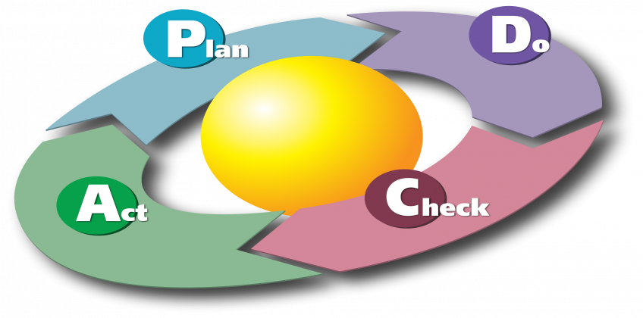
Solutions to improve productivity management
2. The PDCA - maintenance method tool
The PDCA, or Deming wheel, is a technique aiming to enhance your industrial projects anticipation and management. This tool helps you organize your ideas and divide the work you have to do into several steps in order to ensure that everything goes well. The PDCA acronym corresponds to:
P – “Plan”: plan what you are going to do
D – “Do”: do what was planned
C – “Check”: check that the work done corresponds to what was planned in the first place
A – “Act”: react according to the assessment of the work done.

Slide 29
References
https://www.daltile.com/why-daltile/national-reach
https://www.daltile.com/about-us/company-information
https://managementhelp.org/operationsmanagement/
https://www.moresteam.com/toolbox/ishikawa-diagram.cfm
https://whatis.techtarget.com/definition/ishikawa-diagram
https://www.fiixsoftware.com/blog/evaluating-maintenance-strategies-select-model-asset-management/
http://www.lysator.liu.se/~ej/public_notes/public_notesse2.html
https://www.researchgate.net/publication/291176641_Techniques_and_Tools_for_Maintenance_Management
https://www.moresteam.com/toolbox/fishbone-diagram.cfm
https://whatis.techtarget.com/definition/fishbone-diagram

Slide 30
Thank you!

