Slide 1
Observation Unit Patient Discharge Optimization

Slide 2
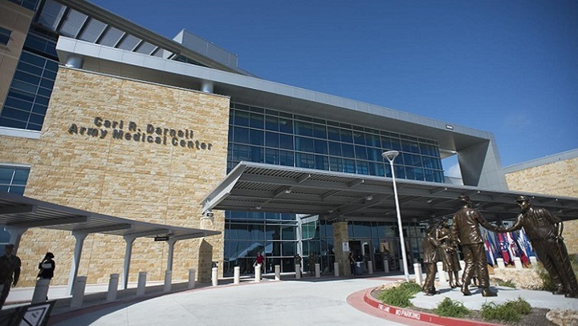
Problem Statement
The University Medical Center has the need to decrease the length of stay of a patient that is under the care of the Observation Unit, the goal is to optimize the time from 36 hrs. to at least 30 hrs.

Slide 3
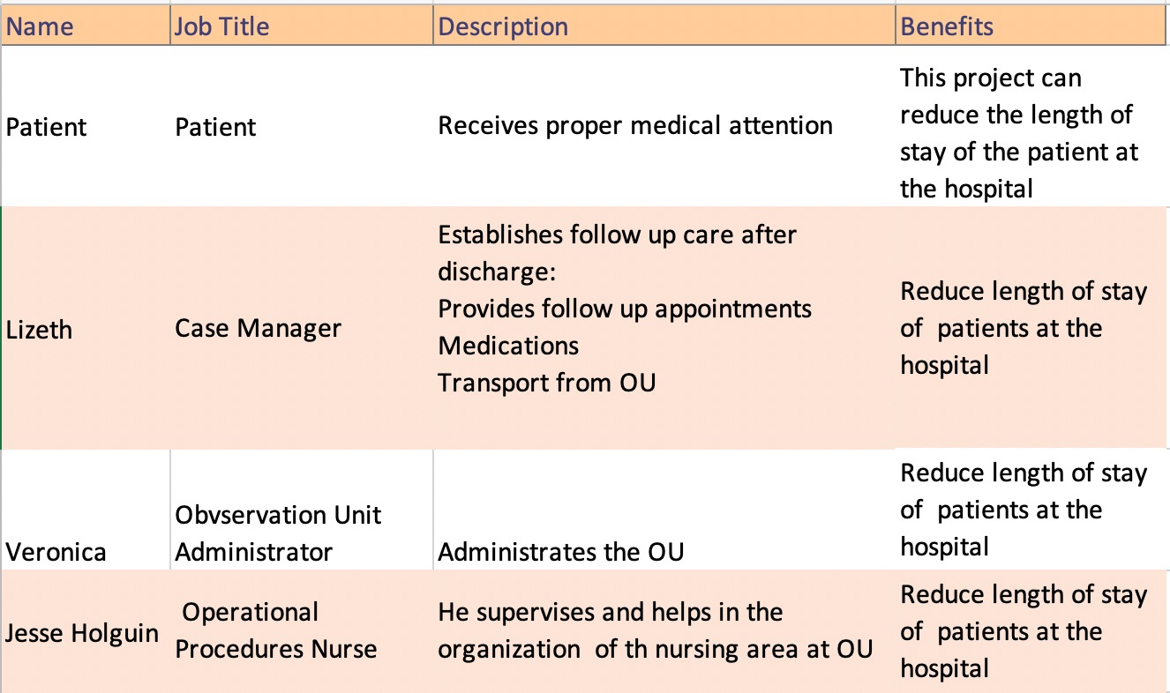
Stakeholders List

Slide 4
Project objective
Decrease the length of stay of outpatients in the Observation Unit (OU) . The goal is to decrease the time from 36 hours to at least 30 hours at the room in the OU.
Enhance communication in the OU to optimize workflow and atmosphere. As Jesse Holguin (registered nurse of the observation unit) said we need to communicate to make the work successful.
Establish processes that have longevity and room for continuous improvement.
To raise the OU’s priority in the operations of all ancillary services in the highest rank before the Emergency Department.

Slide 5
1. The hospital just recently created a new unit called an Observation Unit. The program was implemented four months ago for that reason, historical data is limited.
2. The time that it takes to translate the patient from the emergency to the observation unit can affect the length of stay due to some delay or difficulties that the transporter may face during the transportation of the patient, at the most the hospital has 5 transporters at the same time for the whole hospital.
3. Environmental services are a department at the hospital that has the duty to clean and disinfect the room in order that is safe and hygienic for the next patient. The time to clean a room may be an important factor impacting length of stay.
4. The pharmacy needs to give specific medications to the patients, frequently it takes too long for the pharmacy to deliver the medicines to the patients at the time of discharge.
5. In some cases patients may be taken to the incorrect unit.
6. For most patients it is necessary to make laboratory examinations, this may take more time than necessary because the observation unit it's not a priority for the hospital and may take longer to have the laboratory examinations.
Technical Problems

Slide 6
IE Tools
1. Excel
2. Visio
3. Six Sigma DMAIC approach
4. Pivot Tables
5. Surveys

Slide 7
Data collected in our measure phase of DMAIC
Data Collected Measure Phase of DMAIC​
Interpretation of processes to design process flow maps for General System (Moment of entry to discharge of the patient), admission to Emergency Department, ED, and OU.
Spreadsheet with raw data regarding the OU. It includes length of stay for patients, symptoms, causes, tests ordered, physicians that are taking care of patient, and all required medical cares.
Information from interviewing hospital staff, terminology, practices and concerns for a better understanding of the systems and people part of the organization.

Slide 8
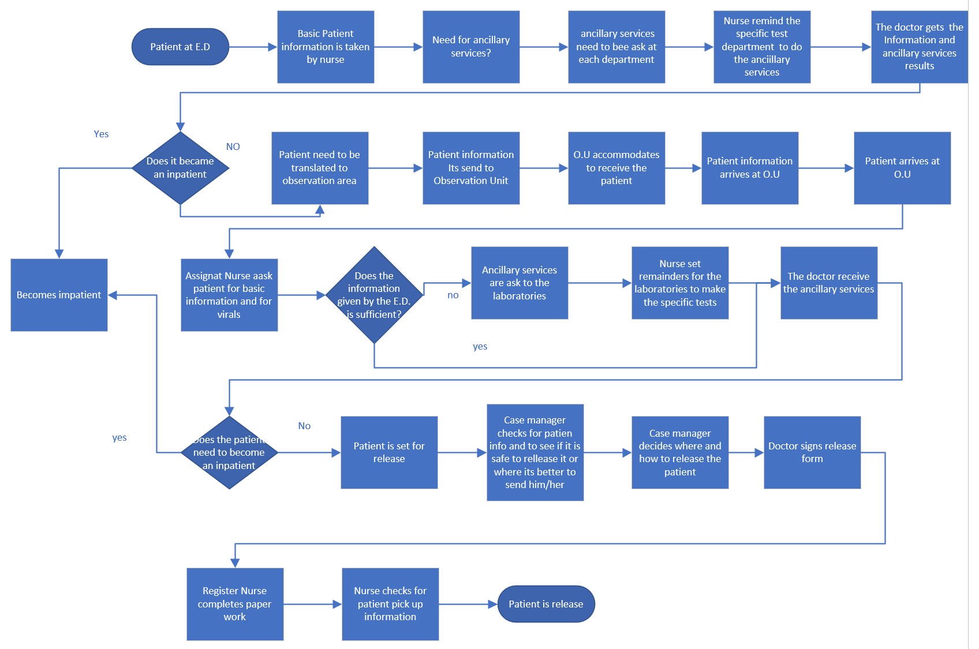
Process Map: General System

Slide 9
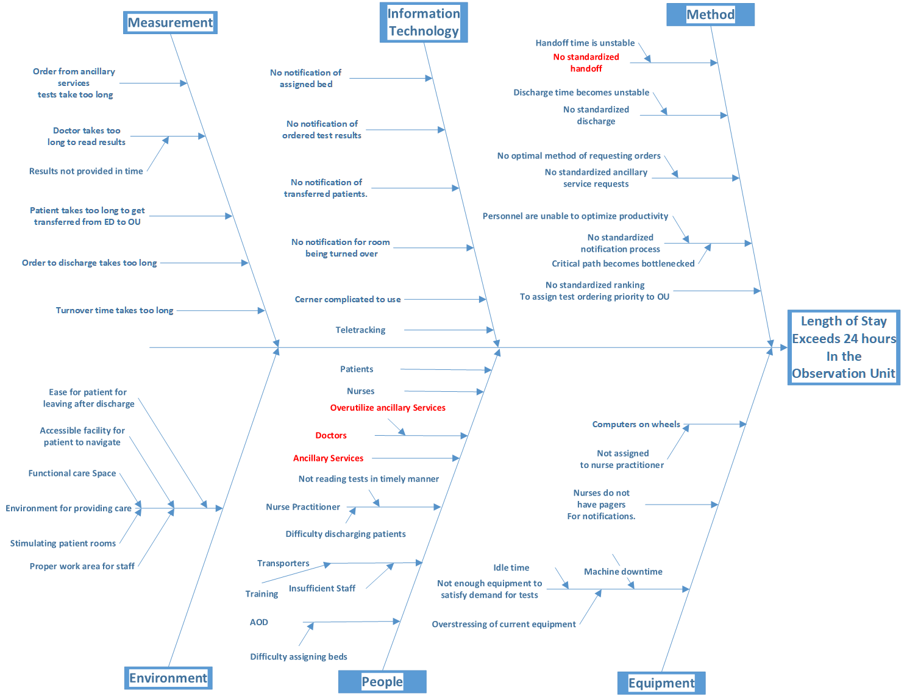
Cause and Effect Diagram for Analysis

Slide 10
Results of the Analysis of OU Raw Data

Slide 11
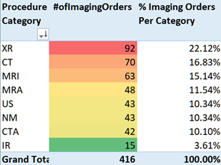
Most Ordered Imaging Categories
The top 3 most ordered categories of tests in descending order are:
1. XR
2. CT
3. MRI.

Slide 12
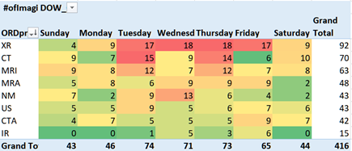
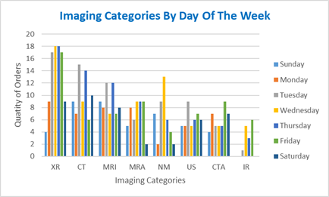
Utilization of Imaging Services by Grouping per day of week
As indicated by the data below Tuesday, Wednesday and Thursday see the most orders respectively out of all of the days of the week

Slide 13
Top 5 doctors that sign ordered test results in Imaging
These are the radiologists that have signed at least 10 orders ranked by shortest average (shorter is better) and Dr. Ezhapilli has the best average, out of this particular top 5 Dr. Gavito has the longest read to sign average.

Slide 14
Busiest Times of the day for Imaging

Slide 15
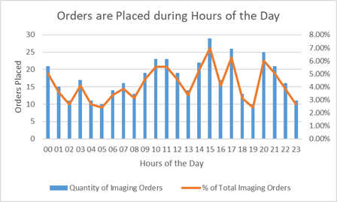

Slide 16
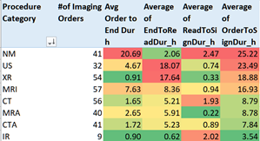
Average Durations by Procedure Category

Slide 17
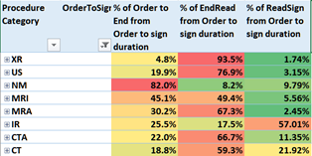
Fraction of Orders in Stages by Procedure Category

Slide 18
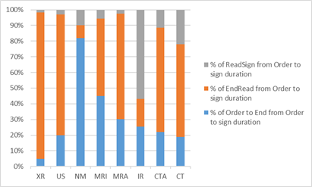

Slide 19
Imaging Activity in Terms of Days of The Week

Slide 20
Generation of Design Solution

Slide 21
Design Solution
Utilization Review Committee (URC)
Nuclear medicine test orders
Ultrasound
MRI
Lack of ordered tests standard for prioritization

Slide 22
Methodology used to generate design solution
The methodology to arrive to a solution would be to analyze the imaging section deeper. This could lead to discover underlying issues such as but not limited to:
•Shortage of staff
•Inefficiency in the use of time and resources
•Insufficient testing equipment
•Lack of communication within departments and with other departments
•Inefficiency to allocate staff
•Lack of training
•Lack of standardization
•Inadequate prioritization system

Slide 23
Conclusions
With the averages of order to sign durations shown in section 3.5.7 it is clear that it is not feasible for the OBSU (regardless of the way the data is sliced) to meet their targeted Length of Stay window of <24 hours and thus our analysis of this particular aspect strongly suggests that the problem is underlying in the bottlenecking that occurs in the imaging ancillary services section.
The team strongly believes that overhauling the Utilization Review Committee to educate and correct overutilization behaviors among hospital personnel would have the deepest impact and in a sense it could be a catch all of sorts to avoid waste and increase efficiency, which would ultimately lead to a reduction in the Length of Stay of the OU.

Slide 24
Lessons Learned
Performing analysis under real world conditions
Must not lose
Curiosity
Persistence
Patience
Expanded knowledge on analyzing data with
Pivot Tables
Advanced Formulas
Data Models
You can learn anything as long as you want to put in the work

Slide 25
References
UMC New Employee orientation from https://www.epcc.edu/Academics/Health/Nursing/Documents/UMC_Online_Student_Orientation.pdf
Issa, & E., D. (2017, January 5). H.R.21 - 115th Congress (2017-2018): Midnight Rules Relief Act of 2017. Retrieved from https://www.congress.gov/bill/115th-congress/house-bill/21
CRC Press. (2012). Lean Six Sigma for the healthcare enterprise: methods, tools, and applications. Boca Raton.
CRC Press. (2012). Lean Six Sigma for the healthcare enterprise: methods, tools, and applications. Boca Raton. Determine and Validate Root Causes pp 45
Ahmed, S. (2019). Integrating DMAIC approach of Lean Six Sigma and theory of constraints toward quality improvement in healthcare, Reviews on Environmental Health, 34(4), 427-434. doi: https://doi.org/10.1515/reveh-2019-0003
Fukazawa, Y., Sakamoto, K., Kuboaki, S., Washizaki, H., & Shiohama, R. (2016). Investigating the relationship between project constraints and appropriate iteration length in agile development through simulations. International Journal of Computer Applications in Technology, 54(4), 311. https://doi:10.1504/ijcat.2016.10001351
Hawkins, J. W., & Haggerty, L. A. (2003). Diversity in health care research: Strategies for multisite, multidisciplinary, and multicultural projects. New York: Springer Pub.​
Iswanto, A. H. (2019). Lean implementation in hospital departments: How to move from good to great services. New York, NY : Productivity Press​
Kerzner, H. (2017). Project management: A systems approach to planning, scheduling, and controlling. Hoboken, New Jersey : Wiley, 2017​
Protocol-Driven Emergency Department Observation Units. (2017). Journal of Emergency Nursing, 43(5), 457–463. https://doi.org/10.1016/S0099-1767(17)30397-5​

