Slide 1
PRODUCT SEPARATION SYSTEM DESIGN
Group members :
Retaj Bourabaa
Masoud Almutairi
Rawan Bourabaa
Khaled Alazemi
Abdullah Aldaas

Slide 2
Introduction:
Color as a vital parameter for segregation
Aim is to design an optical separator
It works on major 2 steps :
Read Color
Separate object

Slide 3
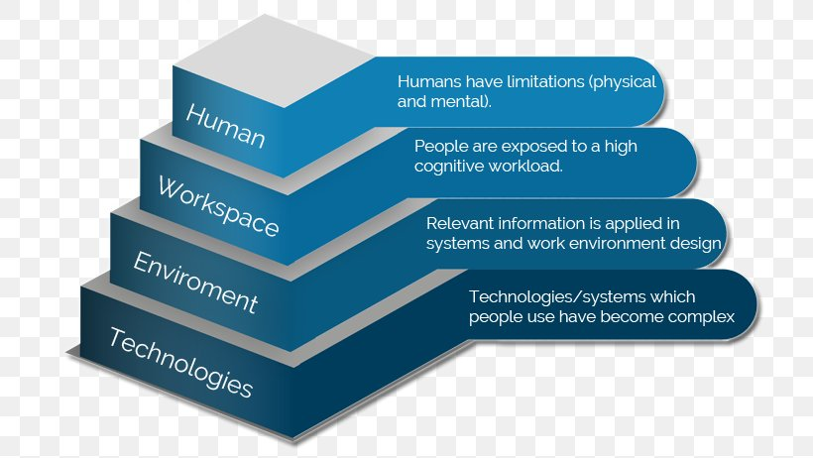
WORKING
It includes following steps :
Placement on conveyer
Read the color
Signal to microcontroller
Segregation of product
Storage

Slide 4
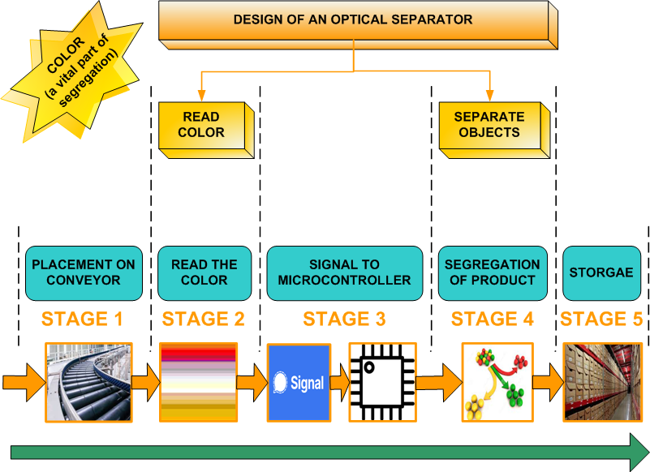
DEMONSTRATION OF IDEA

Slide 5
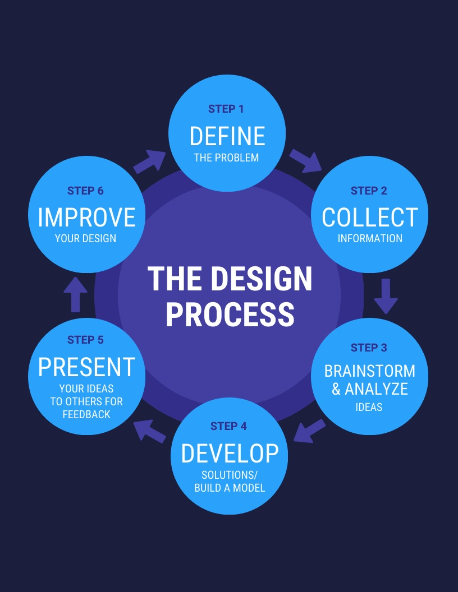
Design process :

Slide 6
DESCRIPTION OF SYSTEM DESIGN
The design consists of 5 following subsystems:
Role of Conveyer to transport the goods
Color sensor linked with brain of system
RGB signal generation
Identification of color
Role of servomotor for storage

Slide 7
SYSTEM Decomposition and Requirements

Slide 8
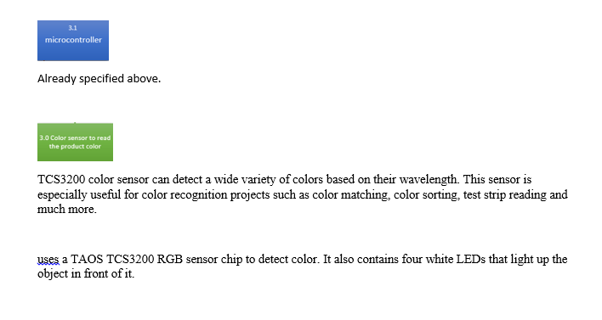
Subsystem and Part Design (COLOR SENSOR)

Slide 9
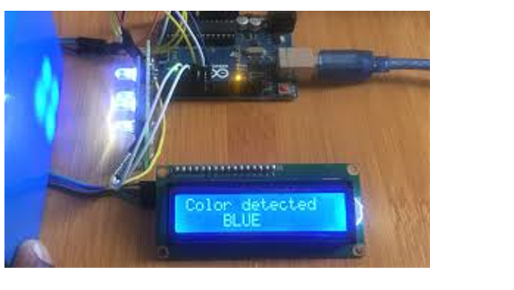
Subsystem and Part Design (COLOR SENSOR)

Slide 10
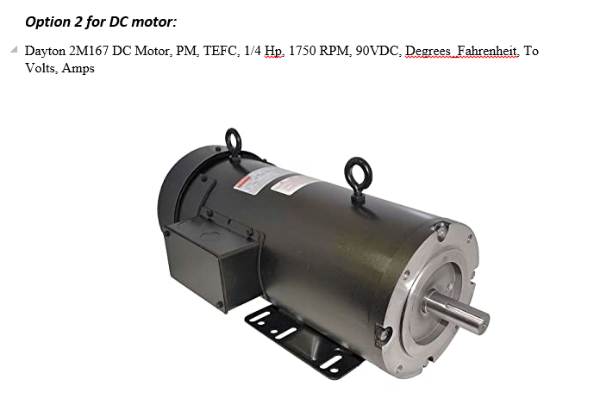
Subsystem and Part Design (DC MOTOR)

Slide 11
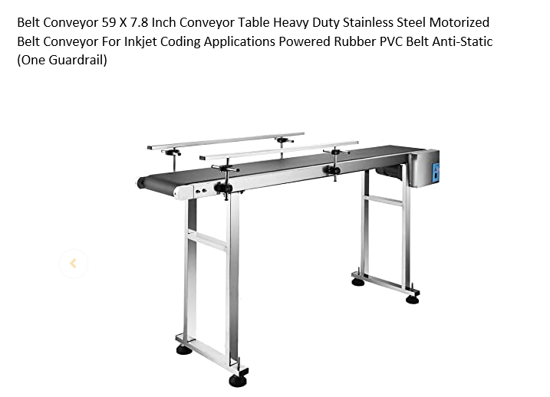
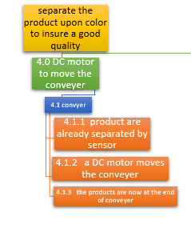
Subsystem and Part Design (CONVEYOR)

Slide 12
Recomposing Parts into Final System

Slide 13
Stakeholders

Slide 14
Stakeholders
#1 Customers
Stake: Product/service quality and value
#2 Employees
Stake: Employment income and safety
#3 Investors
Stake: Financial returns

Slide 15
ALTERNATIVE DESIGN
To gain a same aim , there can be several methods , like
Special waves to identify the color
While the tradeoff is
Complexity
Cost
Accuracy

Slide 16
Requirements Validation and Verification Plan

Slide 17
Validating Overall System
Putting the product on the production line will results in the movement of the product along the line to go through the next step.
Supplying the production line by the necessary power will result in the movement of the production line.
Once the product reach the color sensor the sensor will read the color for each product separately and send RGB value to the microcontroller specifying the color for each product.
Once the product reaches the color sensor the sensor will read the color for each product separately and send RGB value to the microcontroller specifying the color for each product.
If we supplied the Dc motor by the necessary power it will result in the movement of the conveyer carrying the product to the next step through the production line.
when connect the servomotor to the production line and the microcontroller and supply power to it it will rotate the containers

Slide 18
Validating Overall System
After the classification process comes to an end .we can make a validation by the eye to check if each specific color product is really in the right container or not.
we have to check the connection of the production line with the conveyer and the microcontroller to ensure the validation of the product as it is reaching the color sensor
If we have a red apples and green apples. We must do an eye validation to ensure that we have two separate colors
. If we put the product on the conveyer this will resulting in the products ending up in the containers and being classified
As the microcontroller gives the instructions to the rest components of the system. The conveyer has to move smoothly without problems hence we know the microcontroller is valid.
As the microcontroller gives the instructions to the rest components of the system. The containers has to rotate smoothly without problems hence we know the microcontroller is valid.

Slide 19
BUSINESS PLAN
Marketing plans include methods to promote business
It defines :
Marketing aims
Road map to achieve them

Slide 20
PROCEDURAL STEPS
Identifying the area of interest and more value
Done by past experience
Ways to flow the road map
Organize marketing objectives and strategies

Slide 21
CONCLUSION
Use of engineering to get segregation of objects
Color is the key parameter for segregation
The aim is to help the human life by different inventions

Slide 22
Questions?

