Slide 1
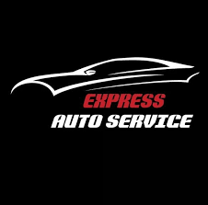
Express Auto Centre Problems and Solutions
Student name
University name
Class code
Teacher name
Submission date

Slide 2
Introduction
This presentation contain details regarding EXPRESS AUTO CENNTRE, Its working issues and solutions related to that.
EXPRESS AUTO CENNTRE operates in vehicle dealership industry. In its work process its provides repairs and maintenance services (He, et al., 2020).
This industry directly deals with customers and can be survive based on customer satisfaction.
Maintenance on good communication, quality in services and keeping advance management for workflow, can only be the tool for success.

Slide 3
Issues in work process
.
This work has identified three major issues in work process of EXPRESS AUTO CENNTRE.
These are “Organization of customers”, “time management in ordering and managing parts delivery” and third is “storing parts in inventory”. Services related to vehicle repairs and dealing involves high customer interaction.
Major issue faced by the company is keeping uninterrupted communication and data of their specification and service requirements (Harika, et al., 2021).
Other issue in customer handling is tracking of work status of respective customer services. These issues are impacting goodwill of company and generating consumer trust issues

Slide 4
Issue of time management in ordering auto parts
The second issue encountered is time management in ordering auto parts on time and avoid delay in delivery.
Since delay in auto parts delivery directly influence service delivery time. This issue has serious impact on company stability and growth prospectus.
Continue flow of consumer service could be maintain only when company having all required parts and inventory on time (Govindan, et al., 2020.

Slide 5
Continued…
Industry of vehicle dealing and services stands on timely delivery of quality work. It creates trust and reputation among customers.
This issues also involves keeping a balance between required liquidity and inventory for continue vehicle services (Govindan, et al., 2020).
Here both the aspects are crucial to have company in good and growing working environment. Issue encountered is incapability to keep parts as per requirement and maintaining least blockage of financial resources.

Slide 6
Storing parts in inventory
Inventory management is one of the most challenging task for an organization.
It involves categorization of inventory on different basis. It involve many management and financial expertise.
EXPRESS AUTO CENNTRE facing this issue as not able to store parts in inventory in such a way that will make work flow easy.
Issue faced is adapting such work process and technology that will assist in storing parts in most efficient manner (Singh and Verma, 2018).
This work process issue creating problem in inventory tracking and easy flow of delivery parts as and when required in vehicle services.
This problem is also basis of second issue of not able to order parts on time and generating delay delivery issues.

Slide 7
Solution to the Problems

Slide 8
Customer Organization
One method to keep engagement alive is to adapt to the changing world.
Customer service is more than just chatting on the phone with someone.
Customers are always on their cellphones, tablets, or laptops as the digital era advances.
They want businesses to deliver the same quality of service regardless of the manner of communication or platform they utilize.
A vehicle dealership should deliver a consistent client experience to increase engagement (Müller and Däschle, 2018).
The level of service must be consistent regardless of who they are speaking with at the dealership.

Slide 9
Continued…
In car fixing garages the owner of the garages must use software to organize the customers.
Software like which can keep the track of customer’s needs, their behavior and relation towards to your business, and the all related business terms.
The customer engagement score should be measured which could help in organizing the customers and as well as the garage (Müller and Däschle, 2018).
Net promoter score should also be used to identify the weakness and strengths of the company; through this the sentiments of the customer related to your company can be identified.

Slide 10
Ordering a part and delay in delivering
Mostly the parts are ordered from website of the company or sometimes directly from the store.
In order to save the store reputation from delay deliveries it is advised to stay transparent (Asdecker and Felch, 2018).
When order is being placed the availability of the auto part should be mentioned on the website and if the order is placed through store then availability of auto part should be checked before confirming the order.

Slide 11
Continued….
Secondly, fastest and reliable courier services should be chosen for the delivery of the auto parts.
Third and the most important, update the inventory list everyday so there should be a proper daily record of the auto parts available at the store, it will lessen the issue of late delivery.

Slide 12
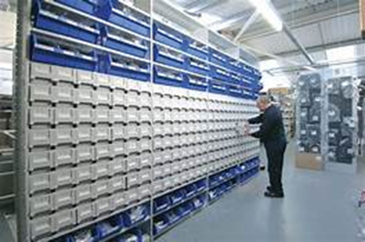
Storing parts in inventory
Implementing a barcode system is one approach to make inventory management easier, more streamlined, and more organized.
Because your inventory is digitally tracked in several ways, barcoding and scanning take organization and accuracy to a new level (Zhang, et al., 2022).
Automotive parts barcoding systems are almost typically used in conjunction with inventory management software,

Slide 13
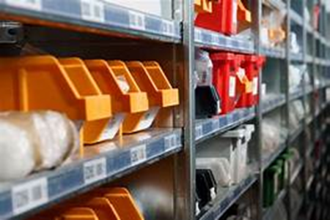
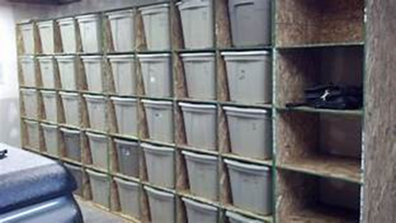
Continued…
which means that you already have all of the inventory data you need in the cloud. While all of the parts of an automobile are significant, there are certain that must be included in your inventory figures.
To put it another way, you must first identify and then manage your most valuable assets.
The ABC analysis approach is the most effective way to do this.
It provides a simple and efficient method of determining which parts should be available at all times (Zhang, et al., 2022).
This might indicate that some vehicle components are more popular than others, or that they are more likely to need replacement or reordering.

Slide 14
Continued…
Larger items, such as engines and electrical components, may be placed in boxes, while smaller parts, such as screws, hose clamps, nuts and bolts, bulbs, cables, and more, can be put in plastic bins and readily identifiable.
In summary, large items should be placed in labeled boxes, whereas smaller items and supplies should be stored with more care.

Slide 15
Conclusion
Analyses of the company work process in this reports states that issues identified are having direct link on company market value and growth opportunity.
Issue of Consumer organization is rightly noticed and very much accurately sorted.
Keeping high tech consumer management software will definitely improve customer interaction and services flow.
Software that will keep the tracking of customer’s needs, specification advised, their behavior and relation towards to company’s business will surely benefit the organization.

Slide 16
Continued
Solution to the second issue is also preferable as it will create transparency regarding availability of parts as per customer’s requirements.
Providing advance information about availability of searched parts to customer in process of providing service will enhance consumer service experience.
Solution of third issue is also perfect to the issue as barcoding will increasing the speed of tracking parts available and parts out off stock.
This solution will make organization able to respond consumer’s needs on time.
Sorted parts in inventory will also increase the work delivery time and build good reputation the industry.
It can be concluded that barcoding will keep a track on parts in inventory and assist in reorder on time without delay.

Slide 17
References
Asdecker, B. and Felch, V., 2018. Development of an Industry 4.0 maturity model for the delivery process in supply chains. Journal of Modelling in Management.
Govindan, K., Mina, H., Esmaeili, A. and Gholami-Zanjani, S.M., 2020. An integrated hybrid approach for circular supplier selection and closed loop supply chain network design under uncertainty. Journal of Cleaner Production, 242, p.118317.
Harika, A., Sunil Kumar, M., Anantha Natarajan, V. and Kallam, S., 2021. Business process reengineering: issues and challenges. In Proceedings of Second International Conference on Smart Energy and Communication (pp. 363-382). Springer, Singapore.
He, Y., Zhou, F., Qi, M. and Wang, X., 2020. Joint distribution: service paradigm, key technologies and its application in the context of Chinese express industry. International Journal of Logistics Research and Applications, 23(3), pp.211-227.
Müller, J.M. and Däschle, S., 2018. Business model innovation of industry 4.0 solution providers towards customer process innovation. Processes, 6(12), p.260.
Singh, D. and Verma, A., 2018. Inventory management in supply chain. Materials Today: Proceedings, 5(2), pp.3867-3872.
Zhang, L., Deng, Q., Miao, B., Liu, X. and Shao, H., 2022. Parallel service mode of production and inventory for spare part inventory optimization. Knowledge-Based Systems, 241, p.108282.

