Slide 1
Meeting President Obama’s 2020 College Completion Goal: Increasing Latino Success Martha Kanter, Under Secretary Eduardo Ochoa, Assistant Secretary Brenda Dann-Messier, Assistant Secretary Rosemarie Nassif, Senior Policy Advisor Excelencia In Action September 29, 2011
Notes:
1

Slide 2
Martha Kanter Under Secretary of Education

Slide 3
“America cannot lead in the 21st century unless we have the best educated, most competitive workforce in the world.”
President Barack Obama
Remarks on Higher Education
April 24, 2009
“By 2020, America will once again have the highest proportion of college graduates in the world... So tonight I ask every American to commit to at least one year or more of higher education or career training... every American will need to get more than a high school diploma.”
President Barack Obama
Address to Joint Session of Congress
February 24, 2009

Slide 4
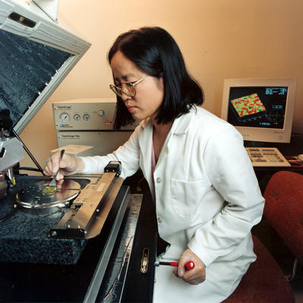
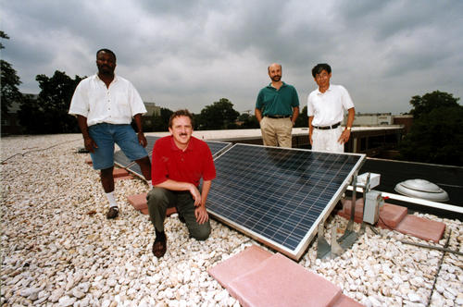
“Of the 30 fastest growing occupations in America, half require a Bachelor's degree or more. By 2016, four out of every 10 new jobs will require at least some advanced education or training.”
President Barack Obama
Speech to the Hispanic Chamber of Conference on Education
March 10, 2010
Fastest-Growing Occupations
Healthcare Professional and Technical
STEM and Social Science
Education
Community Services and Arts
Managerial and Professional Office
Georgetown University Center on Education and the Workforce

Slide 5
Education Requirements for Jobs, 2018
Georgetown University, Center on Education and the Workforce, 2010 p. 14
http://www9.georgetown.edu/grad/gppi/hpi/cew/pdfs/FullReport.pdf

Slide 7
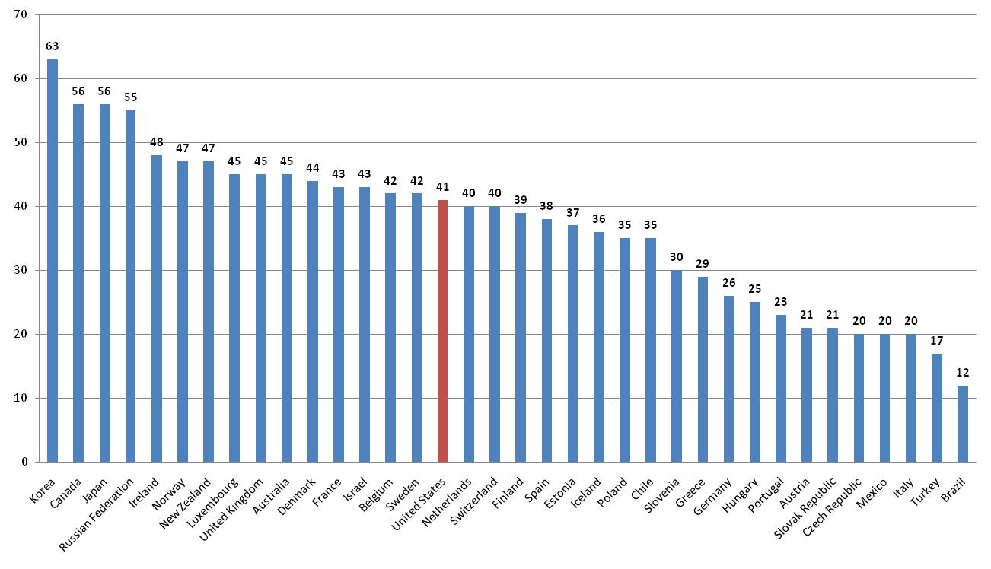
Percentage of Adults Age 25-34
with Postsecondary Education
(Associate Degree of Higher in U.S. per 2008 Current Population Survey, U.S. Census Bureau)
Source: OECD Education at a Glance 2011
Table A1.3a Population with tertiary education (2009)

Slide 8
The Achievement Gap
Current Educational Attainment
% of Adults Age 25-34 with an Associate’s Degree or Higher

Slide 9
Education for a Vibrant Democratic Society
It’s not only about preparing students for jobs or restoring our place as first in the world…
We need Americans who are prepared for informed, effective participation in democratic life.
We need educated Americans with the capacity to solve the most pressing problems of our time.

Slide 10
The College Completion Challenge
Only half of all undergraduates complete a college degree in six years.
38% of all U.S. students take a remedial course in their first or second year.
More than 60% of jobs will require a postsecondary education.
Students with a bachelor’s degree will earn 40% more in their lifetime (29% more with a community college degree) than students with only high school diplomas.
The U.S. is 16th in the world in college attainment for the 25-34 year old population.
19 States have college completion plans.
29 states have joined Complete College America.

Slide 11
President Obama’s
2020 Strategic Vision and Goals
Goal
10 million more graduates from community colleges, four-year colleges and universities by 2020 (beyond 2+ million expected due to growth)
Goal
Create and support opportunities for every American to complete one year or more of higher education or advanced training in his/her lifetime
Result
“Best educated, most competitive workforce in the world”

Slide 12
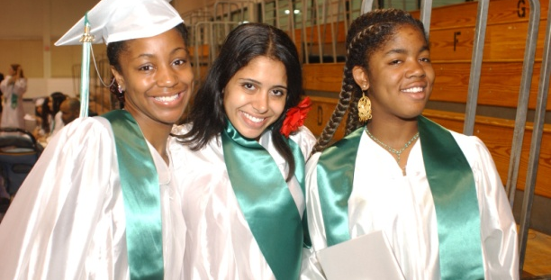
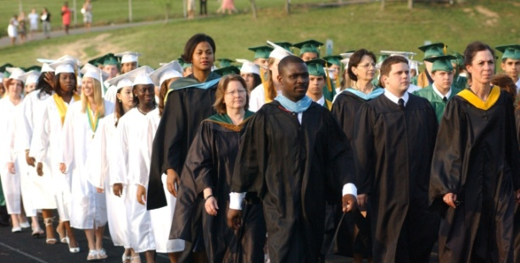
Strategic Objectives
Access
Close the opportunity gap by improving affordability and increasing access to college and workforce training, especially for adult learners, low-income students, and under-represented minorities.
Quality
Foster institutional quality with accountability and transparency.
Completion
Increase degree and certificate completion and job placement, with special attention to fast growing first generation, under-represented and economically disadvantaged populations.

Slide 13
Achieving the 2020 College Completion Goal
Increase the U.S. College Degree Attainment Rate from 40 to 60% 10 million additional Americans ages 25-34 with an associate or baccalaureate degree (includes 8 million beyond projected growth)
3.7 million more high school graduates will become college graduates
6.3 million adult learners will become college graduates
Note: The attainment rate reflects the number of individuals in the population who have attained the degree or diploma. This differs from the graduation/completion rate, which measures the number of individuals within a cohort who graduate or complete their program within a certain amount of time.

Slide 14
Eduardo M. Ochoa Assistant Secretary for Postsecondary Education

Slide 15
Challenges to the Completion Agenda
Reductions in State funding

Slide 16
Challenges - Affordability

Slide 17
OPE – Current Support Activities
COMPLETION: TRIO ($920 m)
ACCESS: Gear Up ($323 m)
ACCESS (w/FSA): Pell grants, Direct Loans
Institutional Support: MSI programs ($612 m)
QUALITY: International Programs ($107 m)
QUALITY: Program Integrity Rules

Slide 18
Opportunities
2012 Proposals for Expanding Capacity
FIPSE/First In The World
College Completion Challenge Grants
Convening Higher Education
ACE Presidential Commission
SHEEOs, NASH, Excelencia in Education
Promoting Best Practices
College-ready High School Graduates
Improved Retention and Graduation Rates
Shorter time to degree
Streamlined business operations
Greater economies of scale for business functions
Program consolidation

Slide 19
Brenda Dann-Messier Assistant Secretary for Vocational and Adult Education

Slide 20
OVAE Overview
CTE Students – Secondary and Postsecondary
Youth and Adult Learners
Immigrants/English Learners
Re-Entry Students

Slide 21
OVAE’s GOALS
All youth and adults are ready for, have access to, and complete college and career pathways leading to 21st Century jobs.
All youth and adult students have effective teachers and leaders.
All youth and adult students have equitable access to high-quality learning opportunities on demand.

Slide 22
Program Areas
ADULT EDUCATION
COMMUNITY COLLEGES

Slide 23
Community College Accomplishments
5 million more students than expected need to graduate by 2020
October 5, 2010
First White House Summit for Community Colleges
February-April 201
Four Regional Summits held
May 2011
Virtual Community College Summit held
September 2011
Trade Adjustment Assistance Community College and Career Training Grants

Slide 24
Community Colleges: Focal Points
College Affordability
Reinventing Developmental Education
Improving Transfer and Articulation
Improving Business and Industry Engagement
Serving Veterans, Service Members, and Their Families
Scaling Effective Practices

Slide 25
OVAE Program Areas, continued
IMMIGRANT PROFESSIONALS
Policy Summits and Economic Analysis
Demonstration Project
Interagency Work Group on Immigrant Integration

Slide 26
OVAE Program Areas, continued
Career and Technical Education
CTE Transformation Strategy
Reauthorization of the Perkins Act
Bringing Rigorous Programs of Study/Career Pathways to Scale
Promoting “Career Skills for All Students”
Remaking the CTE Accountability System

Slide 27
OVAE Program Areas, continued
Correctional Education
Partnership with Departments of Justice and Corrections to Design Evidence-based Reentry Programs.

Slide 28
Rosemarie Nassif Special Advisor

Slide 29
Completion Strategies
Advance the Conversation
Connect States / Postsecondary Institutions / Federal Government
Integrate Efforts with All Stakeholders/Partners
Identify Key Levers/Drivers
Incentivize Effective Strategies/Practices
Create Synergy

Slide 30
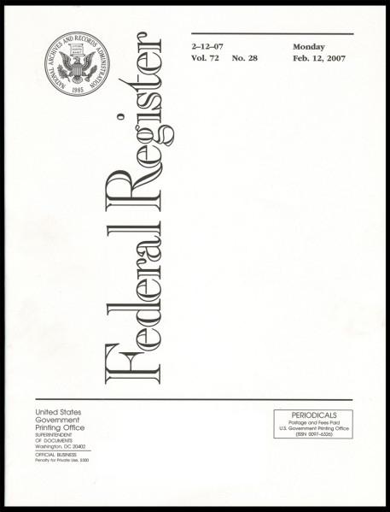
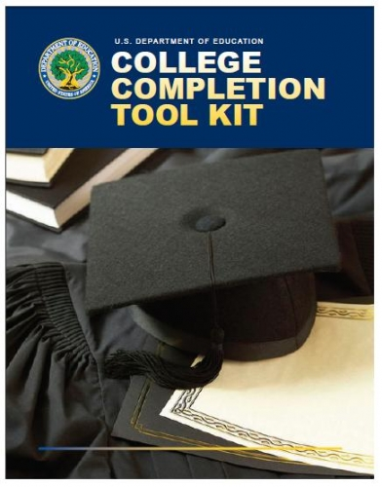
Initiatives Launched / Ongoing
College Completion Tool Kit for States
Data Dashboard for ED Website
Request for Information (RFI)

Slide 31
Tool Kit for States
Set Goals; Develop an Action Plan
Embrace Performance-Based Funding
Align High School Standards with College Entrance Standards
Make it Easier for Students to Transfer
Use Data to Drive Decision Making
Accelerate Learning and Reduce Costs
Target Adults With Some College

Slide 32
Momentum Forward
Think-Tank Researchers/Practitioners
Evidenced/Research-Based Practices
Resource Packet for Higher Education
External Stakeholders
External Advisory Board
Game Changer

Slide 33
Latino Student Hurdles
Less likely to graduate from high school
Less likely to be enrolled in college
More likely to be part time
More likely to be English language learners
More likely to be low income and first generation

Slide 34
Latino Student Advantages
Strong family bond
Desire to engage
Willingness to work hard
Belief in people
Strong cultural identity
Connect with a higher purpose

Slide 35
Latino Student Levers
A campus climate that values and validates their culture
Academic programs that promote collaboration
Clear procedures to simplify the transfer process
Well articulated pathway to a degree
Strong faculty advising to help students make connections between degrees and careers

Slide 36
Areas of Focus
First Year Experience
Learning Communities
Developmental Education/Remediation
ESL
Bridge Programs
Accelerated Delivery
Distance Learning
Transfer/Articulation
Financial Literacy
First Generation/Minority/Low Socioeconomic Income
Student Engagement/High Impact Experiences
Dual Enrollment
Mentoring/Advising
Role of Leadership

Slide 37
Steps to Completion
Have a plan
Focus on academics
Talk Regularly with your advisor
Engage with other students
Get practical experience
Make a difference
Manage your finances
Believe in yourself

Slide 38
Three Commandments
Be Attentive
Promote Innovation
Celebrate Results
Rosemarie.Nassif@ed.gov

Slide 39
A vibrant and prosperous America depends on its educational system – in fact, the future of our democratic society depends on the positive contributions of our active, engaged and well-educated citizens.
Higher education, workforce training, career advancement and civic participation are the social and economic engines for communities, states and our nation to thrive, reduce poverty and build capacity for the future.
Better connecting these systems to increase our effectiveness and leadership capacity as a nation is evermore essential if we are to succeed in the 21st century.
1

