Slide 1
NVIDIA Nsight Tools
An introductory tutorial

Slide 2
Comparative Overview
When to Use Each Tool:
Nsight Systems: For an overarching view of system and application behavior.
Nsight Compute: For deep-dive, kernel-specific performance analysis.
Complementary Usage:
Use Systems to pinpoint problematic segments.
Follow up with Compute to optimize the identified kernels.

Slide 3
PART ONE
Nsight Systems

Slide 4
Part One: Table of contents
01
02
03
04
05
Overview
Usage
Commands
Demo: Profiling Python
Demo: Profiling CUDA

Slide 5

1.01
Overview

Slide 6
Nsight System
Purpose:
Capture a broad view of the application’s behavior
Visualize CPU/GPU interactions on a timeline
Key Features:
Identify high-level performance bottlenecks
Analyze system events and concurrent execution
Complement kernel-level insights from NSight Compute

Slide 7
Key Features
Timeline Visualization: Displays a chronological view of events (e.g., kernel launches, API calls, CPU scheduling).
Event Tracing: Collects CPU context switches, NVTX events, and other system events.
Multi-Process Analysis: Capable of profiling entire process trees and concurrent sessions.
CLI & GUI Options: Run analyses using simple CLI commands (the GUI is currently unavailable with our servers)

Slide 8
Profiling Fundamentals
Profiling: Collecting performance data through a session that includes both sampling and tracing.
Sampling: Periodically halts the profilee (application under investigation) to collect statistical data such as backtraces and hardware counters. Inherently imprecise if only a few samples are collected.
Tracing: Collecting exact, event-level details (e.g., API call durations, precise timestamps).

Slide 9
1.03
Usage and Commands

Slide 10
Commands
Command-Line Format:
Two forms: global options (nsys [global_option]) and command switches (nsys [command_switch] [options] [application] [app-options]).
Session Management:
Create and manage profiling sessions with commands such as launch, start, stop, and shutdown.

Slide 11
1.04
Demo: Profiling Python

Slide 12
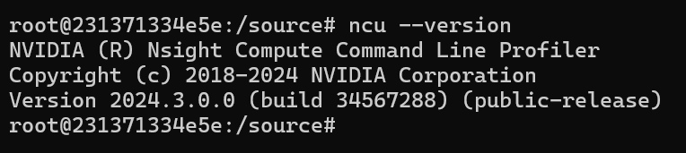
docker pull nvcr.io/nvidia/pytorch:23.07-py3
docker run --rm -it --gpus all --volume $(pwd):/source nvcr.io/nvidia/pytorch:23.07-py3 /bin/bash

Slide 13
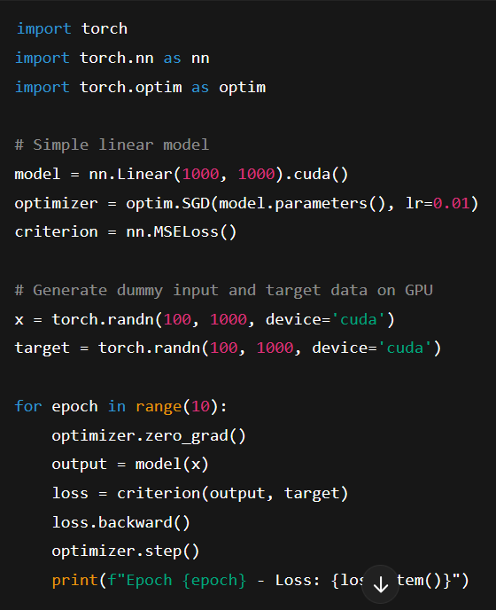

Slide 14
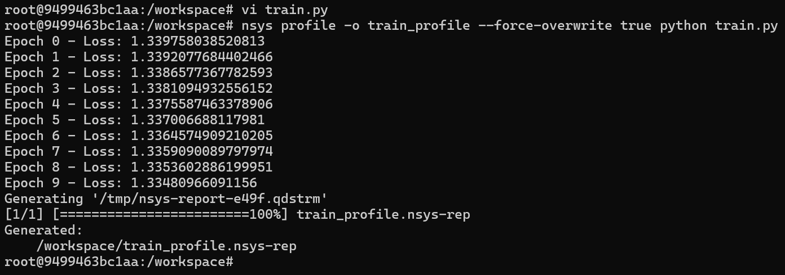

Slide 15
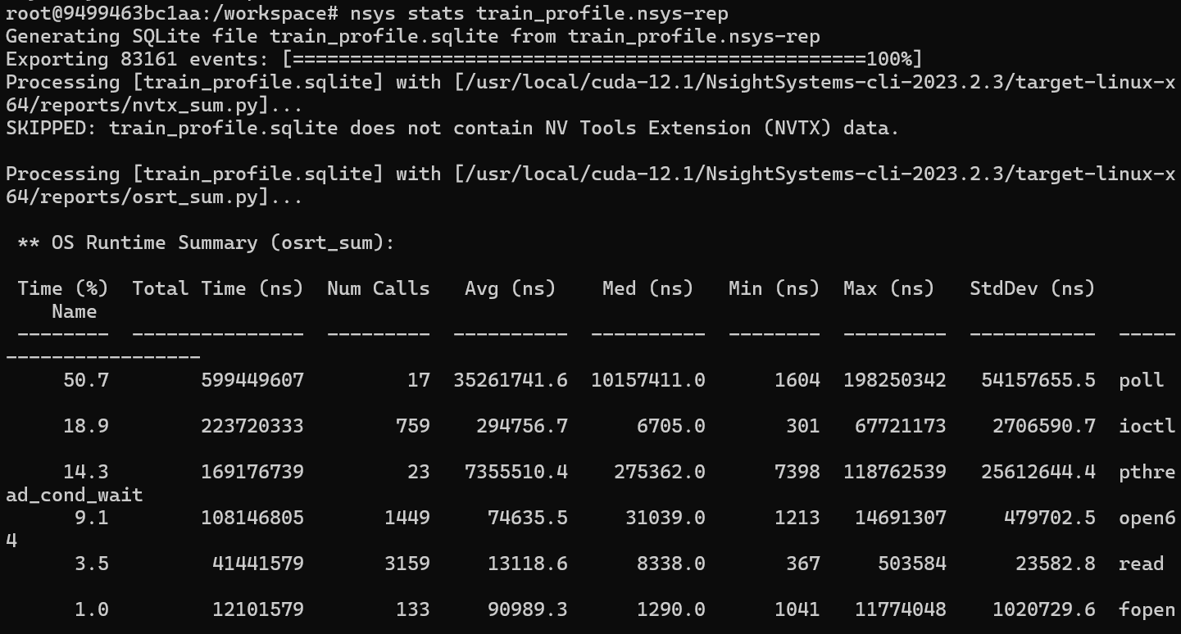

Slide 16
1.05
Demo: Profiling CUDA

Slide 17
PART TWO
Nsight Compute

Slide 18
Part Two: Table of contents
01
02
03
04
05
Overview
Kernel-Level Analysis
Command-Line Usage
Demo: Profiling Python
Demo: Profiling CUDA

Slide 19
2.01
Overview

Slide 20
Nsight Compute - kernel-level profiler for NVIDIA GPUs
Provides detailed metrics on kernel execution
Interactive UI and Command-Line Interface (CLI)
Detailed analysis of memory usage, occupancy, and instruction throughput
Customizable data collection through “sections” and metric groups
Provides real-time profiling and in-depth performance analysis.

Slide 21
Key Features
Detailed Metrics Collection: Collects metrics like occupancy, memory utilization, execution time, and instruction throughput.
Customizable Analysis: Uses “sections” to group metrics logically; users can select a basic set or full set.
User Interface & CLI Options: Provides both interactive UI reports and advanced CLI commands for automation.
Kernel Renaming & Filtering: Simplifies complex kernel names and enables filtering by kernel names or IDs for targeted analysis.

Slide 22
2.02
Kernel-Level Analysis

Slide 23
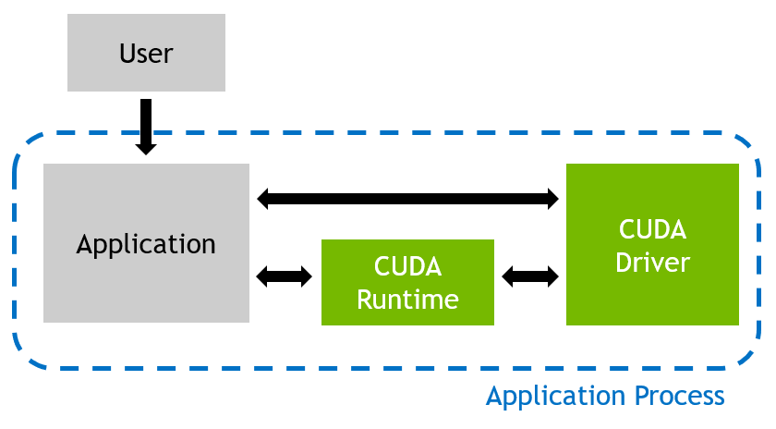
Regular Execution
CUDA application communicates directly with CUDA driver.
No performance tracking
In this mode, there’s minimal overhead and no runtime insight into performance.

Slide 24
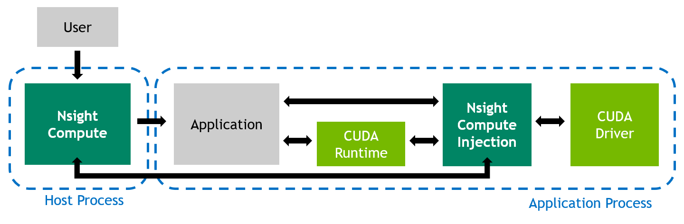
Profiled Application Execution
Nsight Compute intercepts CUDA calls. Inserts measurement libraries.
Collects performance metrics from the GPU.
Profiling may introduce additional overhead due to metric collection and kernel replays.

Slide 25
Metric Collection
Nsight Compute collects performance metrics using pre-defined sets.
Metric Sets:
Basic: Quick profiling with minimal overhead.
Full: Detailed profiling with replay overhead.
Choosing a set:
--set default (light profiling)
--set full (comprehensive analysis)
Command: ncu --set full ./my_cuda_app

Slide 26
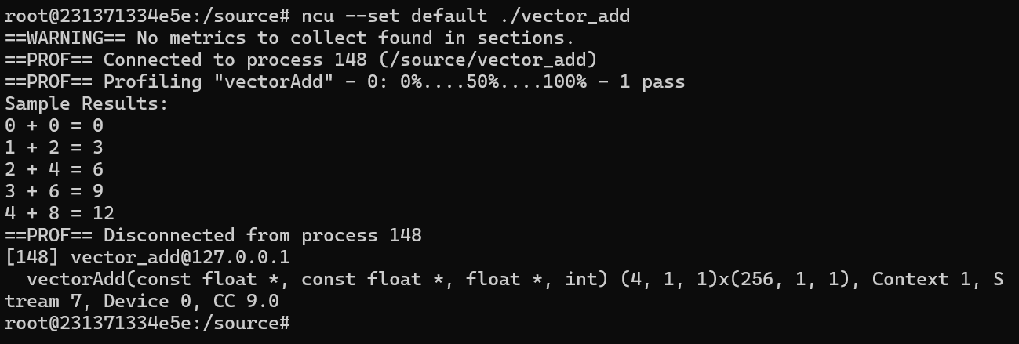
Light profiling ncu --set default ./vector_add

Slide 27
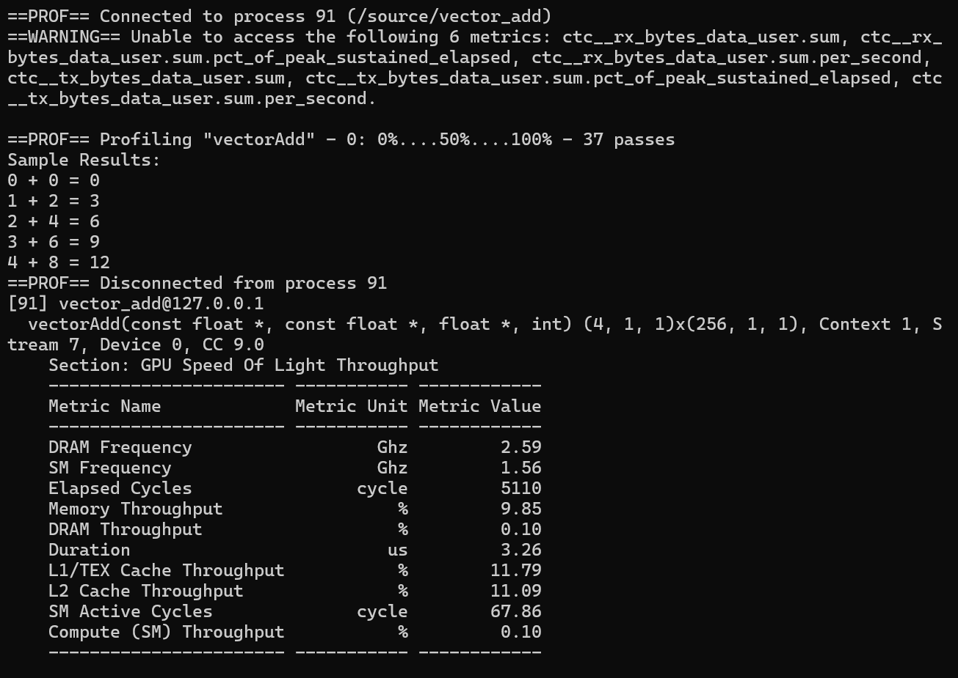
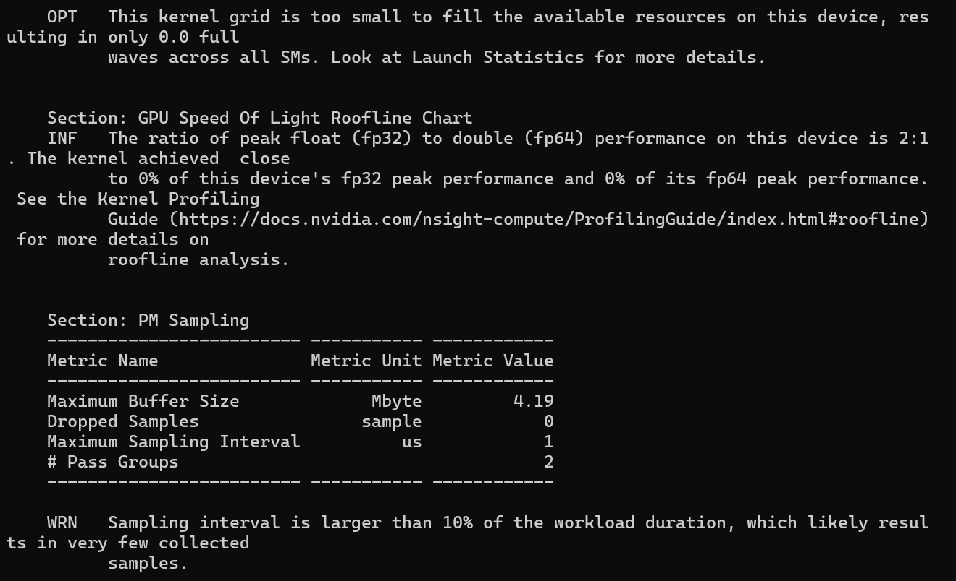
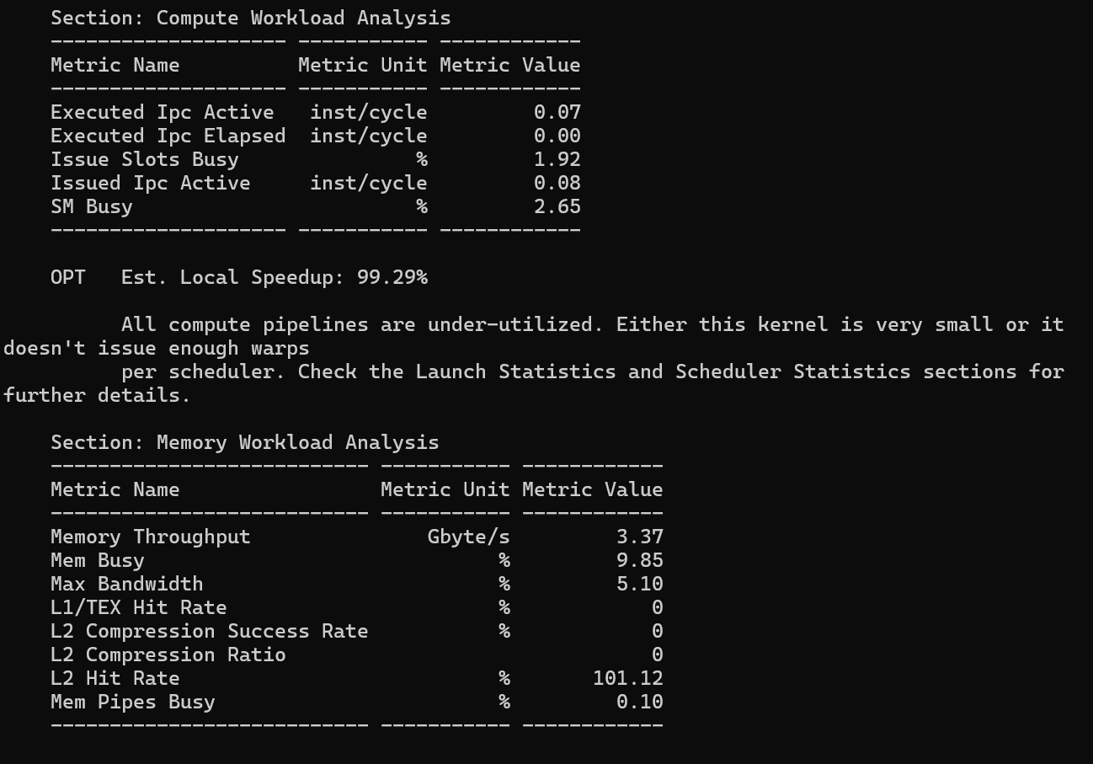
Full profiling ncu --set full --target-processes all ./vector_add

Slide 28
Types of Performance Metrics
Compute Workload Analysis: Measures instructions per clock (IPC), SM utilization.
Memory Workload Analysis: Analyzes memory bandwidth, cache usage.
Scheduler Statistics: Tracks warp activity and issue stalls.
Occupancy Analysis: Measures how efficiently GPU threads are utilized.

Slide 29
Nsight Compute CLI Commands
Basic Profiling | ncu --set default ./my_cuda_app
Full Profiling | ncu --set full ./my_cuda_app
List Available Metrics | ncu --list-metrics
List Available Sections | ncu --list-sections

Slide 30
05
Demo: Profiling python

Slide 31
docker pull nvcr.io/nvidia/pytorch:23.07-py3
docker run --rm -it --gpus all --volume $(pwd):/source nvcr.io/nvidia/pytorch:23.07-py3 /bin/bash

Slide 34
06
Demo: Profiling simple CUDA

Slide 35
docker run --rm -it --gpus all --volume $(pwd):/source --workdir /source nvcr.io/nvidia/nvhpc:24.9-devel-cuda_multi-ubuntu22.04

Slide 36
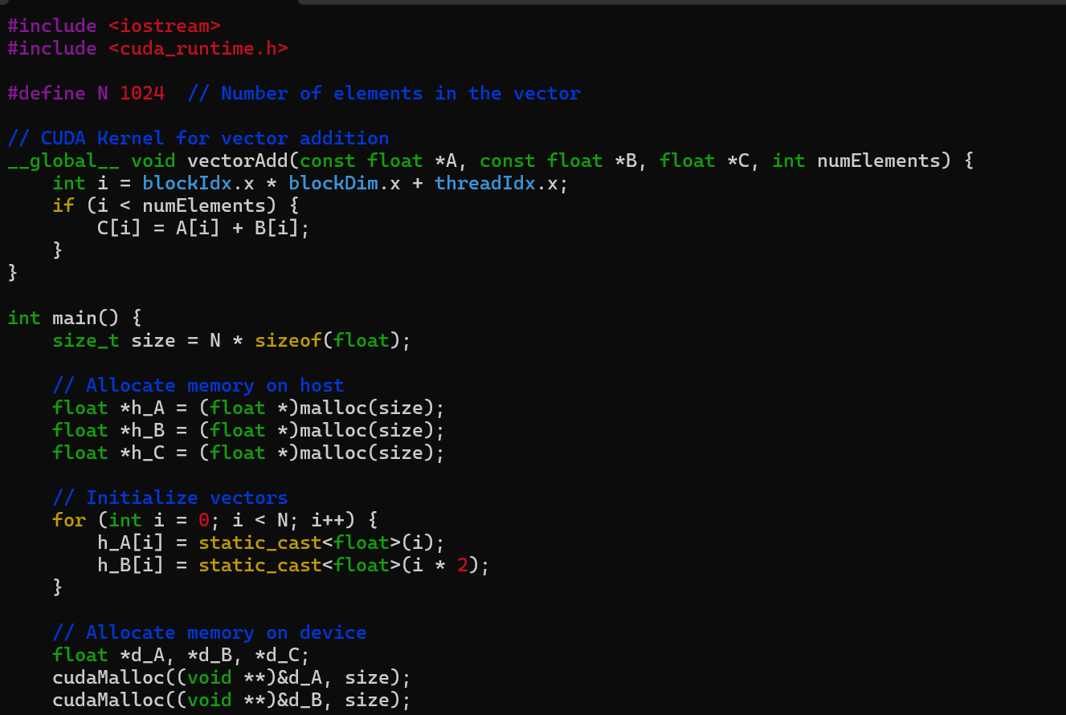

Slide 37
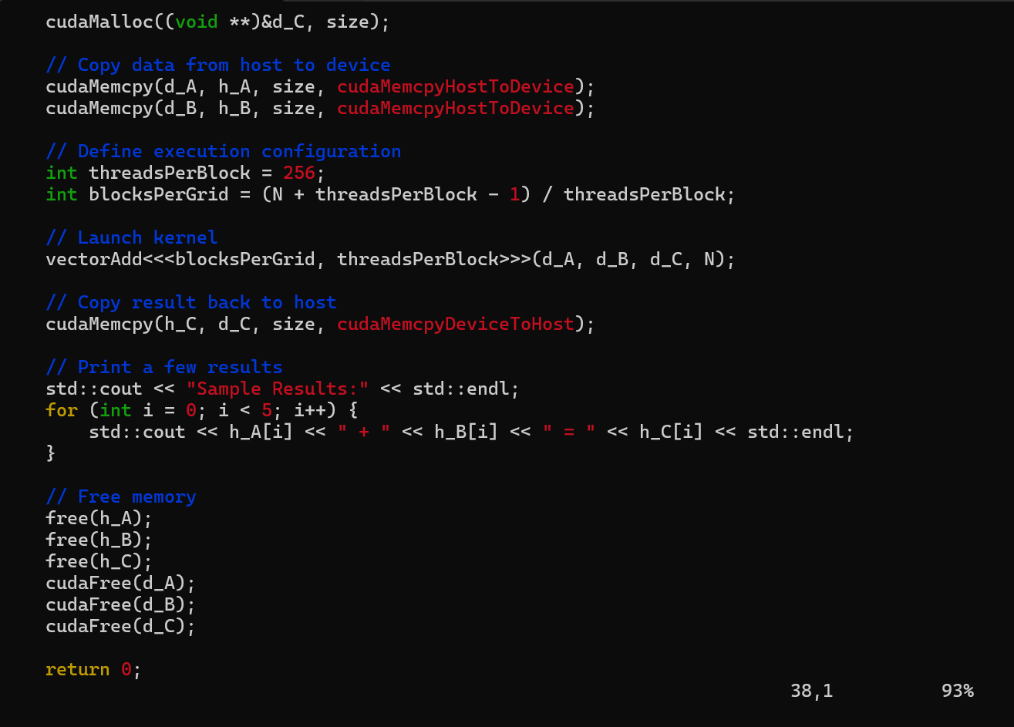

Slide 38
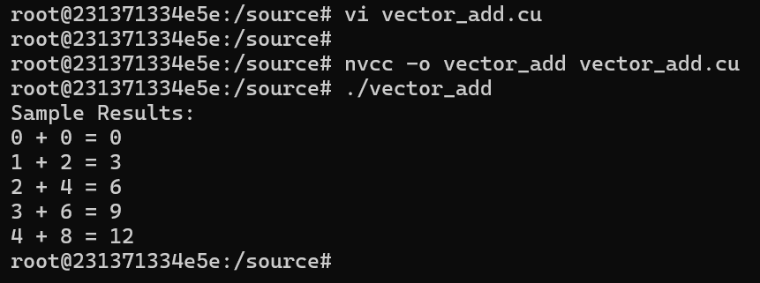

Slide 39
Light profiling

Slide 40
Light profiling ncu --set default ./vector_add

Slide 41
Full profiling ncu --set full --target-processes all ./vector_add

Slide 42
Thank you!
Please email us at cchopper@utep.edu for any questions or feedback

