Slide 1
PyTorch
a Python Package for Computation and Neural Networks

Slide 2
Table of contents
01
02
03
04
05
06
TENSORS
Datasets & DataLoaders
Transforms
Build the Neural Network
Save and Load Model
Exercises 1 & 2

Slide 3
01
Tensors

Slide 4

What are tensors?
Tensors are a specialized data structure that are very similar to arrays and matrices. In PyTorch, we use tensors to encode the inputs and outputs of a model, as well as the model’s parameters.

Slide 5
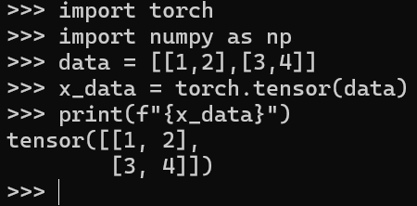
Initializing a Tensor
Directly from data
Tensors can be created directly from data. The data type is automatically inferred.

Slide 6
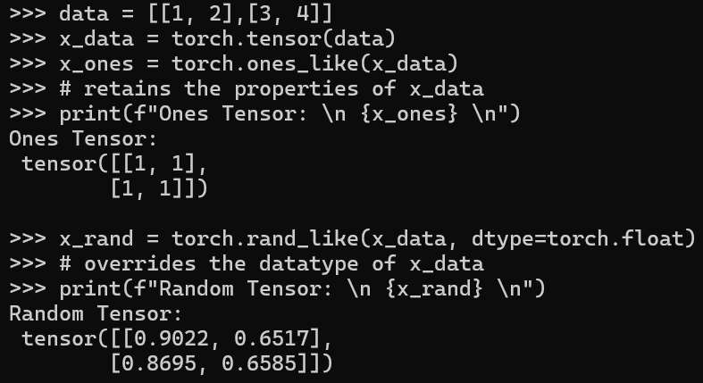
Initializing a Tensor
From another tensor:
The new tensor retains the properties (shape, datatype) of the argument tensor, unless explicitly overridden.

Slide 7
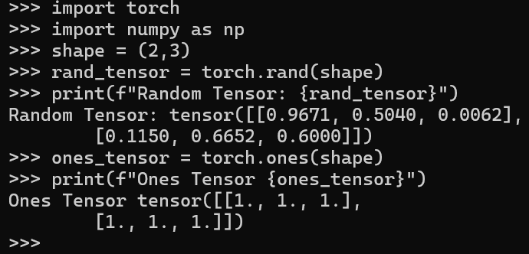
Random and Constant Values
Ex: Shape is a tuple of tensor dimensions. t determines the dimensionality of the output tensor.

Slide 8

Attributes
Tensor attributes describe their shape, datatype, and the device on which they are stored.

Slide 9
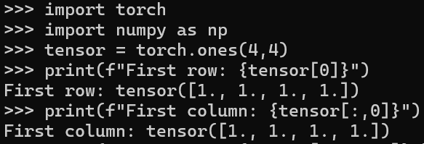
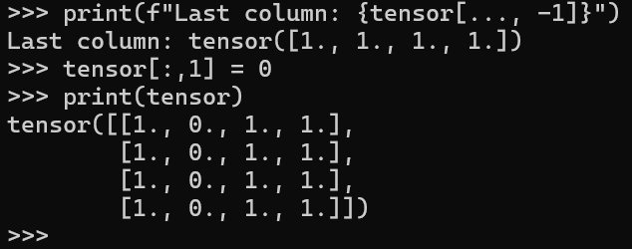
Operations: indexing & slicing

Slide 10
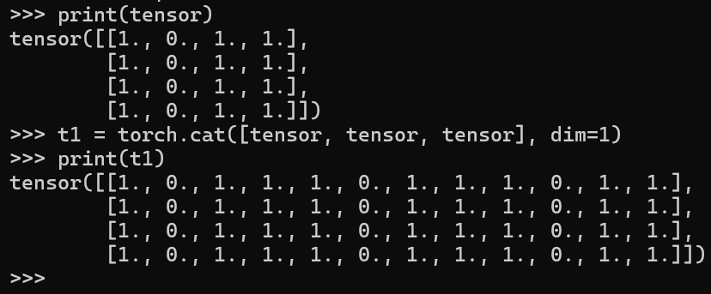
Operations: concatenation
You can use torch.cat to concatenate a sequence of tensors along a given dimension.

Slide 11
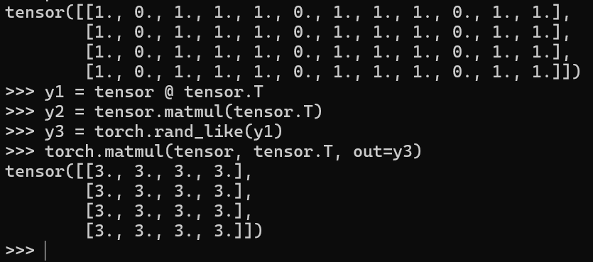
Operations: matrix multiplication
This computes the matrix multiplication between two tensors. y1, y2, y3 will have the same value. ``tensor.T`` returns the transpose of a tensor

Slide 12
02
Dataset & DataLoaders

Slide 13
What are Dataset?
Dataset stores the samples and their corresponding labels
PyTorch domain libraries provide a number of pre-loaded datasets that subclass torch.utils.data.Dataset and implement functions specific to the particular data.
They can be used to prototype and benchmark your model.
Source: https://pytorch.org/tutorials/beginner/basics/data_tutorial.html

Slide 14
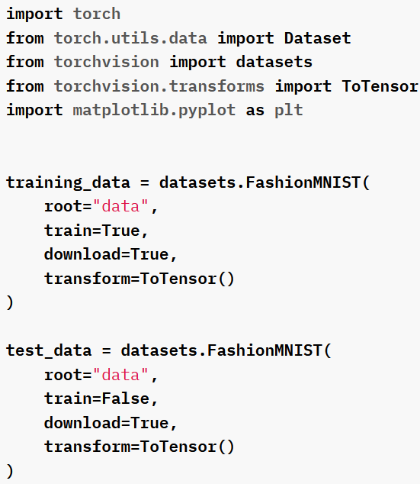
Loading a dataset
  root is the path where the train/test data is stored,
  train specifies training or test dataset,
  download=True downloads the data from the internet if it’s not available at root.
  transform and target_transform specify the feature and label transformations

Slide 15
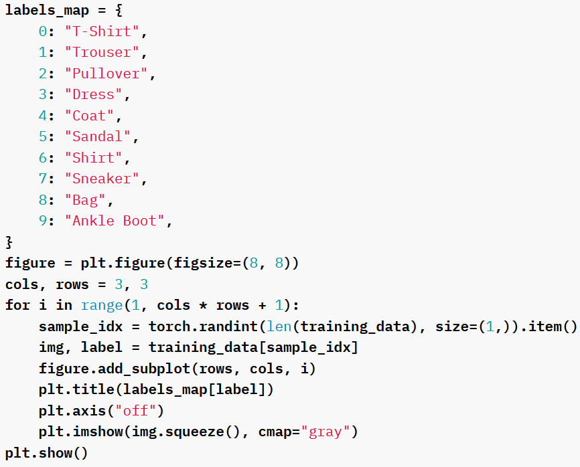
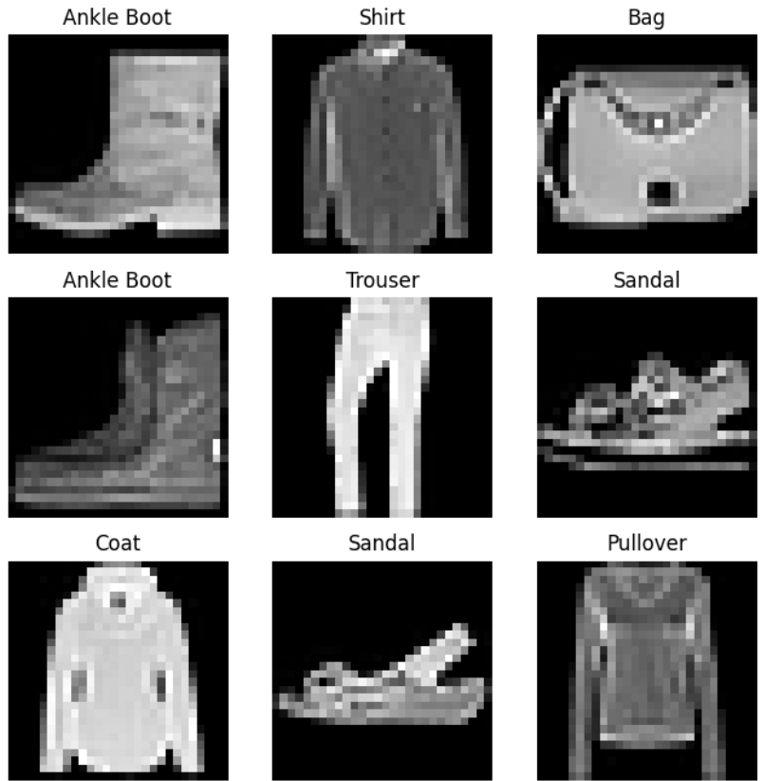
Iterating and Visualizing the Dataset
  We can index Datasets manually like a list: training_data[index].
  We use matplotlib to visualize some samples in our training data.

Slide 16
What are DataLoader?
DataLoader wraps an iterable around the Dataset to enable easy access to the samples.
DataLoaders are essential while training a model, as they allow us to pass samples in minibatches, reshuffle the data at every
iteration to minimize overfitting, and leverage Python’s
multiprocessing capabilities to accelerate data retrieval.

Slide 17
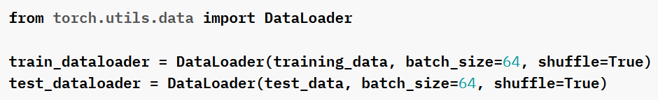
Preparing data for DataLoaders
  We load the dataset into the DataLoader so that it can iterate through the dataset as needed.
Source: https://pytorch.org/tutorials/beginner/basics/data_tutorial.html

Slide 18
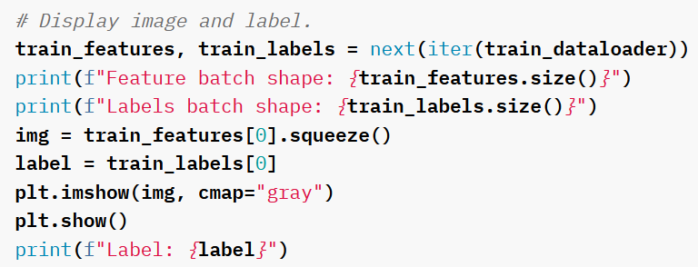
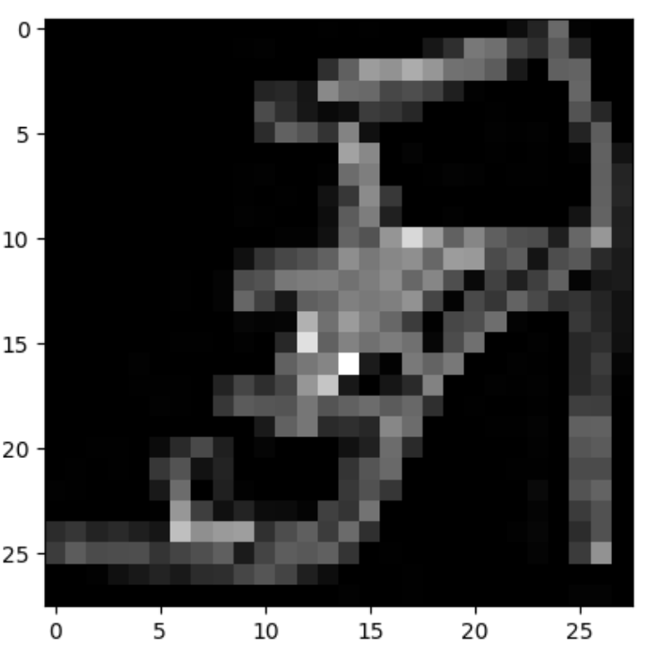
Iterate through DataLoader
  Each iteration below returns a batch of train_features and train_labels
  Because we specified shuffle=True, after we iterate over all batches the data is shuffled

Slide 19
03
Transforms

Slide 20
What are Transforms?
Transforms are essential because data doesn't always come in its final processed form that's required for training
machine learning algorithms.
They allow us to manipulate the data and make it suitable
for training.
Source: https://pytorch.org/tutorials/beginner/basics/transforms_tutorial.html

Slide 21
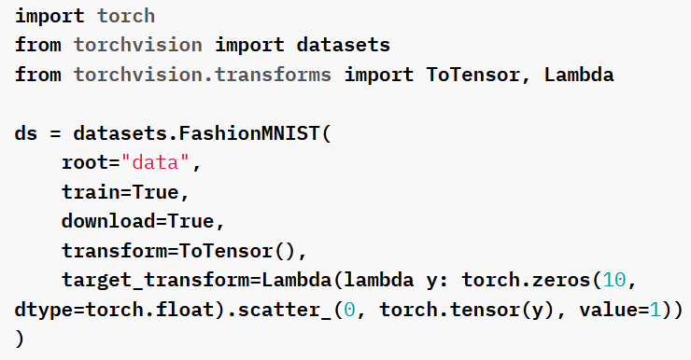
Transforming
  All TorchVision datasets have two parameters -transform to modify the features and target_transform to modify the labels - that accept callables containing the transformation logic.

Slide 22
ToTensor() & lambda transforms
  ToTensor converts a PIL image or NumPy ndarray into a FloatTensor. and scales the image’s pixel intensity values in the range [0., 1.]
  Lambda transforms apply any user-defined lambda function.
  We define a function to turn the integer into a one-hot encoded tensor. It first creates a zero tensor of size 10 (the number of labels in our dataset) and calls scatter_ which assigns a value=1 on the index as given by the label y.

Slide 23
04
Build the neural network

Slide 24
What Neural Network?
Neural networks comprise of layers/modules that perform operations on data.
The torch.nn namespace provides all the building blocks you
need to build your own neural network. Every module in PyTorch subclasses the nn.Module.
A neural network is a module itself that consists of other modules (layers). This nested structure allows for building and managing complex architectures easily.

Slide 25
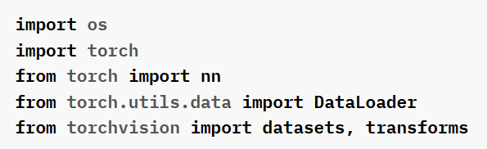
Step 1: Import
  First the import statements:

Slide 26
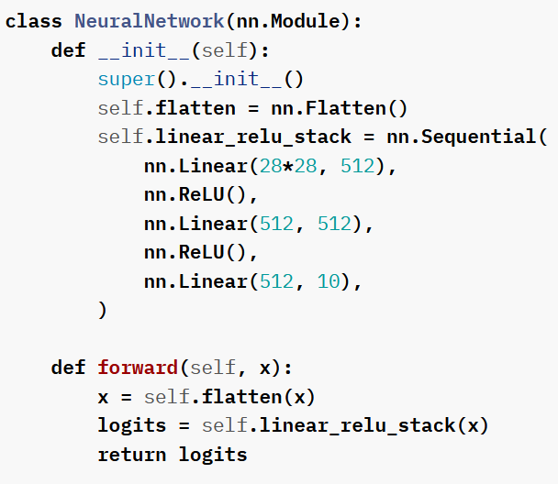
Step 2: Define the Class
  We define our neural network by subclassing nn.Module
  Initialize the neural network layers in __init__.
  Every nn.Module subclass implements the operations on input data in the forward method.

Slide 27

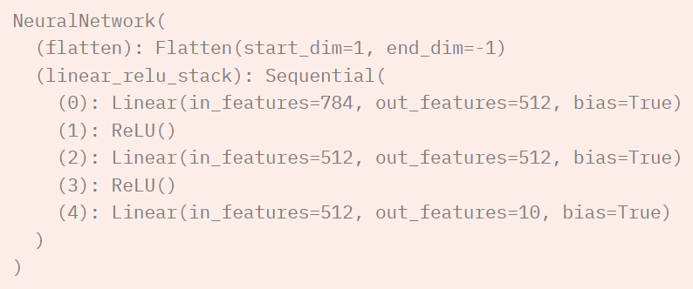
Step 3: Instantiation
  create an instance of NeuralNetwork
  move it to the device
  print its structure.
  OUTPUT:

Slide 28
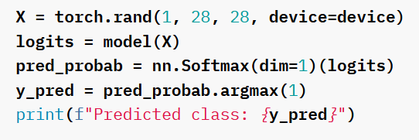

Step 4: Pass Input Data
  To use the model, we pass it the input data.
  This executes the model’s forward, along with some background operations.
  Do not call model.forward() directly!
  OUTPUT:

Slide 29
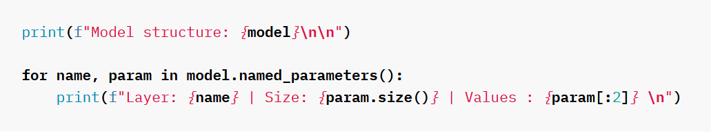
Model Parameters
  Many layers inside a neural network are parameterized, i.e. have associated weights and biases that are optimized during training.
  Subclassing nn.Module automatically tracks all fields defined inside your model object, and makes all parameters accessible using your model’s parameters() or named_parameters() methods.
  In this example, we iterate over each parameter, and print its size and a preview of its values.

Slide 30
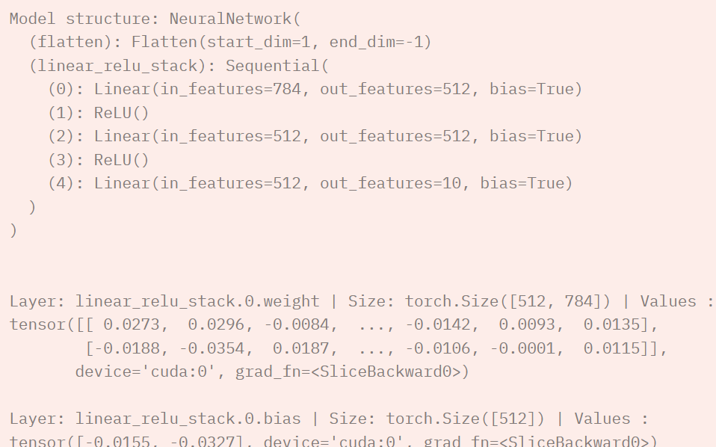
Model Parameters
  OUTPUT:

Slide 31
05
Save and Load Model

Slide 32


Saving and Loading Model Weights
PyTorch models store the learned parameters in an internal
state dictionary, called state_dict. These can be persisted via the torch.save method:

Slide 33
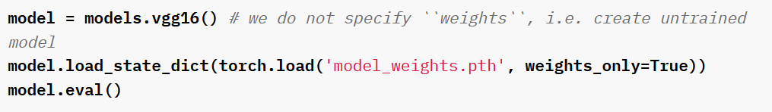
To load model weights
  To load model weights, you need to create an instance of the same model first, and then load the parameters using load_state_dict() method.
  In the code below, we set weights_only=True to limit the functions executed during unpickling to only those necessary for loading weights. Using weights_only=True is considered a best practice when loading weights.

Slide 34

Saving and Loading Models with Shapes
  When loading model weights, we needed to instantiate the model class first, because the class defines the structure of a network.
  Then load the model:

Slide 35
Exercises!
Images Analysis
Distributed Data Parallel
NVIDIA Modulus:
analyzing and extracting information from images using techniques such as machine learning, deep learning / vision transformer
Using Multiple GPUs for a deep learning model
Using Multiple GPUs for a deep learning model

Slide 36
Ex 1
Image Analysis

Slide 37
Running resnet18 on cifar-10 dataset
Data Transformation: The CIFAR-10 images are resized to 224x224 pixels to match ResNet's input requirement, normalized to improve training.
Model Modification: The final layer (model.fc) is replaced to output 10 classes, aligning with CIFAR-10’s 10 categories.
Training Loop: The model is trained using Stochastic Gradient Descent (SGD), iterating over the dataset multiple times (epochs).
Testing: After training, the model's accuracy on the test set is calculated to assess performance.

Slide 38
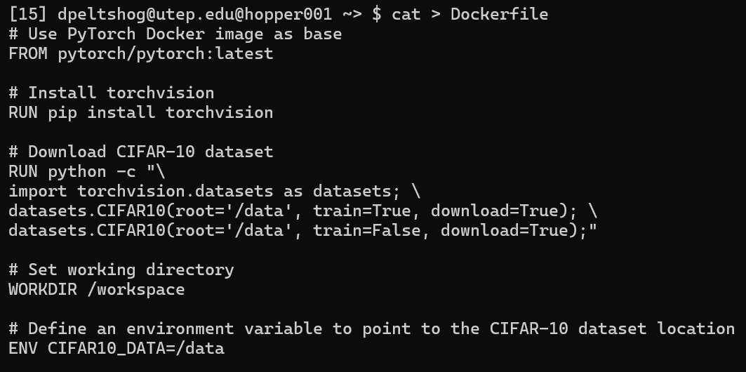
Step 1 : Write the Dockerfile
  Press Ctrl + D to end the cat > command

Slide 39
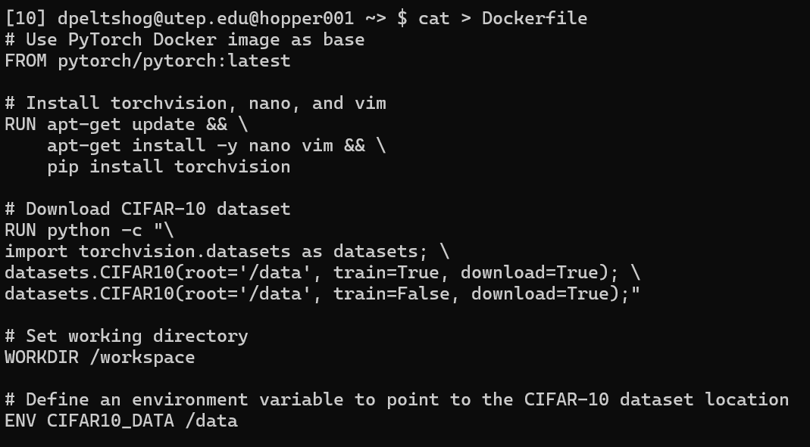
Step 2 : Write the build the image
  Press Ctrl + D to end the cat > command

Slide 40
Ex 2
PyTorch DistributedData Parallel (DDP)

Slide 41
DistributedData Parallel
In PyTorch, parallel training allows you to leverage multiple GPUs or computing nodes to speed up the process of training neural networks and other complex machine learning algorithms.
PyTorch Distributed Data-Parallel (DDP) is an advanced parallel training technique that synchronizes model training across multiple GPUs, whether they are on a single machine or spread across several machines.

Slide 42
Key Features of DDP
Scalability | DDP allows seamless scaling from one GPU to multiple GPUs, and from one machine to multiple machines. This scalability is critical for training large-scale models and handling extensive datasets efficiently.
Synchronous Training | DDP employs synchronous training, meaning gradients are averaged across all GPUs before updating the model parameters. This ensures consistent model updates and helps maintain model accuracy across different GPUs.
Fault Tolerance | DDP is designed to be robust, with built-in mechanisms to handle hardware failures. If a GPU or machine goes down, DDP can recover and continue training with minimal disruption.
Performance Optimization | DDP optimizes performance by overlapping computation and communication. While one GPU is performing computations, another can be communicating with other GPUs, reducing idle times and improving overall training efficiency.

Slide 43
How PyTorch DDP Works
each process initializes its own model replica and data loader.
each GPU independently performs computations on its subset of the data
Initialization
Forward Pass
Partitioned
Backward Pass
dataset is partitioned across all GPUs, enhancing the efficiency of the training process
gradients computed by each GPU are averaged across all GPUs, allows distributed model to converge
Finally, each GPU independently updates its model parameters using the synchronized gradients. This parameter update step ensures that the models on all GPUs remain consistent

Slide 44
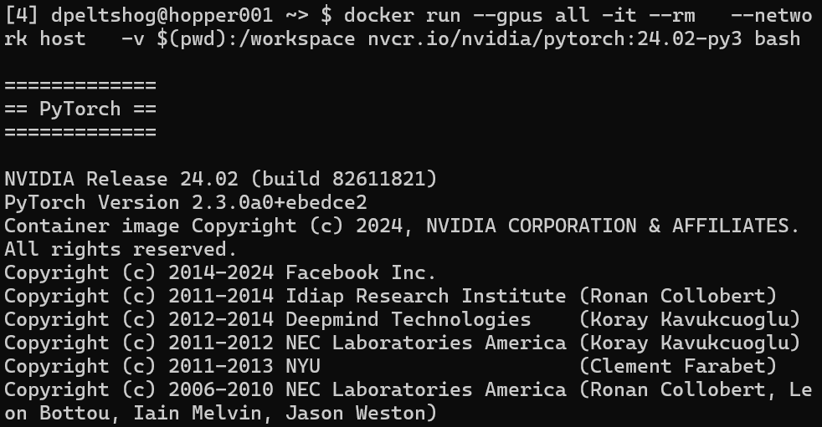
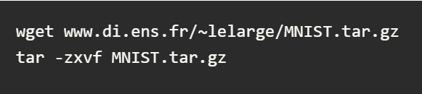
Set Up the Environment
  Pull and run pytorch container
  Download and extract the sample MNIST data to the data folder

Slide 45
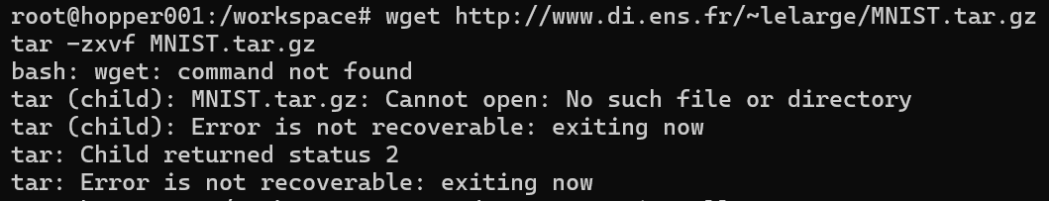
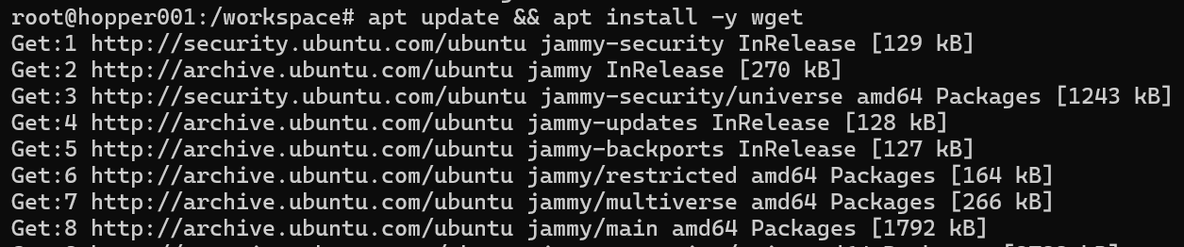
Note: update to install wget
  If you run into errors of wget not available , run this:
  apt update && apt install -y wget

Slide 46
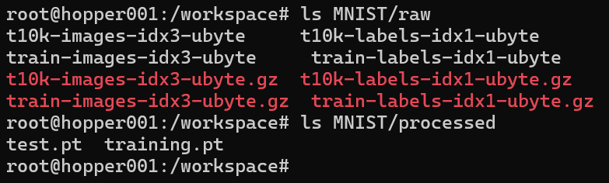
Verify files downloaded

Slide 47
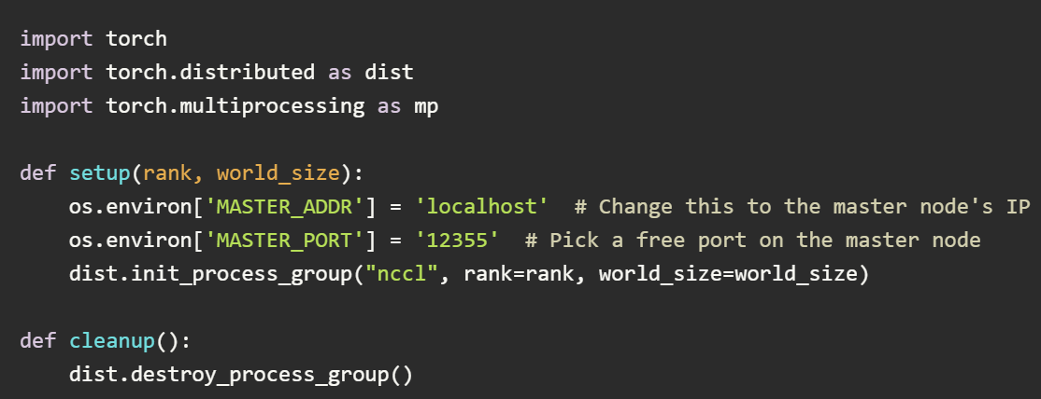
Initialize the DDP Environment
  Start by initializing the DDP environment.
  (Setting up the process group and specifying the backend for communication)
  Click her for Full code here
  cat > ddp_train.py (paste code) then Ctrl + D
  python ddp_train.py

Slide 48
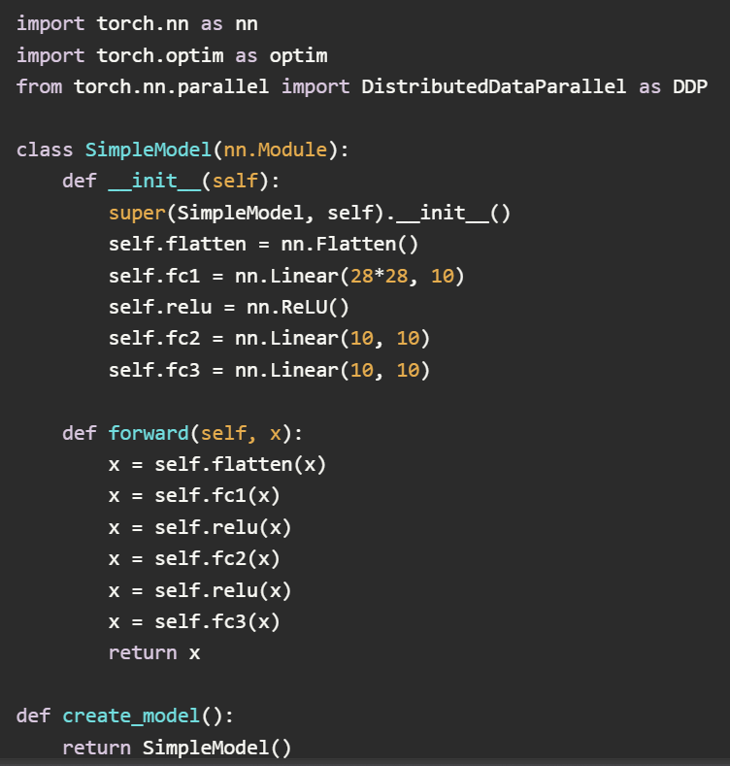
Define Model Wrap with DDP
  Define your model and wrap it with DistributedDataParallel.
  This ensures that the model is replicated across all GPUs, gradients are synchronized
  Click her for Full code here
  cat > ddp_train.py
  python ddp_train.py

Slide 49
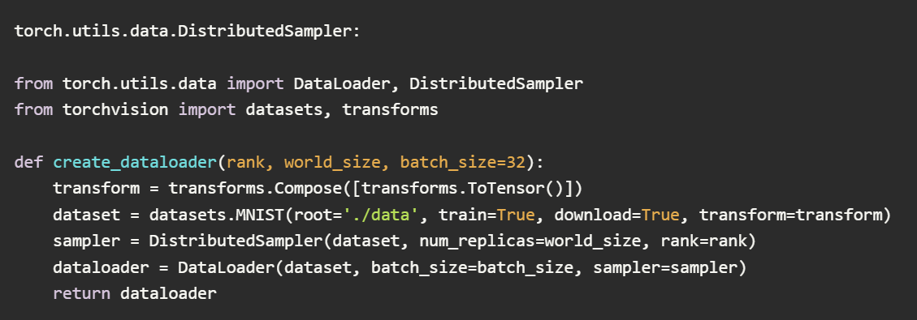
Partition the Dataset
  To ensure an even distribution of data across all GPUs, use torch.utils.data.DistributedSampler:
  Click her for Full code here
  cat > ddp_train.py
  python ddp_train.py

Slide 50
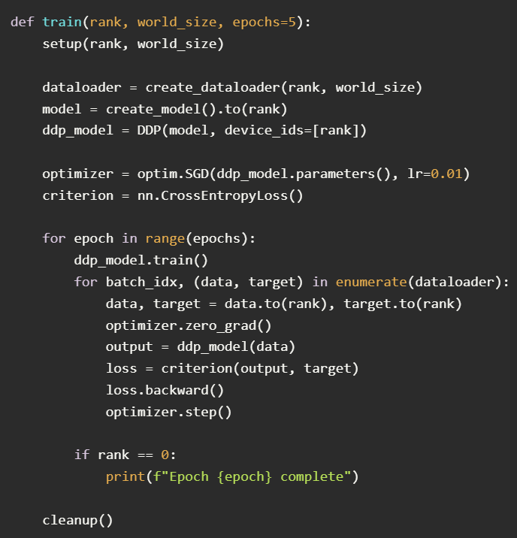
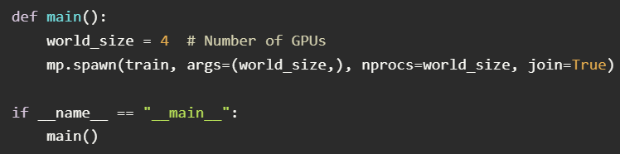
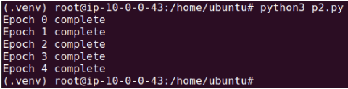
Step 5: Implement the Training Loop
  The output should look like this:

Slide 51
Implement the Training Loop
  Click her for Full code here
  cat > ddp_train.py
  python ddp_train.py
  The output should look like this:

Slide 52
Ex 3
NVIDIA Modulus: Darcy FNO

Slide 53
NVIDIA Modulus
NVIDIA Modulus is an open-source deep learning framework for AI-driven science and engineering applications.
It provides tools for solving problems that combine physics knowledge with data.
It’s designed to simplify the development, training, and deployment of Physics-Informed Machine Learning (SciML) models.

Slide 54
Darcy FNO
The Darcy FNO (Fourier Neural Operator) example in NVIDIA Modulus demonstrates how to solve the 2D Darcy flow problem, a type of partial differential equation (PDE), using Fourier Neural Operators (FNOs).
Darcy Flow Problem
Darcy's Law models the flow of fluid through porous media, commonly used in fields like:
  Hydrology: Groundwater flow modeling.
  Petroleum Engineering: Oil reservoir simulation.
  Environmental Engineering: Contaminant transport.

Slide 55
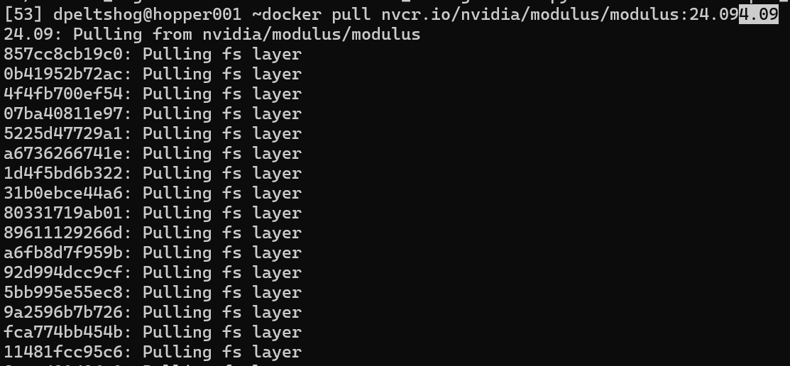
Step One: Set Up the Environment
Pull the docker container needed for running darcy FNO:

Slide 56
Step One: Set Up the Environment
docker run --shm-size=1g --ulimit memlock=-1 --ulimit stack=67108864 --runtime nvidia \--rm -it --gpus all --network=host -v $(pwd):/workspace --workdir /workspace nvcr.io/nvidia/modulus/modulus:24.09 bash
  --shm-size=1g: Allocates shared memory to the container.
  --ulimit memlock=-1: Disables memory locking restrictions.
  --ulimit stack=67108864: Increases the stack size limit.
  --runtime nvidia: Enables the NVIDIA runtime for GPU access.
  --gpus all: Allows access to all GPUs.
  -v $(pwd):/workspace: Mounts the current working directory to /workspace inside the container.
  --workdir /workspace: Sets the working directory inside the container.

Slide 57
Step Two: Clone the repo
  Proceed to clone the directory
git clone https://github.com/NVIDIA/modulus.git
cd modulus/examples/cfd/darcy_fno/
Step Three: Pip Install ML flow
  Install MLFlow inside the container by running the following command:
pip install mlflow

Slide 58
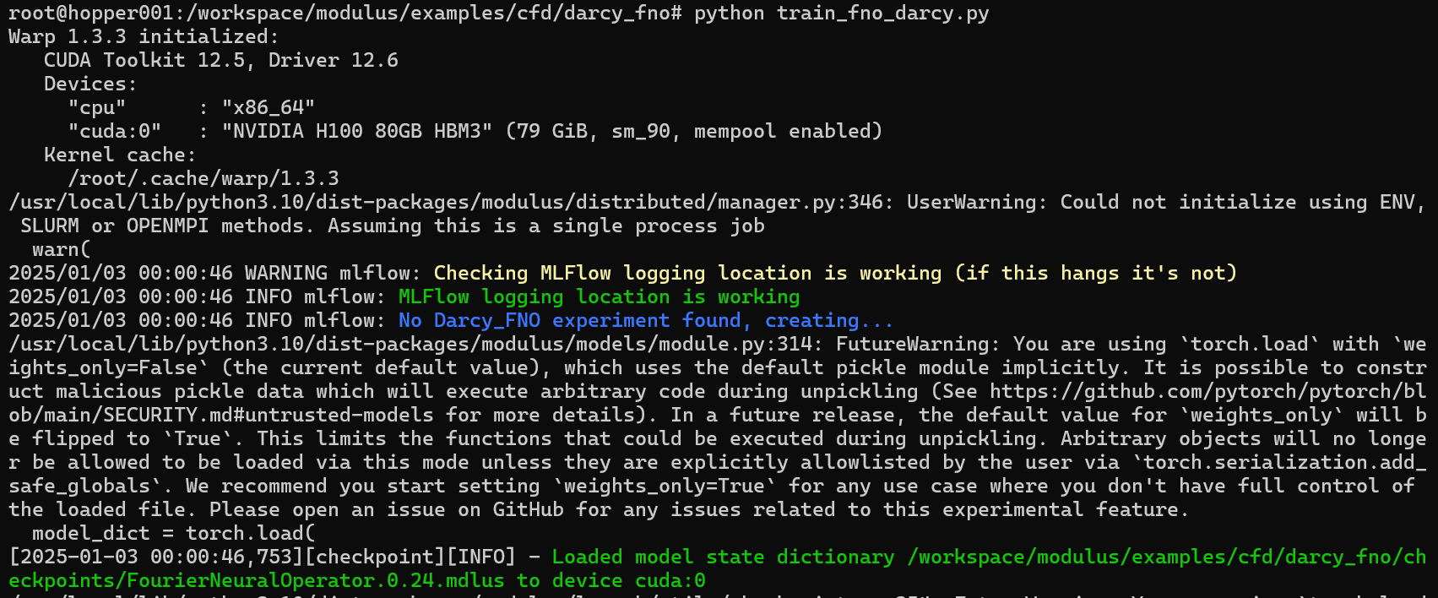
Step Four: Run Training Script
python train_fno_darcy.py

Slide 59
Thank You
Please email cchopper@utep.edu for any questions or feedbacks you may have ~

