Slide 1
DOCKER Introduction
Beginner - Intermediate

Slide 2
Table of contents
01
02
03
04
05
06
What are containers?
Docker Concepts
DockerFile Basics
Docker Commands
Demo: Hello World
NVIDIA HPC SDK

Slide 3
01
What are containers?

Slide 4
Containers
lightweight, isolated environment
similar to a virtual machines, in a way
packages an application and its dependencies, such as libraries, system tools, and settings, into a single portable unit.

Slide 5
Containers VS Virtual Machines (VM)
Both provide isolation (host local machine – guest virtual machine).
Problems in the host would not affect the VM and vice versa.
Encapsulates application code and dependencies
Can run on various host systems (Linux, Windows, etc.)
Containers are light and portable
Resouce efficient since it shares OS resources with host
VM are heavy and less portable
Resource intensive but completely isolated (including computer resources

Slide 6
Containers in Docker
Docker is a tool that allows developers to deploy their application and its dependencies (libraries, environment variables, etc) into a single container.
Doing this ensures the application runs consistently across different environments—whether it’s a developer’s local machine, a staging server, or a production environment in the cloud.

Slide 7
02
Docker Concepts

Slide 8
Docker Images
a lightweight, standalone, and executable package that includes everything needed to run a piece of software, such as the code, runtime, libraries, environment variables, and configuration files.
composed of Layers, where each layer adds something to the image (e.g., installing a new package, copying files, setting environment variables).
Think of it like a blueprint for creating containers

Slide 9
Docker Containers
a runnable instance of a Docker image.
While images are static and read-only, containers are dynamic and can have read-write operations.
Containers use the image to create an isolated environment where the application runs with its dependencies. Containers share the host system's kernel but remain isolated from each other.

Slide 10
Docker Daemon
a crucial component in Docker's architecture
manages the containers, images, networks, and volumes that are part of your Docker environment.
Listens for API requests (from CLI or tools) and executes request
E.g. when you use the command “docker run” , the CLI sends the request to the Daemon who starts the container

Slide 11
Docker Registry
Docker registry stores Docker images.
Docker Hub is a public registry that anyone can use, and Docker looks for images on Docker Hub by default. You can even run your own private registry.
When you use the docker pull or docker run commands, Docker pulls the required images from your configured registry.
When you use the docker push command, Docker pushes your image to your configured registry.

Slide 12
Docker Volume
Docker volumes are a key feature for managing persistent storage in Docker containers.
They allow data to persist beyond the lifecycle of a container, which is important because when containers are stopped or deleted, all data inside them is lost.
Volumes provide a way to retain data even after containers are removed or restarted.

Slide 13
03
DockerFile

Slide 14
DockerFile
a text file that contains a set of instructions to automate the process of building a Docker image
The file is literally called “Dockerfile” (no extensions)
defines everything needed to create a container, including the base image, software dependencies, environment variables,
Think of it like a blueprint for creating docker images

Slide 15
Sample Dockerfile
# Step 1: Use a base image
FROM python:3.9-slim
# Step 2: Set the working directory inside the container
WORKDIR /app
# Step 3: Copy the requirements file from the host to the container
COPY requirements.txt .
# Step 4: Install dependencies
RUN pip install -r requirements.txt
# Step 5: Copy the application code into the container
COPY . .
# Step 6: Run the application
CMD ["python", "app.py"]

Slide 16
Dockerfile instructions
FROM: Specifies the base image to use (e.g., Ubuntu, Python, etc.).
COPY: Copies files from the host machine into the container.
RUN: Executes commands inside the container during the image build process (e.g., installing packages).
CMD: Specifies the command to run when the container starts.
WORKDIR: Sets the working directory inside the container.
ENV: Sets environment variables inside the container.
EXPOSE: Specifies the port on which the container will listen at runtime.

Slide 17
04
Docker Commands

Slide 18
Basic Commands
docker pull image_name | Downloads Docker images from a remote repository (usually Docker Hub) to your local machine.
docker run [OPTIONS] IMAGE [COMMAND] [ARG...] | Creates and runs a container from a specified Docker image.
docker ps (-a) | Lists all running containers. (-a to also show stopped containers)
docker stop container_name_or_id | Stops a running container by sending a termination signal.
docker rm container_name_or_id | Removes a stopped container.
Docker build –t image_name . | Builds a Docker image from the Dockerfile in the current directory.
Docker images | See your local images.

Slide 19
docker pull <image_name>
Example: docker pull pytorch/pytorch:latest

Slide 20
docker run -it <image_name> Example: docker run -it --gpus=all pytorch/pytorch bash

Slide 21
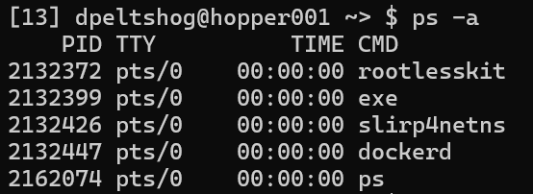
docker ps -a
When you run docker ps without any options, it only lists the containers that are currently running.
By adding -a, Docker will list all containers, including those:
Running, Stopped, Exited, Paused, Created (but not started)

Slide 22
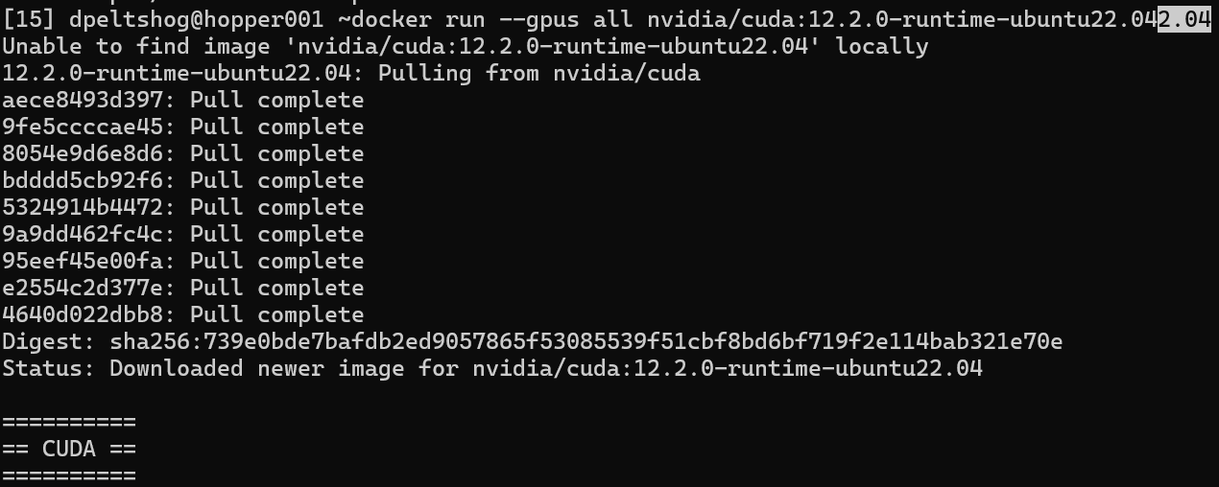
docker run --gpus all nvidia/cuda:12.2.0-runtime-ubuntu22.04
If you do run without pulling the image, you will automatically pull image (if available) and then run it

Slide 23
nvidia-smi - shows current gpu usage

Slide 24
Stopping Docker
stop_rootless_docker.sh --quiet
exit
- Used from outside the container and need to gracefully stop a running container from a host system
- Again, this is specific to cchopper
- Used inside from inside the terminal and want to stop the session

Slide 25
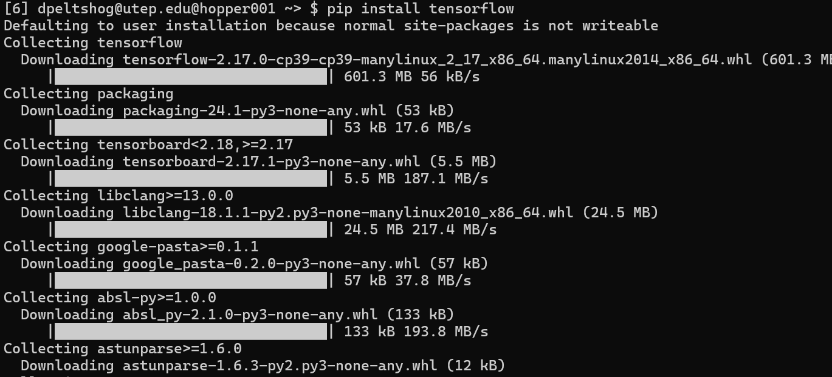
pip install <package_name>
used to install Python packages from the Python Package Index (PyPI) or other sources, for example TensorFlow.

Slide 26
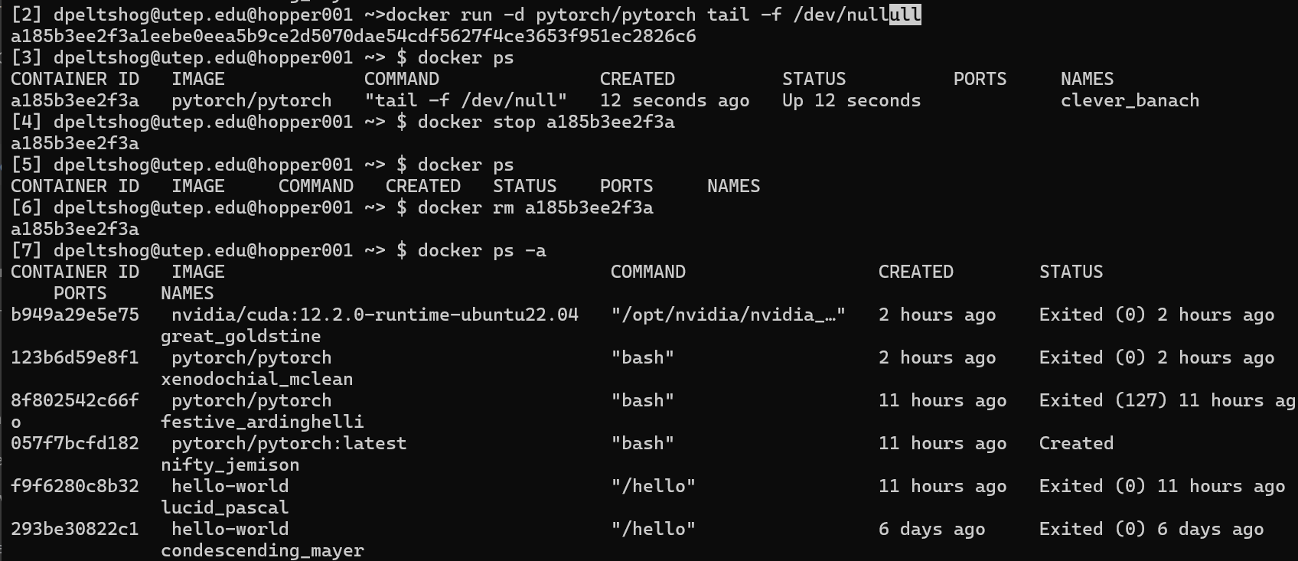
docker rm <container_id>
(try deleting your PyTorch container)

Slide 27
05
Exercise: Hello world

Slide 28
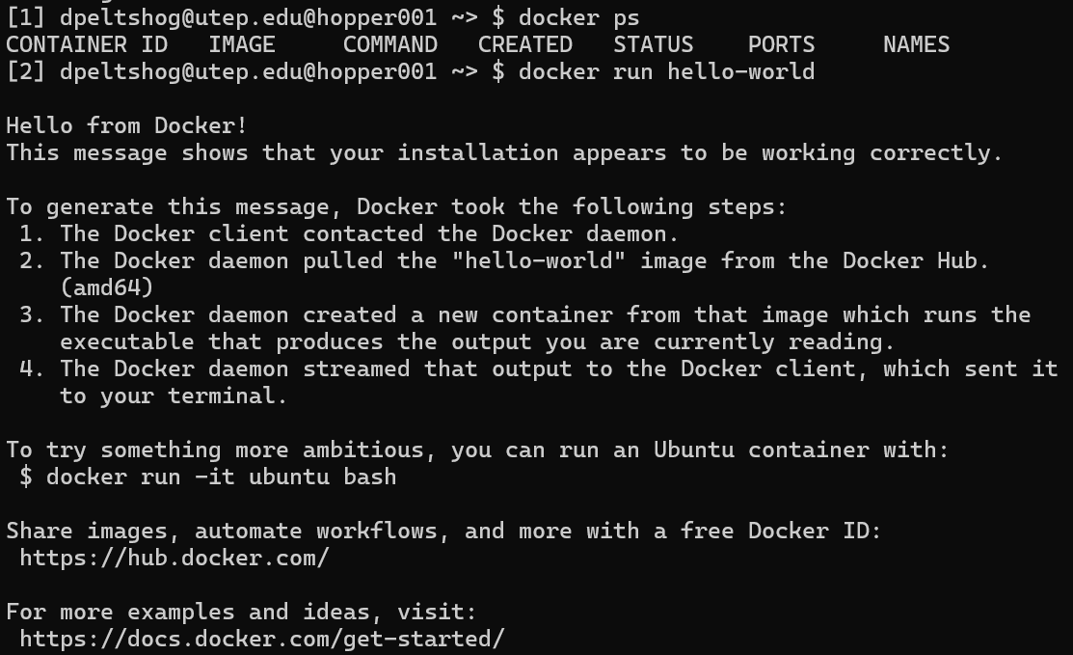
#0: hello-world container: docker run hello-world

Slide 29
#1: pytorch container (we did this already)
docker pull pytorch/pytorch:latest
docker run –it –gpus=all pytorch/pytorch

Slide 30
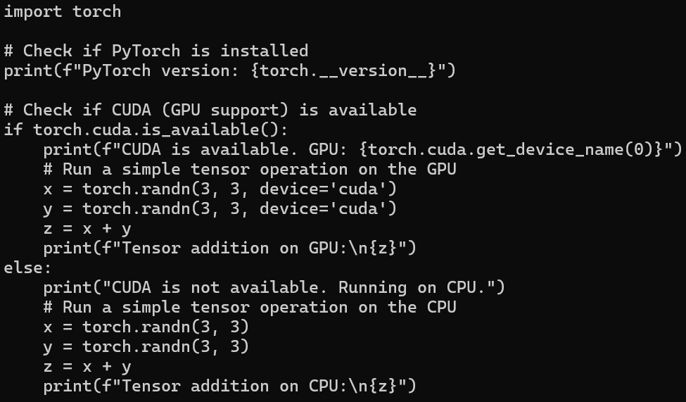
#2: simple pytorch
mkdir test
cd test
vi hello-world.py

Slide 31
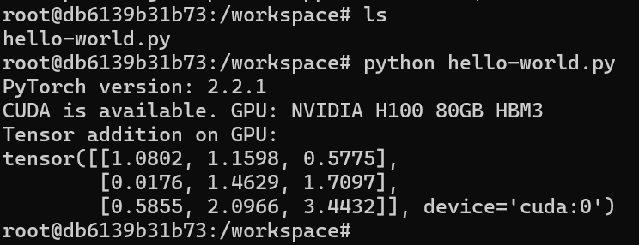
#2: simple pytorch
docker run -it --gpus all -v $(pwd):/workspace pytorch/pytorchorch

Slide 32
06
Exercise: Batch Script – Docker

Slide 33
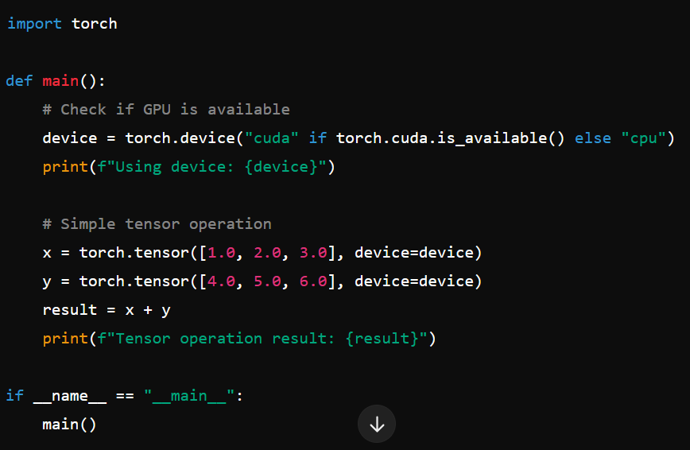
#0: simple pytorch script (simple_pytorch.py)
Use (shift+zz) to exit

Slide 34
#1: pull image
docker pull nvcr.io/nvidia/pytorch:23.02-py3

Slide 35
#2: write batch script (run_pytorch_container.sbatch)
#!/bin/bash
#SBATCH --job-name=pytorch-container-job # Job name
#SBATCH --output=output_%j.log # Standard output and error log
#SBATCH --error=error_%j.log # Error log
#SBATCH --ntasks=1 # Number of tasks (1 per container)
#SBATCH --cpus-per-task=4 # Number of CPU cores per task
#SBATCH --gpus=1 # Request 1 GPU
#SBATCH --mem=16GB # Memory required
#SBATCH --time=00:30:00 # Time limit (HH:MM:SS)
#SBATCH --partition=gpu # Specify DGX or HGX
# Load required modules
module load docker continued on next slide

Slide 36
#2: write batch script (run_pytorch_container.sbatch)
# Set variables
DOCKER_IMAGE="nvcr.io/nvidia/pytorch:23.02-py3" # NVIDIA PyTorch container
SCRIPT_PATH="/workspace/pytorch_script.py" # Path to script inside container
CONTAINER_WORKDIR="/workspace" # Container working directory
# Pull the Docker container image (in case not already pulled)
docker pull $DOCKER_IMAGE
# Run the PyTorch script inside the Docker container
docker run --gpus all \
-v $(pwd):$CONTAINER_WORKDIR \ # Bind mount current directory to container
-w $CONTAINER_WORKDIR \ # Set container working directory
$DOCKER_IMAGE \ # Specify the container image
python $SCRIPT_PATH # Command to execute inside the container

Slide 37
#3: submiting batch job
Output log will be in the directiory:

Slide 38
Thank you~
Please email cchopper@utep.edu for any questions or feedback
Please keep this slide for attribution

