Slide 1
Countering criminalization from a human rights perspective
The University of Texas at El Paso
23 June 2023

Slide 2
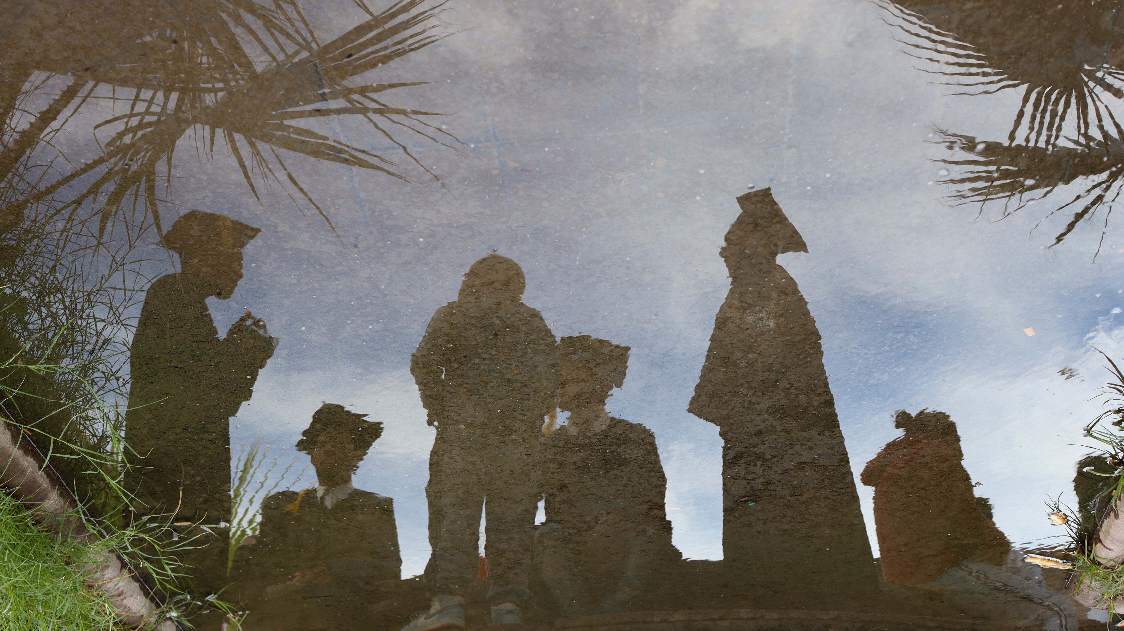
“Whomever forgets the past is doomed to repeat it”

Slide 3
Recommendation CNDH: 74/2009
Seven adolescents illegally deprived of their freedom by the institution in charge of protecting them between 2008 and 2009.
Adolescents detained for longer periods.
The National Commission of Human Rights issued precautionary measures to restore the young people’s freedom.

Slide 4
Juvenile Referral Program (JRP): 2014-2015
Detection and retention of children eligible for criminal prosecution given their involvement in smuggling.
Implemented in South Texas: Rio Grande Valley.
JRP adolescents detained for longer periods than unaccompanied minors, often in high-security facilities.
Civil rights organizations concerned over legal rights of children and their potential referral to prosecution.
500+ children estimated to have gone through program.

Slide 5
Human Rights Perspective
Misconceptions: Polleritos, coyotitos, muleritos.
Criminalization of poverty: Disposable people
Gender-based violence.
Risks to physical health and life.
Weakest link in the criminal structure.

Slide 6
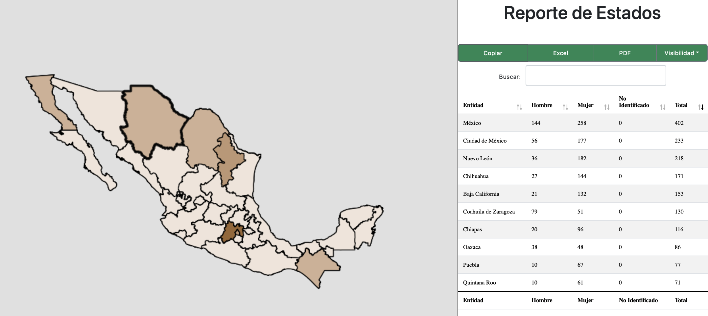
Trafficking
National Observatory for the Prevention of Recruiment.

Slide 7
Recruitment
Entailment – Link - up | Perrmanent.
Methods | Coercion, persuasion.
Affectation | Disrupts development and physical and psycho-emotional health.
Participation | With one or several specific activities within an organized crime group.
Isolation | Family and community contact is reduced.
Environments | Rural and urban.
Attributable persons | Organized crime group.
Training | On the development of criminal activities.

Slide 8
Recommendations
Inclusion of children and adolescents in the National Child Protection Roadmap
Data generation
Strengthening research and risk analysis capacities – PAPNNAF
BP: abuses and risk identification.

Slide 9
Thank you! Blanca Navarrete
direccion@dhia.com.mx

