Slide 1
Child recruitment for the Facilitation of Irregular Border Crossings on the Mexico-US Border: the El Paso-Ciudad Juarez Case
UTEP, June 23, 2023

Slide 2
Agenda
What is FICOSEC?
Our areas of interest and target populations
Tackling the participation of boys, girls and adolescents in the facilitation of irregular border crossings
What we have accomplished
What is left to do

Slide 3
FICOSEC
A public-private alliance established by over 42.000 business owners from the state of Chihuahua.
Our goal is to impact public safety and competitiveness
Founded by decree on 2012, via an initiative by the business community.
Financed through a 5% contribution of its members’ payroll tax.

Slide 4
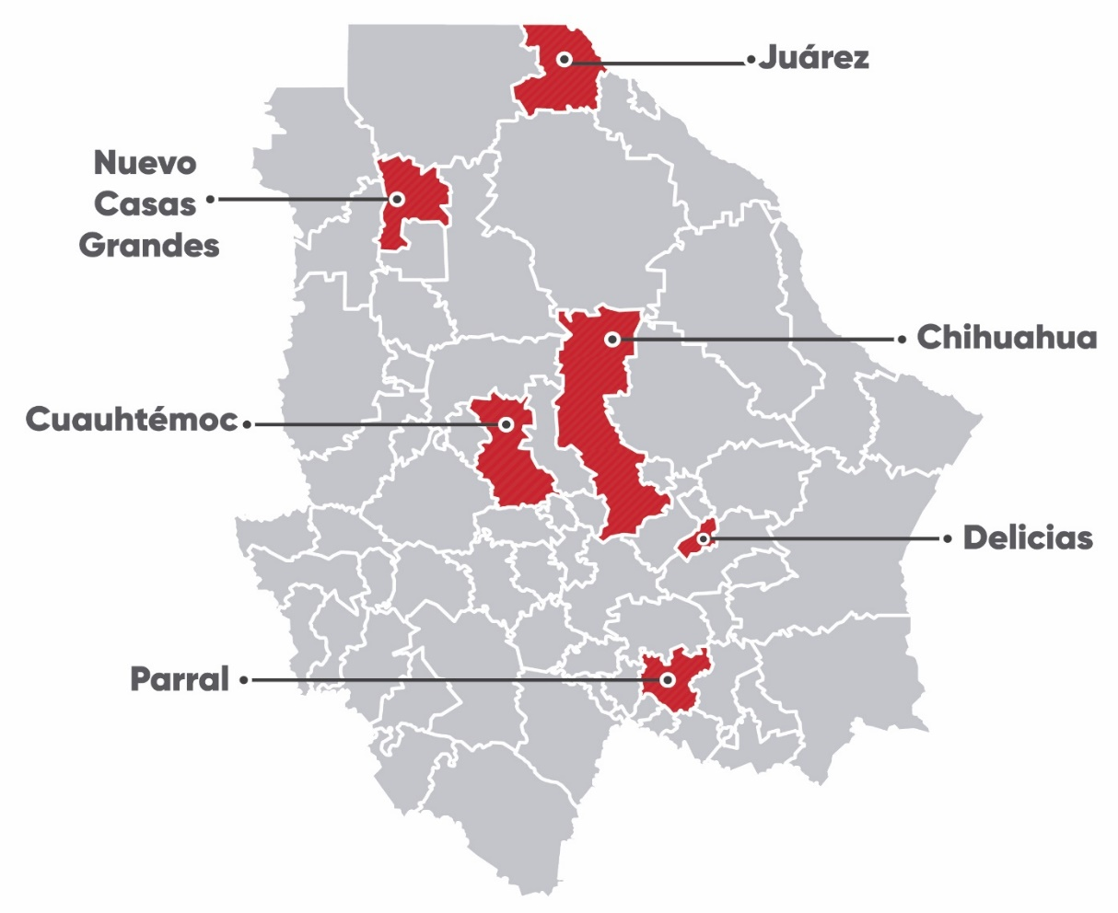
Ficosec North
Seguridad y Justicia de Ciudad Juárez, A.C.
Ficosec South Central
Fundación Ficosec, A.C.

Slide 5
Our goal: Erradicate impunity “By strengthening prevention, security, justice and competitiveness through collaborations among civil society, business owners and government.”

Slide 6
Our Role
Topics
Prevention
Security
Justice
*Competitiveness*
Children and Adolescents
At-risk youth
Women victims of violence
Institutions
Strengthen Measure Evaluate
Promote
Link
How we do it
Target population

Slide 7
Our approach to boys, girls and adolescents involved in the facilitation of irregular border crossings
Interest of the board of directors
Avoid growth/escalation
Lack of baseline studies/research concerning the topic
Funding the project

Slide 8
What we have done
Baseline diagnostic relying on oficial data
Outcomes:
Need for additional data
Additional research
Raise awareness

Slide 9
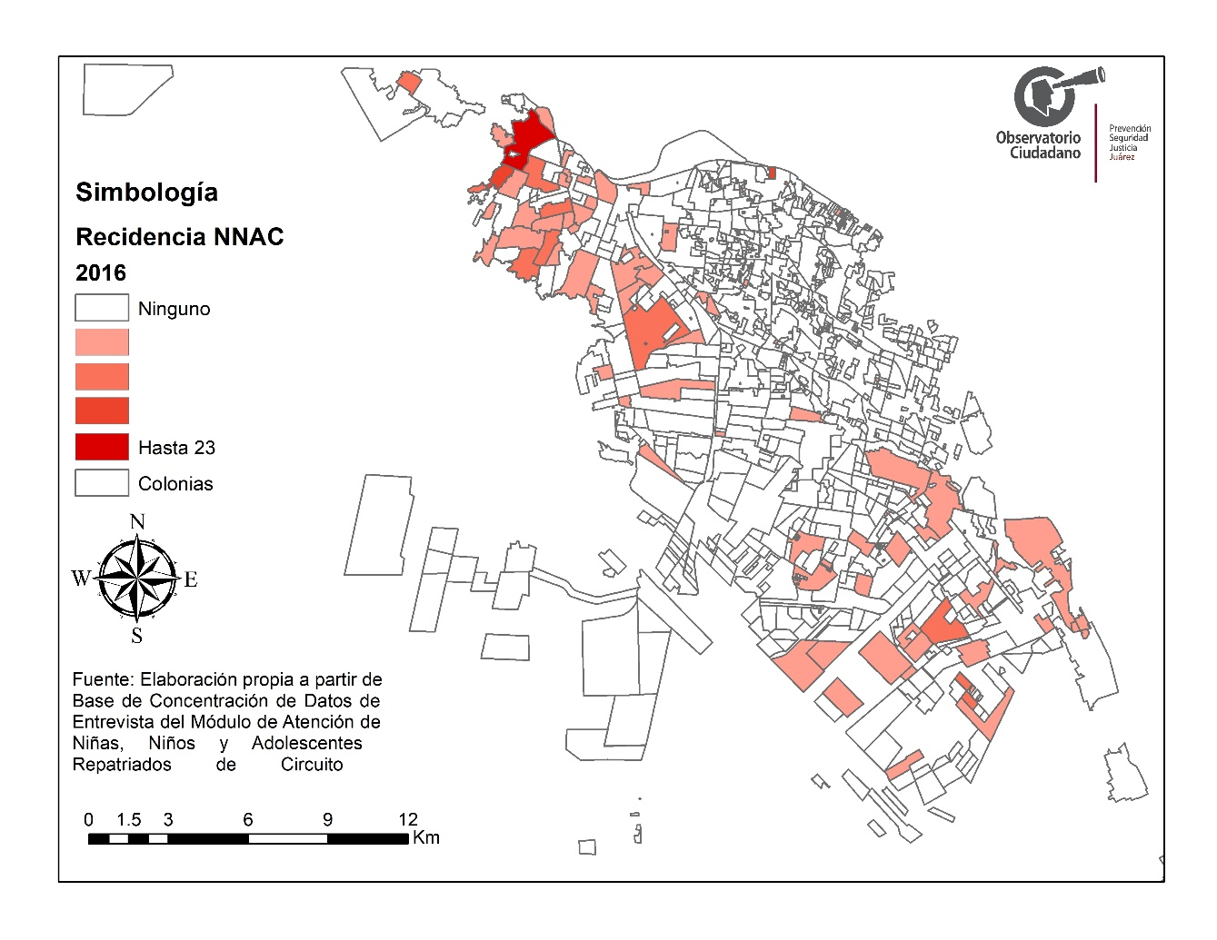

Slide 10
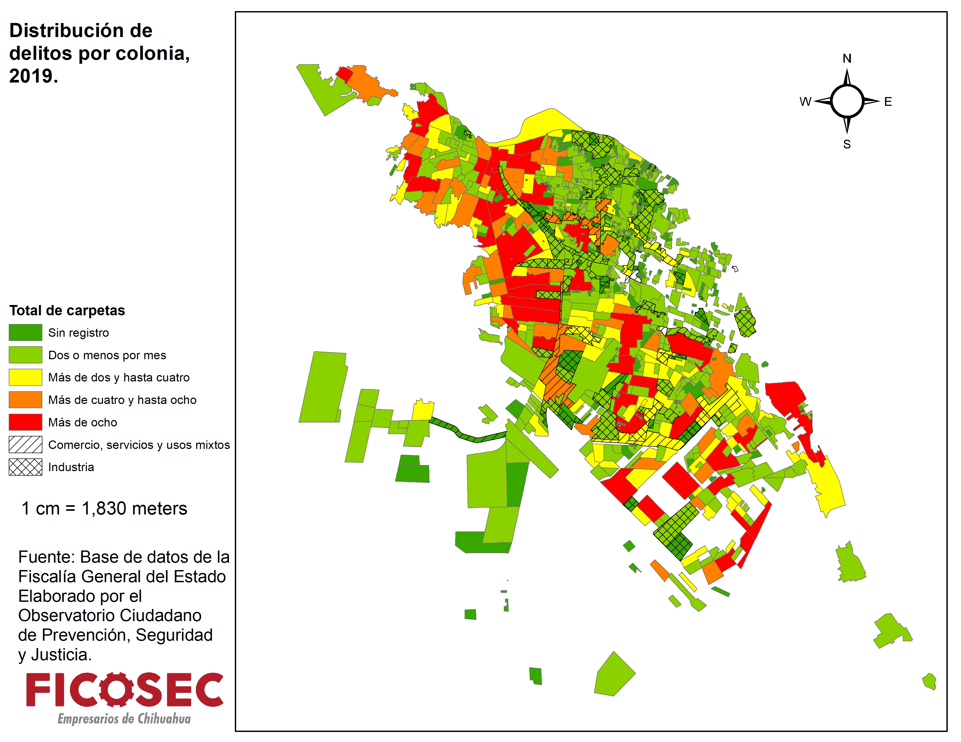

Slide 11
Financing DHIA’s Project
Care and Prevention Program for Border Migrant Girls, Boys and Adolescents (PAPNNAMF)
Strengthen protection elements
Restore children’s rights
Prevention initiatives at the individual, family and community levels.

Slide 12
What we have left to do
Sistematize the experience
In-Depth research to improve the understanding of circuit migration
Create a workplan with key stakeholders to generate further actions to contribute to child protection activities.
Situate the phenomenon in the agendas of state institutions
Create a protection protocol in collaboration with government agencies, civil society and experts to ensure a human rights perspective.

Slide 13
Thank you! Oscar I. Bueno oscar.bueno@ficosec.org

