Slide 1
Micro:bits for computer science
By: dora Jones

Slide 2
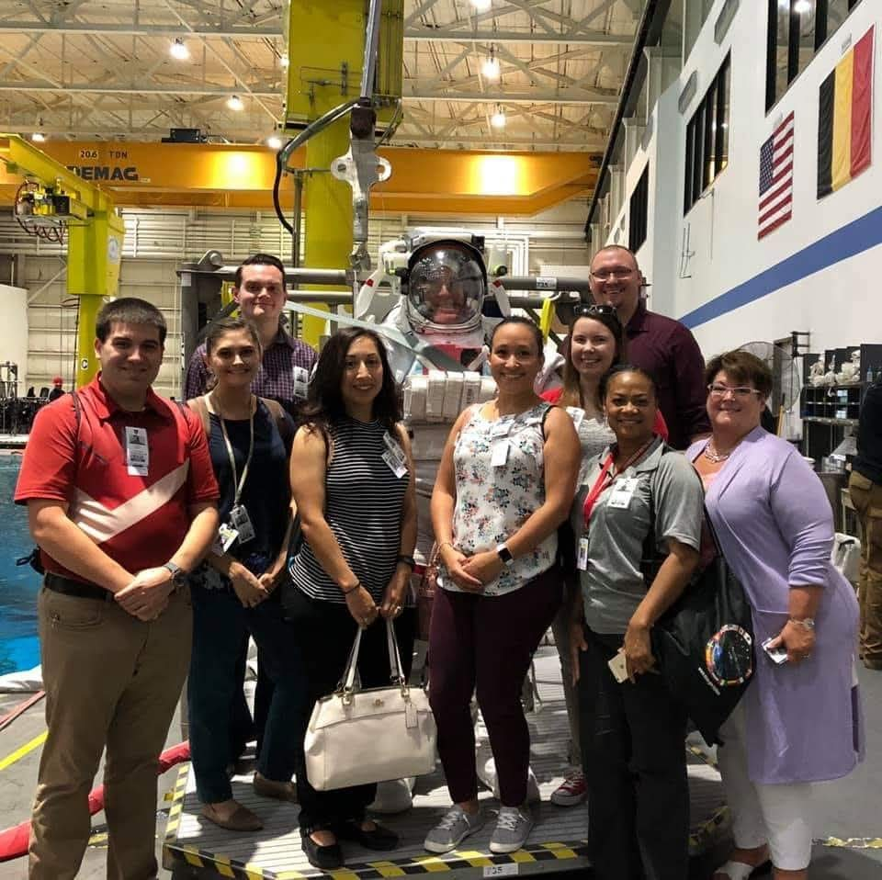
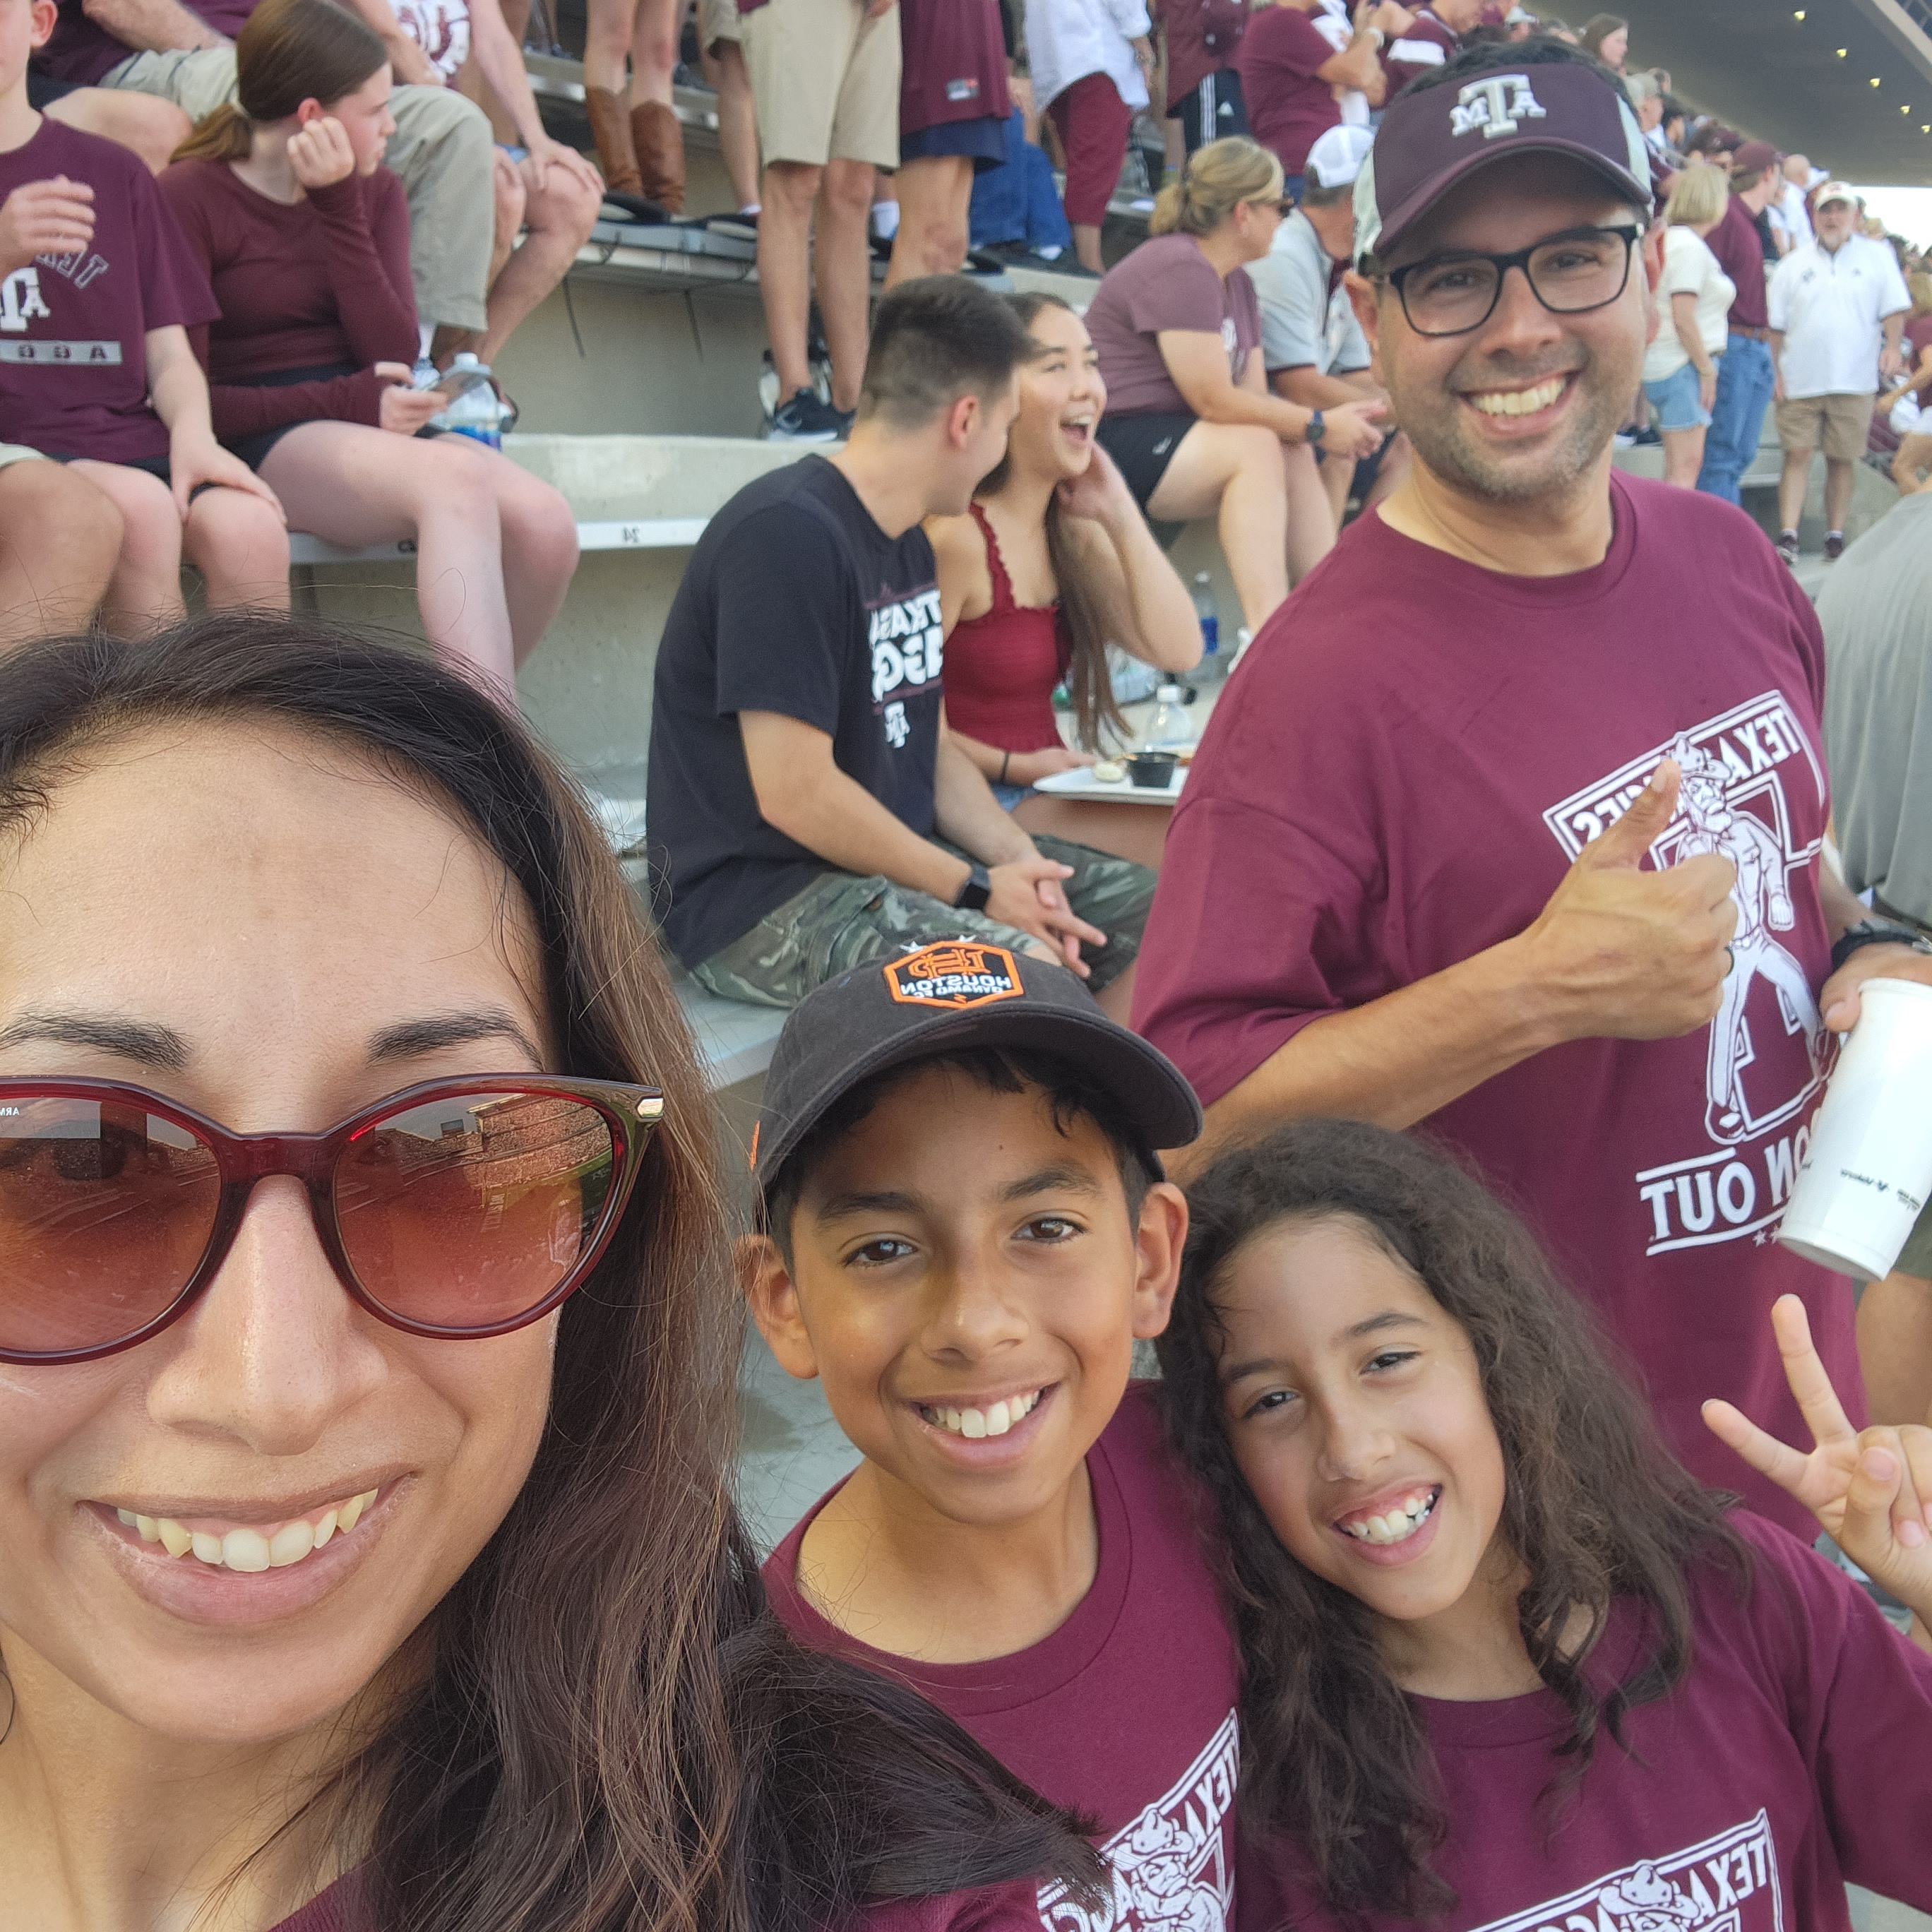
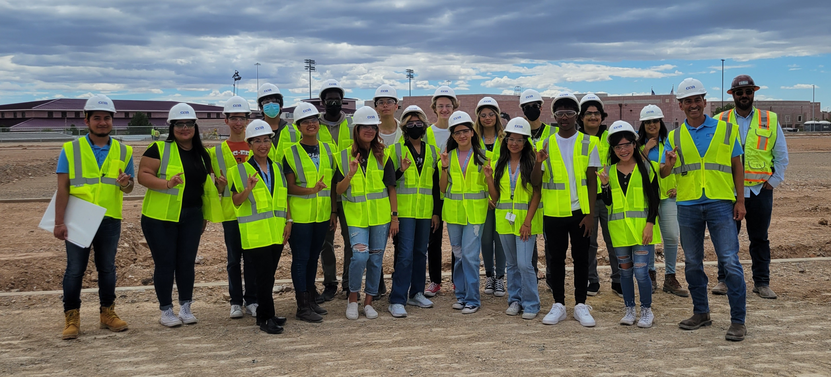
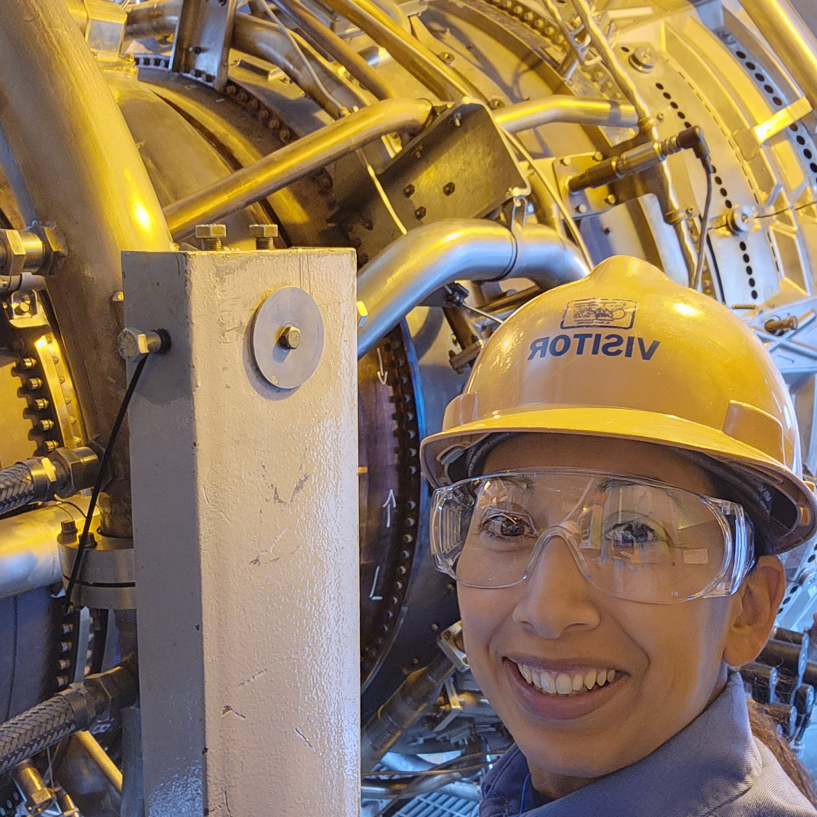
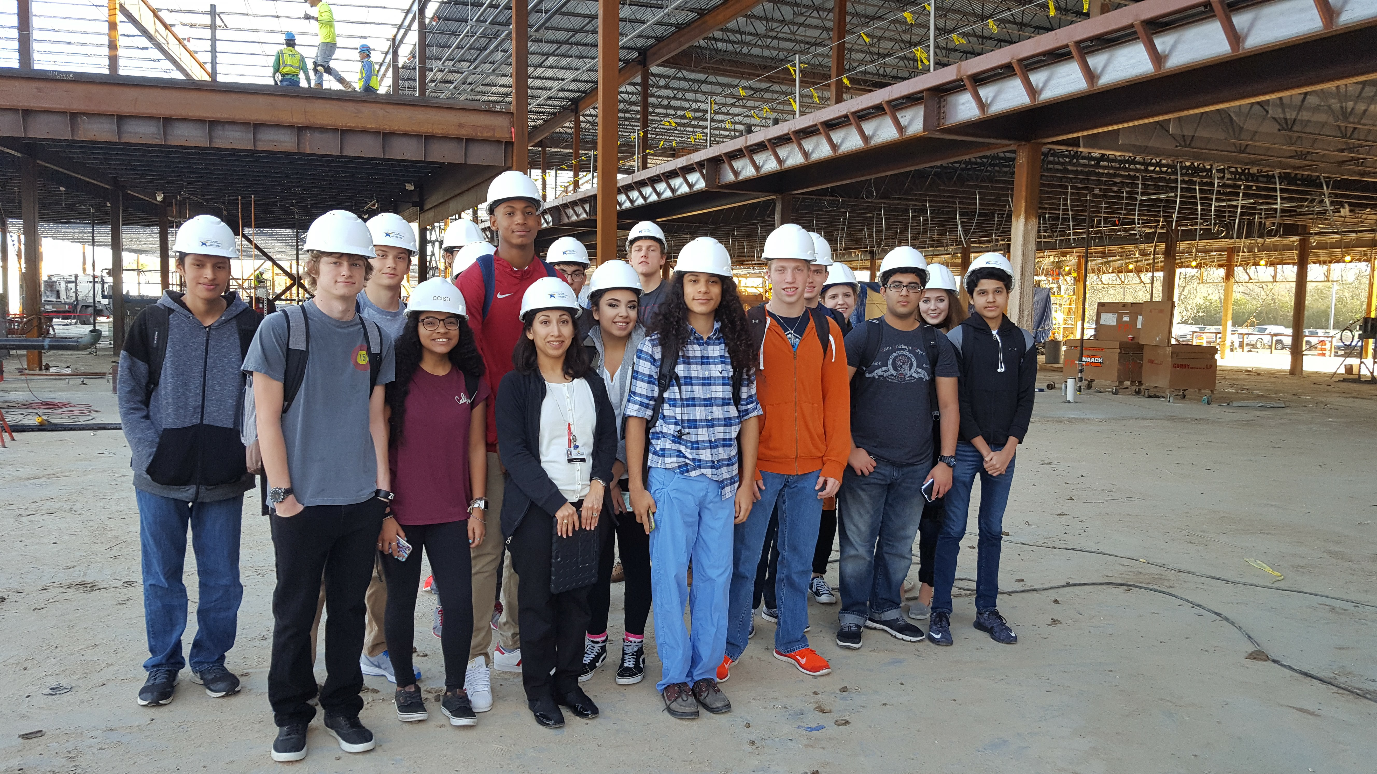
About me

Slide 3
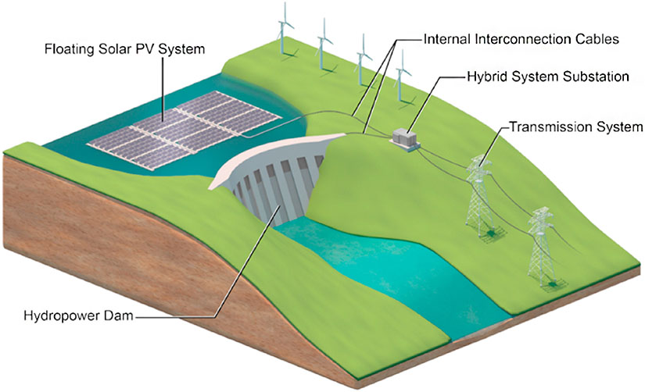
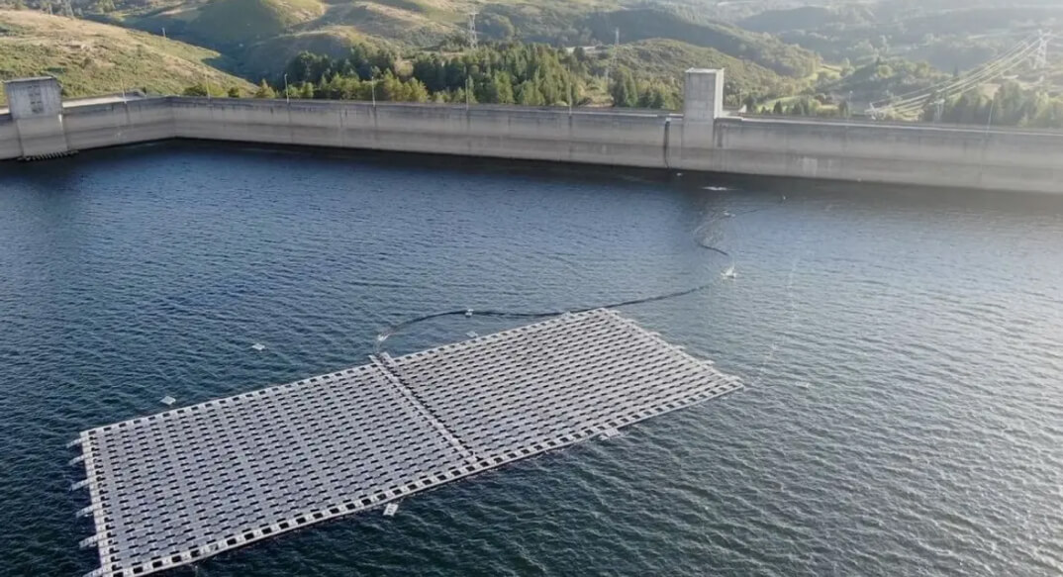
SUMMER RESEARCH WITH CREEDS

Slide 4
ARTIFICIAL INTELLIGENCE, CYBERSECURITY, DATA SCIENCE
This project builds a predictive model for reservoir water releases forecasting using LSTM neural networks and RealPaver. It analyzes how storage levels respond to inflow, outflow, and evaporation, aiming to improve water and energy planning under climate stress.

Slide 5
AP COMPUter science principles
Big Idea 1: Creative Development
  You’ll learn how important collaboration is in developing programs and how to use an iterative process in your work.
Topics may include:
  Collaboration
  Program design and development
On the Exam
  10%–13% of exam score

Slide 6
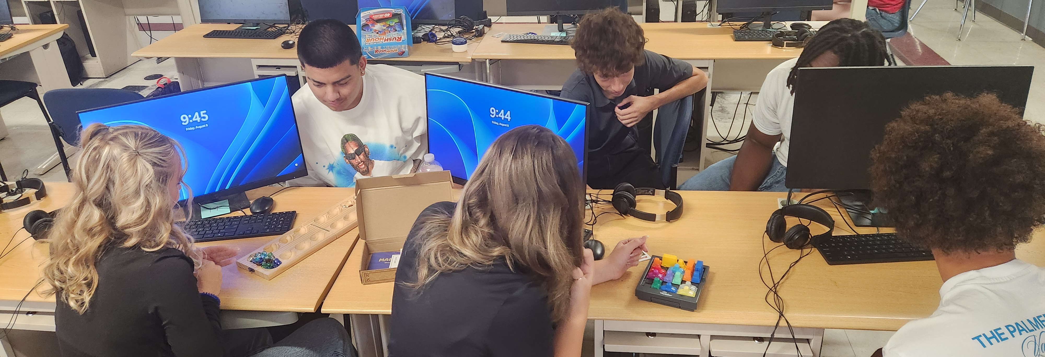

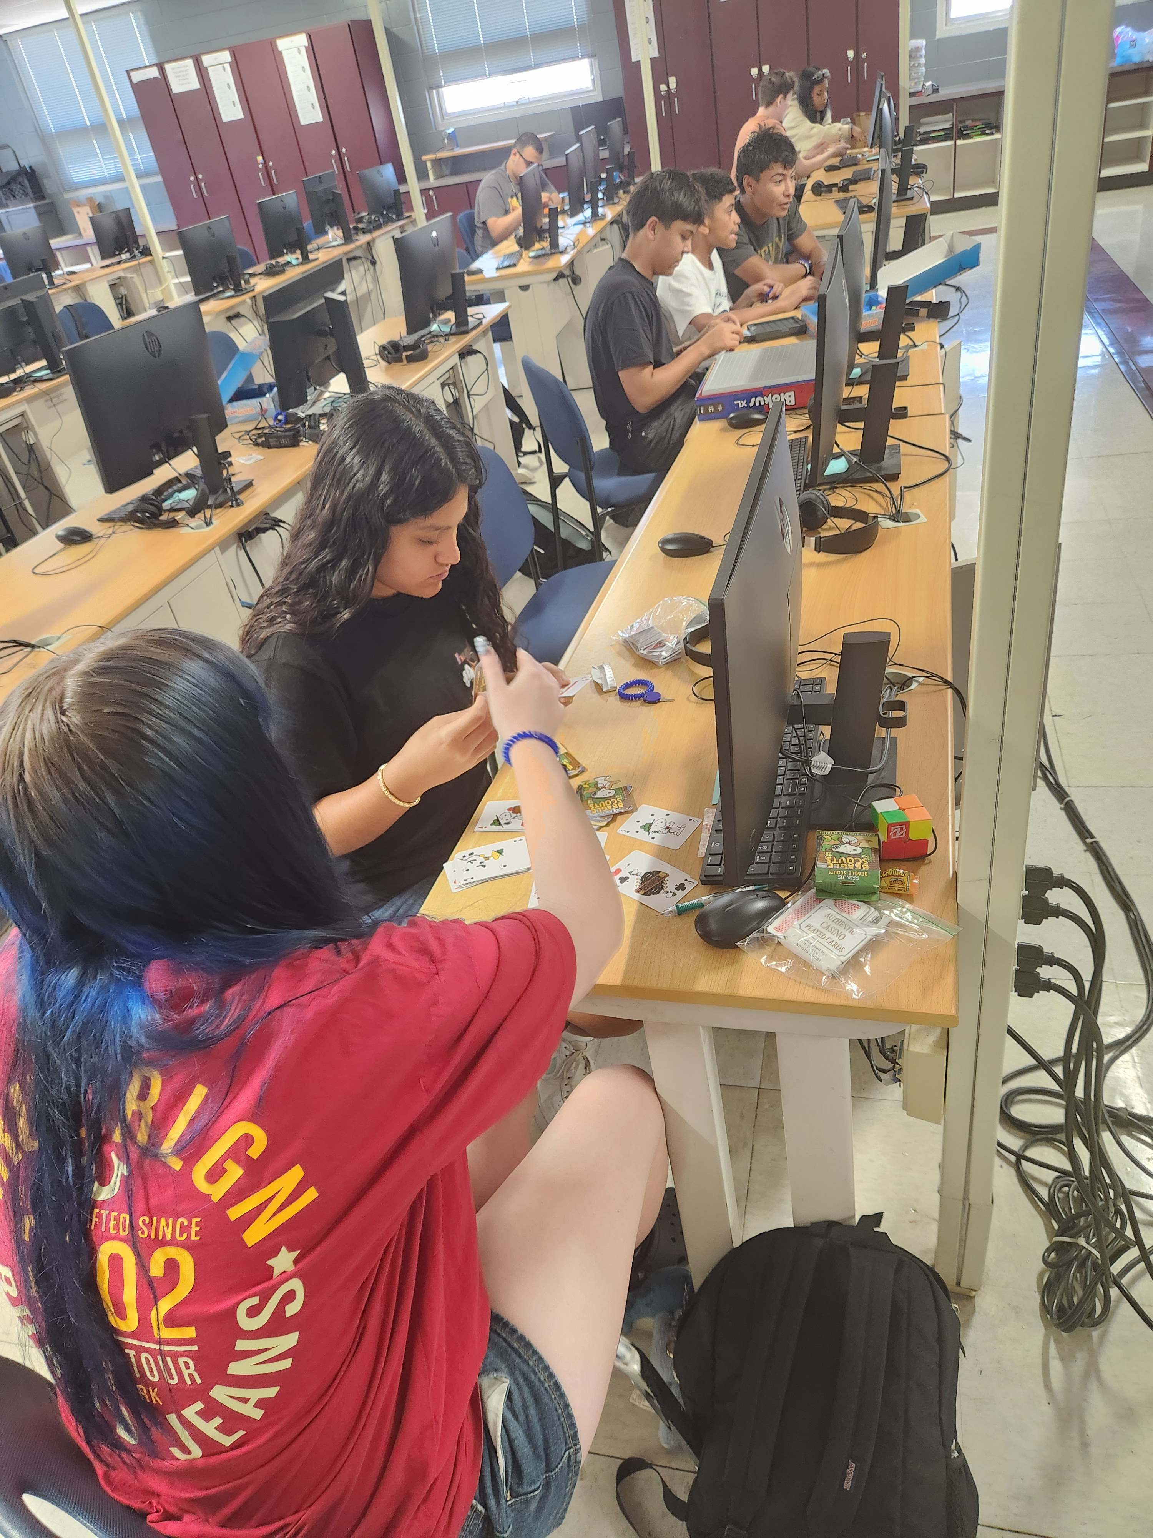
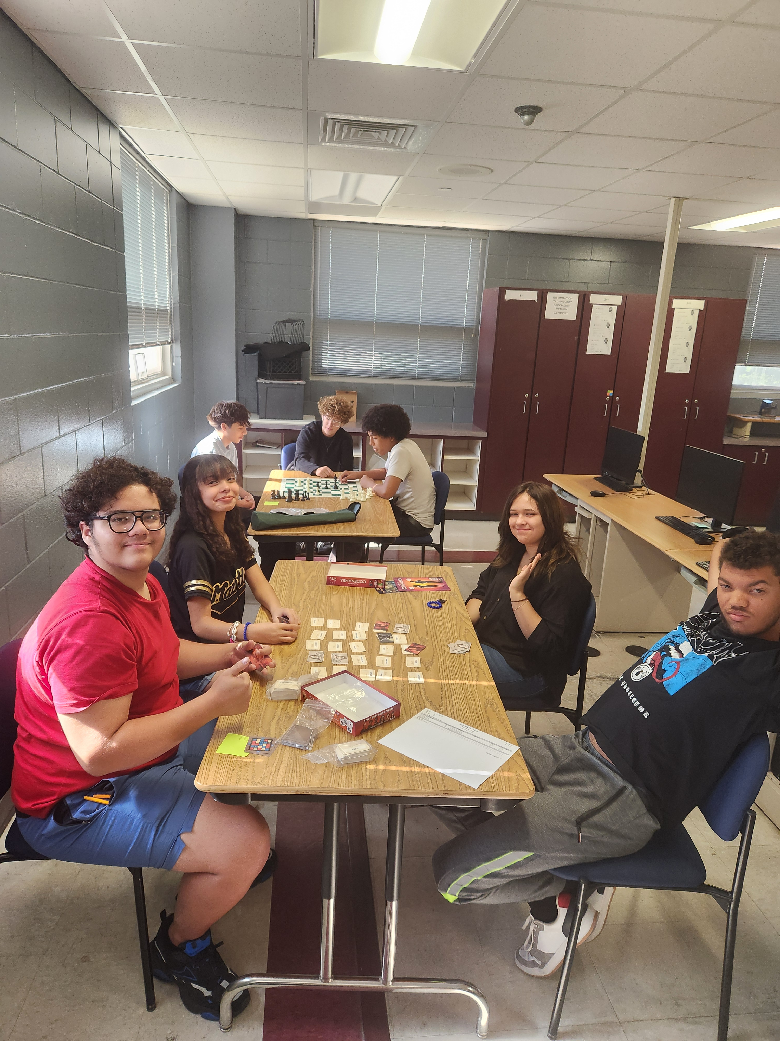
Overcoming
LOGIC AND STRATEGY GAMES

Slide 7
AP COMPUter science principles
Big Idea 2: Data
  You’ll explore how computers handle data and how data can be used to produce new information and solve problems.
Topics may include:
  Data compression
  Extracting information from data
On the Exam
  17%−22% of exam score

Slide 8
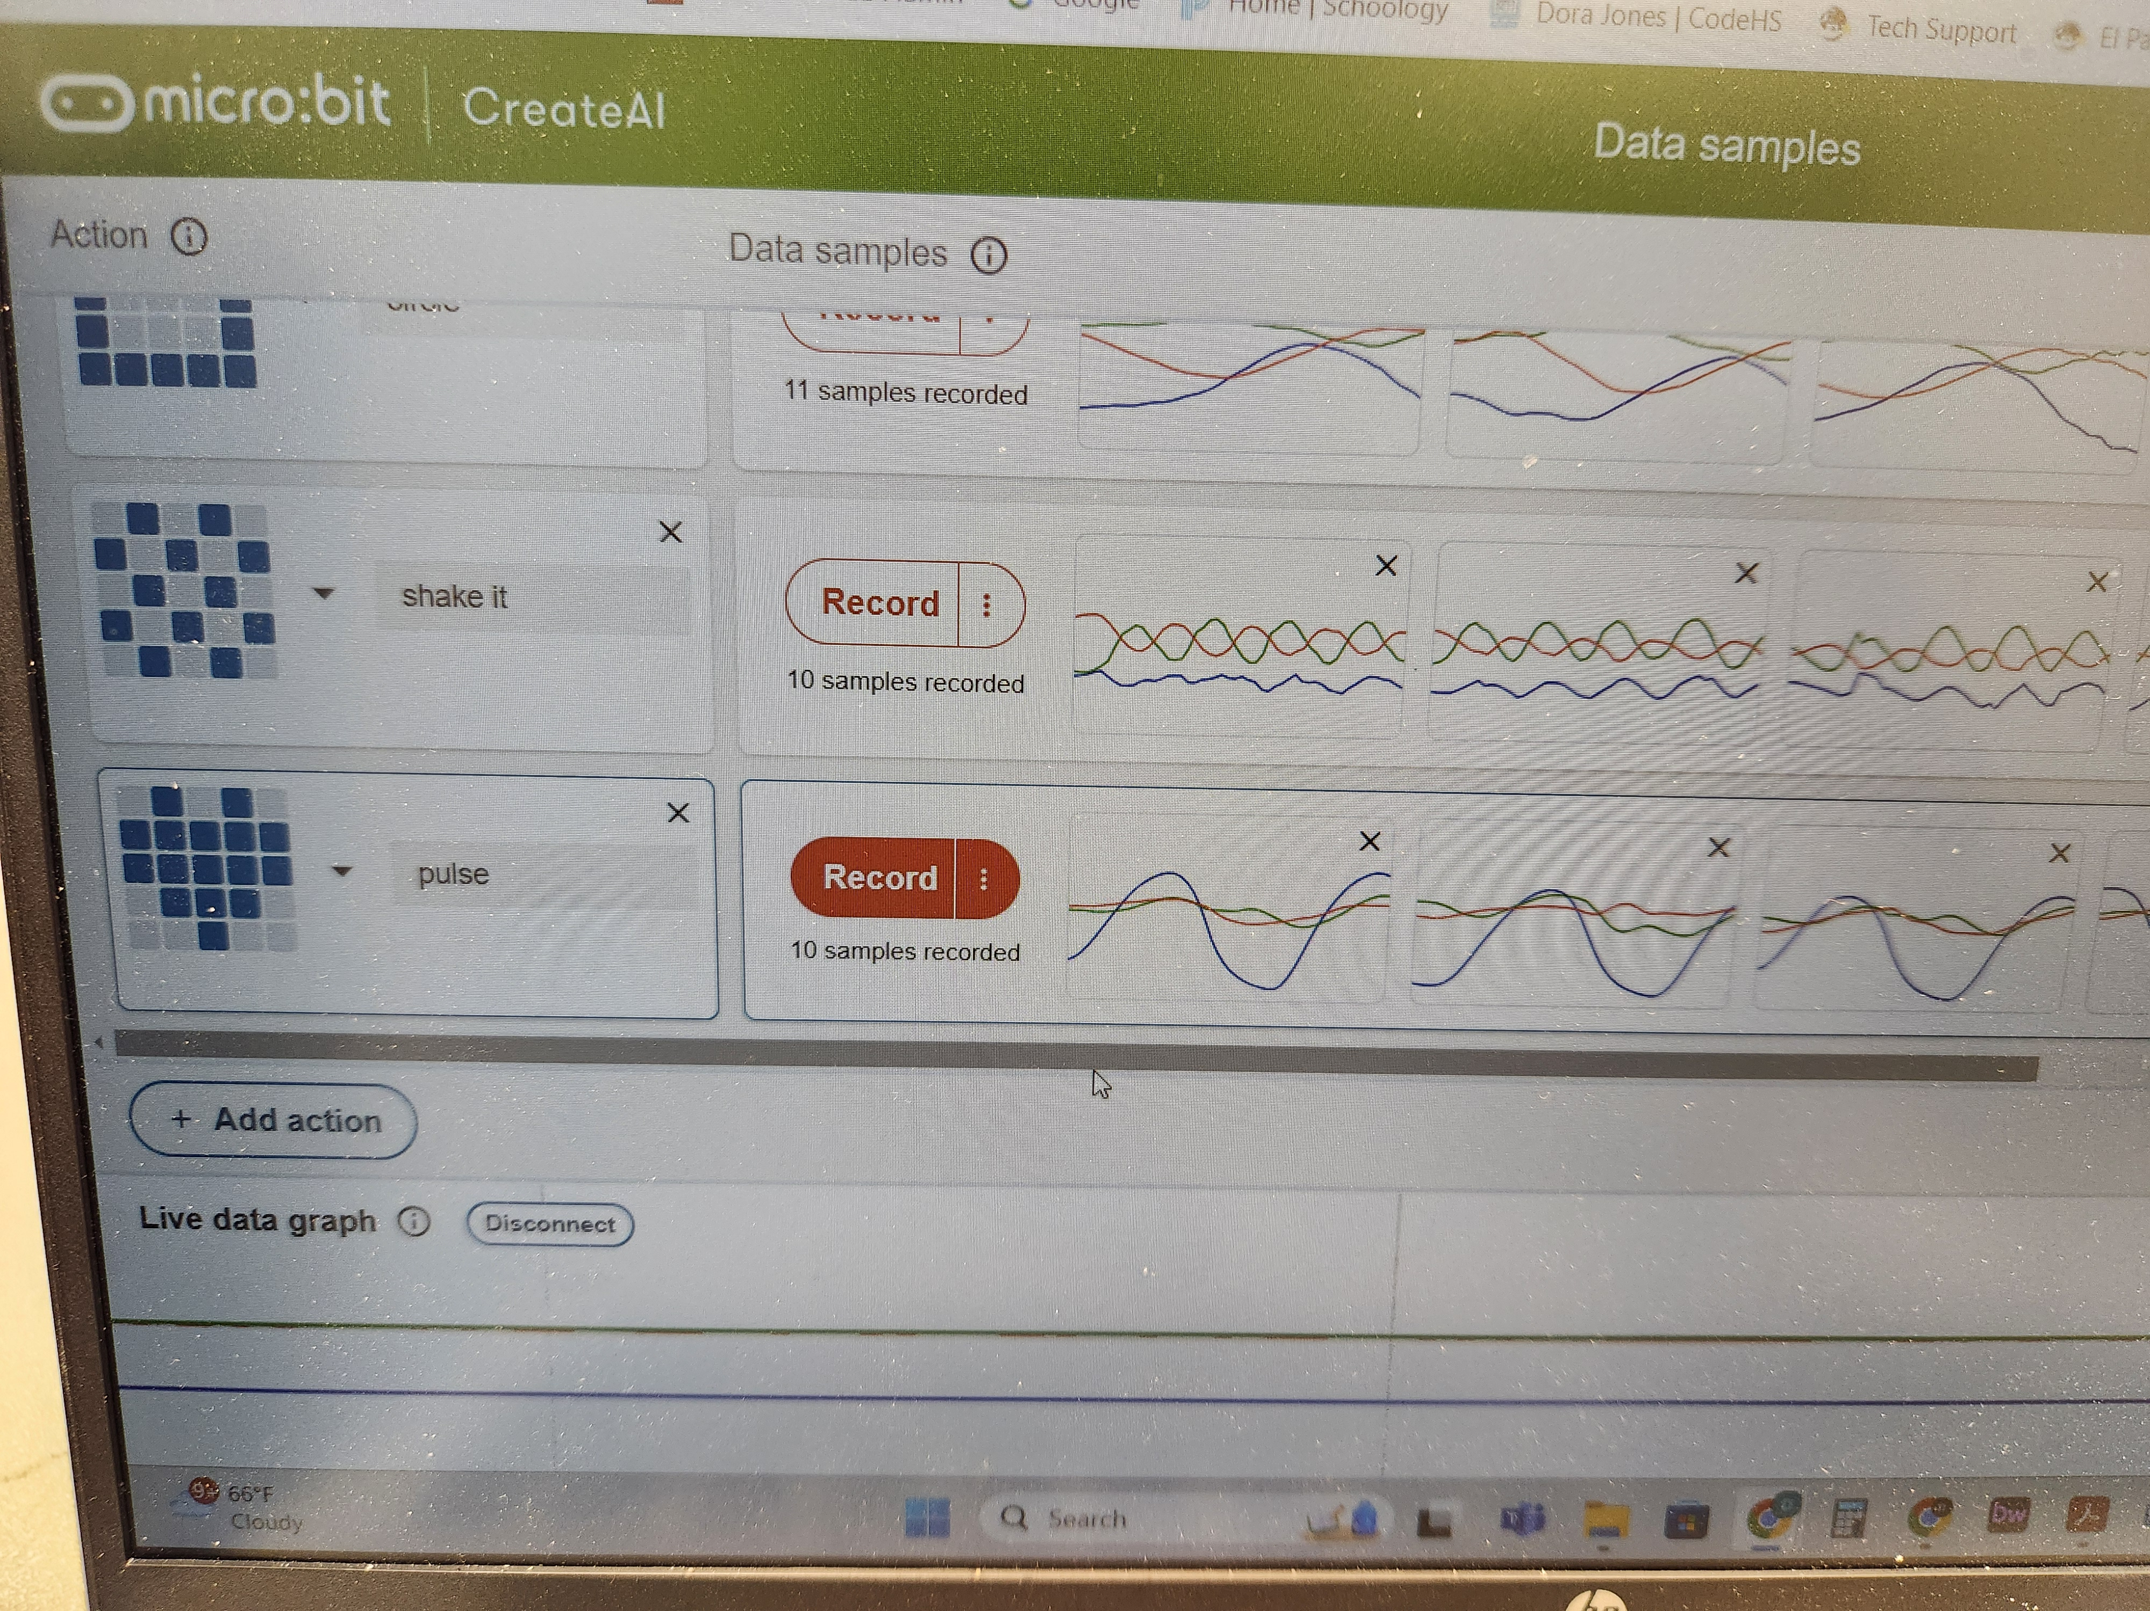
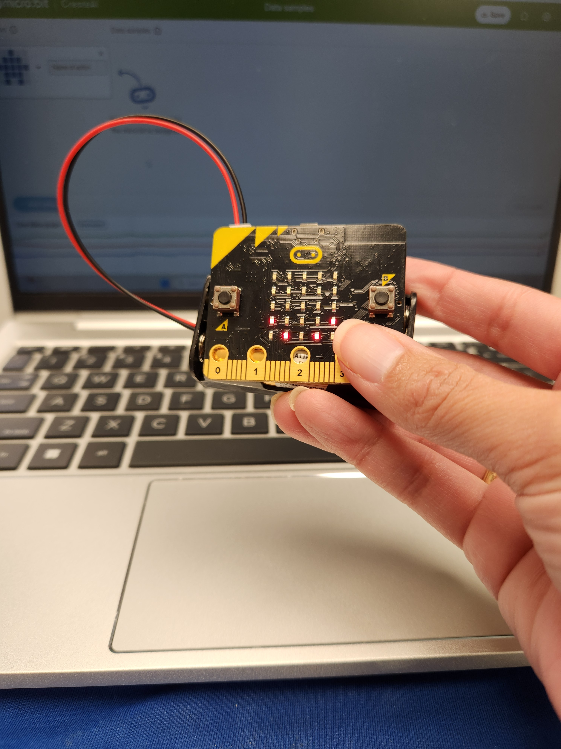
ENGAGING THE AUDIENCE
Make eye contact with your audience to create a sense of intimacy and involvement
Weave relatable stories into your presentation using narratives that make your message memorable and impactful
Encourage questions and provide thoughtful responses to enhance audience participation
Use live polls or surveys to gather audience opinions, promoting engagement and making sure the audience feel involved
MICRO:BITS

Slide 9
AP COMPUter science principles
Section II: Create Performance Task
30% of score
  Create performance task program code, video, and student-authored Personalized Project Reference | 9 hours in-class
  2 written response questions | 60 minutes end-of-course exam

Slide 10
CREEDS EXPERIENCE and impact

Slide 11
Questions?

