Slide 1
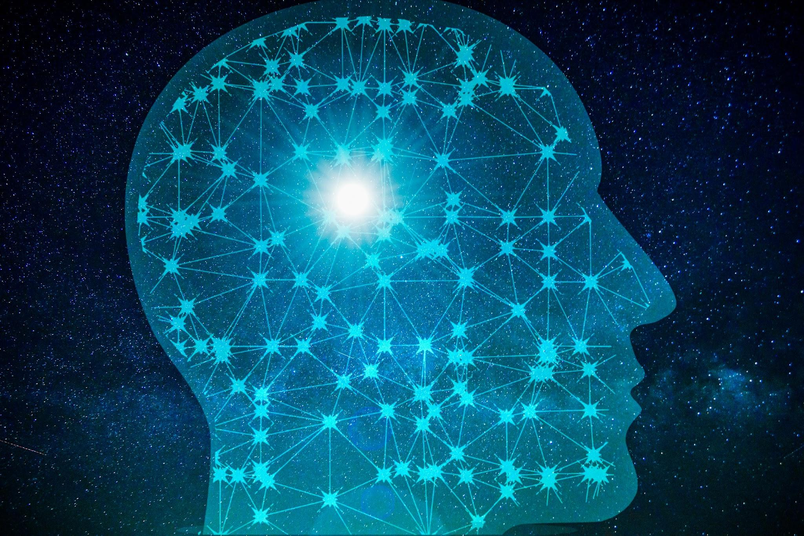
ML That Minds Its Business(And Yours): Fair, Accurate, and Private
Holly Lopez, Teacher, Mountain View High School
2025 CREEDS Summer Institute
The University of Texas at El Paso
This work is supported by National Science Foundation Award # 2206982

Slide 2
All About Holly Lopez
I have a BS in Applied Mathematics from NMSU with a minor in Algorithm Theory. I am certified to teach Mathematics, Computer Science, and Special Education. I also has a supplemental certification in English as a Second Language.
This is going to be my 14th year as a High School Math Teacher. I have taught almost every subject to include: Algebra 1, Algebra 2, Geometry, Pre-Calculus, Math Models, AQR, and AP Statistics. I was also a Special Education Math Teacher for 4 of those years where I was both a Co-Teacher and taught Resource level classes.
This IS my 4th year teaching at Mountain View. I taught at Canutillo for 8 years prior to that, and for 2 years at Fort Hancock.
I like to have fun in my classroom and plan many activities and games to keep my students engaged.
I am also a mother to 3 wonderful children: Kenzie who is a 7th grader, Brighley who is a 4th grader, and Jesse who is in Pre-K.

Slide 3
ML That Minds Its Business (And Yours): Fair, Accurate, and Private
This research explores how machine learning models can be designed to be not only accurate, but also fair and privacy-preserving. It investigates the ethical trade-offs in AI by analyzing datasets, applying techniques such as differential privacy and fairness mitigation
As machine learning is increasingly used to make high-stakes decision, it’s critical that models do not perpetuate bias or compromise individuals’ sensitive data. Striking a balance between predictive performance, fairness, and privacy ensures ethical and trustworthy AI

Slide 4
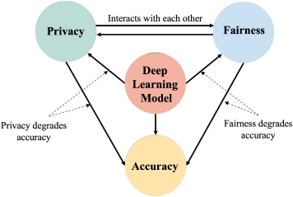

Slide 5
Dataset | Prediction Target | Key Features
1. Diabetes Dataset | Likelihood of developing diabetes | Sex, Age, Diet, Lifestyle
2. Recidivism Dataset | Likelihood of recommitting a crime | Age, Prior Offenses, Race
3. Income Dataset | Whether someone makes over $50K per year | Age, Education, Occupation, Hours per Week, etc.
4. Student Performance Dataset | Academic performance of students | Study Time, Absences, Family Support, Test Scores
Provided Datasets

Slide 6
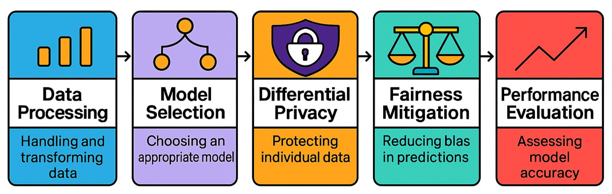
ML That Minds Its Business (And Yours): Fair, Accurate, and Private
✅ What I Did to Meet My Goal
Cleaned & preprocessed data to improve model accuracy
Trained & compared models (e.g., Logistic Regression, Random Forest)
Applied differential privacy using diffprivlib to protect sensitive data
Implemented fairness techniques with fairlearn to reduce bias
Balanced accuracy, privacy & fairness with minimal performance loss
Visualized results to highlight trade-offs across models

Slide 7
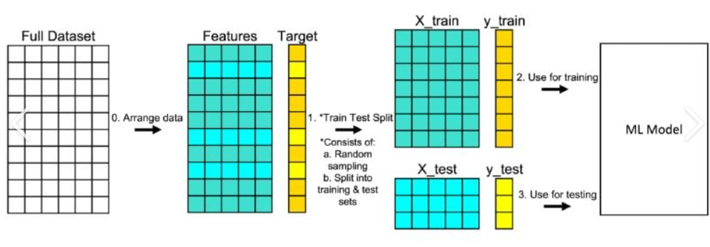
TRAIN TEST SPLIT (80-20)

Slide 8
Classifier Models Used
Random Forest
K-Nearest Neighbor
Naive Bayes
Logistic Regression
Linear Regression

Slide 9
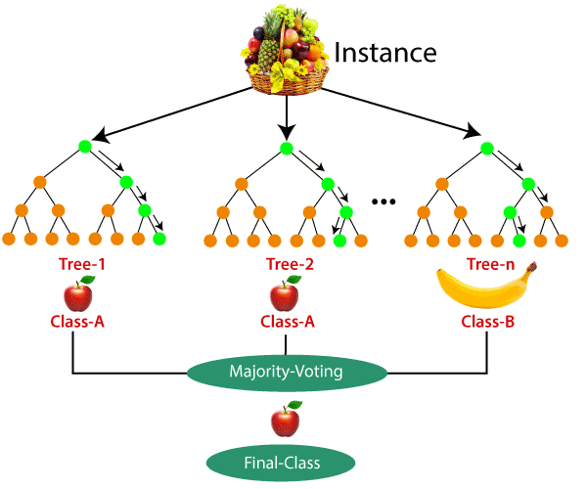
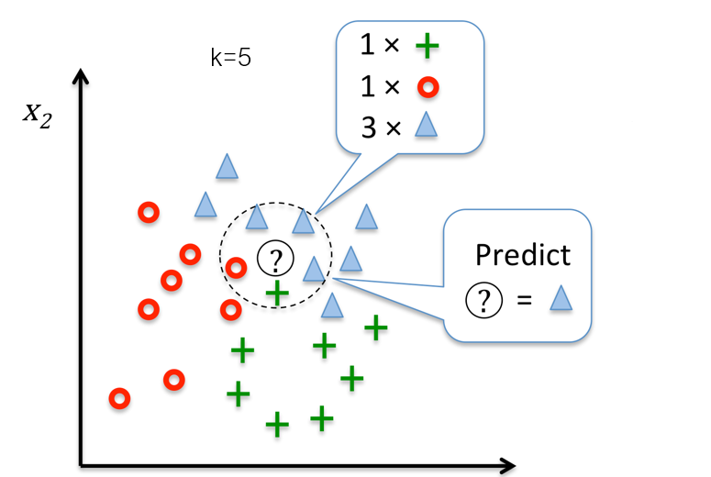
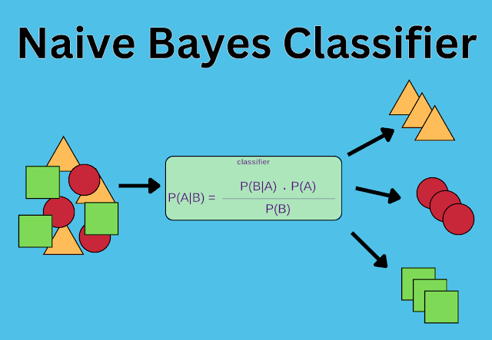
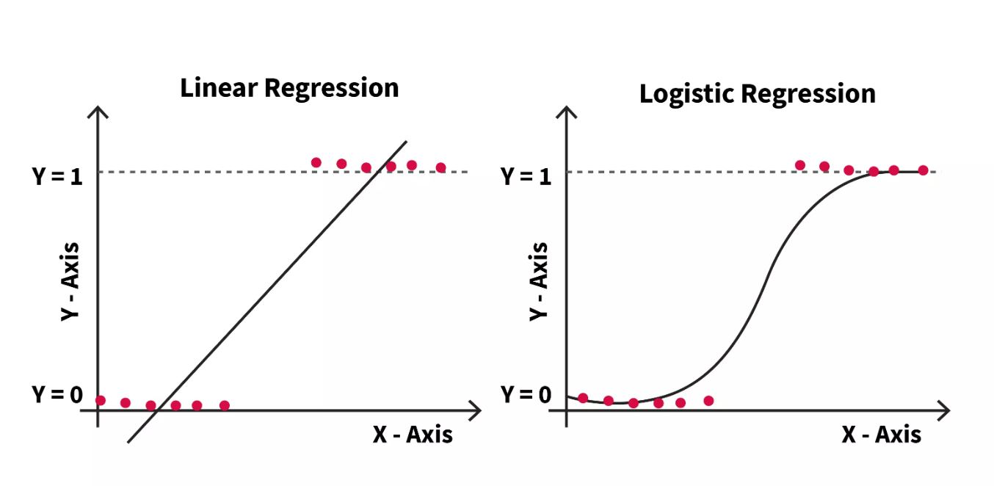
RANDOM FOREST
KNN

Slide 10
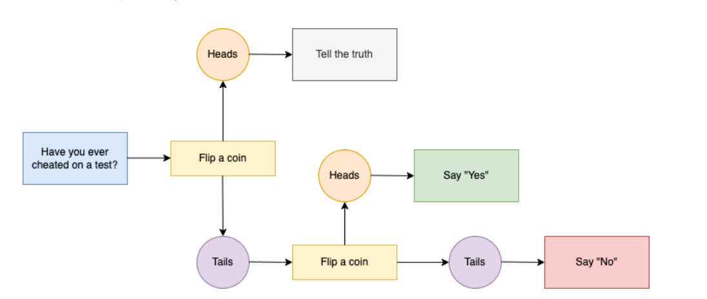
Adding in Differential Privacy

Slide 11
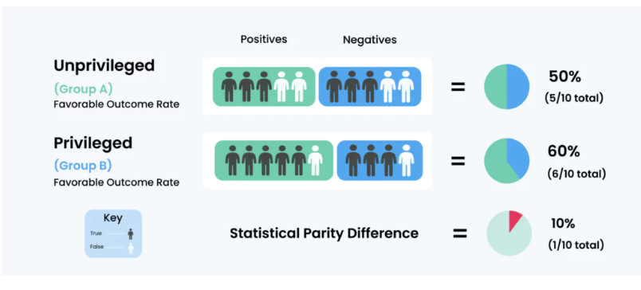

Slide 12
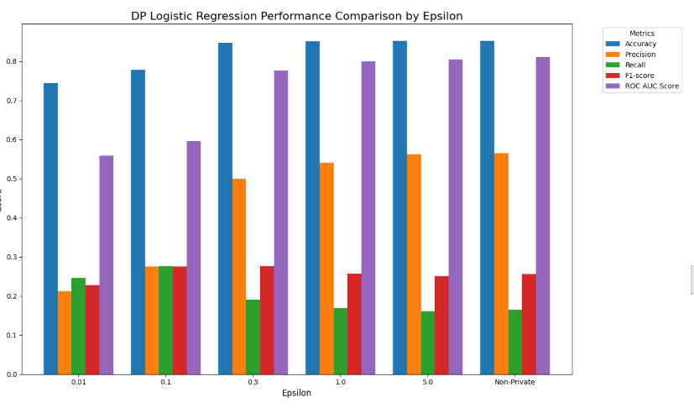
Visual comparisons confirmed a balance between accuracy, fairness, and privacy
How Holly Knew Her Goal Was Met:
Epsilon (ε = 0.5) provided a meaningful level of data privacy
The private & fair model achieved 0.8478 accuracy, close to the standard model at 0.8529
Fairness metrics improved, reducing bias across demographic groups
Minimal accuracy loss (only 0.0051) showed strong performance despite added privacy and fairness

Slide 13
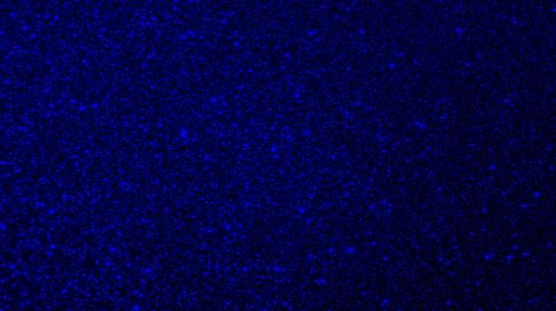
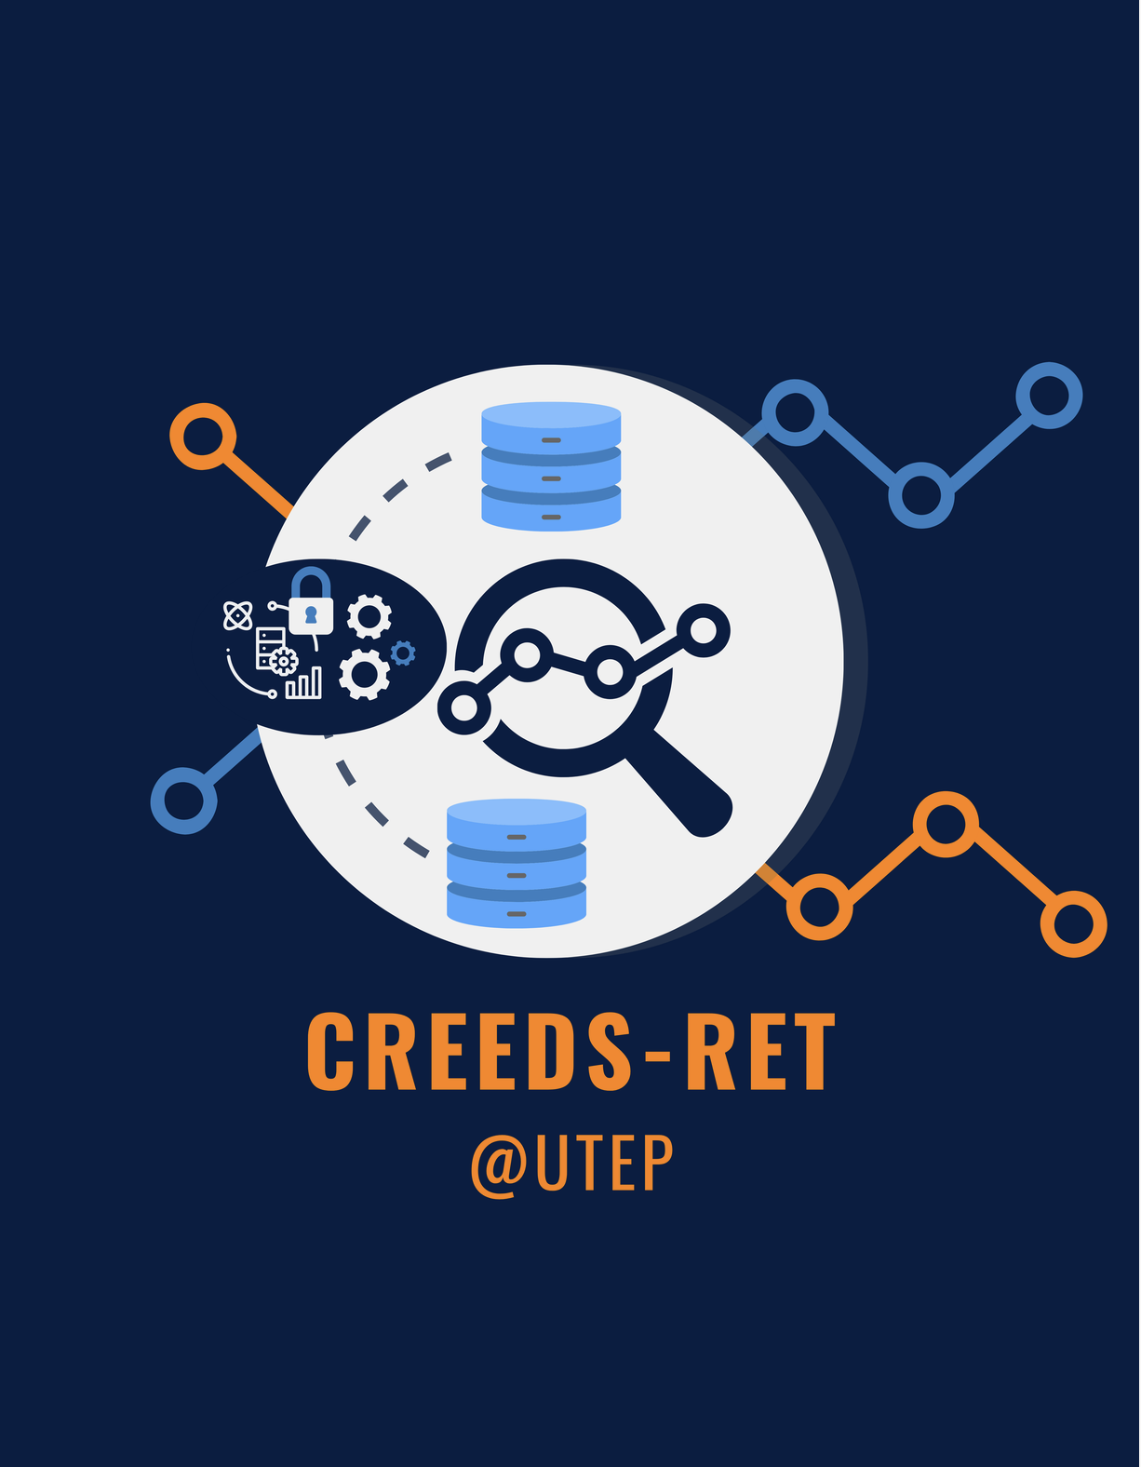


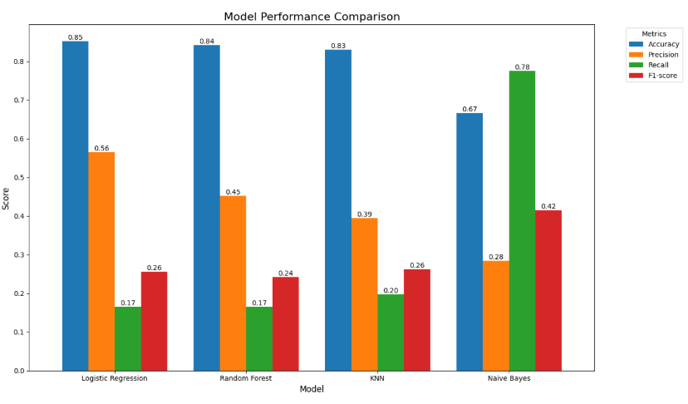
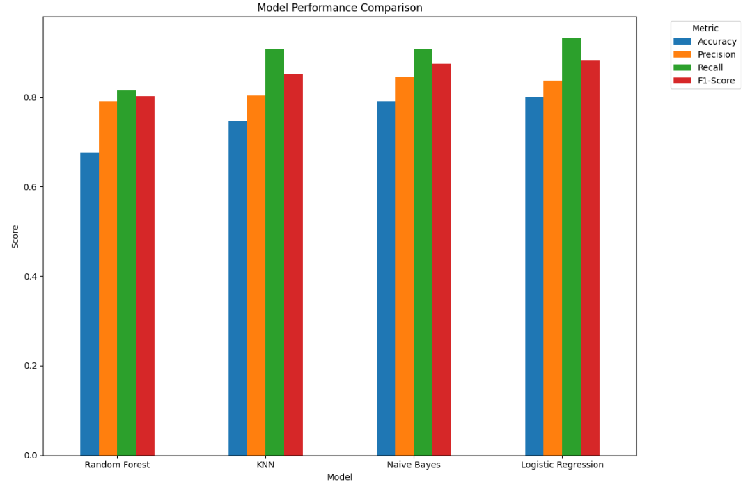
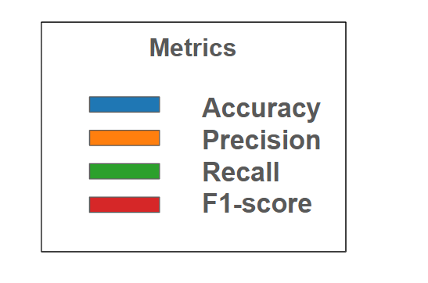
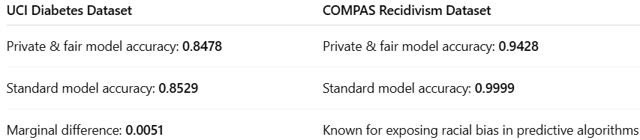
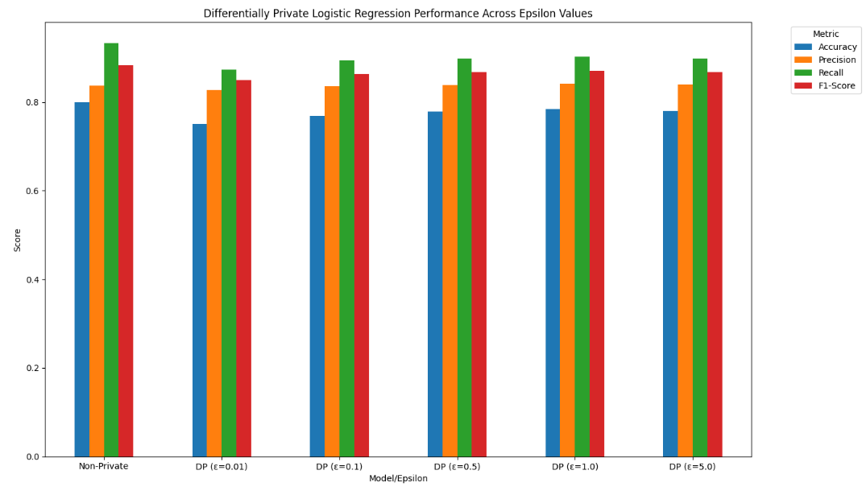
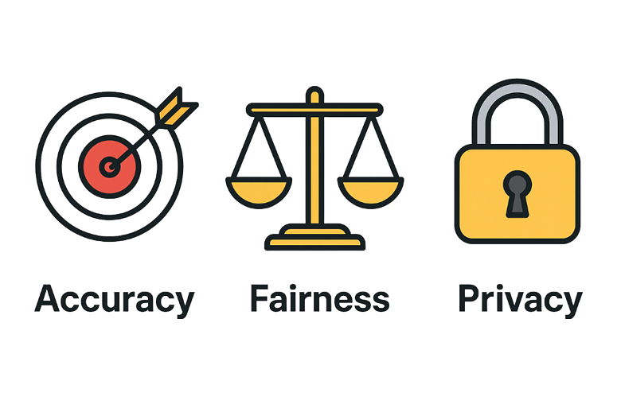
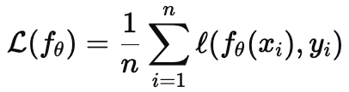
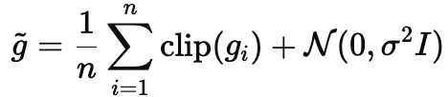
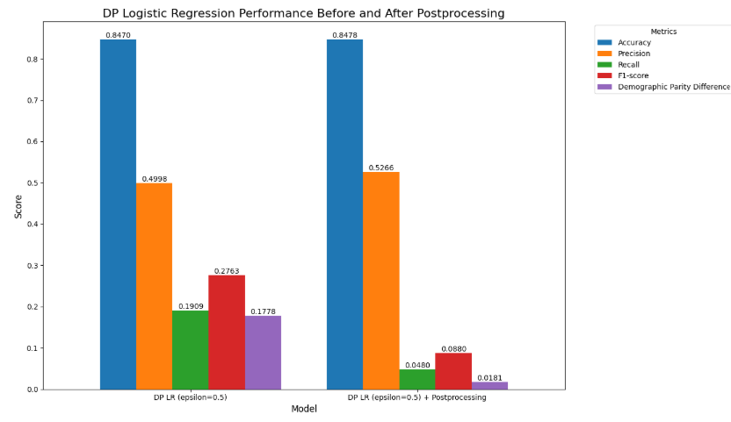
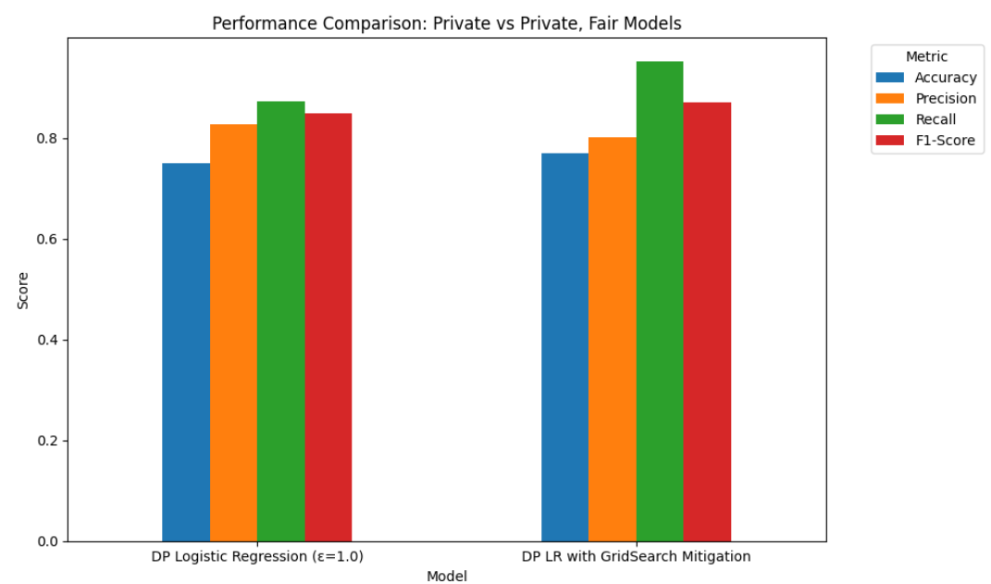

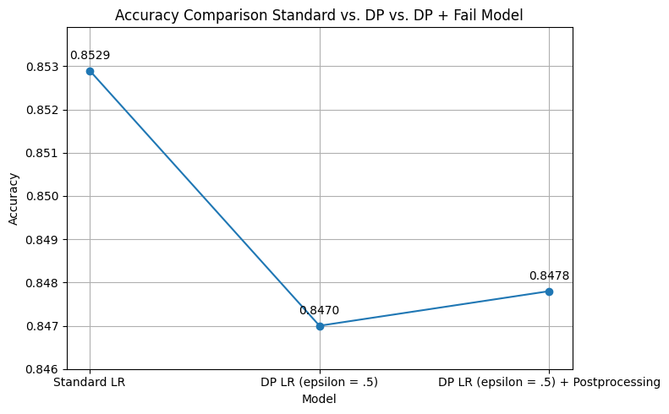
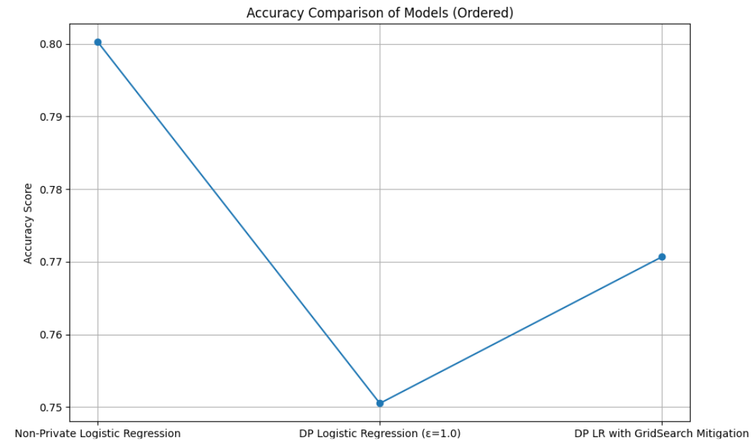
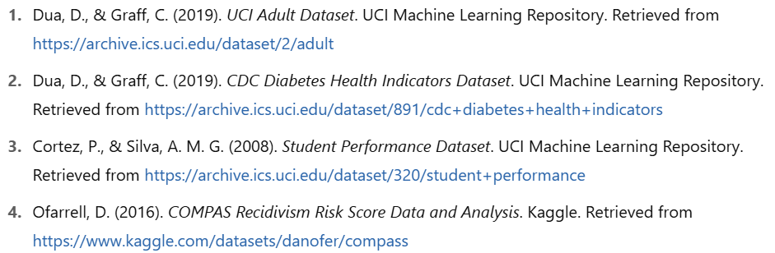
ML That Minds Its Business (and Yours): Fair, Accurate, and Private
Michelle Buraczyk, Holly Lopez, Leo Mercado, Dr. Anaanta Kotal
NSF RET Site: Cybersecurity Research Experience For Educators Through Data Science (CREEDS)
The University of Texas at El Paso
Abstract
In today's data driven world, machine learning models are increasingly responsible for making decisions that affect people's lives – from loan approval and job recommendations to medical diagnoses and personalized services. With this growing influence comes a critical responsibility; ensuring that these models are not only accurate, but also fair and privacy preserving.
Introduction
RESULTS: UCI Diabetes
RESULTS: . COMPAS Recidivism Racial Bias
Conclusion
Our research explores how machine learning can make accurate predictions while ensuring fairness and privacy. We focused on two datasets with different ethical challenges.
These cases allowed us to examine how machine learning models can remain accurate while minimizing bias and protecting sensitive information, especially in critical areas like healthcare and criminal justice.
Achieving a machine learning model that is fully accurate, private, and fair is inherently challenging due to the trade-offs among these goals. Our objective was to fine-tune the privacy parameter (epsilon) and apply fairness mitigation techniques to develop a model that balances all three as effectively as possible.
These results demonstrate that while some accuracy may be sacrificed, it is possible to design models that are meaningfully private and fair without significantly compromising predictive performance.
Dataset | Prediction Target | Key Features
1. Diabetes Dataset | Likelihood of developing diabetes | Sex, Age, Diet, Lifestyle
2. Recidivism Dataset | Likelihood of recommitting a crime | Age, Prior Offenses, Race
3. Income Dataset | Whether someone makes over $50K per year | Age, Education, Occupation, Hours per Week, etc.
4. Student Performance Dataset | Academic performance of students | Study Time, Absences, Family Support, Test Scores
Figure 1.1 – Performance comparison of various machine learning models based on accuracy, precision, recall, and F1-score. Logistic Regression outperformed the other models across most metrics and was selected as the final model for the project.
Figure 2.1 – Performance comparison of various machine learning models based on accuracy, precision, recall, and F1-score. Logistic Regression outperformed the other models across most metrics and was selected as the final model for the project.
Methodology
Potential Lesson Plan Elements
We began by preprocessing the datasets—removing missing values, applying one-hot encoding, and scaling numerical features—followed by a train-test split. We trained and evaluated models including Logistic Regression, Random Forest, KNN, Linear Regression, and Naive Bayes to identify the most accurate baseline.
1. Accuracy First
We train models to minimize prediction error:
This gives us strong baseline performance.
Next, we integrated differential privacy using IBM’s diffprivlib, varying Epsilon (ϵ) to explore the trade-off between accuracy and privacy. Smaller ε values ensured stronger privacy at the cost of performance.
2. Then Privacy
We use DP-SGD to protect individual data. Gradients are clipped and noised:
This ensures (ϵ,δ)-differential privacy.
Finally, we applied fairness interventions with the fairlearn library, testing bias mitigation techniques to produce a model that balanced accuracy, privacy, and fairness.
3. Fairness, Finally
We add fairness constraints, like demographic parity, during training using:
Balancing performance, privacy, and fairness—together.
Learning Objectives
By the end of this lesson or unit, students will be able to:
• Open and run a notebook in Google Colab.
• Use Pandas to:
Load and inspect datasets.
Clean and filter data to improve model accuracy
Perform basic statistical analysis (mean, median, mode, etc.).
• Use Matplotlib to:
Create visualizations such as histograms, scatter plots, and box plots.
Interpret distributions, outliers, and trends in context to include differentially private models and differentially private/fair models
AP Statistics Tie-ins
• Center & Spread – Use .mean(), .median(), .std() in Pandas
• Data Distribution – Visualize using histograms, box plots
• Outliers – Identify from boxplots or using IQR method
• Two-variable analysis – Create scatter plots to show relationships (e.g., Glucose vs. Age)
Assessment Ideas
• Mini Project: Students choose a column in the dataset, calculate stats, and create visualizations.
• Exit Ticket: "What does the histogram of 'Age' tell you about the distribution? Is it skewed?"
• Notebook Check: Review importance of creating private and fair machine learning models.
Figure 1.2 – Impact of differential privacy on model performance across five epsilon values. Varying levels of noise were introduced to assess the trade-off between privacy and accuracy. An epsilon value of 0.5 was ultimately selected, achieving an accuracy of 0.8470 while ensuring a reasonable level of data privacy.
Figure 2.2 – Impact of differential privacy on model performance across five epsilon values. As epsilon increases (from 0.01 to 5.0), the performance metrics generally tend to increase, moving closer to the performance of the non-private model. A smaller epsilon (e.g., 0.01) provides stronger privacy but results in lower performance metrics. A larger epsilon (e.g., 5.0) provides weaker privacy but results in higher performance metrics.
Overview of Common Machine Learning Models
Model | Purpose | Detailed Description
Logistic Regression | Predicts categories | Estimates the probability that a data point belongs to a specific class using the logistic (sigmoid) function. Often used in binary and multiclass classification tasks.
Random Forest | Improves prediction reliability | An ensemble of decision trees that reduces overfitting by averaging multiple trees’ outputs. Increases model stability and accuracy.
K – Nearest Neighbors (KNN) | Compares similarity | Classifies based on the majority class among K closest neighbors using a distance metric. No training phase makes it simple and intuitive.
Linear Regression | Predicts continuous values | Fits a straight line through the data to model the relationship between input features and a numerical target, ideal for trend prediction.
Naive Bayes | Predicts categories using probabilities | A probabilistic classifier based on Bayes’ Theorem. Assumes feature independence, making it fast and effective for text and spam classification.
Figure 1.3 – Fairness was introduced to the differentially private model using a post-processing mitigation technique. This approach balanced fairness and privacy while maintaining strong performance, improving the model’s accuracy from 0.8470 (private only) to 0.8478 (private and fair).
Figure 2.3 - The bar chart comparing the accuracy of the Standard Logistic Regression model, the Differentially Private Logistic Regression model (epsilon=1.0), and a Standard Logistic Regression model with post-processing.
References
Figure 1.4 – Comparison of accuracy across three models: the Standard Logistic Regression model, the Differentially Private model, and the Private and Fair model. This highlights the trade-offs and performance impact of adding privacy and fairness constraints.
Figure 2.4 – The bar chart is a comparison of the model accuracy for the standard, differentially private and fair data sets using a Differential Privacy Logistic Regression epsilon value of 5 and the Random Forest Classifier Machine Learning Model.
Acknowledgements
This work is supported by National Science Foundation Award # 2206982
Thank you Dr. Kotal, Dr. Piplai, Dr. Ceberio, Dr. Tosh for all your hard work.

Slide 14
AP Statistics Tie-In
Students will be given data sets that they will import into Colab and visualize with a graph of their choice (i.e. bar graph, dot plot, box plot, histogram)
Once they create the desired graph they will describe the distribution using SOCS method.
  Categorical variables - bar graphs, pie charts
  Quantitative variables - histograms, box plots, dot plots, stemplot
Students will learn how to identify which possible outliers are actual outliers using my Activity 1 and checking their results using my Activity 2 and learning how to handle the outliers
I will incorporate the 1,2,4 pedagogy from my Activities

Slide 15

WHERE WE ARE NOW

Slide 16

TOP GROSSING DISNEY ADVENTURE MOVIES

Slide 17
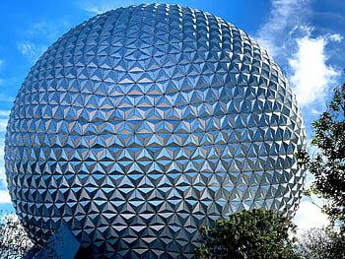
DATASET - “DISNEY MOVIES 1937-2016 GROSS INCOME

Slide 18

VARIABLES
MOVIE TITLE - categorical
RELEASE DATE - categorical
GENRE - categorical
MPAA RATING - categorical
TOTAL GROSS - quantitative
INFLATION ADJUSTED GROSS - quantitative

Slide 19
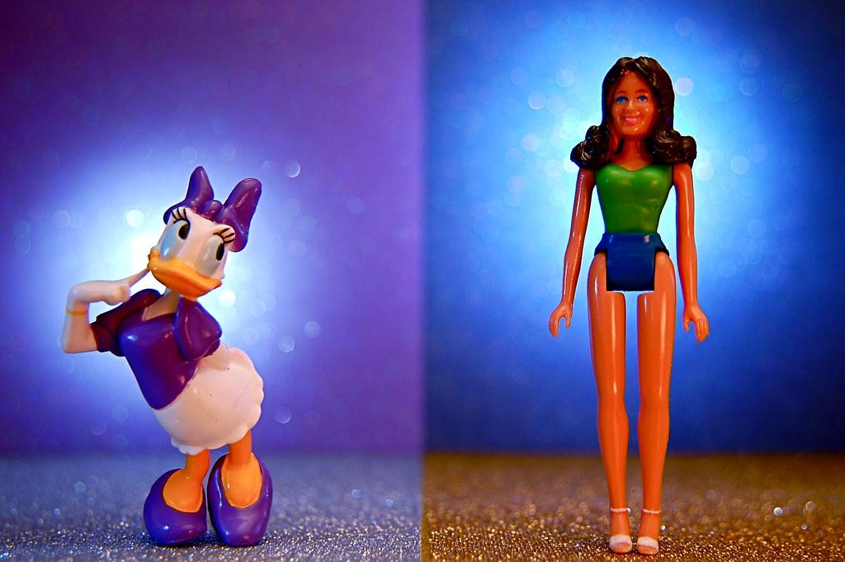
Categorical Variables Compared
Split the data by genre (selected “Adventure” movies)
Split the “Adventure” movies by “Rating”
Looked at top 5 total grossing Adventure films by rating

Slide 20
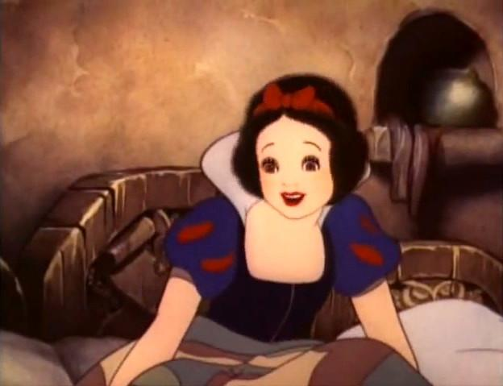
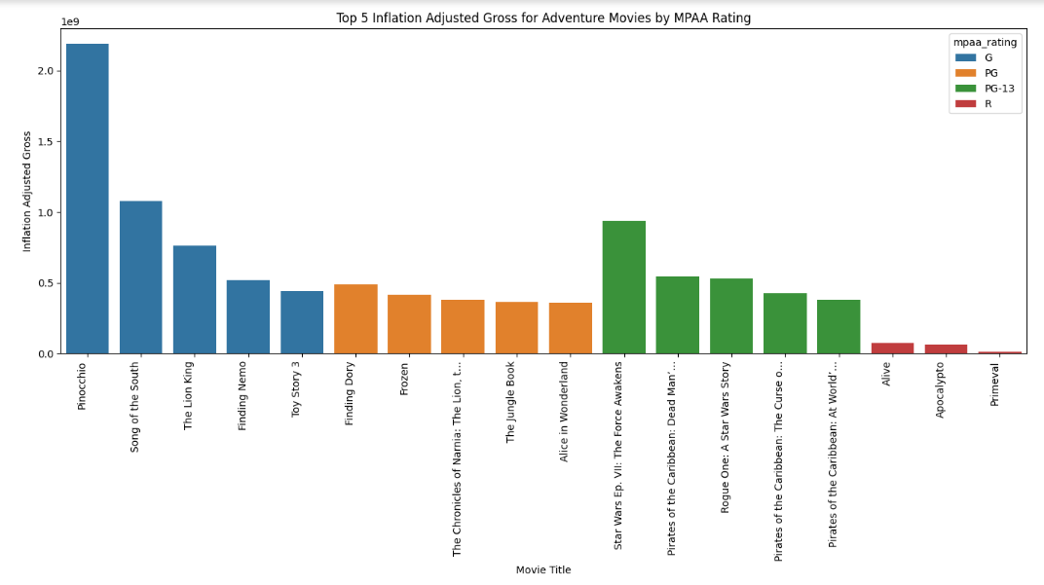

Slide 21
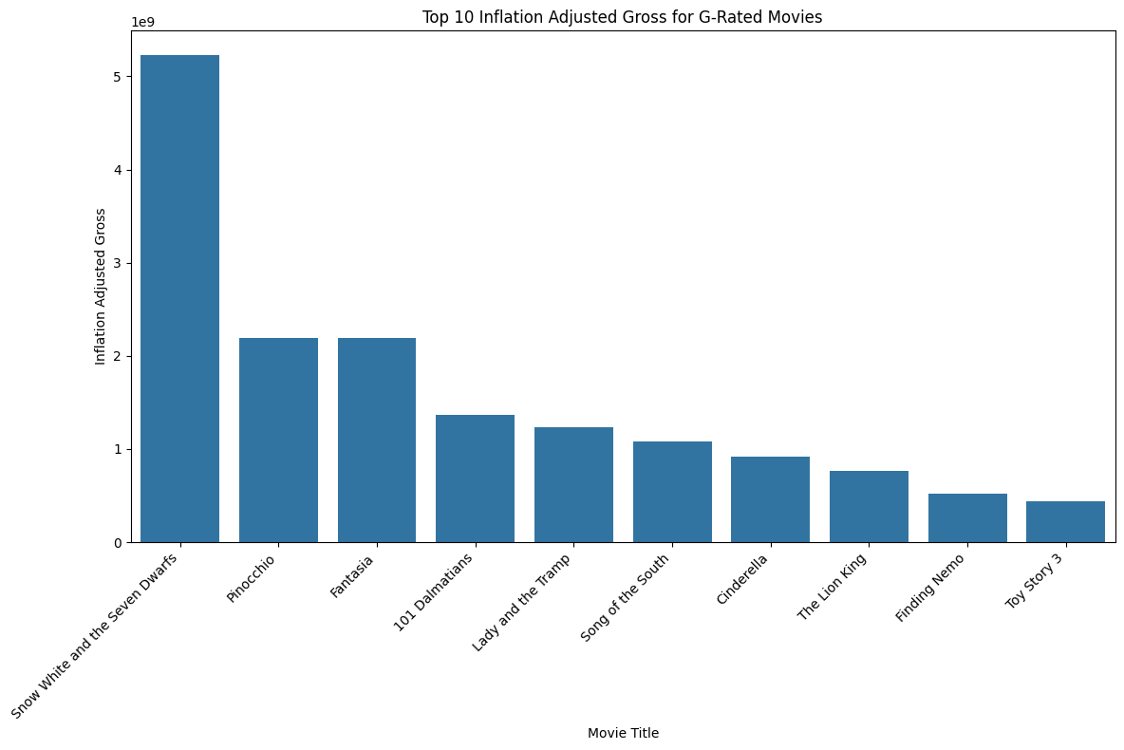
G-RATED MOVIES IN BOTH CATEGORIES SEEM TO GROSS MORE. HERE ARE THE TOP GROSSING G-RATED MOVIES

Slide 22
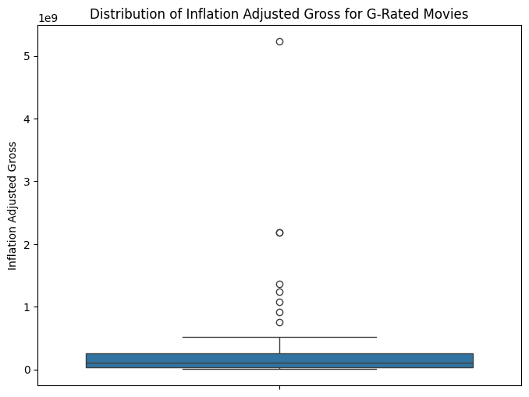
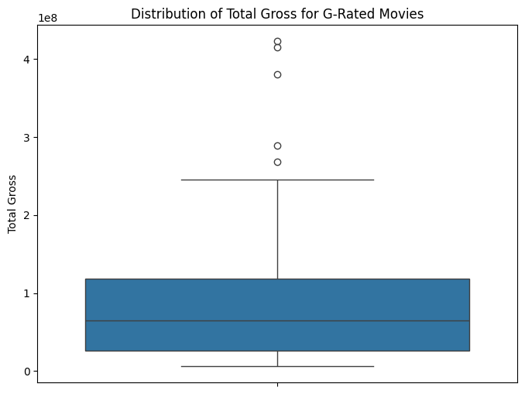
G RATED MOVIES INFLATION-ADJUSTED GROSS AND TOTAL GROSS BOXPOTS

Slide 23
COMPARING THE DISTRIBUTIONS
Shape:
  Both Skewed Right
Outliers:
  Both have outliers
Center:
  103154765.5 is the median for inflation adjusted
  65140890.5 is the median for total gross
Spread
a. 5221057543 is the range for inflation adjusted
b. 416582274 is the range for total gross
Both graphs are right skewed with outliers showing that not very many G-Rated movies made a lot of money, only a few outliers, which both graphs have. The median amount of money made was way higher when adjusted for inflation than the total gross earnings. The range of values was also much greater for the inflation adjusted than the total gross earnings.

Slide 24

WHERE WE ARE GOING

Slide 25
Survey Creation
Every project must include a “Fairness, Privacy, and Ethics” reflection section where students answer:
How did we protect participants’ privacy?
Was our sample fair/representative?
Could the results be misused or misunderstood?

Slide 26
Suggested Timeline
Day 1: Choose topic, draft RQ, design survey/instrument, plan sampling.
Day 2–3: Collect data, maintain privacy safeguards, build data dictionary.
Day 4–5: Clean data, graphs/descriptives, choose inference method.
Day 6–7: Run inference, write conclusions, complete FPE reflection.
Day 8: Presentations.

Slide 27
Extension Options (optional, extra credit)
Privacy technique: Add small random noise to individual quantitative responses (±1 within bin) and show that group summaries barely change.
Fairness audit: Re-run analysis by subgroups (e.g., grade) and compare results; discuss equity implications.
Ethical brief: One-page memo on how your findings should not be used or interpreted.

Slide 28
Holly’s 3 TAKEAWAYS from the CREEDS Program
Machine learning must balance accuracy, fairness, and privacy—trade-offs are inevitable but manageable.
Preprocessing and ethical considerations directly impact model performance and bias.
Statistical skills (e.g., distributions, inference, data visualization) are essential in building responsible AI.

Slide 29

In Conclusion:
This project shows that it’s possible to build machine learning models that are accurate, private, and fair—but doing so requires intentional design, ethical awareness, and a solid understanding of data. As future educators and data scientists, we must ensure that the tools we build and teach reflect the values of responsibility, transparency, and equity.

