Slide 1



2025 CREEDS Summer Institute
The University of Texas at El Paso
Michelle Buraczyk – Franklin High School
ML That Minds Its Business (and Yours): Fair, Accurate, and Private
This work is supported by National Science Foundation Award # 2206982

Slide 2
About Me:
I obtained a Bachelor’s of Science in Electrical Engineering and a Master’s of Art in Teaching Mathematics both from the University of Texas at El Paso.
Currently have 30+ years of teaching experience at multiple high schools.
I teach at Franklin High School and own my own drone videography and photography business. The name of my business is BorderSky Drone Services.
This year I will be teaching Principles of Applied Engineering, Engineering Design and Presentation 1 and 2.
I have been married for 32 years. I have 5 children and one granddaughter. My oldest daughter is an emergency medicine physician, second daughter is an emergency medicine nurse, my eldest son just graduated with a degree in metallurgical and materials engineering, my third daughter is a cheerleader at Franklin High School and my youngest son is a football player at Hornedo Middle School.

Slide 3

Machine Learning that Minds Its Business (and Yours): Fair, Accurate, and Private
The main topic of our project was to determine if a data set was accurate, private and fair.
  We were given four sets of data but only focused on two of them. We looked at whether or not a person would get diabetes based on numerous variables. The other set of data focused on the likelihood of someone recommitting a crime also based on numerous variables.
  The dataset entitled Recidivism in Racial Bias is a dataset used to assess the risk of recidivism, violence, and failure to appear in court for individuals involved in the justice system. It includes scores generated by the COMPAS algorithm based on individual characteristics and case data. This dataset has been widely used in fairness, bias, and algorithmic accountability research — particularly to examine racial or gender disparities in automated risk assessments.

Slide 4
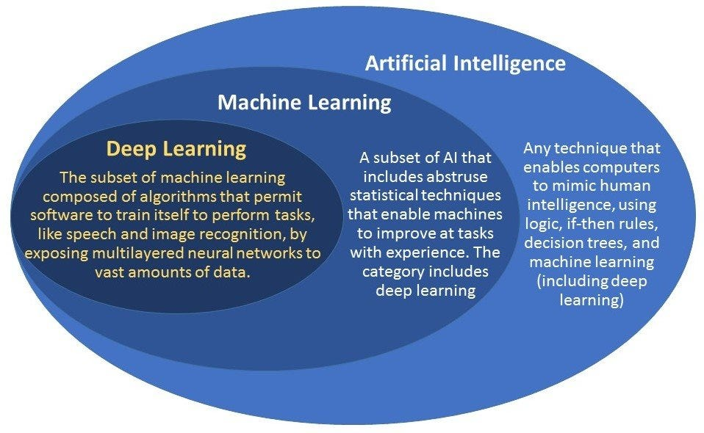
COMPAS: Recidivism Racial Bias
How is the data set information related to AI/DS/Cyber?
What It Is:
A dataset used to assess recidivism risk (likelihood of reoffending) using the COMPAS algorithm in the U.S. criminal justice system.
AI & Machine Learning:
Predictive modeling: Algorithms classify whether someone is at low, medium, or high risk of reoffending.
Bias & fairness: AI researchers study how algorithms like COMPAS may show racial or gender bias, making this dataset central to ethical AI debates.
Data Science:
Feature analysis: Analyzing which factors (e.g., prior convictions, age, race) impact the risk score.
Model evaluation: Assessing model accuracy, fairness metrics (e.g., disparate impact), and interpretability.
Cybersecurity:
Privacy concerns: The data contains sensitive personal and criminal records. Misuse or breaches can cause serious harm.
Algorithmic transparency: Security overlaps with trustworthy AI — are the models secure, and is their decision-making traceable?

Slide 5

Role in the Project
My role in this project focused on analyzing the COMPAS Recidivism Racial Bias Dataset to evaluate three key principles: accuracy, fairness, and privacy in predictive modeling.
Using Google Colab as my development environment, I:
Cleaned, encoded, and scaled the raw dataset to prepare it for analysis.
Split the data into training and testing sets using standard data science practices.
Trained and compared five different machine learning models:
  Logistic Regression
  Linear Regression
  Naïve Bayes
  Random Forest Classifier
  K-Nearest Neighbors (KNN)
To examine data privacy, I integrated a Differential Privacy library and tested various values of the privacy parameter epsilon (ε) to observe its effect on model performance.
For fairness, I implemented parity-based metrics to evaluate whether outcomes were equitable across different demographic groups—particularly by race, which is a central concern in the COMPAS dataset.

Slide 6
RELEVANCE OF RESEARCH PROJECT
Learning how to use a machine learning model is helpful for teaching students in Engineering Design and Presentation by utilizing the following:
Predictive Maintenance:
Problem: Predict when a bridge design will fail.
ML Use: Train a model on sensor data (vibration, temperature, weather conditions) to detect early signs of wear or failure.
In Class: Students can use historical maintenance and sensor datasets to build a classification or regression model.
Model type: Logistic Regression, Random Forest, or Time Series models like LSTM
Design Optimization
Problem: Optimize the design of a bridge (e.g., shape, weight, strength, materials used).
ML Use: Use reinforcement learning or supervised learning to explore the design space more efficiently than brute force methods.
In Class: Students can experiment with optimizing trusses, beams, or thermal systems.
Model type: Genetic Algorithms + ML, Bayesian Optimization, Reinforcement Learning
AI Tools: Quickly and efficiently perform tasks that might otherwise take days or weeks to finish manually.

Slide 7
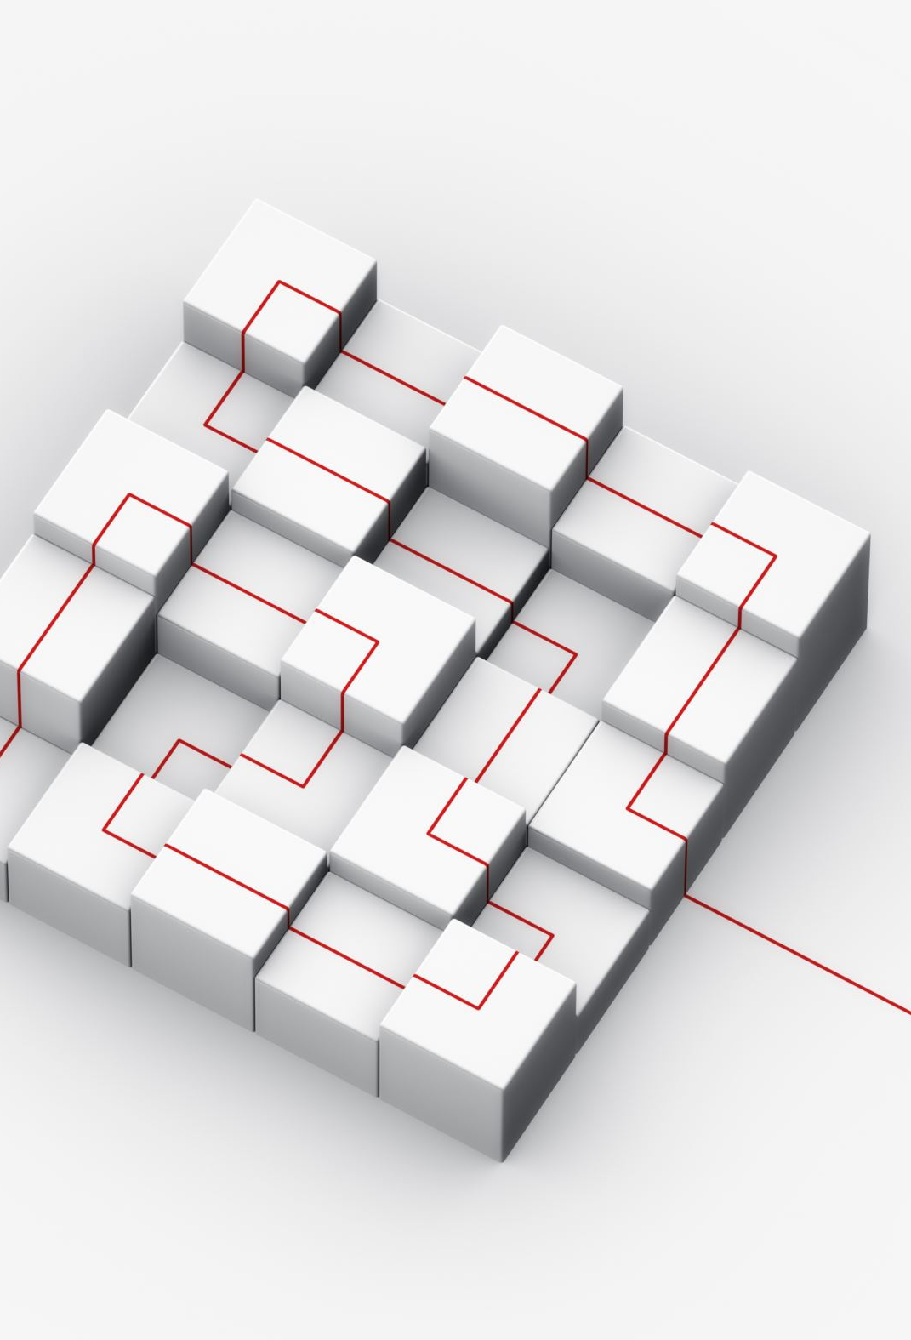
TEACHING MODULE
Target Audience
High school engineering/computer science students.
Duration
4–6 class periods (90 min each).
Activity: “Optimize a Bridge Design Using AI”
Step 1: Design a bridge structure in Autodesk Fusion.
Step 2: Use an AI-powered simulation to test for stress and load
Step 3: Present results using AI-generated visuals and presentation support

Slide 8
Use AI to Support Each Design Phase in an Engineering Design and Presentation Class:
Design Phase | AI Tool Integration Ideas
Problem Definition | Use ChatGPT to brainstorm problem statements or refine design challenges.
Research & Ideation | Introduce AI search assistants to gather technical background or summarize articles.
Concept Development | Use generative design tools (like Autodesk Fusion 360 with AI-driven design options) to explore multiple prototypes.
Modeling & Simulation | Use AI-based simulators to test material strength, thermal properties, or system behavior.
Decision-Making | Show how AI optimization tools help weigh trade-offs (e.g., weight vs. cost, durability vs. flexibility).

Slide 9

Artificial Intelligence in Engineering Design:
Teach
Teach AI Concepts with Hands-On Projects
Make
Make AI Part of the Curriculum:
Have
Mini-Project: Have students use a machine learning model to optimize part of their design (e.g., material selection or failure prediction).
Add
AI in Engineering Module: Add a short unit explaining how AI is used in fields like civil engineering, manufacturing, and product design.
Ask
Reflection Assignment: Ask students to reflect on how AI helped their design and communication process.

Slide 10
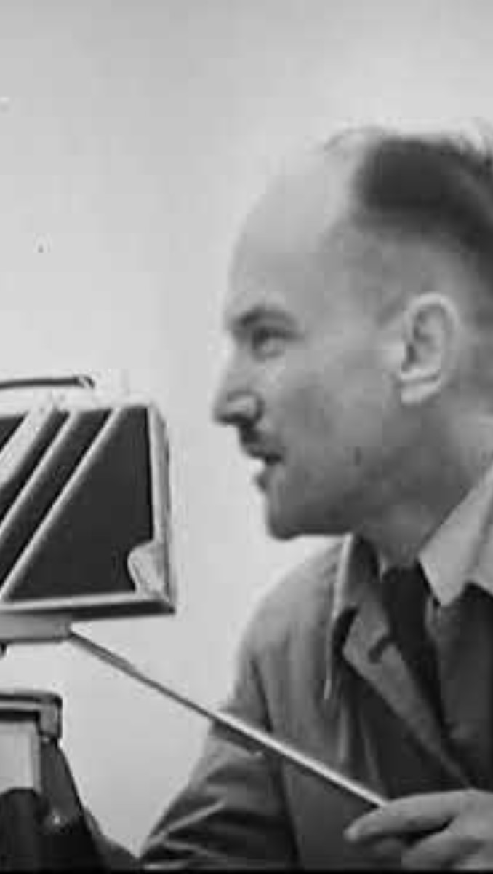
The Lesson:
Part 1 – Introduction to Bridge Design and Failure
Discuss real-world engineering: Why do bridges fail?
Introduce concepts:
Stress (σ = F/A)
Yield strength vs. failure point
Load distribution in beams/trusses
Show examples of famous bridge collapses and lessons learned.

Slide 11

Part 2 – Autodesk Fusion Bridge Model Setup
Open Autodesk Fusion and start a new parametric design.
Demonstrate modeling a simple truss or beam bridge.
Define parameters (length, width, height, material).
  Example parameters:
    Bridge length = 100 m
    Bridge width = 30 m
    Material = Aluminum 6061

Slide 12

Part 3 – Python Coding in Fusion 360
Students will write Python code to automate load testing by incrementally increasing the force applied.
import adsk.core, adsk.fusion, traceback
def run(context):
ui = None
try:
app = adsk.core.Application.get()
ui = app.userInterface
design = app.activeProduct
# Get the simulation workspace
simManager = design.simulationManager
sim = simManager.createStudy(adsk.fusion.StudyTypes.StaticStressStudyType)
# Apply a material (e.g., Aluminum 6061)
matLib = design.materialLibraries.itemByName("Fusion 360 Material Library")
aluminum = matLib.materials.itemByName("Aluminum 6061")
design.activeComponent.material = aluminum
# Apply a fixed constraint at one end
fixedFace = design.activeComponent.bRepBodies[0].faces[0]
sim.study.physicsResults.addFixedConstraint(fixedFace)
# Apply a load to the opposite end
loadFace = design.activeComponent.bRepBodies[0].faces[1]
forceVal = 1000 # Newtons
load = sim.study.physicsResults.addForce(loadFace, adsk.fusion.ForceDirections.NormalDirectionType)
load.magnitude = forceVal
# Run the simulation
simResults = sim.study.results
sim.study.solve(True)
# Extract max stress value
stress = simResults.maxVonMisesStress
ui.messageBox(f'Max Stress under {forceVal}N = {stress.value} Pa')
except:
if ui:
ui.messageBox('Failed:\n{}'.format(traceback.format_exc()))

Slide 13

What the code does:
Assigns a material
Applies a greater load
Runs a static stress analysis
Displays the maximum stress
Load Testing Loop - Students modify the script to run increasing loads until the stress exceeds the yield strength.

Slide 14

Part 5 – Analysis & Discussion
Students record:
  Load at failure
  Stress distribution plot
  Failure location (weakest part of bridge)
Class discussion:
  How could the bridge be redesigned to hold more weight?
  What changes in material or geometry matter most?
Assessment
Students submit:
  Python script they wrote/modified.
  Screenshot of simulation results.
  Short reflection on how their bridge failed and how they’d improve it.

Slide 15
Pedagogical Approaches in Bridge Design and Building
In the bridge design and build activity the pedagogical approach I will utilize will be the 5 E’s.
Engage
Explore
Explain
Elaborate
Evaluate

Slide 16


Products Purchased for my Classroom

Slide 17
THE 3 TAKEAWAYS from the CREEDS Program
I am so grateful to have met such an amazing group of intelligent, dedicated and driven group of individuals.
I will be able to go back into the classroom with a variety of different activities and curriculum that I did not have before the institute.
I have learned how to analyze data sets using Colab by Google and have been taught how to determine whether the data is accurate, fair and private.

Slide 18

In Conclusion:
AI is transforming bridge design and construction through automation, predictive maintenance, and optimization. AI-powered systems are used to analyze designs, predict structural issues, optimize construction processes, and monitor bridge health in real-time. This leads to safer, more efficient, and cost-effective bridge construction and maintenance.
"By applying the tools I’ve learned at this institute, my students and I will be empowered to surpass even our greatest ambitions—not only in building bridges, but in constructing anything we set our minds to."

