Slide 1

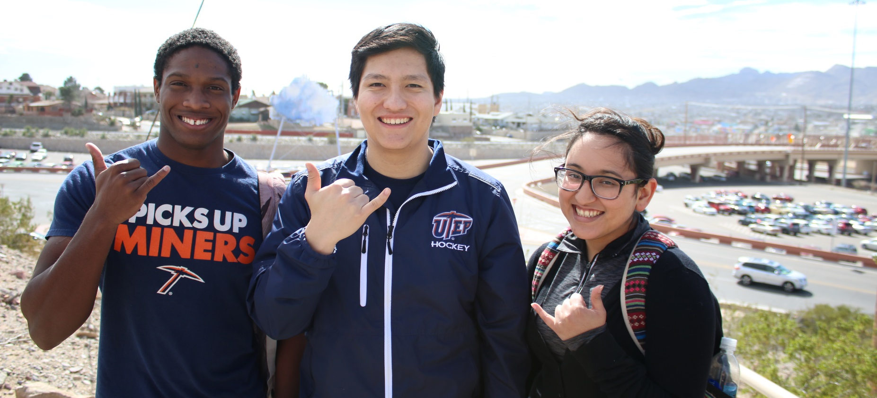
CONGRATULATIONS
Welcome Parents and Family
Notes:
Introduce yourself (name, position/role at UTEP, how long at UTEP, etc.).

Slide 2

Notes:
Provide an overview of UTEP Edge:
UTEP EDGE is a our University's framework. It is our approach to help students develop their competitive Edge. Using this framework our goal is to achieve a greater number of graduates ready to succeed in career and life, improve educational outcomes, increase prosperity in the region and economic opportunity for students.
What is it? Student success philosophy based on 3 pillars
Talented students
Enriching experiences
Lifelong success
Why is it important for parents to know? We want parents to:
Feel more connected to the University and become active partners
Realize that the University is invested in student success and wants to support parents’ investment, too= equal partnership
Understand the resources available at UTEP

Slide 3

THIS SESSION
Identify Key Assets
Identify Edge Experiences
Connect your daughter’s or son’s strengths and activities to career preparation
Identify additional resources at UTEP
Notes:
Briefly go over objectives/goals for today’s session.

Slide 4

TALENTED
STUDENTS
UTEP students have talent, motivation, and life experiences which will enable them to succeed on our campus, in the world of work, and in the global community
Notes:
Give some example of talents/assets/strengths students bring to UTEP:
Bilingualism
Biculturalism
Hard work
Time management
Discipline
Organization
Musicality/Athleticism/Art
Ease reasoning/mathematics/writers/readers

Slide 5

DEFINING
ASSETS
Talents, skills, capacities, and strengths of individuals, associations, and communities that can be mobilized for action/change

Slide 6
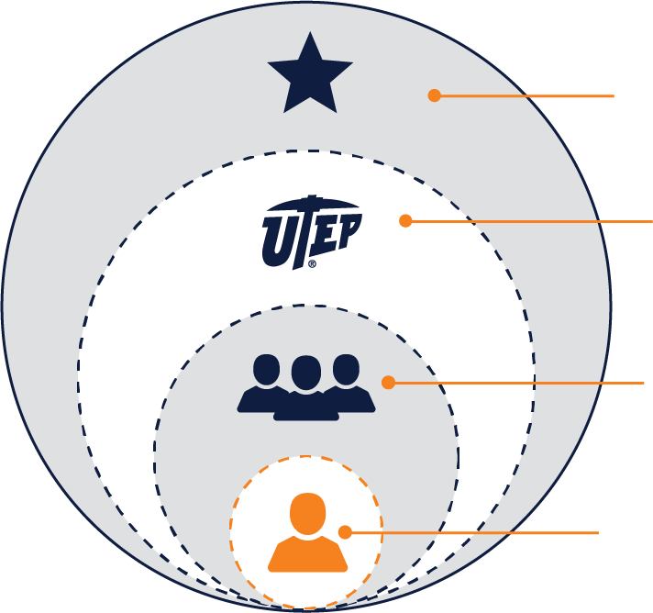
EL PASO & BORDER COMMUNITY
UTEP
Associations, Support Offices, Campus Services
UNIT/DEPT/MAJOR
Expertise, Teaching Approaches, Advising, Research
INDIVIDUAL
Talents, Skills, Internal Strengths, Knowledge, Networks
Notes:
Discuss Individual Assets vs Collective Assets. Think about yourself and your assets. Think about the assets of your son or daughter. Now think about the assets the community (UTEP, respective neighborhood, etc.) has to support your son or daughter while in college.

Slide 7
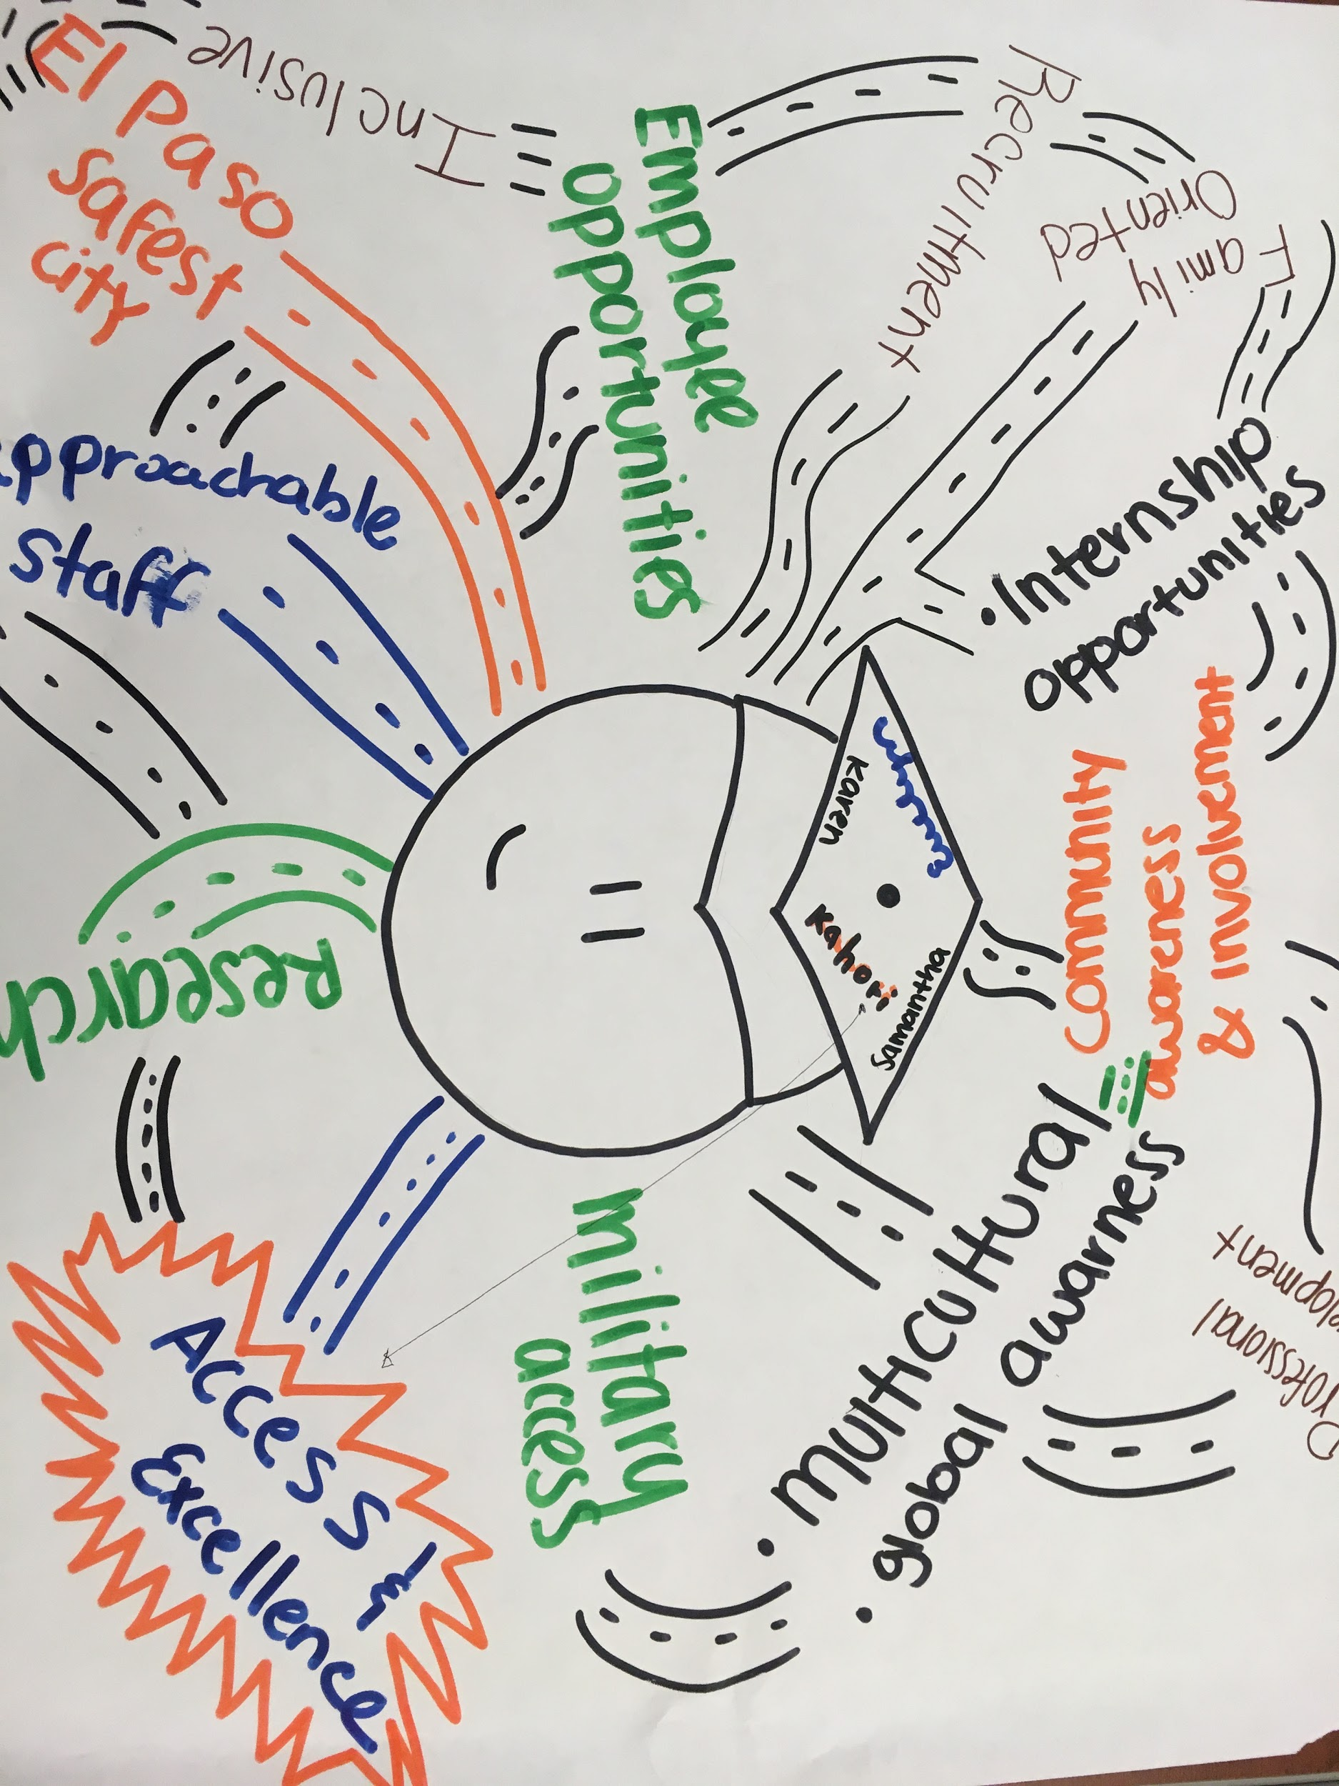
IDENTIFYING KEY ASSETS
Who am I? What am I good at?
Create a list of:
Your unique assets, talents, and strengths. Identify your Top 5 assets.
Your son’s or daughter’s assets, talents, and strengths. Identify their Top 5 assets.
Your community’s assets and strengths.
Notes:
Activity 1- Ask parents to pull out their handout and explain that this is homework for them to do with their student. Explain to them that this is a way for them to think about their assets and strengths.
"Sit down with your student and list their assets. Can anyone give an example of their son or daughter's strengths?"
"Then, you can list your assets as a family. Can anyone give some examples of strengths you bring as a family?"
"What about UTEP? Can anyone give an example of some community assets at UTEP?" "Right, some examples include caring faculty and staff members, library, Career Center, CASS, Counseling, Advising, student organizations, etc."
"We encourage you to think of neighborhood assets (rec center, family/friends living close-by, city library, etc.) and communicate these assets with your son or daughter."

Slide 8

ENRICHING
EXPERIENCES
Students will build on these talents and skills through a variety of high-impact experiences tailored to individual needs and aspirations
Notes:
Your son’s or daughter’s talents are enhanced by seeking out enriching experiences like the following:
Study abroad/away
Faculty led research
Senior projects
Student organizations

Slide 9

Notes:
Briefly go over the EDGE experiences.

Slide 10
Enriching Experiences
Pick the top three experiences you would like your daughter or son to take advantage of while at UTEP.
Pick the top three experiences you believe your daughter or son chose for herself or himself as the top three experiences that they would like to do at UTEP.
Are they the same? Different? How can you support your daughter or son?
Notes:
Activity 2 – This is the back page of the handout. Here you will tell parents again that this is part of their homework.
"The second part of your homework is on the back side of the handout"
"List 3 experiences you think your daughter or son would most benefit from participating in."
"Then, think of the resources you think they will need to make that happen. How will you help provide that support?"

Slide 11
Enriching Experiences
Research tells us that students engaged in extracurricular activities (enriching experiences):
Are more likely to stay in school
Report enjoying their college years more so than those students not engaged
Tend to graduate college at a faster pace
Notes:
Emphasize the importance of having their son or daughter engaged while in college

Slide 12

LIFELONG
SUCCESS
Combined, these talents and high-impact experiences equip students with a competitive advantage for success in their academic, professional, and
civic lives
Notes:
Developing the competitive advantage, by recognizing talents and participating in enriching experiences, will lead to lifelong success- career or graduate work. We work on expanding a student’s toolkit through EDGE Advantages (go to next slide to display advantages)

Slide 13

EDGE ADVANTAGES
Students will graduate with the following skills:
Leadership
Problem-solving
Communication
Entrepreneurship
Social responsibility
Confidence
Global awareness
Teamwork
Critical thinking
Notes:
These are the skills that employers often look for.

Slide 14

BRINGING IT ALL TOGETHER
What do you want your son or daughter to get out of their experience at UTEP?
Reflecting on your son or daughter’s key assets and core values, free-write about what you would like him or her to get out of their UTEP experience.
Share with your son or daughter.
Notes:
Activity 3 – Again, explain that this is homework or an opportunity to reflect with their student.
“What do you want your son or daughter to get out of their experience at UTEP? Does this align with what they want to get out of UTEP?”

Slide 15
Additional Resources
Study Abroad/Away – (915)747-5190
University Career Center- (915)747-5640
On Campus Employment
Internships
Help with your resume
Research- (915)747-8282
Notes:
Encourage parents to take a picture of this slide and contact these offices if they have more information.

Slide 16
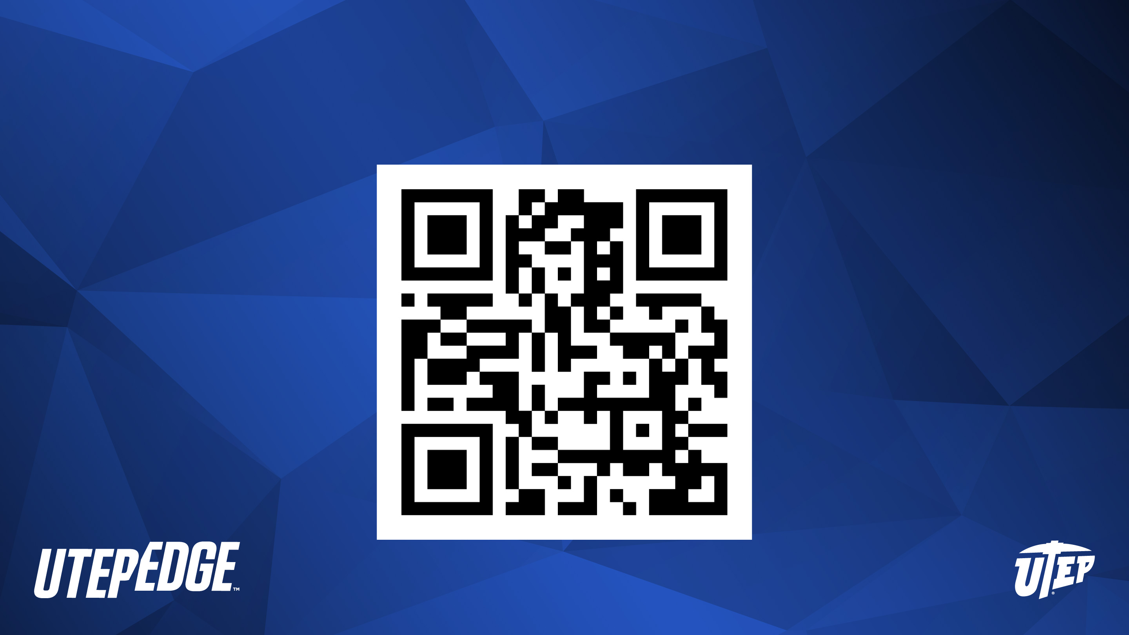

Scan to stay in touch!

