Slide 1

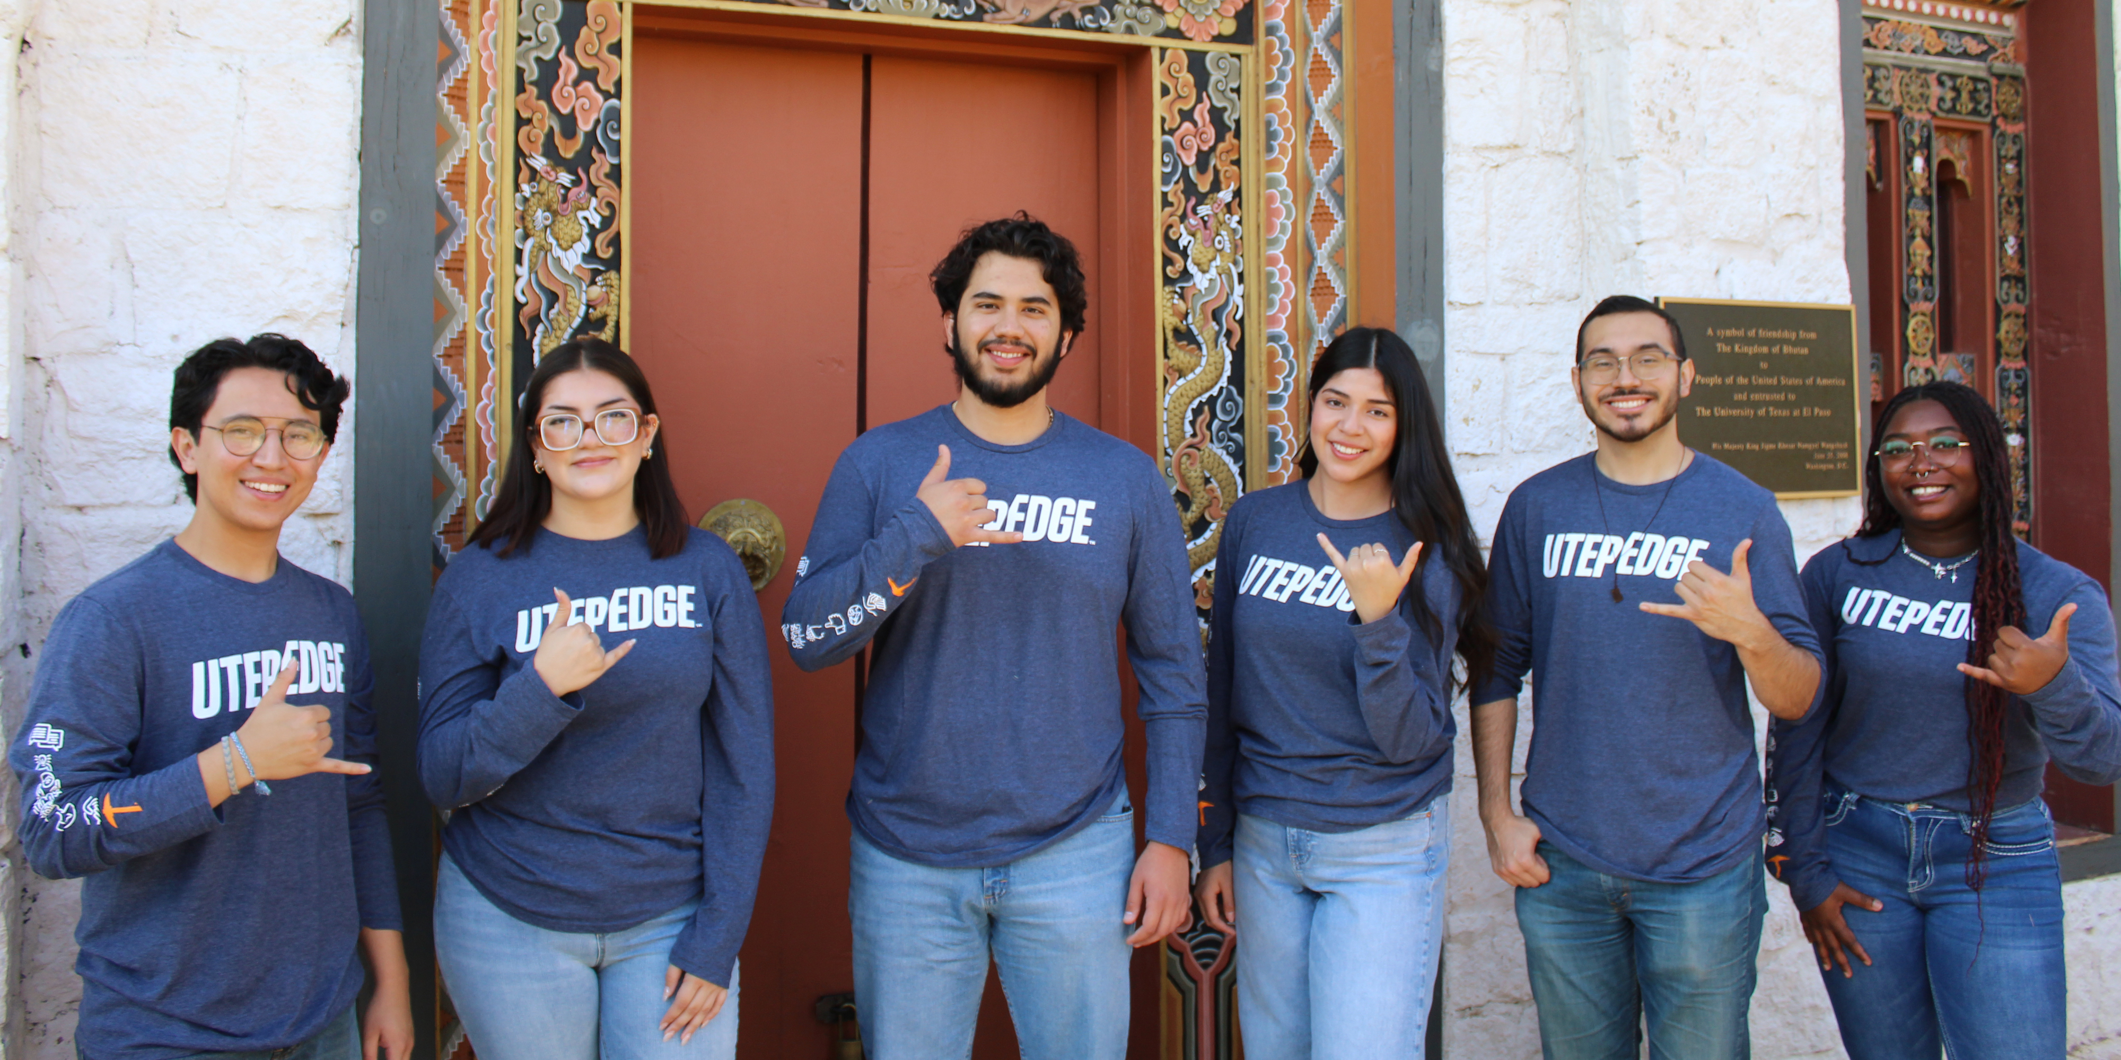
FELICIDADES
Bienvenidos Padres y Familiares
Notes:
Introduce yourself (name, position/role at UTEP, how long at UTEP, etc.).

Slide 2

Notes:
Provide an overview of UTEP Edge:
UTEP EDGE is a our University's framework. It is our approach to help students develop their competitive Edge. Using this framework our goal is to achieve a greater number of graduates ready to succeed in career and life, improve educational outcomes, increase prosperity in the region and economic opportunity for students.
What is it? Student success philosophy based on 3 pillars
Talented students
Enriching experiences
Lifelong success
Why is it important for parents to know? We want parents to:
Feel more connected to the University and become active partners
Realize that the University is invested in student success and wants to support parents’ investment, too= equal partnership
Understand the resources available at UTEP

Slide 3

EN ESTA SESIÓN
Identificaremos fortalezas
Identificaremos las Experiencias Edge (que representan ventajas competitivas)
Vincularemos las fortalezas y cualidades de su hija o hijo con la preparación de su carrera
Identificaremos recursos adicionales que se ofrecen en UTEP
Notes:
Briefly go over objectives/goals for today’s session.

Slide 4

ESTUDIANTES
TALENTOSOS
Los estudiantes de UTEP tienen talento, motivación y experiencias de vida que les permitirán tener éxito en nuestro campus, en el mundo laboral y en la comunidad global
Notes:
Give some example of talents/assets/strengths students bring to UTEP:
Bilingualism
Biculturalism
Hard work
Time management
Discipline
Organization
Musicality/Athleticism/Art
Ease reasoning/mathematics/writers/readers

Slide 5

DEFINIR
FORTALEZAS
El talento, las habilidades, capacidades y experiencias de las personas, las asociaciones y comunidades que pueden utilizarse para la acción y el cambio

Slide 6
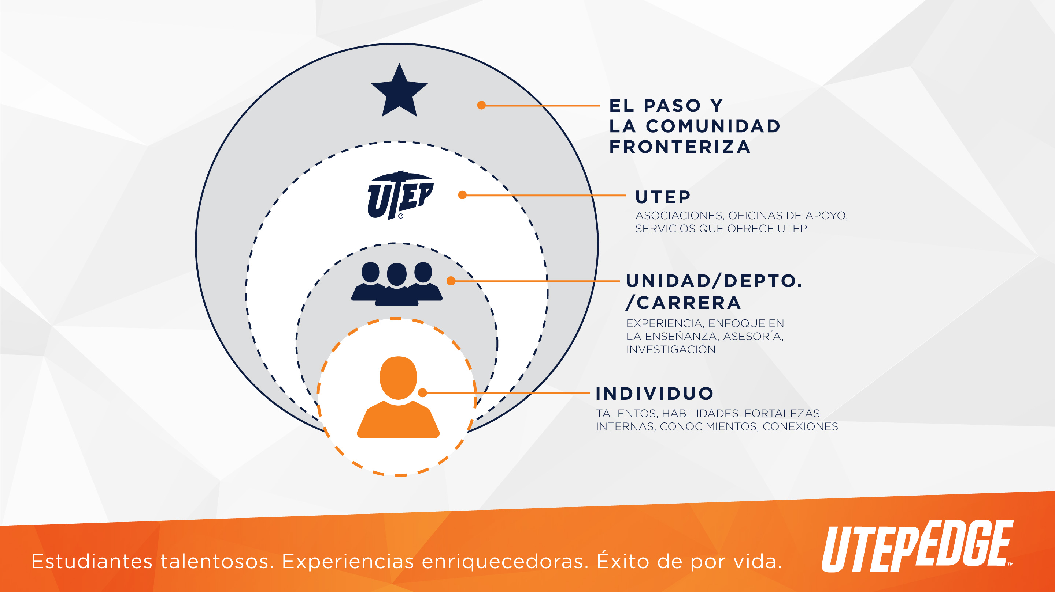
Notes:
Discuss Individual Assets vs Collective Assets. Think about yourself and your assets. Think about the assets of your son or daughter. Now think about the assets the community (UTEP, respective neighborhood, etc.) has to support your son or daughter while in college.

Slide 7
IDENTIFICANDO FORTALEZAS
¿Quién soy yo? ¿En qué soy bueno?
Crear una lista de:
Sus fortalezas, talentos y habilidades únicas. Identifique sus 5 fortalezas principales.
Fortalezas, talentos y habilidades de su hija o hijo. Identifique sus 5 fortalezas principales.
Fortalezas y ventajas de su comunidad.
Notes:
Activity 1- Ask parents to pull out their handout and explain that this is homework for them to do with their student. Explain to them that this is a way for them to think about their assets and strengths.
"Sit down with your student and list their assets. Can anyone give an example of their son or daughter's strengths?"
"Then, you can list your assets as a family. Can anyone give some examples of strengths you bring as a family?"
"What about UTEP? Can anyone give an example of some community assets at UTEP?" "Right, some examples include caring faculty and staff members, library, Career Center, CASS, Counseling, Advising, student organizations, etc."
"We encourage you to think of neighborhood assets (rec center, family/friends living close-by, city library, etc.) and communicate these assets with your son or daughter."

Slide 8

EXPERIENCIAS
ENRIQUECEDORAS
Los estudiantes fortalecerán estos talentos y habilidades a través de una serie de experiencias de alto impacto adaptadas a las necesidades y aspiraciones individuales
Notes:
Your son’s or daughter’s talents are enhanced by seeking out enriching experiences like the following:
Study abroad/away
Faculty led research
Senior projects
Student organizations

Slide 9

Notes:
Briefly go over each of the EDGE experiences

Slide 10
EXPERIENCIAS ENRIQUECEDORAS
Seleccione las tres experiencias principales que a usted le gustaría que su hija o hijo aproveche mientras está en UTEP.
Seleccione tres experiencias que usted considera que su hija o hijo escogería como aquellas que le gustaría realizar en UTEP.
¿Son los mismos o diferentes? ¿Cómo puede apoyar a su hija o hijo?
Notes:
Activity 2 – This is the back page of the handout. Here you will tell parents again that this is part of their homework.
"The second part of your homework is on the back side of the handout"
"List 3 experiences you think your daughter or son would most benefit from participating in."
"Then, think of the resources you think they will need to make that happen. How will you help provide that support?"

Slide 11
EXPERIENCIAS ENRIQUECEDORAS
Hay investigaciones que indican que los estudiantes que se involucran y participan en actividades extracurriculares (experiencias enriquecedoras):
Tienen más probabilidades de continuar en la escuela.
Disfrutan más su tiempo en la universidad que aquellos estudiantes que no se involucran.
Tienden a graduarse más pronto de la Universidad.
Notes:
Emphasize the importance of having their son or daughter engaged while in college.

Slide 12

ÉXITO DE
POR VIDA
La combinación de estos talentos y experiencias de alto impacto, prepara a los estudiantes con una ventaja competitiva para lograr el éxito en su vida académica, profesional y cívica
Notes:
Developing the competitive advantage, by recognizing talents and participating in enriching experiences, will lead to lifelong success- career or graduate work. We work on expanding a student’s toolkit through EDGE Advantages (go to next slide to show advantages).

Slide 13

Notes:
These are the skills that employers often look for.

Slide 14
CONSIDERANDO TODOS ESTOS ELEMENTOS
A Usted, ¿qué le gustaría que su hija o hijo obtenga de su experiencia en UTEP?
Reflexione sobre las fortalezas y valores de su hija o hijo, escriba sobre lo que a Usted le gustaría que ella o él obtenga de su experiencia en UTEP.
Por favor compártalo con su hija o hijo.
Notes:
Activity 3 – Again, explain that this is homework or an opportunity to reflect with their student.
“What do you want your son or daughter to get out of their experience at UTEP? Does this align with what they want to get out of UTEP?”

Slide 15
RECURSOS ADICIONALES
Estudios en el Extranjero
(915)747-5190
Centro de Desarrollo Profesional
Empleo Estudiantil
Prácticas Profesionales
(915)747-5640
Investigaciones y Actividades Académicas
(915)747-8282
Notes:
Encourage parents to take a picture of this slide and contact these offices if they have more information.

Slide 16


Escanéame para saber más!

Slide 17


