Slide 1
College of Education Faculty Research Interests

Slide 2
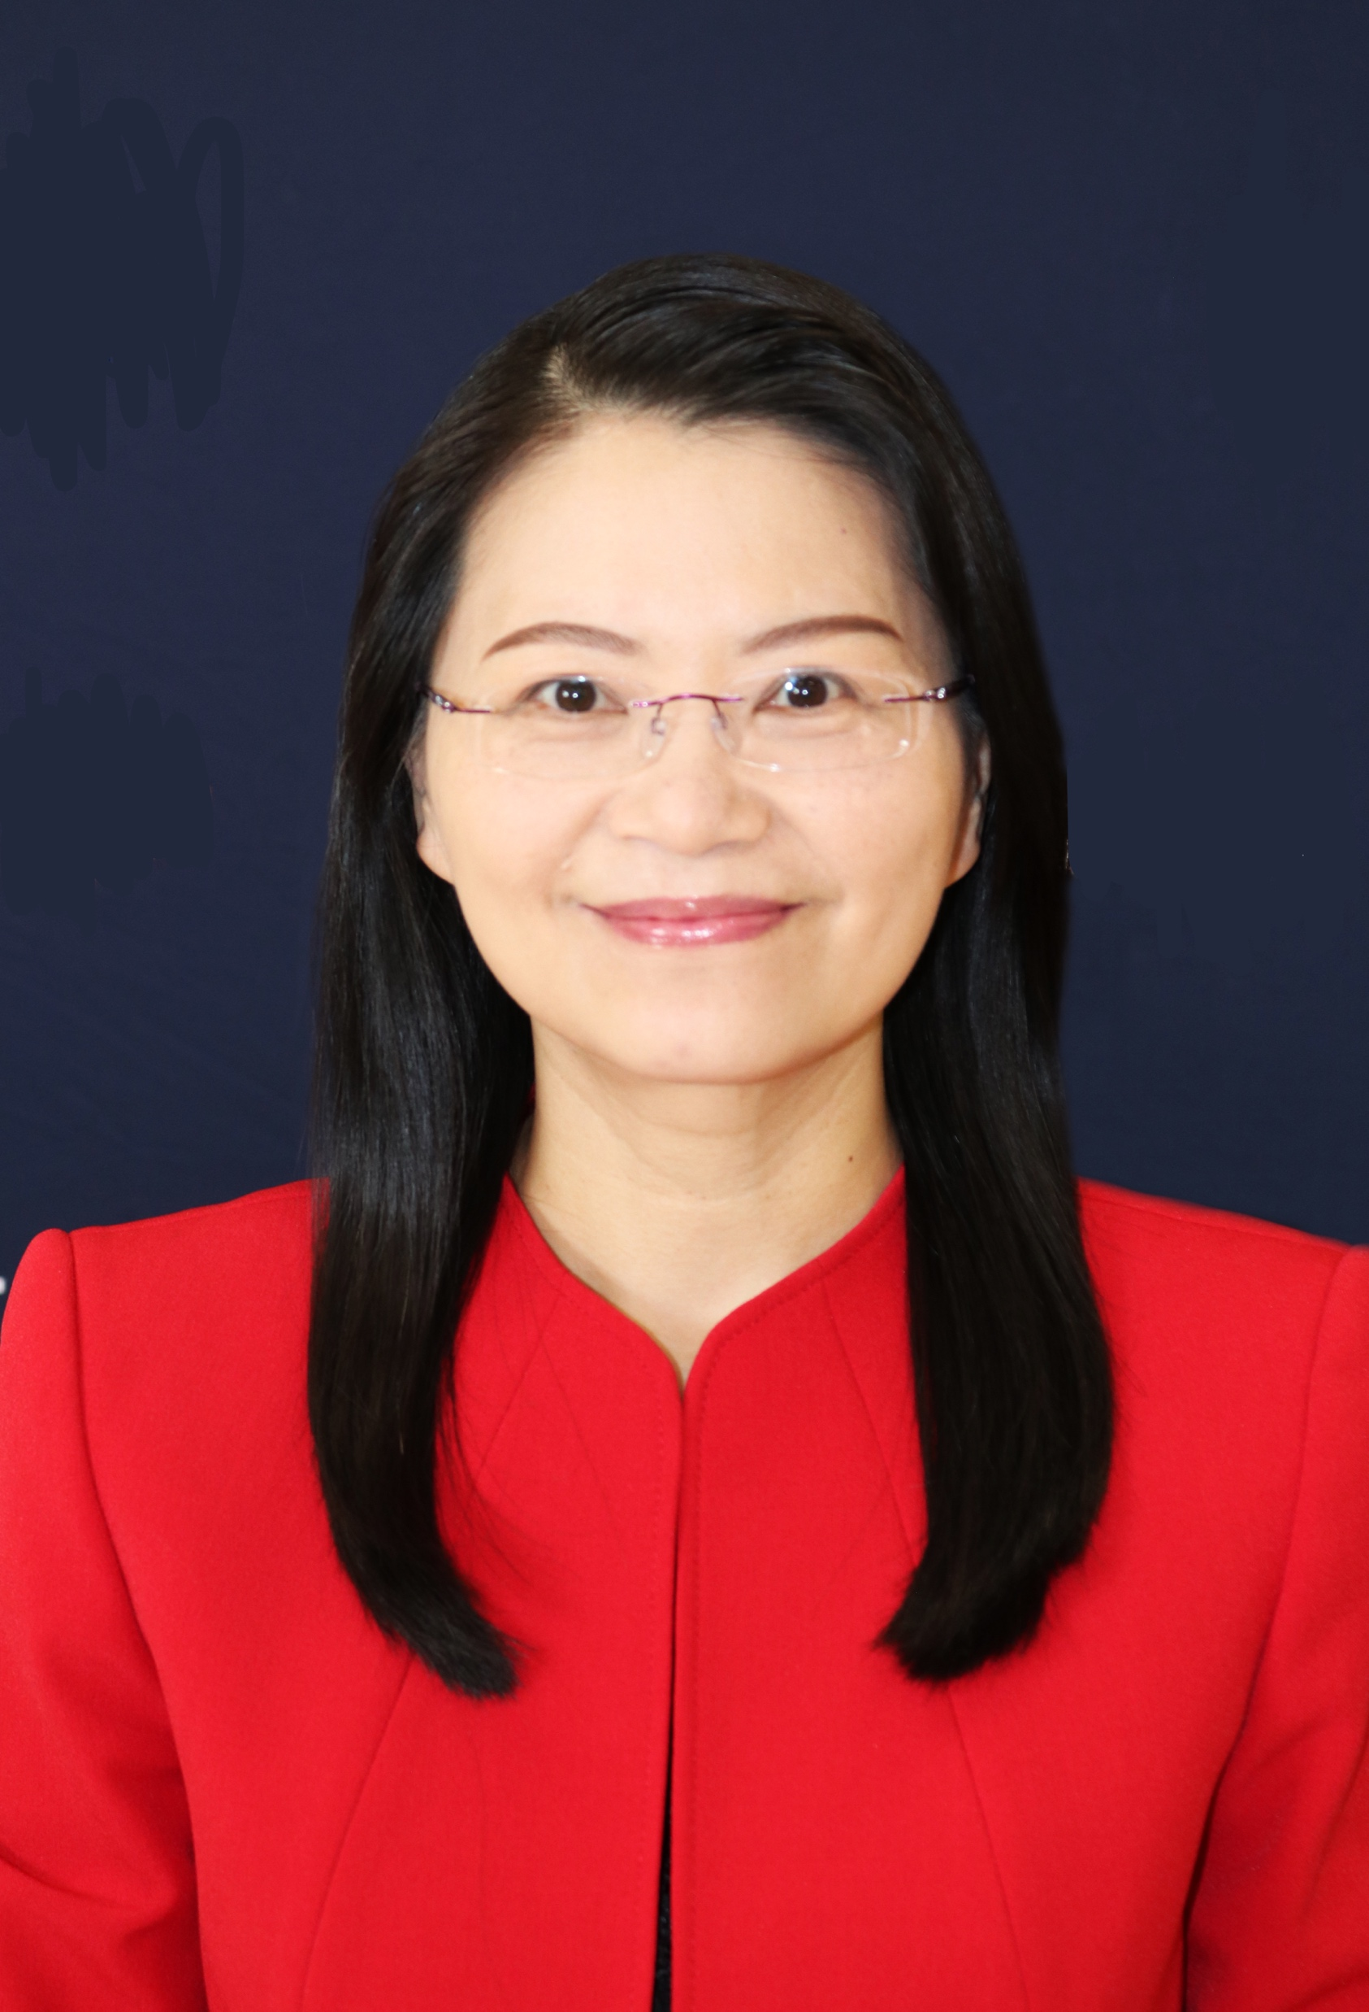
Pei-Ling Hsu, Associate Professor Department of Teacher Education
Science Education, Ph.D.
Research Interests
Science Discourse and Communication
Dialogic Pedagogy
Internship Education
Science Identity
Student-Scientist Partnership
Email: phsu3@utep.edu
Office phone: 915-747-6446
Collaboration Opportunities
Formal/informal science education
Grant/project proposal writing
Data analysis: discourse analysis, conversation analysis, sociocultural analysis

Slide 3
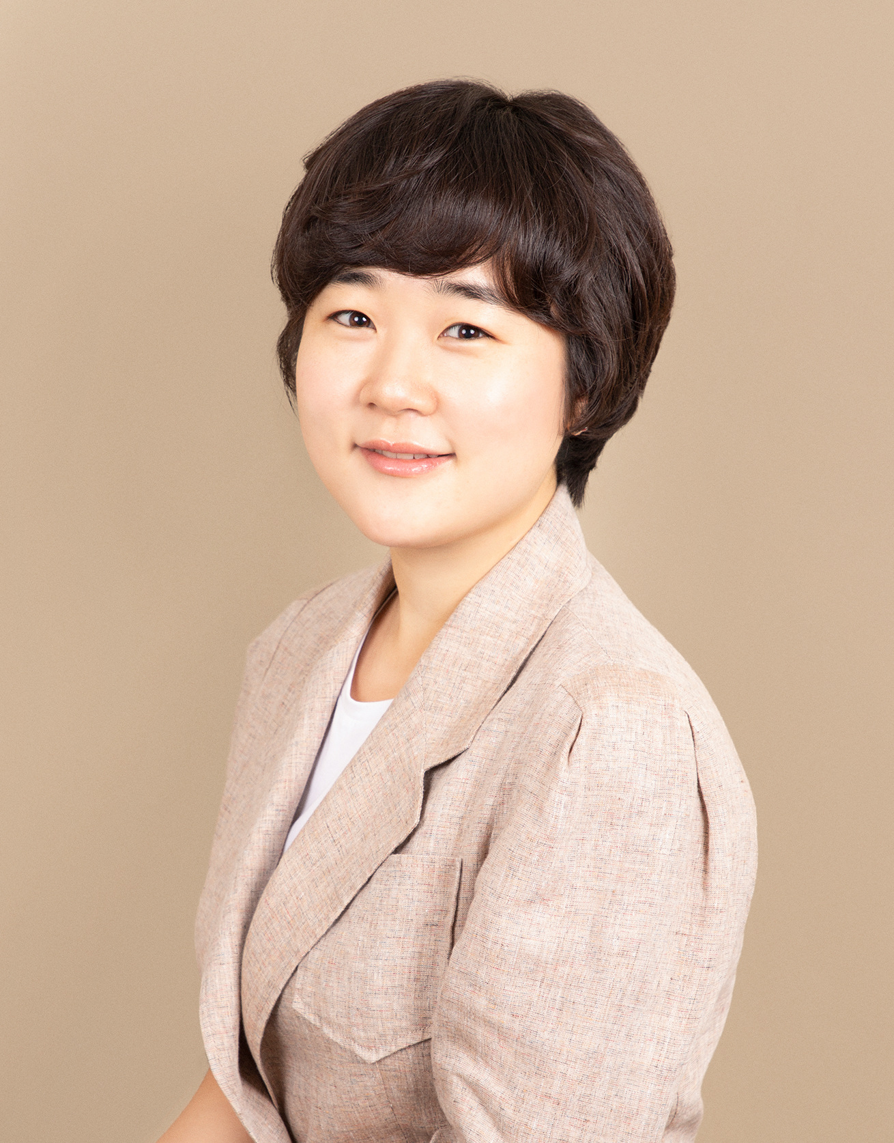
Eunae Han, Assistant Professor Counseling, Special Education, and Educational Psychology
Ph.D. in Counselor Education and Supervision
Research Interests
Feminist approaches to counseling/supervision/counselor education
Trauma-informed care
Research competencies/mentoring
Contact Information
Email: ehan@utep.edu
Office phone: 915-747-7585
Recently Published Projects
Empowering women in counseling by dismantling internalized sexism: The Feminist-Multicultural Orientation and Social Justice Competencies
Using the internalized misogyny scale across sexual orientations: Measurement invariance and item factor analysis
Collaboration Opportunities
Methodologist in advanced stat such as factor analysis
Trauma-informed Care in Counseling and Education

Slide 4
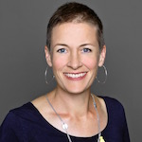
Katherine Mortimer, Associate Professor Teacher Education
Bilingual/Biliteracy Education
Research Interests
Secondary-level dual language education
Bilingual, culturally responsive computer science instruction
Translanguaging pedagogy (fluid use of both languages) in secondary and higher education
Language policy and implementation
Contact Information
Email: ksmortimer@utep.edu
Collaboration Opportunities
Bilingual approaches to broadening participation in STEM+C education
Bilingual/translanguaging pedagogy in secondary and higher education

Slide 5
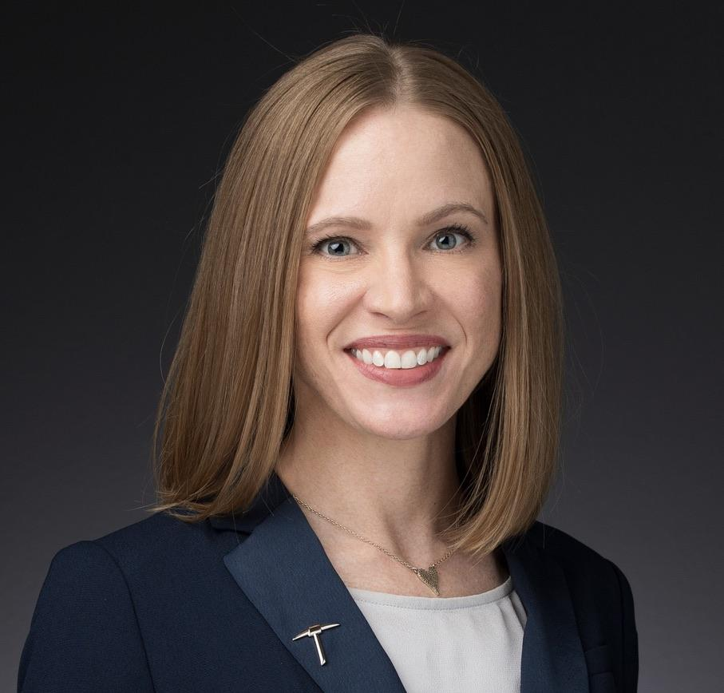
Robyn K. Pinilla, Assistant Professor of
Early Childhood Education
Teacher Education
Research Expertise
Spatial reasoning skills in early grade mathematics teaching and learning
Qualitative research methods – case studies and content analysis
Contact Information
Email: rkpinilla@utep.edu
Current Research
Developing relationships to support Teacher Learning of Early Childhood Mathematics
Teacher Noticing – Equity in Classroom Mathematics Discourse
Collaboration Opportunities
Seeking volunteer student research assistants to support a design-based research study of spatial reasoning in early childhood mathematics. The work will be at a single campus beginning this summer.
Open to contributing to others’ work in early grades teacher preparation and STEM education research

Slide 6
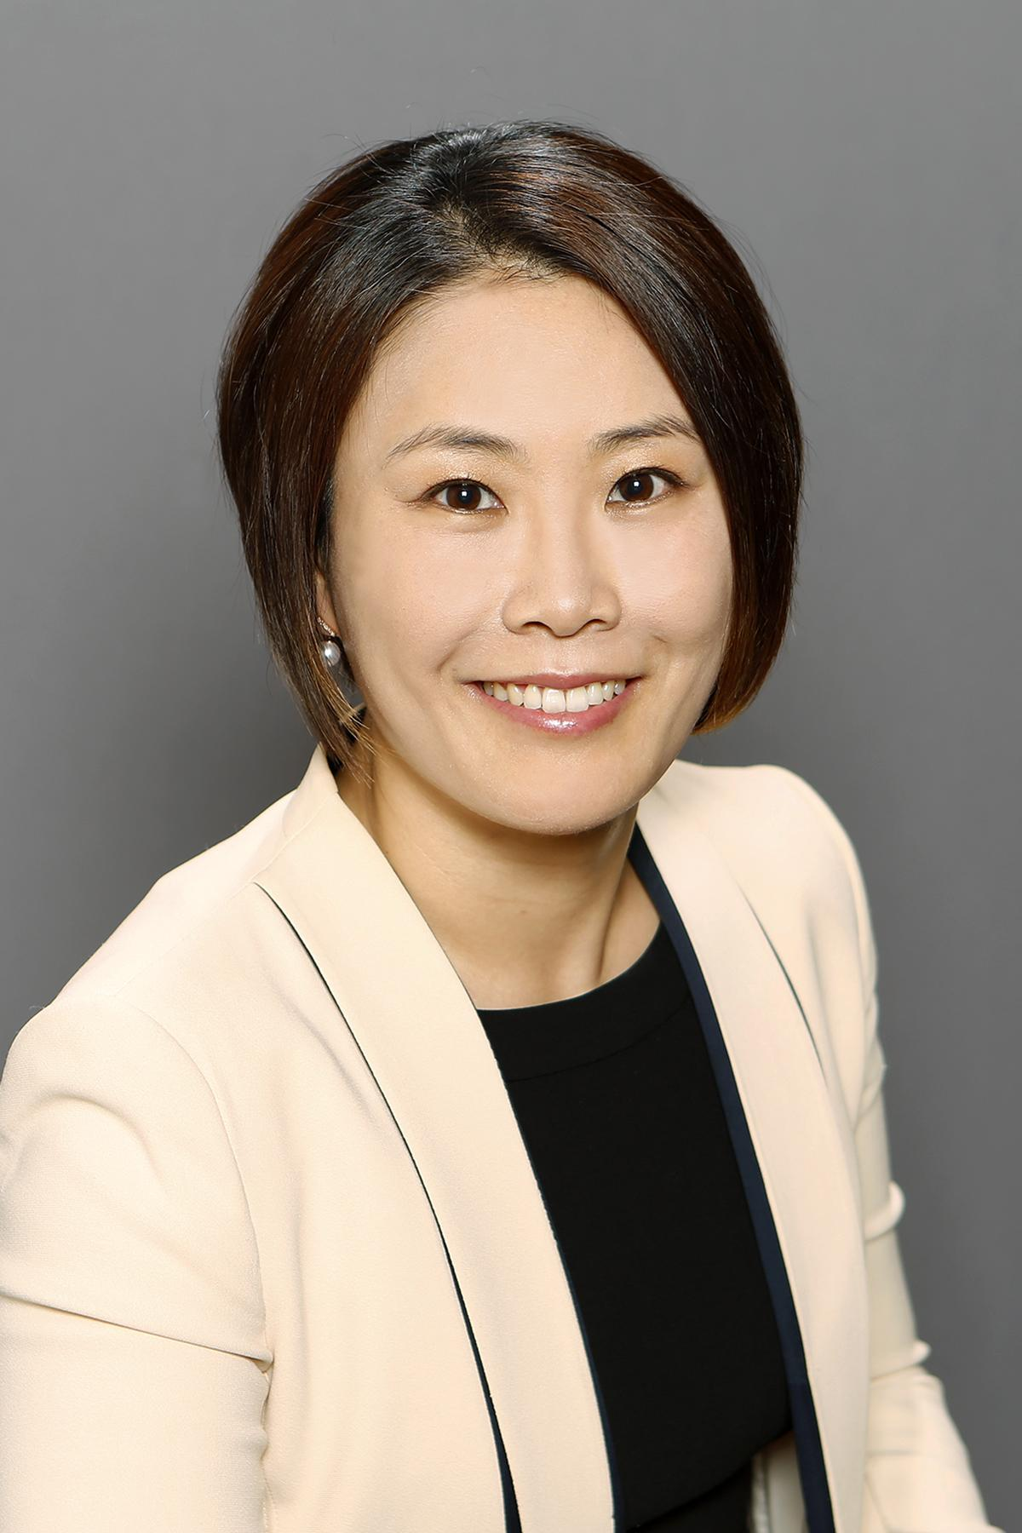
Sang Min Shin, Associate Professor Counseling, Special Education and Ed. Psy.
Mental Health Counseling
Research Interests
Child mental health counseling & counselor education in child counseling
Play therapy, nature-based counseling, filial therapy
Contact Information
Email: sshin2@utep.edu
Office phone: 915-747-7643
Current Research
Nature-based play therapy
Play therapy training, filial therapy
Collaboration Opportunities
Child mental health, parent child relationship/parenting, teacher child relationship, play therapy, nature-based mental health intervention
Qualitative research projects

Slide 7
María Teresa (Mayte) de la Piedra, Professor
Teacher Education Department
Research Interests
Dual Language Bilingual Education
Translanguaging in Pk-20 classrooms
Transfronterizx (border crosser) students and teachers
Engineering education in pre-K-12 dual language settings
Contact Information
Email: mdelapiedra@utep.edu
Office phone: 915-747-5527
Collaboration Opportunities
Translanguanging in higher education (STEM fields)
Projects that need expertise in ethnographic methods

Slide 8
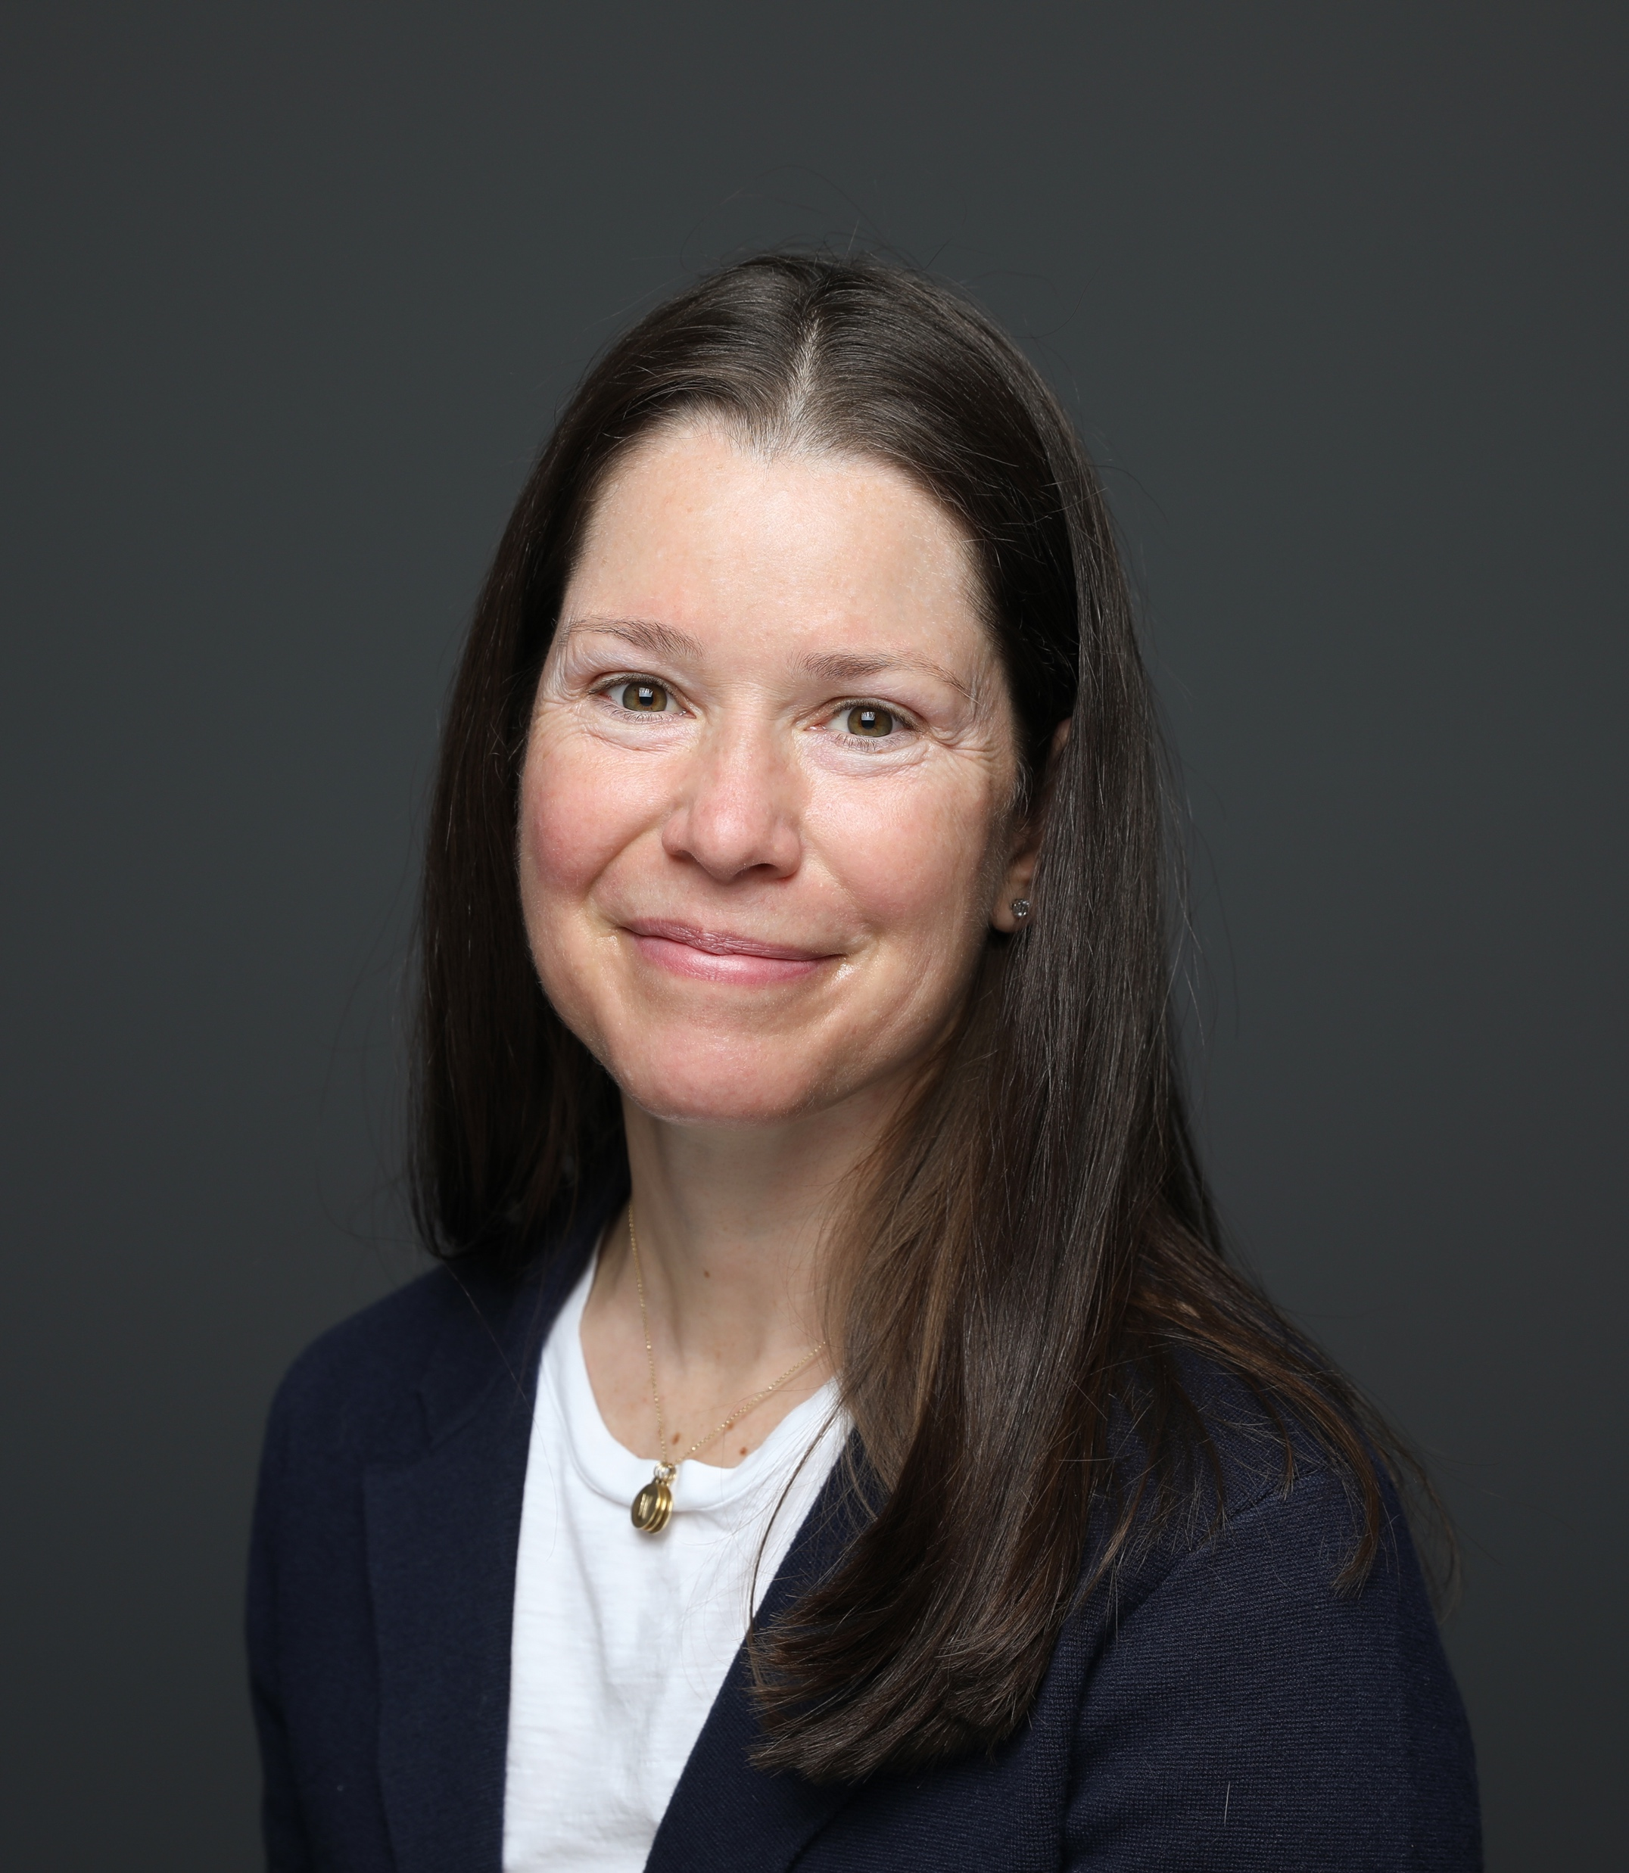
Cynthia A. Wiltshire, Assistant Professor of
Early Childhood Education Teacher Education
Early Childhood Education Teacher Well-being
Comparative analysis of psychological and physiological (cortisol concentration) stress
ECE workforce retention; Caregiving responsibility
Contact Information
Email: cawiltshire@utep.edu
Office phone: 915-747-6655
Current Research
Characterizing ECE Teacher Well-being in 2 ISDs
Characterizing ECE Teacher Well-being in community childcare centers (2 community partnerships; 12 early learning centers)
Collaboration Opportunities
Open to volunteer student Research Assistants looking for experiences in recruitment, data collection, data analysis, literature review, writing
Open to implementing phsyiological measure of stress in others’ ongoing research strands

Slide 9
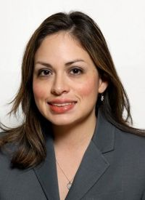
Penelope Espinoza, Associate Professor Educational Leadership & Foundations
Ph.D., Social Psychology
Research Interests
Interdisciplinary research on psychology & education
Social-cognitive biases (especially stereotypes) in educational settings
Contact Information
Email: ppespinoza@utep.edu
Office phone: 915-747-8784
Research Interests
Participation and success of underrepresented groups in STEM, including women and Latinx
Equity in higher education, especially at HSIs
Collaboration Opportunities
Higher education/HSI leadership issues for equity and inclusion
Broadening participation in STEM; environmental justice issues

Slide 10
Rodolfo Rincones, Associate Professor Educational Leadership & Foundations
Educational Management & Development, Ph.D.
Research Interests
Educational Policy
Reform in educational organizations
Rodolfo Rincones
Email: rrincones@utep.edu
Office phone: 915-747-7614
Research Interests
Research Practice Partnerships
Education in México
Collaboration Opportunities
Educator well-being
Organizational culture

Slide 11
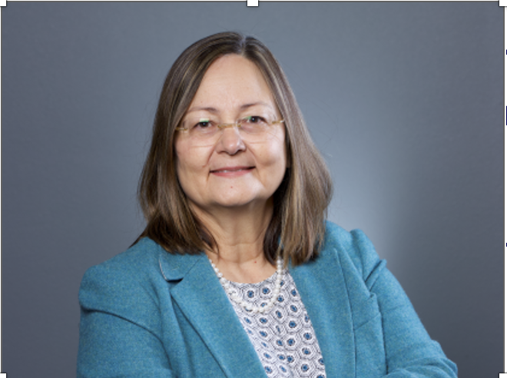
Dr. Diane Elisa Golding Teacher Education
Research Interests
Women Thriving in STEM
First Generation Student Success
Borderland Educators Experiences
EC-16+ Engineering Education
Email: degolding@utep.edu
Office phone: 915-747-8459
Current Research
Women’s Sense of Belongingness and Success in STEM
Latina Work-Integrated Learning Experiences
Educator Border Crossing as Everyday Ritual
Collaboration Opportunities
Center for Research in Engineering and Technology Education
(CREaTE)

Slide 12
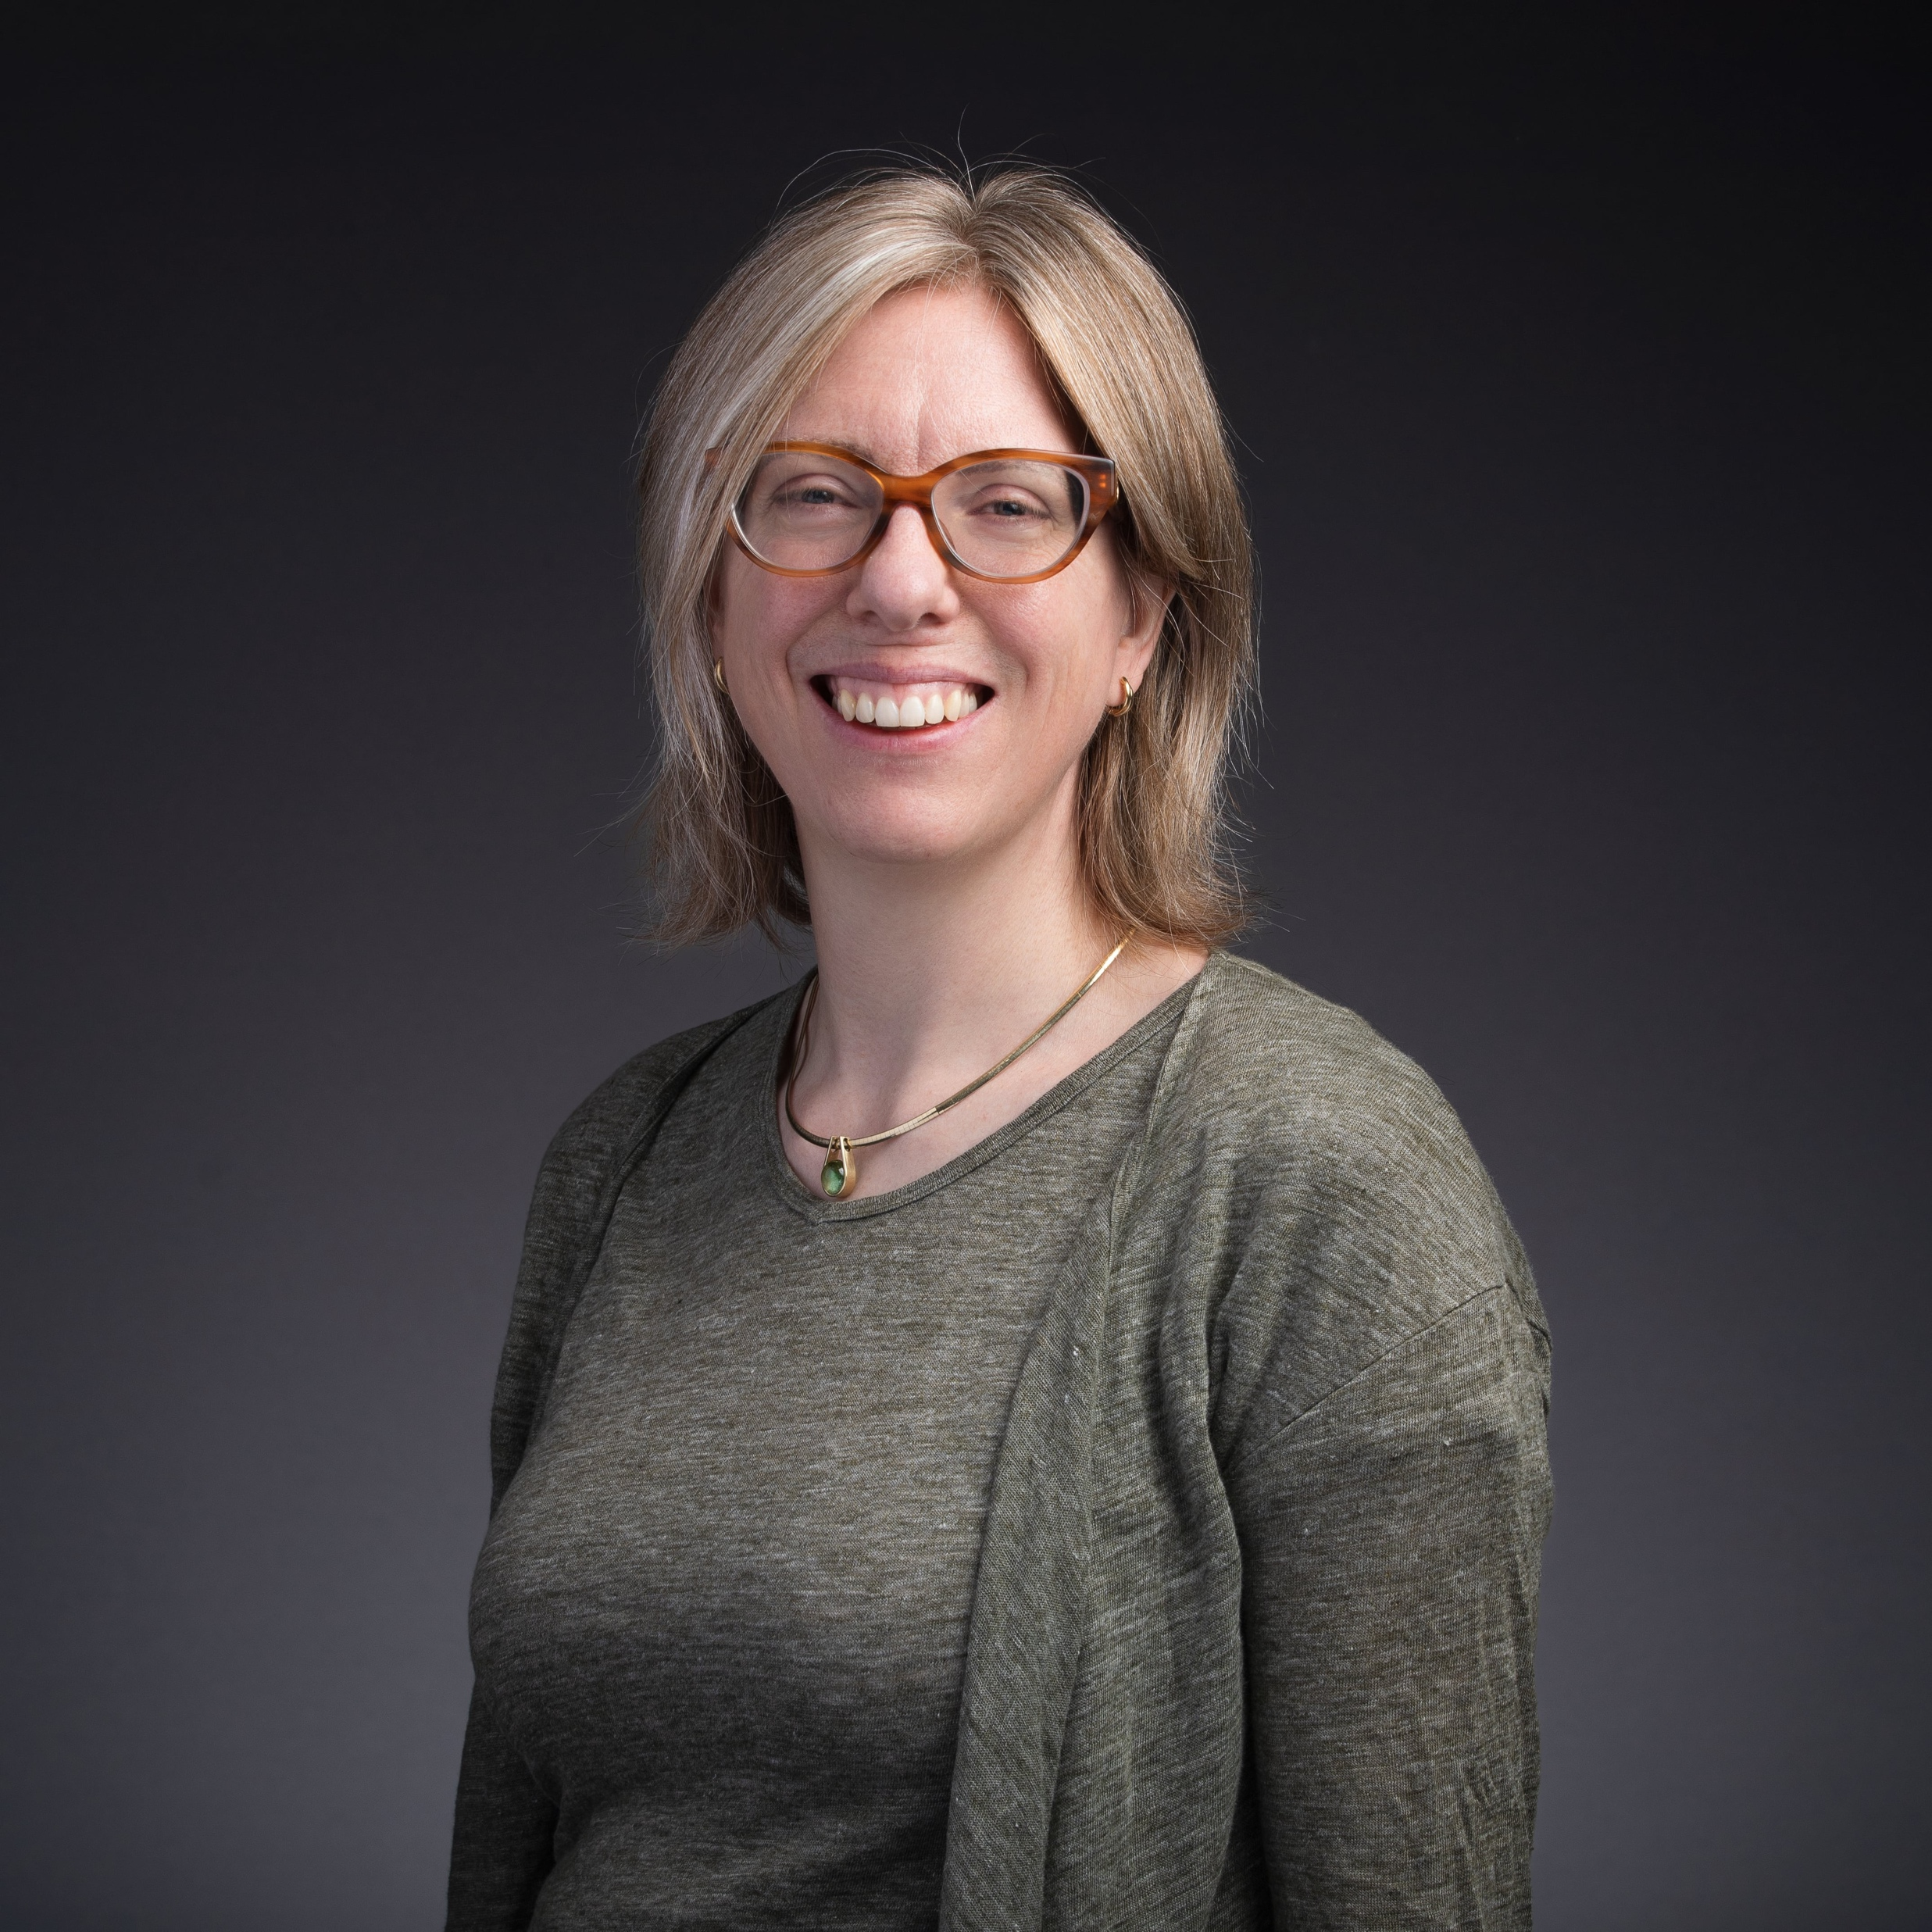
Maartje Van den Bogaard, Ph.D., F.SEFI Teacher Education
STEM Education
Research Interests
Student Success
Work Integrated Learning
Curriculum Studies
Education Change and Innovation
Comparative Education
Maartje Van den Bogaard
Email: mvdbogaard@utep.edu
Office phone: 915-747-7670
Office: COED 310D
Research Methods
Multivariate statistics, Design-Based Research, Mixed Methods, Evaluation
Collaboration Opportunities
Educational change/ innovation
Discipline-Based Education Research

Slide 13
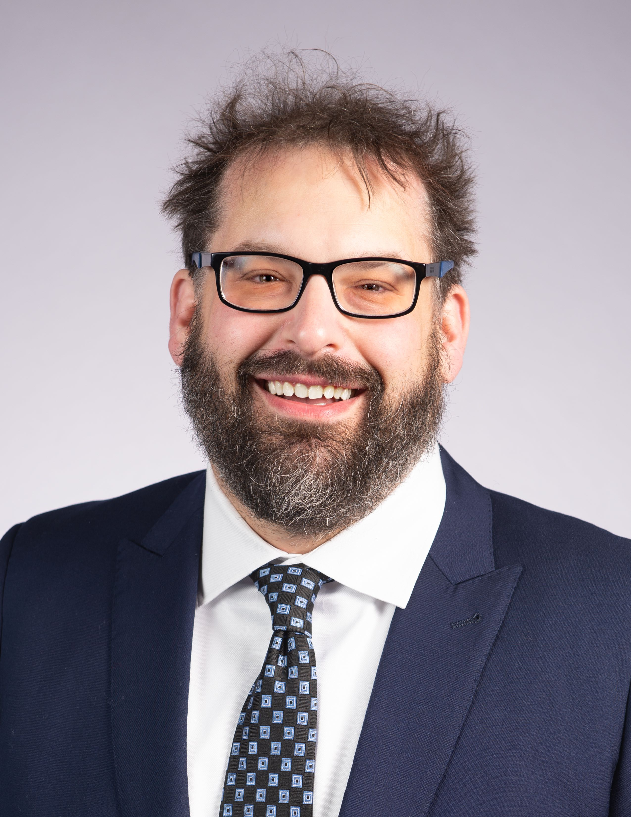
Johannes Strobel, Ph.D., Teacher Education
STEM Education (Engineering & CS Ed)
Research Interests
Epistemological, Ontological Beliefs and Worldviews
Competencies/Emotions/Attitudes in technical fields
Design of Integrated STEM for diverse students
Teachers in STEM (Engineering & CS)
Learning Technologies/AI in Education Research
Johanens Strobel
Email: jmstrobel@utep.edu
Office phone: 219-680-9771
Office: COED 412
Research Methods
Qualitative Methods, Instrument Development, Evaluation, Design-Based Research
Collaboration Opportunities
Any curiosity in any of my broad interest areas
Supporting faculty and graduate students in the pursuit of their research

Slide 14
College of Education Graduate Student Research Interests

Slide 15
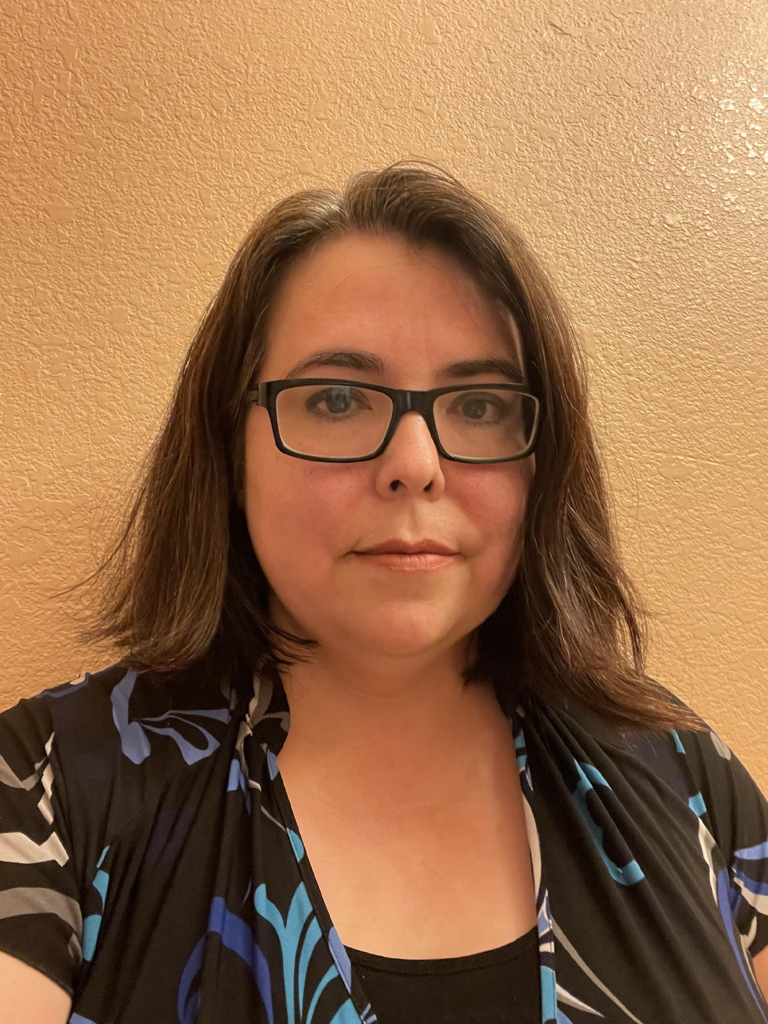
Diana Taylor, Graduate Student Counseling Special Education & Educational
Psychology: Mental Health Counseling
Current Research Project
Counselors-in-Training: The Stigma of the Wounded Healer in the Latino Community
Contact Information
Email: diperegrino@utep.edu
Phone: 915-474-3236
Research Interests
The stigma of mental illness
PTSD in the veteran community
Collaboration Opportunities
Wounded healer phenomenon
Relationship between psychopathology and inner dialogue

Slide 16
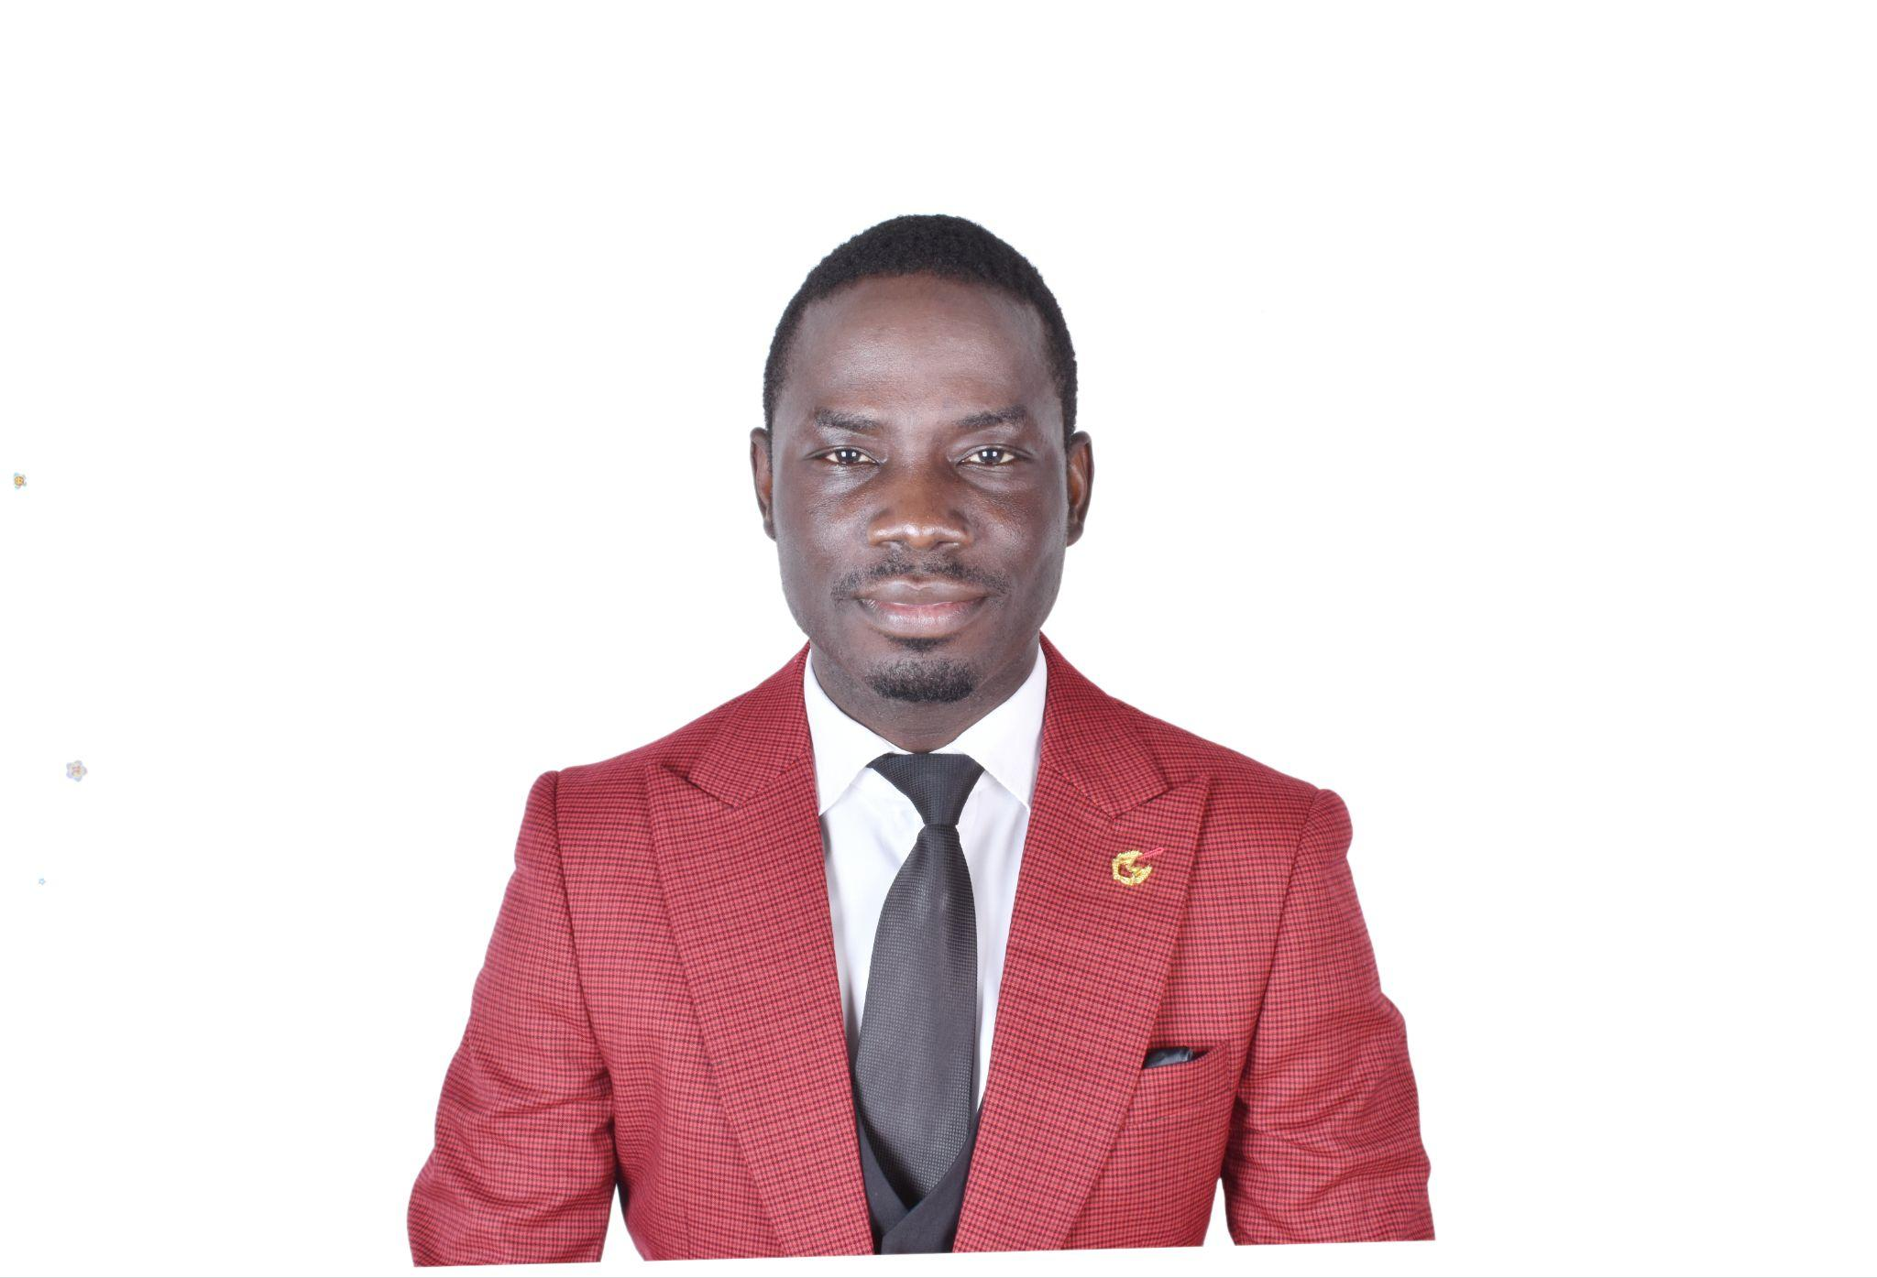
Name: Alex Acquah, Title Department: College of Education
Major/Degree: TLC STEM Education
Research Interests
Item 1: Data science Education
Item 2: Culturally relevant pedagogy in STEM education
Contact Information
Email: aacquah@miners.utep.edu
Office phone: 240-467-8519
Research Interests
Item 1: Equity and access in STEM education
Item 2: Language and Discourse analysis in STEM Education
Collaboration Opportunities
Item 1: Collaborating with researchers from diverse backgrounds to explore issues of equity, diversity, and inclusion in STEM education.
Item 2: Engaging in interdisciplinary collaborations that integrate insights from cognitive science, learning sciences, and educational technology into STEM education research.

Slide 17
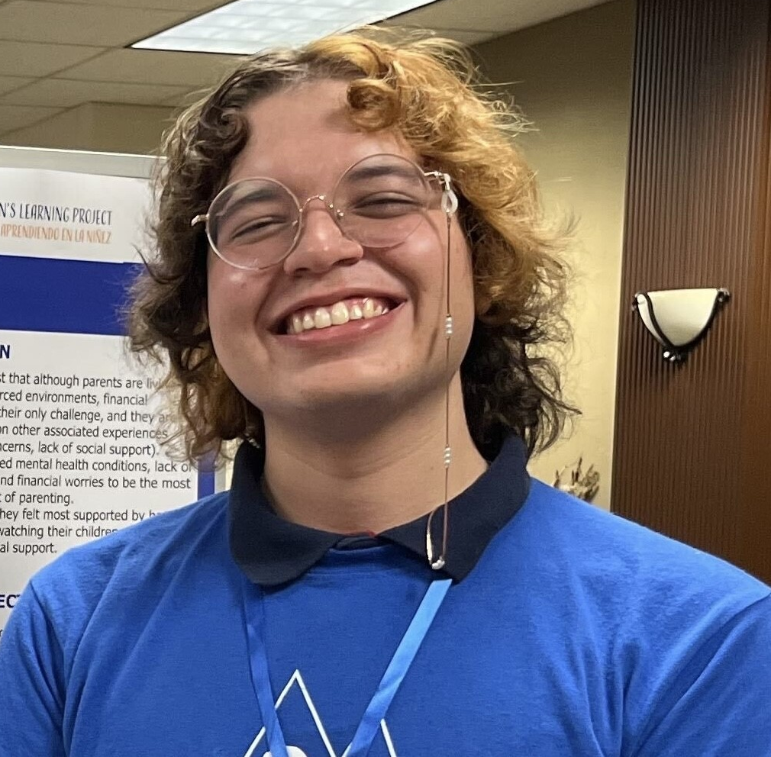
Mayew Quijas, Post-Bachelor Lab Manager Department of Psychology
College of Liberal Arts
Mental Health in Underrepresented Communities
Teacher stress in Latinx communities
Parental mental health and outcomes in child development
Contact Information
Email: mquijas4@utep.edu
Office phone: 915-747-8109
Current Research
Comparative analysis of psychological and physiological stress in early childhood education teacher populations
Examining parental stressors and their effects on parent-child interactions

Slide 18
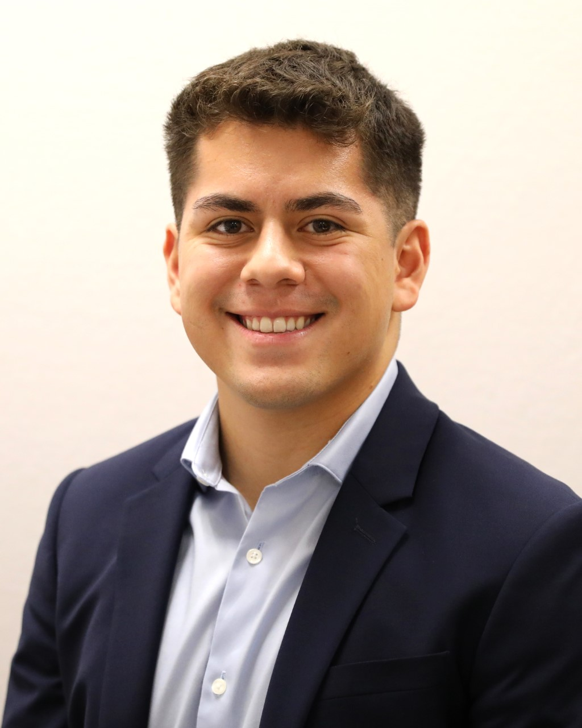
Tristan Hernandez, Research Assistant, Center for Research in Engineering and Technology Education, Multi-Disciplinary Studies
Research Interests
Transition from K-12 education to University
Engineering student experience
Contact Information
Email: tahernandez5@utep.edu
Email: create@utep
Current Research
Freshman Engineering Experience: Peer-Mentorship and Professional Competency Workshops
EmpowerED for Success: Latinas in Engineering
Collaboration Opportunities
Interdisciplinary initiatives
Education and industry partnerships
Open to any collaboration!!

Slide 19
Yolanda D. Castro, Ph.D. Candidate
Teaching, Learning, and Culture Program
Research Interests
* Dual Language Bilingual Education
* Teacher Education
Te
Dissertation Research Question
How do teachers in elementary dual language classrooms create a language-rich learning environment with their available language resources and students’ funds of knowledge?
Contact Information
Email: ydcastro@miners.utep.edu

Slide 20
Alejandra Sanmiguel-López
Doctoral Candidate Department of Teacher Education
Teaching Learning and Culture
acsanmiguel@miners.utep.edu
915-443-0730
Current Research
Transfronterizo families' language policies at the U.S.-México border. (A qualitative multiple case study about the decisions parents make about language in their homes.)
Research and Collaboration Interests
Family Language Policies (parent language use in their home).
Transfronterizo Families (frequent border crossers).
Bilingual Education.

Slide 21
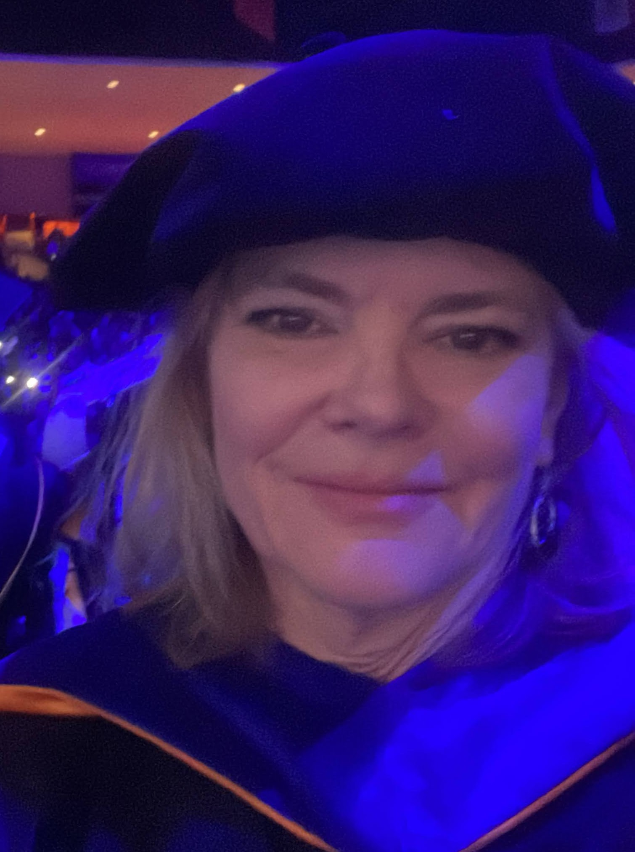
Dina Thomason, Teacher – Biomedical Science
Department of Teacher Education
TLC-STEM
Research Interests
STEM Education
Design Thinking
Contact Information
Email: Dthomason@miners.utep.edu
Office phone: 915-217-6211
Research Interests
Project based learning
Career and Technical Education
Collaboration Opportunities
Design thinking workbook for K-12
Engineering design facilitation

Slide 22
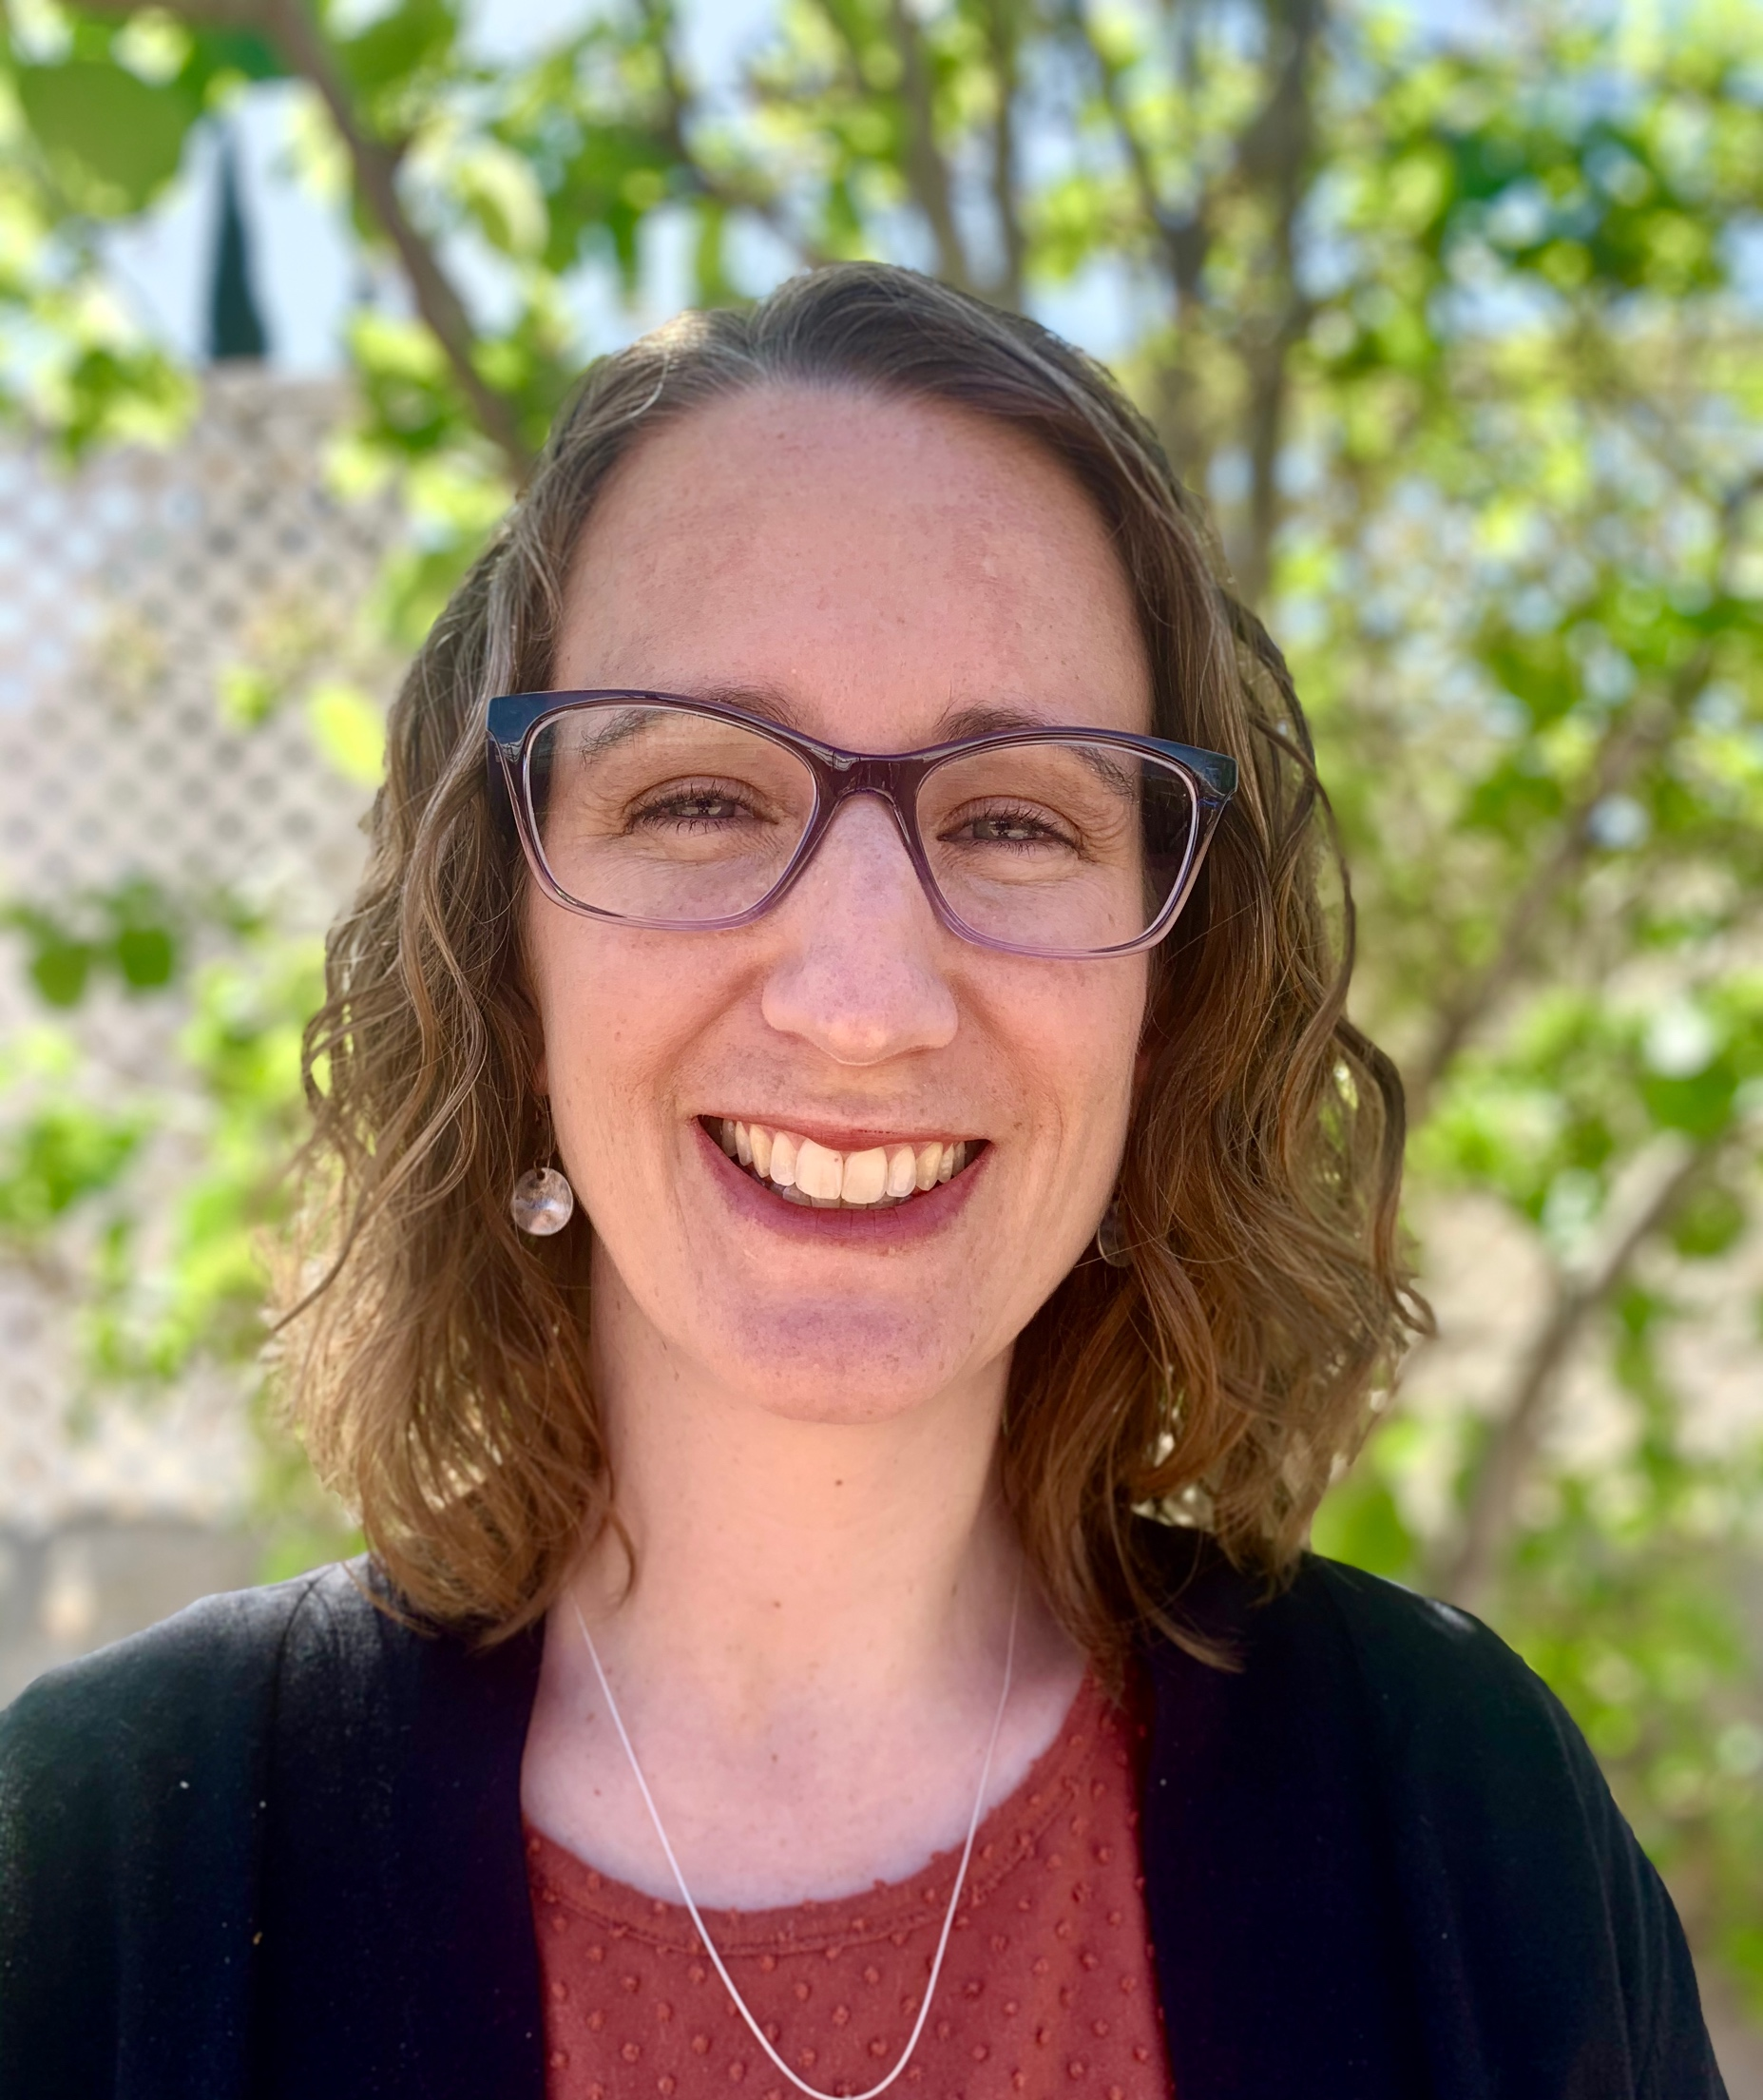
Laura Salazar, PhD Candidate Teaching, Learning, and Culture
Literacy/Biliteracy
Research Interests
Bilingual teacher education
Becoming a bilingual teacher in borderland contexts
Developing ideological clarity in teacher education: a critical view of our beliefs about languages in social contexts
Laura Salazar
Email: ljsalazar@miners.utep.edu
Phone: 915-490-7306
Collaboration Opportunities
I am interested in continuing work in bilingual preservice teachers’ developing conceptualizations of language.
I would like to pursue trends from my current research relating bilingual preservice teachers’ ideas about success to standardized testing in both K-12 school and teacher education programs.

Slide 23
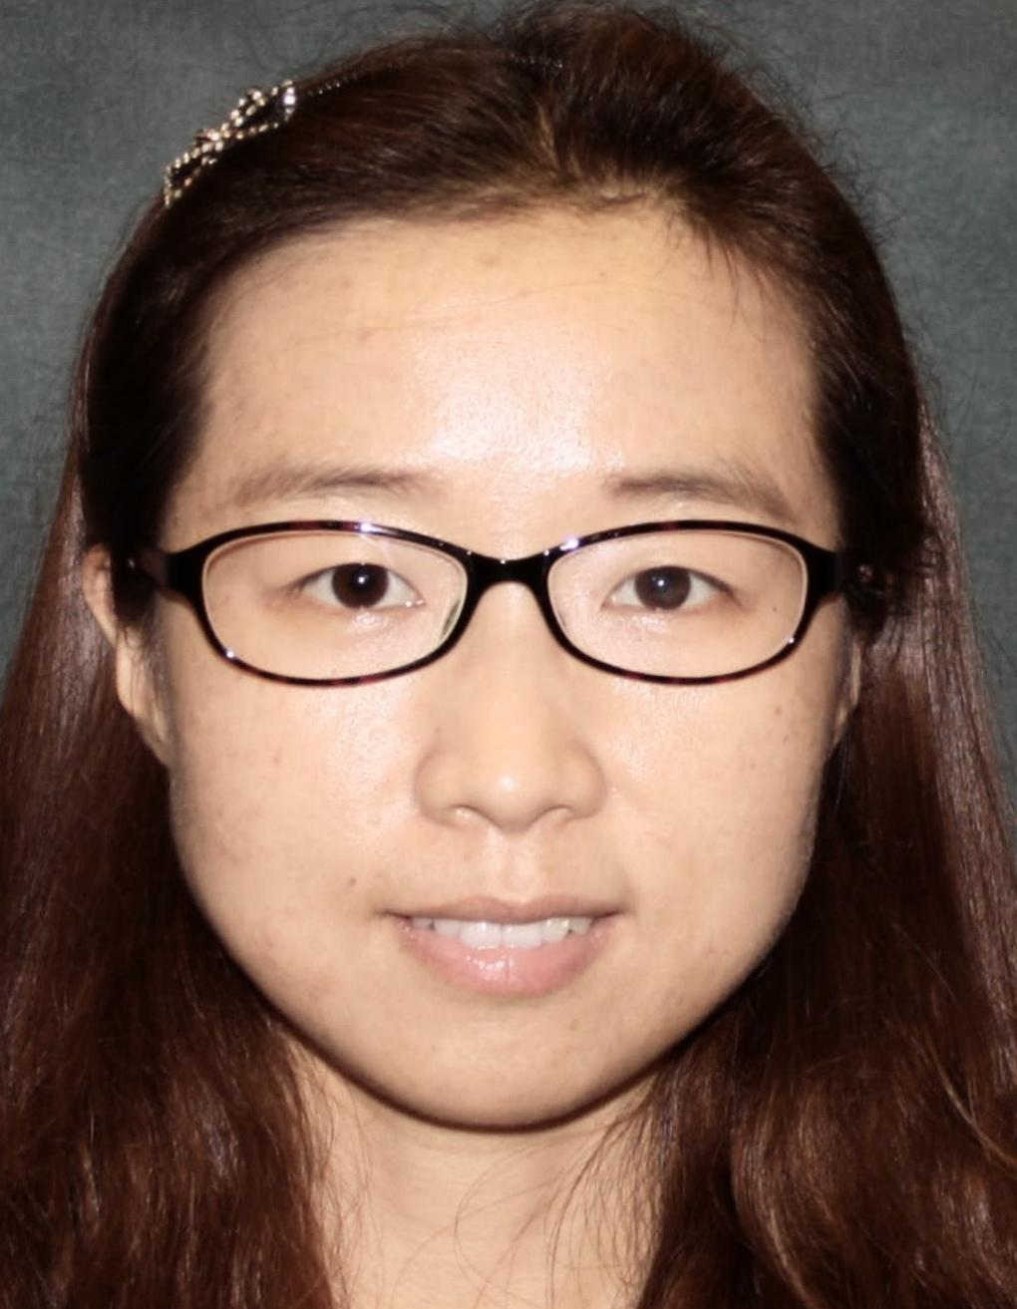
Name: Xuemei Wang
Major/Degree: TLC/Doctoral Student
Supervisor: Pei-Ling Hsu
Research Interests
Teaching English to Speakers of Other Languages (TESOL)
Teaching Chinese to Speakers of Other Languages (TCSOL)
Bilingual/Biliteracy Education
Sociocultural Foundations of Education
Intercultural Education
CS majors’ career aspiration
Xuemei Wang
Email: xwang4@miners.utep.edu
Office phone: 915-272-8612
Collaboration Opportunities
Welcome collaboration opportunities in
TESOL and TCSOL
CS majors’ career aspiration

Slide 24
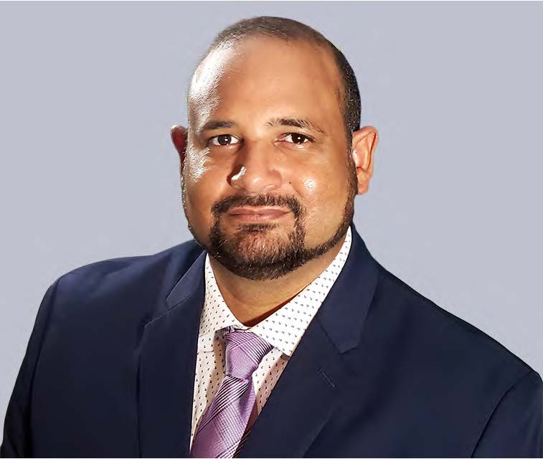
Daniel A Medrano College of Education
Teaching Learning and Culture/ Ph. D.
Contact Information
Email: damedrano2@miners.utep.edu
Research Interests
Item 1 Language in Education Policy Planning
Leveraging learners home language as a pedagogical tool
Translanguaging and the Achievement Gap

