Slide 1
Middle School and High School
These slides are most suitable for grades 7-12

Slide 2

Renewable Energy

Slide 3
Answer these questions…
  What is Energy?
  What types of Energy are there?
  What’s your favorite type of Energy?

Slide 4
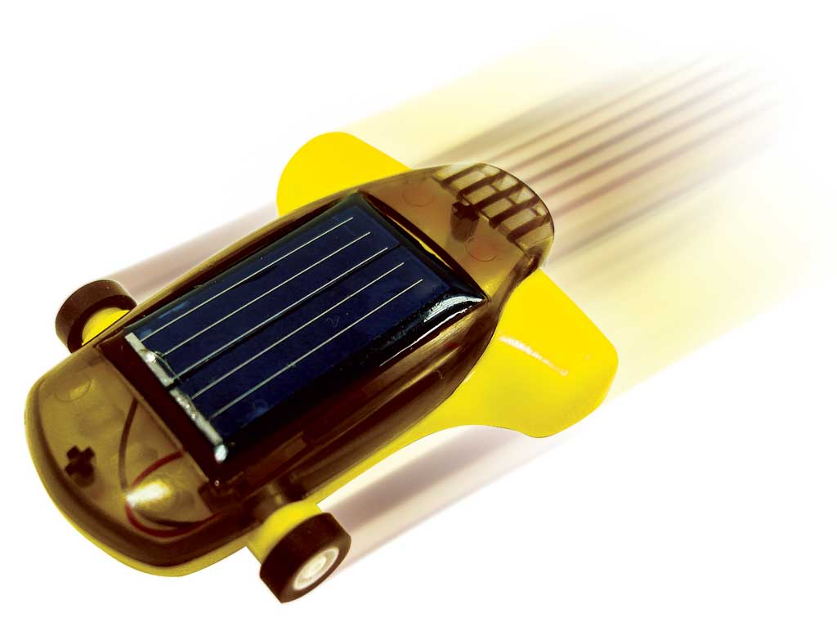
Let’s talk about some of the more common (and visible forms) of energy
Kinetic Energy
  Where have you seen this?
    Wind Turbines
    Nozzles and Diffusers
Potential Energy
  Where have you seen this?
    Pumps
    Hydroelectric Plants

Slide 5
Let’s talk about some of the more common (and visible forms) of energy
Kinetic Energy
  Where have you seen this?
    Wind Turbines
    Nozzles and Diffusers
Potential Energy
  Where have you seen this?
    Pumps
    Hydroelectric Plants

Slide 6


Kinetic Energy
Energy that a system possesses as a result of being in motion, relative to some point of reference, is called kinetic energy (KE).
  Energy associated with mass and velocity!
$KE=m\frac{V^{2}}{2}$ (kJ)

Slide 7
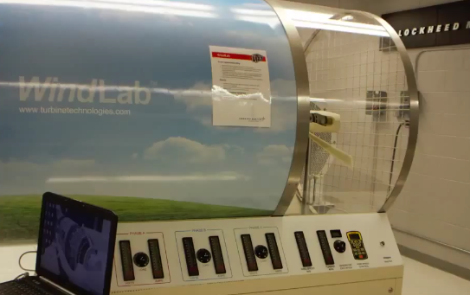
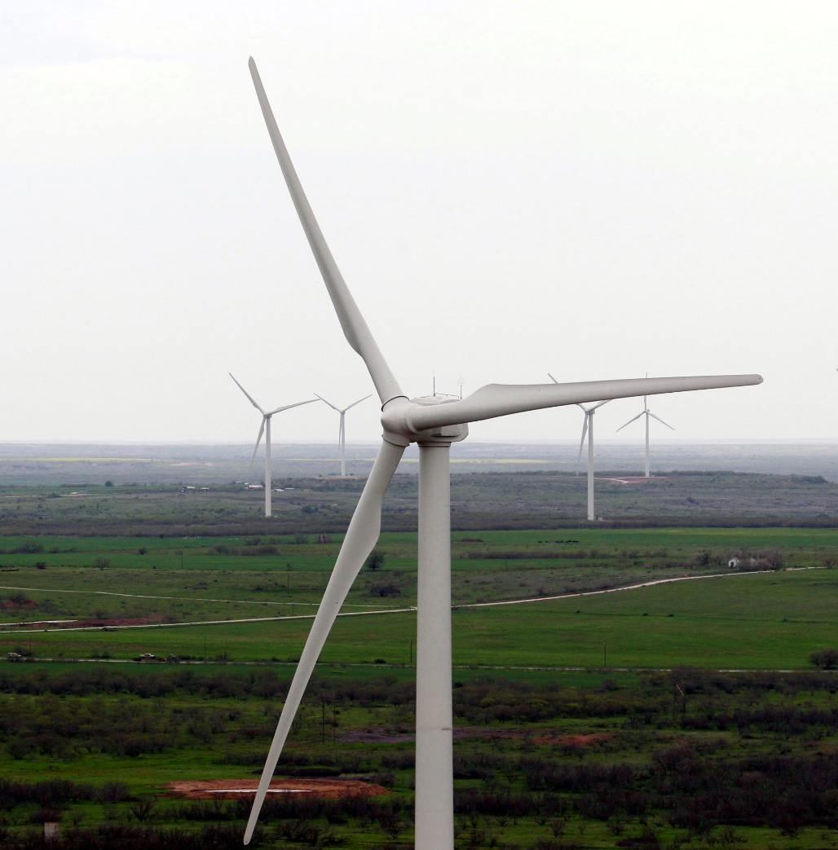
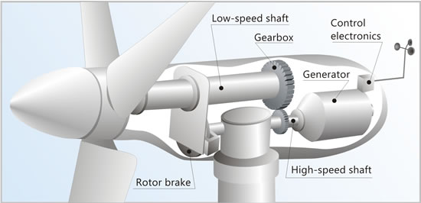
Wind Turbines

Slide 8


Slide 9
Remember…
Mass = Kilograms (kg)
Volume = Meters Cubed (m^3)
Distance = Meters (m)
Velocity = Meters per Second (m/s)
Accelerations = Meters per Second Squared (m/s^2)
Energy = Joules (kJ)
Power = Watts (W)

Slide 10
Group Roles
We will now be splitting up into groups of 5
Assign a role for each student:
1. Voltmeter: Will be in charge of using the voltmeter to read voltage and current
2. Assistant: Will be helping with the voltage and current readings
3. Writer: Will be writing the voltage and current readings on worksheet
4. Accountant: Will be in charge of verifying group calculations
5. Speaker: Will be the representative of the group

Slide 11
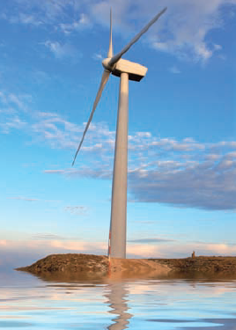
Wind Energy Example Problem
Winds blow at a speed of 16 m/s on a wind turbine.
What’s the amount of power that could come out of the turbine?
We’ll say that 2170 kg/s of air passes through the big turbine.

Slide 12
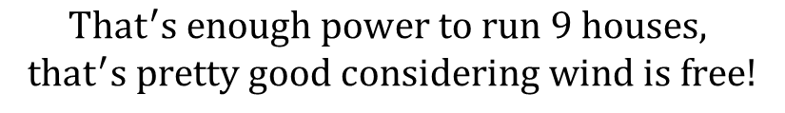

Solution
The mass flow of air in the system is:
The wind speed is:
Our Kinetic Energy formula is:
$$m=2170 kg/s$$
$$That^{′}s enough power to run 9 houses,$$
$$that^{′}s pretty good considering wind is free!$$
$$V=16 m/s$$
$$KE=\frac{1}{2}mV^{2}=\frac{1}{2} x 2170 x {16}^{2}=277,760 W$$

Slide 13
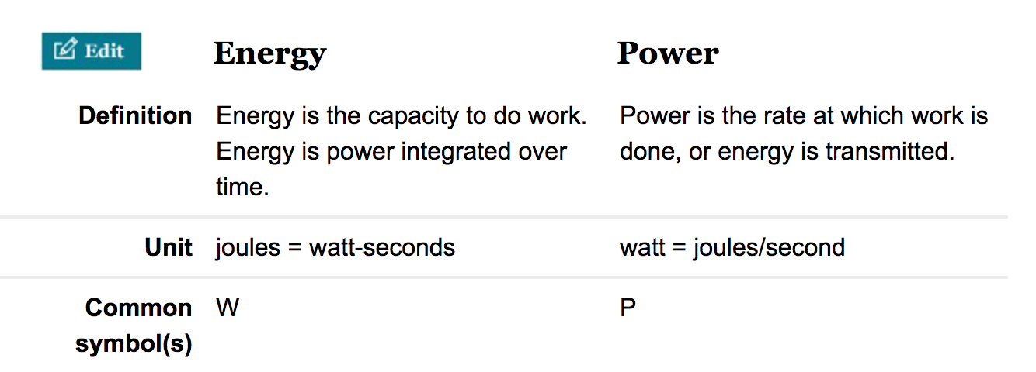
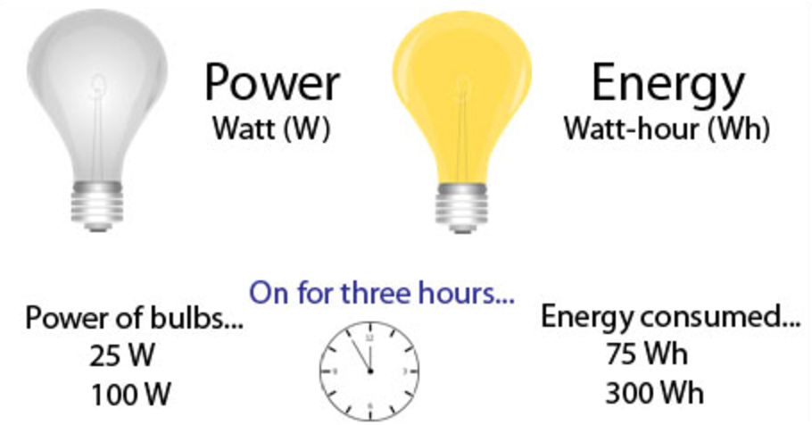
Solution
Real Wind Turbines convert about one-third of this potential to electric power
The mass flow of air in the system is:
The wind speed is:
Our Kinetic Energy formula is:
$$m=2170 kg/s$$
$$V=16 m/s$$
$$KE=\frac{1}{2}mV^{2}=\frac{1}{2} x 2170 x {16}^{2}=277,760 W$$

Slide 14
Wind Turbine Exercise
Please use your formula sheet and your instruction sheet to complete this module
20 Minutes

Slide 15
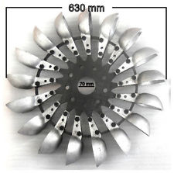
Let’s talk more about Turbines
So we just finished talking about Wind Turbines
  But what is a turbine?
  Let’s just say that a turbine is a device that converts kinetic energy to mechanical motion (which eventually makes electricity)
As the fluid passes through the turbine, work is done against the blades, which are attached to the shaft.
As a result, the shaft rotates, and the turbine produces work and eventually electricity

Slide 16
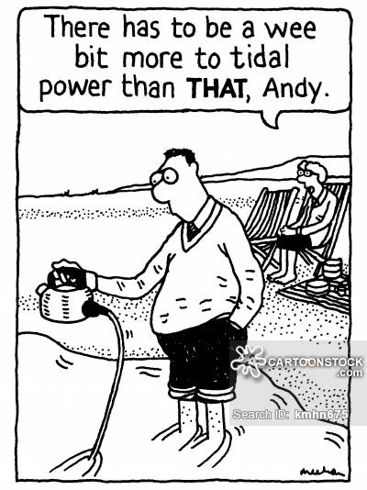
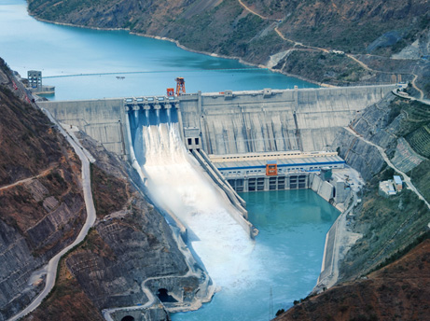
What is Hydro Power?

Slide 17
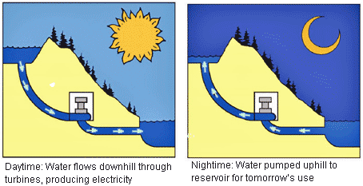
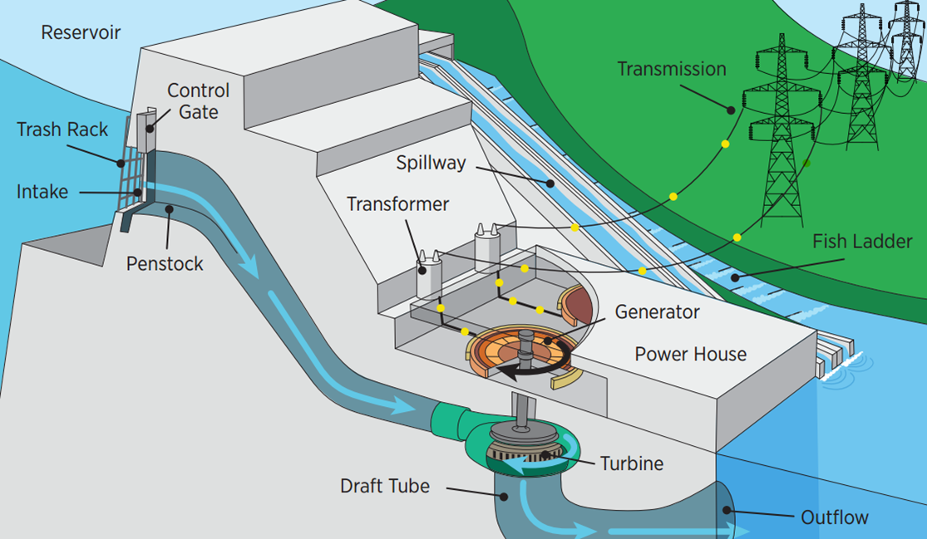
How does it work?
https://www.youtube.com/watch?v=q8HmRLCgDAI

Slide 18
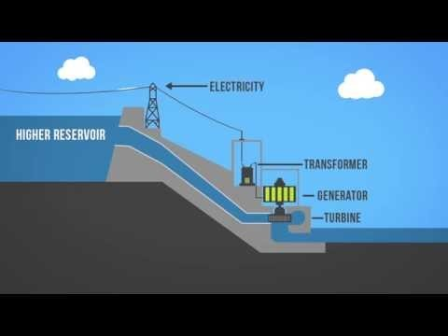

Slide 19
Water Turbine Exercise
Please use your formula sheet and your instruction sheet to complete this module
10 Minutes

Slide 20
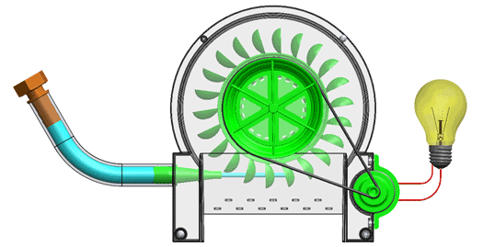
Exercise
Use the Voltmeter to find the power generated by the system (Voltage x Current)
What’s the Kinetic Energy into the system?

Slide 21

Let’s talk about…..Efficiency
We calculated the Kinetic Energy for the Wind and Water Turbines
What did you notice?
  Was KE always smaller than the total power out of the systems?
  Why?
Energy Losses
Nothing can be 100% efficient
So we will use a fraction to characterize how well something works. The closer to 1 the better it works
Efficiency $=\frac{Output of the Device}{Input to the Device}$

Slide 22
Example Problem
A wind turbine produces 100W of power and the Kinetic Energy from the wind into the wind turbine is 300W.
Find the Efficiency of the Wind Turbine
Efficiency $=\frac{Output of the Device}{Input to the Device}=\frac{100W}{300W}=0.333$

Slide 23
Let’s talk about some of the more common (and visible forms) of energy
Kinetic Energy
  Where have you seen this?
    Wind Turbines
    Nozzles and Diffusers
Potential Energy
  Where have you seen this?
    Pumps
    Hydroelectric Plants

Slide 24
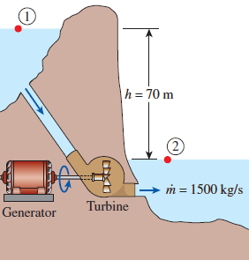

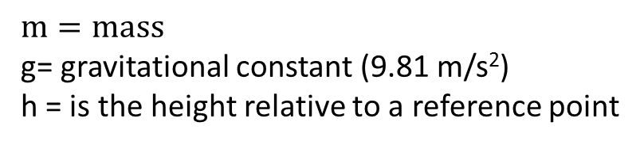
Potential Energy
This is the energy that a system has because of elevation, let’s look at the example below:
  The water on one side of the hill is higher than on the other. That means the water on the left has Potential Energy that could be used.
  Someone put a Turbine in between the two sides to capture some of that energy
$$PE=m∗g∗h$$
$$m=mass$$
g= gravitational constant (9.81 m/s²)
h = is the height relative to a reference point

Slide 25
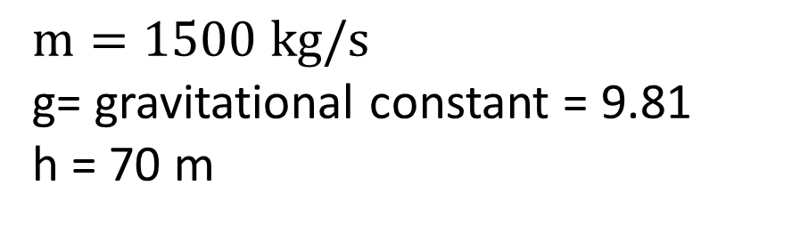
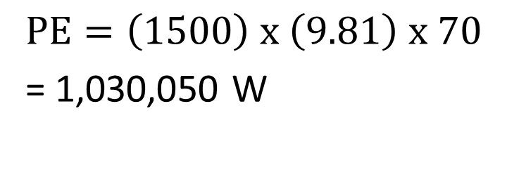
Example Problem
How much Potential Energy does the water have if:
$$m=1500 kg/s$$
g= gravitational constant = 9.81
h = 70 m
$$PE=\left(1500\right) x \left(9.81\right) x 70$$
= 1,030,050 W

Slide 26



Example Problem
What is the efficiency of the Turbine if it produces 750,000 W of electricity?
Efficiency $=\frac{Output of the Device}{Input to the Device}$
Efficiency $=\frac{750,000}{1,030,050}$
Efficiency $=0.73$

Slide 27
Hydro Wheel Exercise
Please use your formula sheet and your instruction sheet to complete this module
20 Minutes

Slide 28
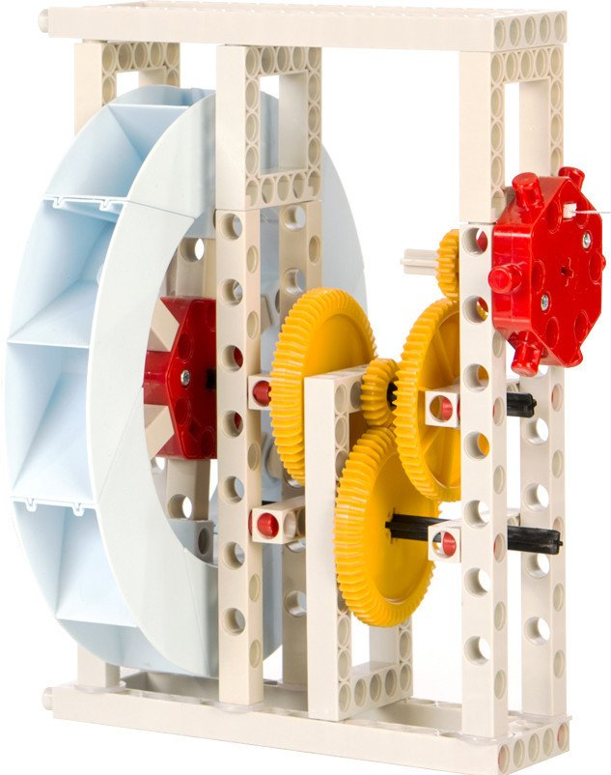
Hydrowheel
Calculate the potential energy
Measure to power output from the wheel
Find the efficiency

Slide 29
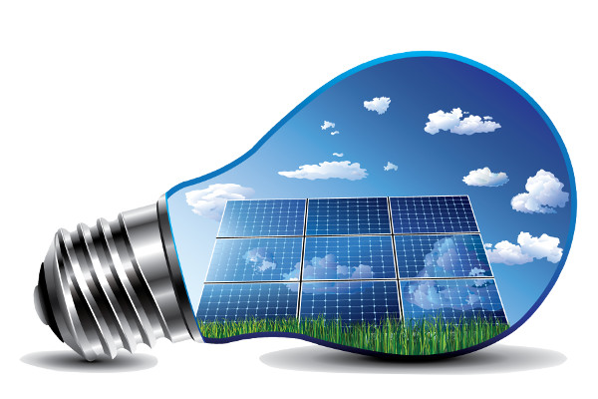

Conservation of Energy

Slide 30
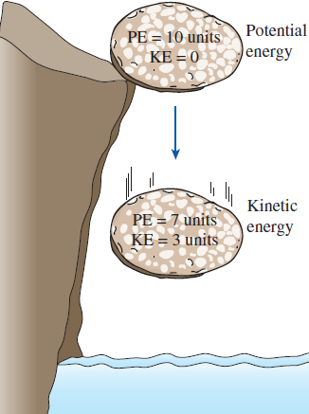

Energy is always conserved
Energy can only change from one form to another
  In the examples below PE is changed to KE
  In some other examples PE and KE are converted to electricity and losses
$E_{in}=E_{out}+Losses$

Slide 31
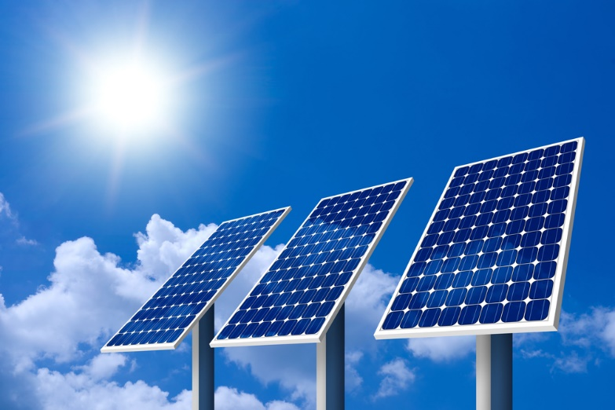
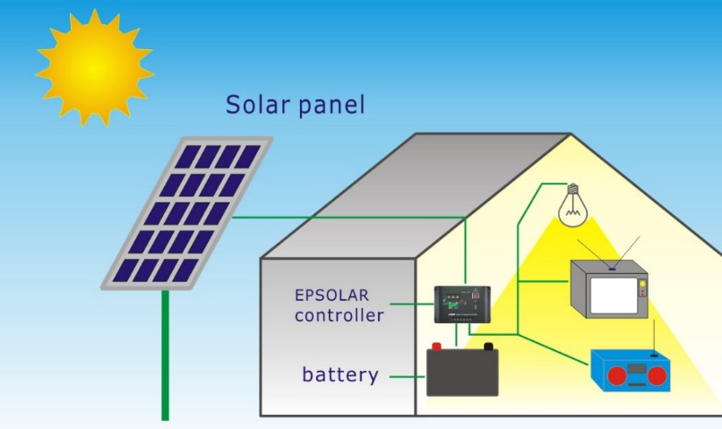
Conservation of Energy with Solar Power
This can also be seen with Solar Powered systems
  You get energy from the sun and convert it to electricity
In El Paso the sun produces 1350 W/m² of power
If you have a solar collector that is 1 x 1 m² then the power the collector receives is 1350 W

Slide 32
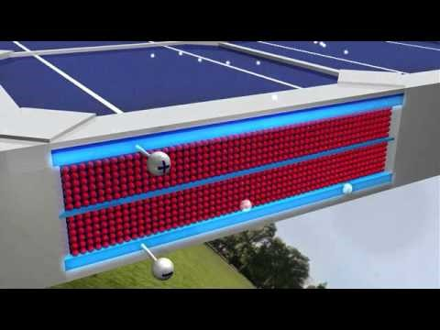

Slide 33
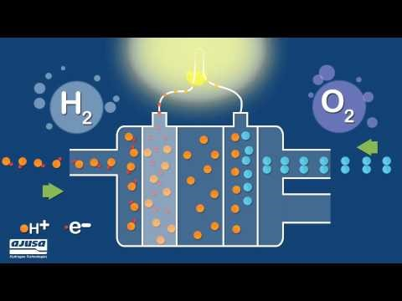

Slide 34
Fuel Cell Car Exercise and
Solar Boat Exercise
Please use your formula sheet and your instruction sheet to complete this module
20 Minutes each

Slide 35
Fuel Cell Car Exercise Activity
Find the amount of energy captured by the solar panel
If the solar panel has an efficiency of 0.30 what is the power delivered to the fuel cell?
Draw a diagram of how the car converts solar energy to movement

