Slide 1
Analysis of Standard Work and Reconfiguration in OPEN Manufacturing Area at Ethicon Independencia Site
Almeraz, Carmen
Holguin, Joshua
Lopez-Terrazas, Rocio J
IE 4466 - Senior Design
May 5th, 2020

Slide 2
Project Objectives
Create a standard work for the current OPEN Area at the Ethicon Independencia Site.
Find and define the current state of the capacity in the area
Cycle times and production capacity.
Update actual layout of the OPEN area using AutoCAD
Propose a reconfiguration of the layout and standard work for improvements.
Improve product flow, increase capacity and/or optimize space.
Line balance according to takt time and capacity to increase productivity.
Identify resources (headcount and machines) needed to meet demand.

Slide 3
Open Manufacturing Area
5 main processes:
Printing Decoration
11 areas
Laser Decoration
4 areas
Sandblasting
1 area
Krytox Lubrication
6 sub-processes
Sodium Lubrication
4 types of process of sodium lubrication
Low runners:
Paralyne
New processes
implementation time : TBA

Slide 4
Reconfiguration of Layout

Slide 5
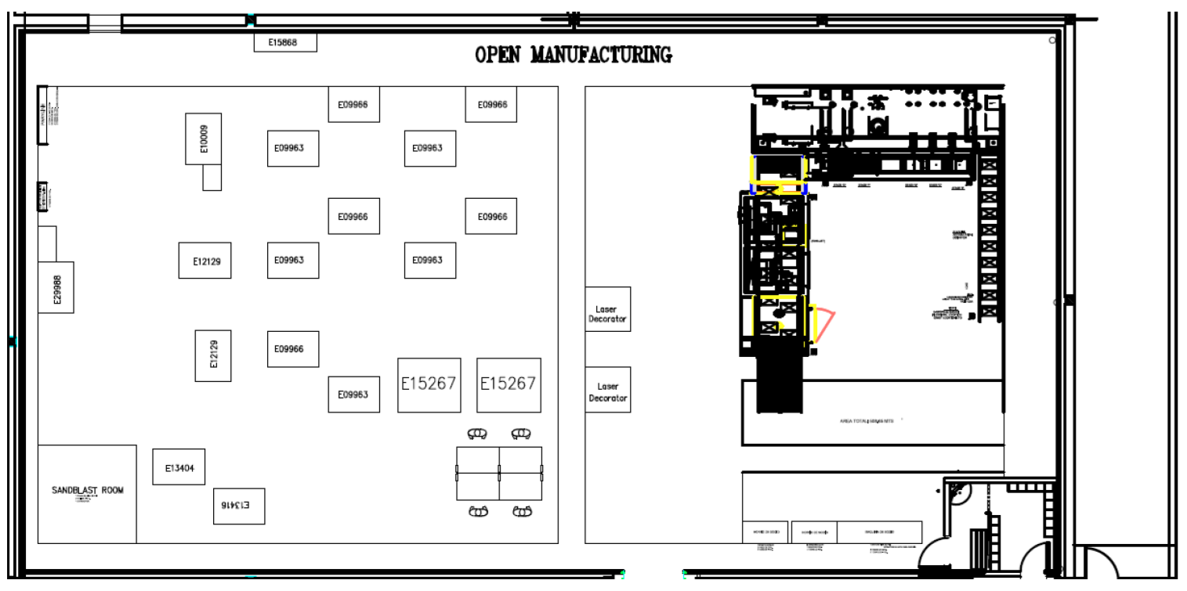
Outdated Layout
Outdated since 2018
New machines added
New processes added
Not complete
Not dimensioned

Slide 6
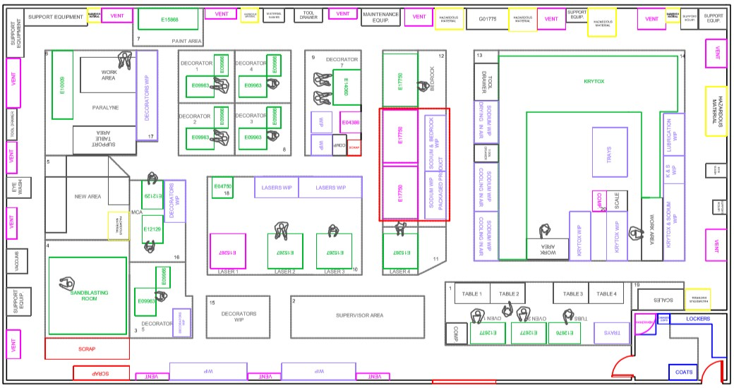
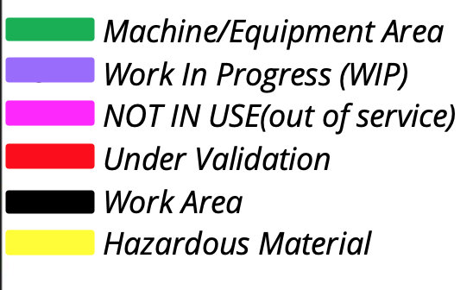
Actual Layout

Slide 7
Flows
Euclidean
Weighted Score : E-Score : E% Score: R-Score: R% Score :
3891.48 300 82.35 300 82.35

Slide 8
Flows
Rectilinear
Weighted Score : E-Score : E% Score: R-Score: R% Score :
4038.49 300 82.35 300 82.355

Slide 9
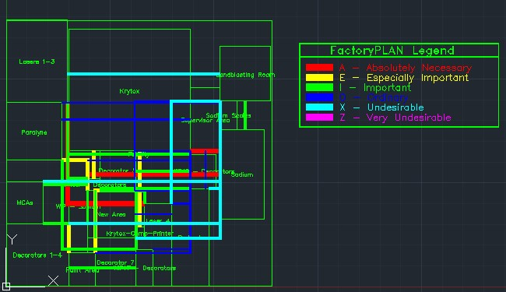
Optimized – AutoCAD Suggestion
Results:
Weighted Score : 3891.48
E-Score : 300
E% Score: 82.35
R-Score: 300
R% Score : 82.35

Slide 10
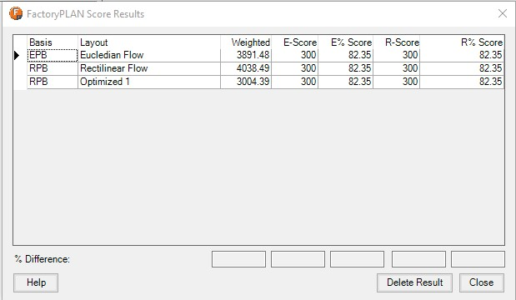
Results
Best reconfiguration option would be to the optimized layout suggestion.

Slide 11
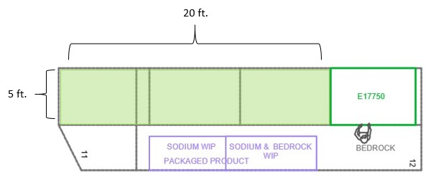
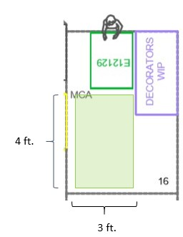
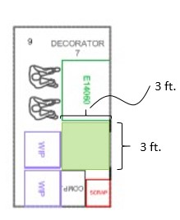
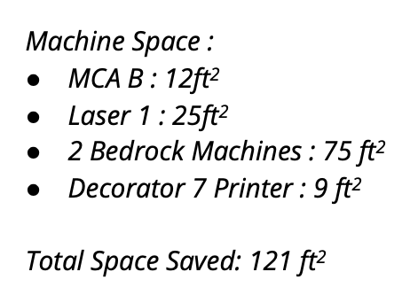
Saved Space

Slide 12
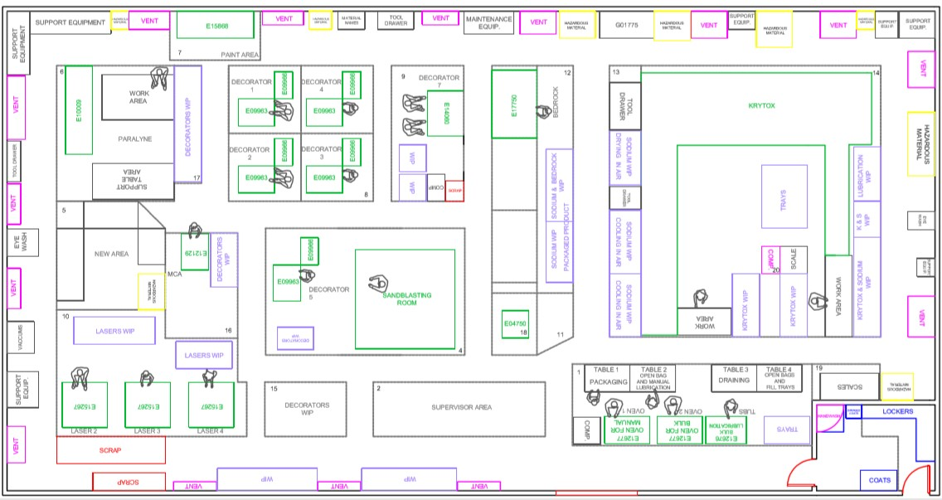
Reconfiguration 1

Slide 13
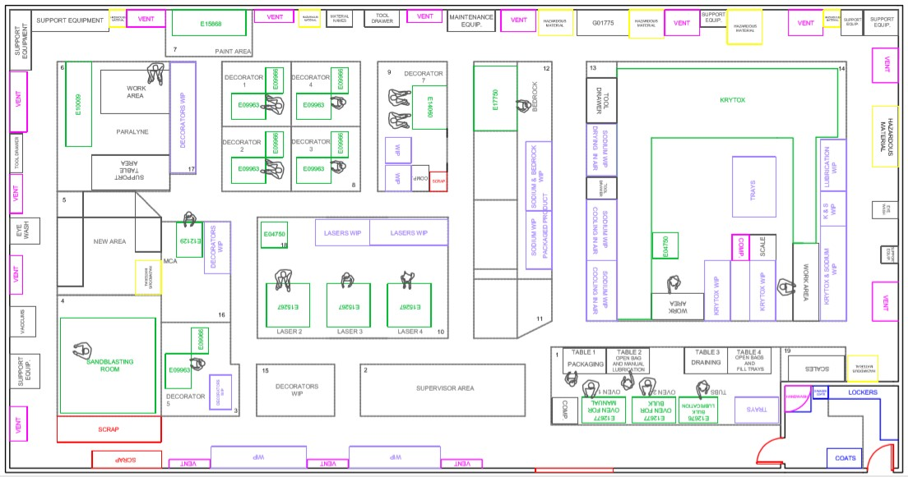
Reconfiguration 2

Slide 14
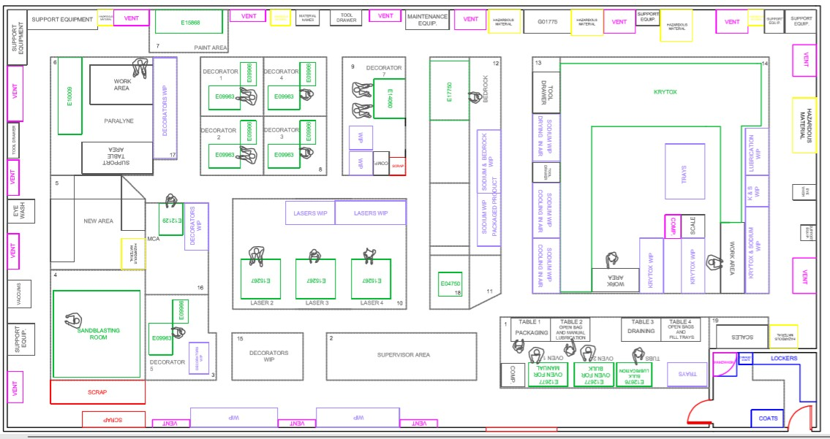
Reconfiguration 3

Slide 15
Overall Results

Slide 16
Decoration Process

Slide 17
Decoration Process
Printing Decoration (11)
8 pad printers
3 bedrock machines
2 are in validation, not currently in use
Laser Decoration
4 lasers
1 is out of service
Receive components
Decoration of components
Drying
Packaging
*with exceptions in some codes that require a re-inspection

Slide 18
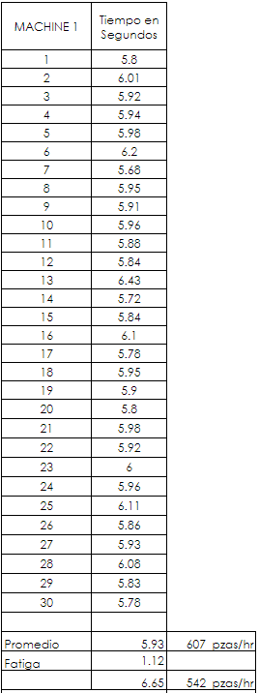
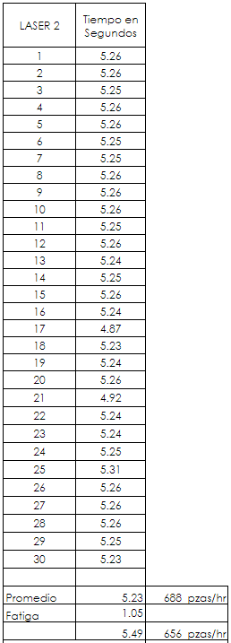
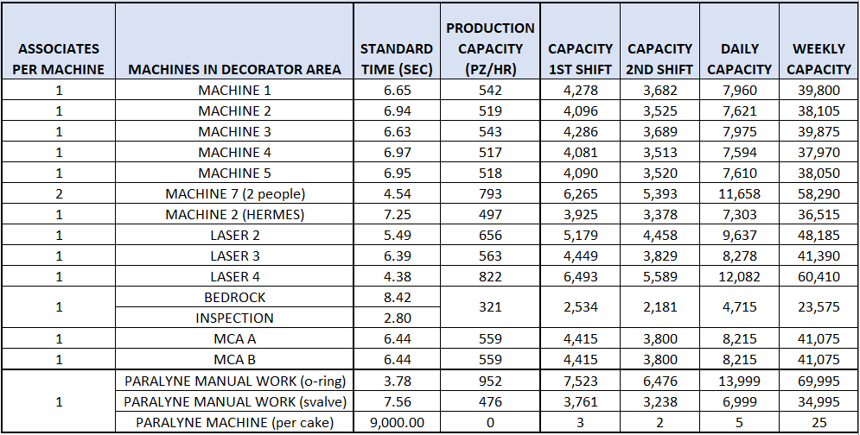
Time Study
*this is not the current production they have

Slide 19
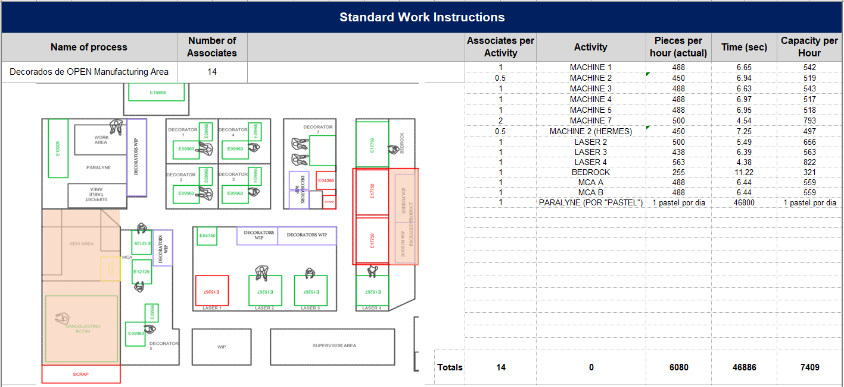
Actual Standard Work for Decoration Process

Slide 20
Production Capacity Analysis
By doing the time study, increment in capacity of 19.77%.
1,255 pieces per hour; 18,448 pieces per day
*Daily demand is calculated in how the area is currently working: All machines need to produced the same.
*Based in takt time we do not need an increment in capacity.

Slide 21
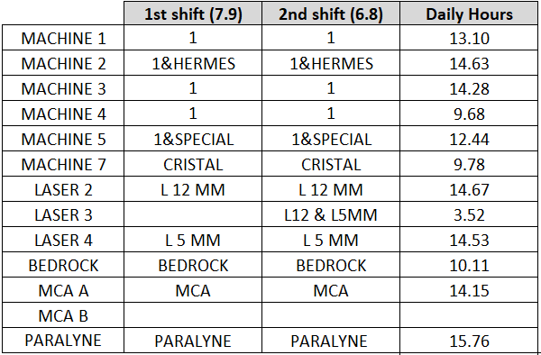
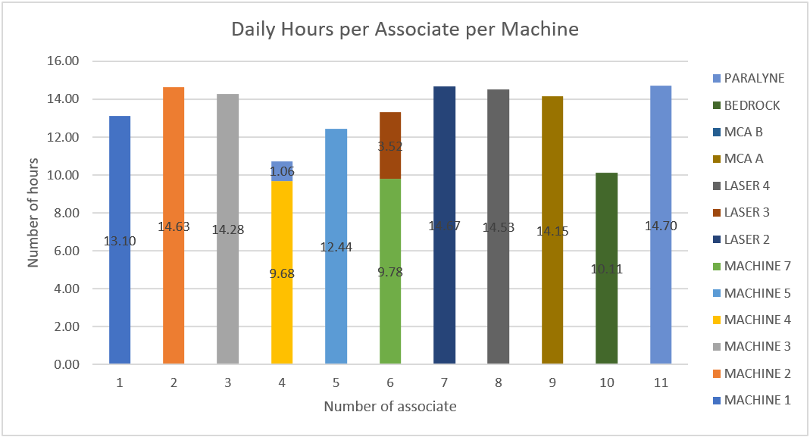
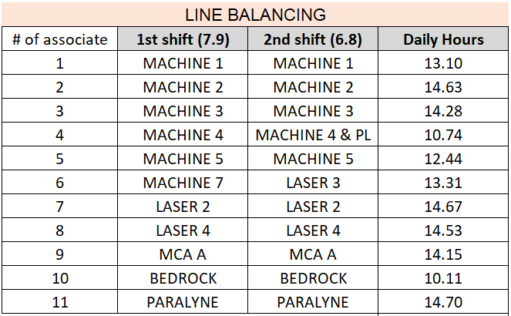
Line Balancing with OEE of 80%

Slide 22
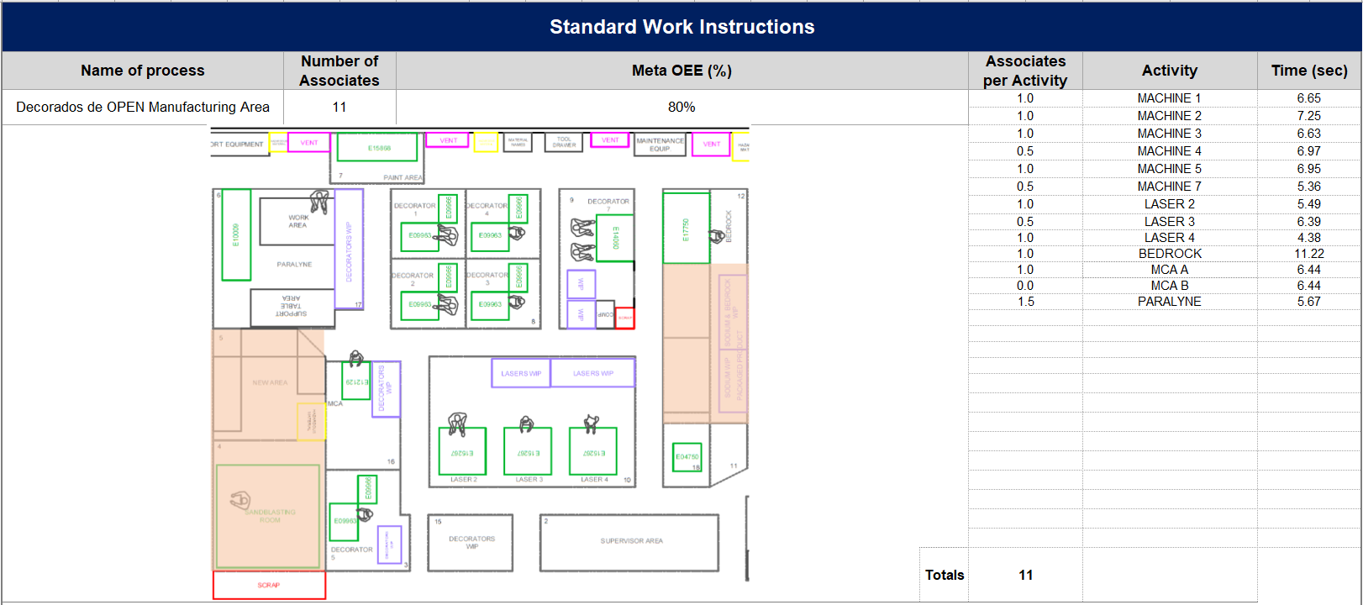
Proposed Standard Work for Decoration Process

Slide 23
Analysis of Decoration Process Area
Daily Demand is 66,713 pieces.
Daily Capacity of 94,234 with OEE of 100%. Extra capacity = 27,521 pieces.
Daily Capacity of 75,387 with OEE of 80%. Extra capacity = 8,674 pieces.

Slide 24
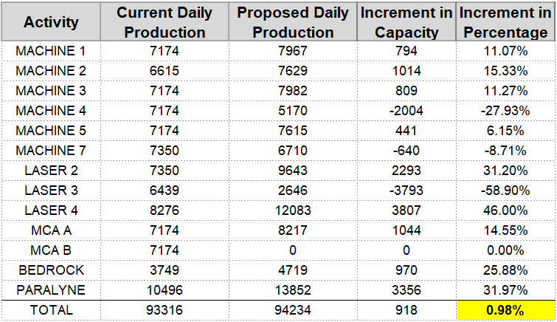
Improvements of Decoration Process Area
Headcount:
1 associate to sodium lubrication.
2 associates available to be reallocated to other area where they are needed the most.
Space:
MCA B (12ft²).
Laser 1 (25ft²).
Capacity:
Increment of 918 pieces per day (0.98%).
Reduction of machine usage
In case there is an increment in demand, there is a possibility
of having one associate per machine per shift and produce
105,447 pieces per day (13.00% increment in capacity).

Slide 25
Sodium Lubrication

Slide 26
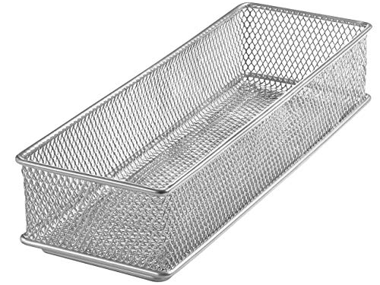
Sodium Lubrication
4 main processes:
Bulk and oven
Manual and oven
Bulk and air
Manual and air
Bulk Lubrication
Oven
Lubri- cation
Drying
Packaging and labeling
Preparation of Lubrication
Manual Lubrication
Air

Slide 27
Sodium Lubrication: Product Family Matrix

Slide 28
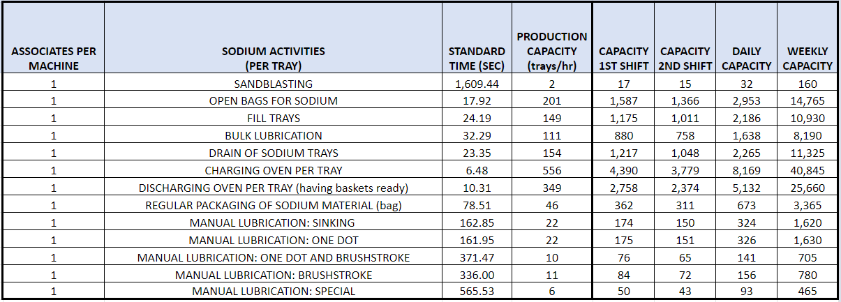
Time Study
All the times are per tray.
Bottleneck will be used to find production capacity.
Current production is not equal to the production capacity

Slide 29
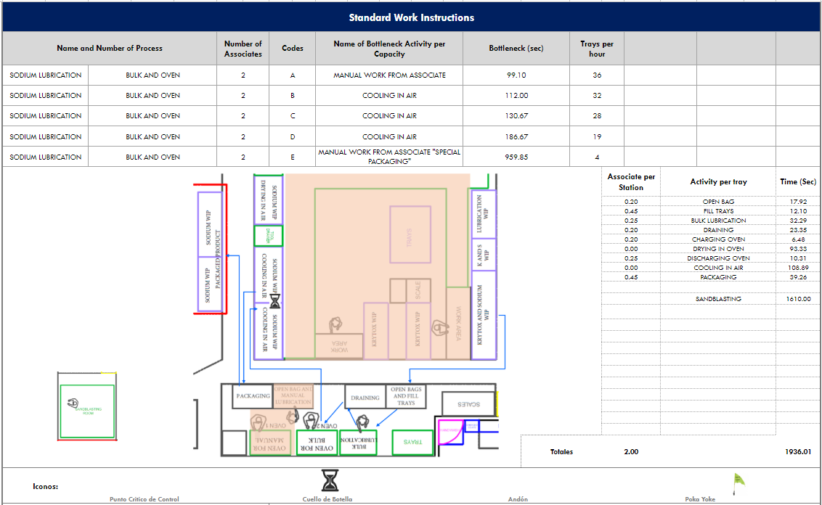
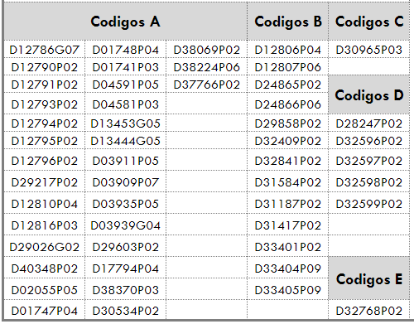
Actual Standard Work for Sodium Lubrication

Slide 30
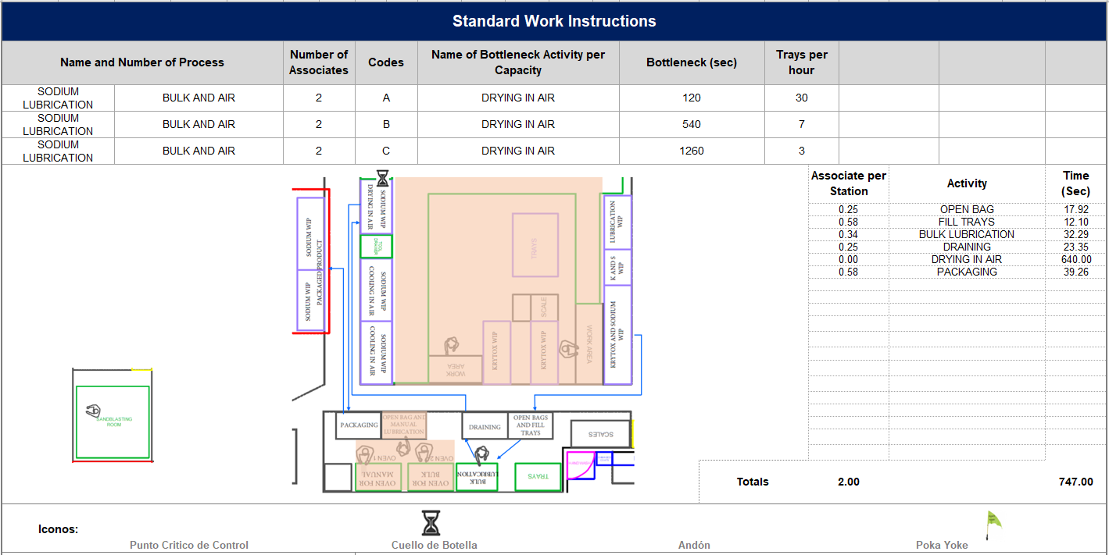
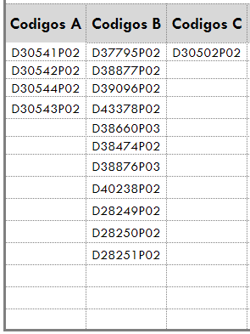
Actual Standard Work for Sodium Lubrication

Slide 31
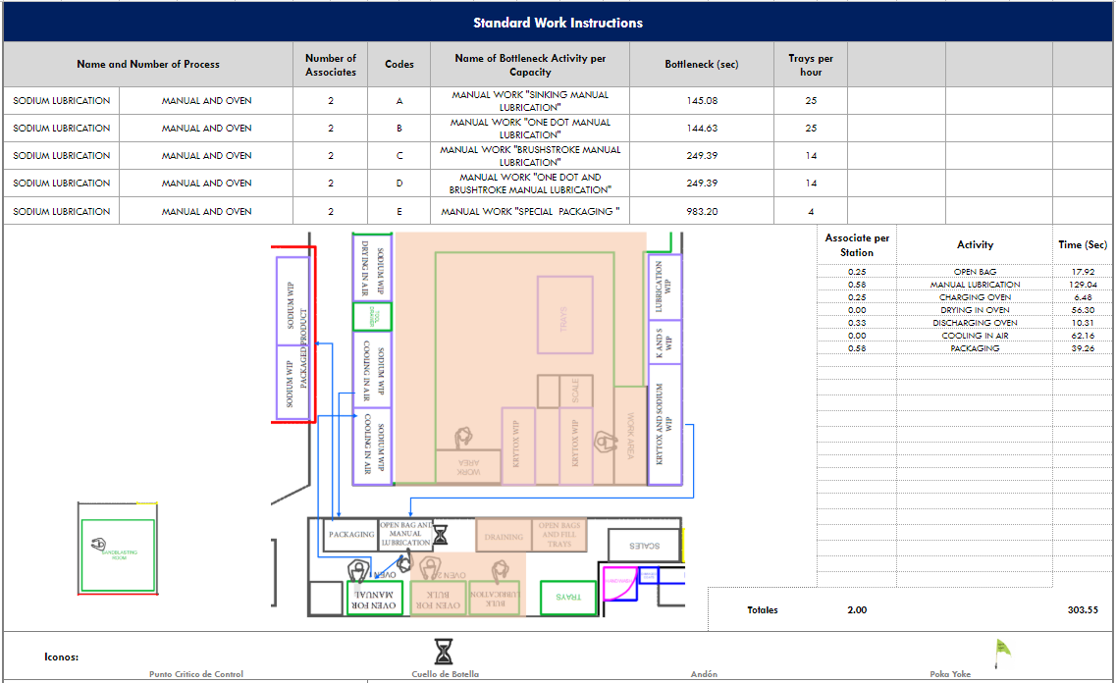
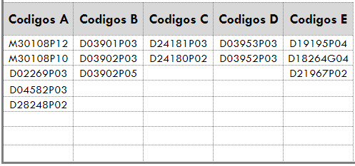
Actual Standard Work for Sodium Lubrication

Slide 32
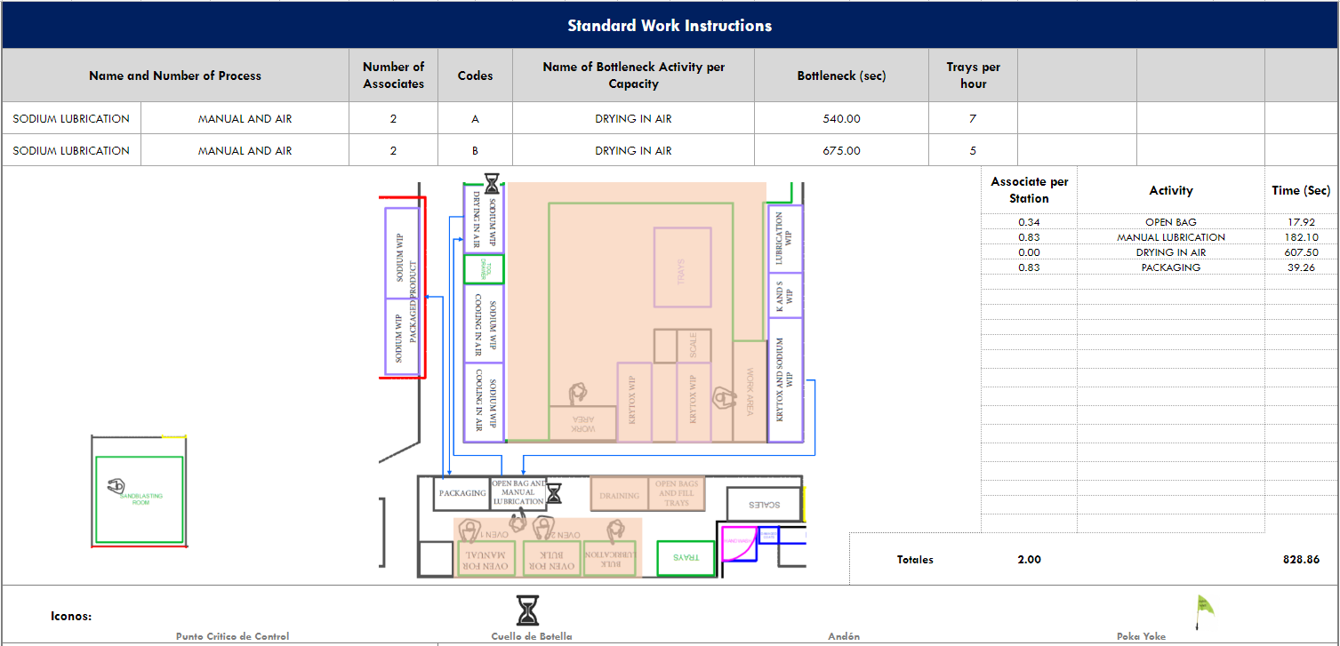
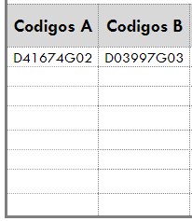
Actual Standard Work for Sodium Lubrication

Slide 33
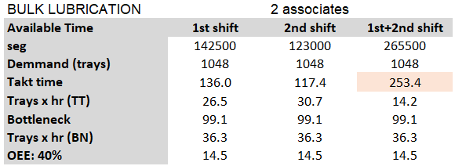
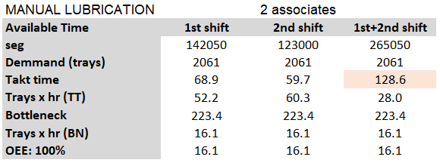
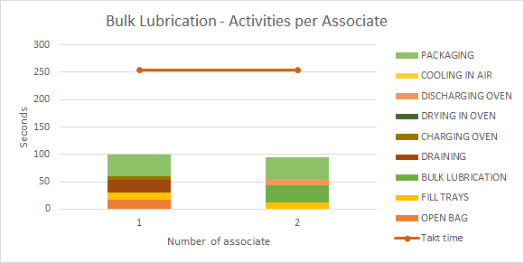
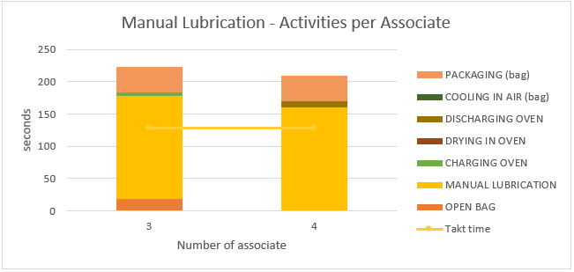
Calculating Takt Time
Current Scenario: 2 associates in bulk and 2 associates in manual lubrication. The solution for ERCA Line is done in the hot tube for manual.

Slide 34
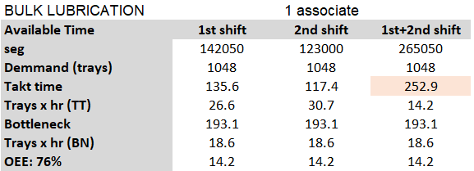
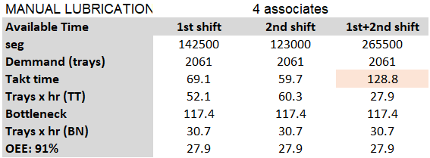
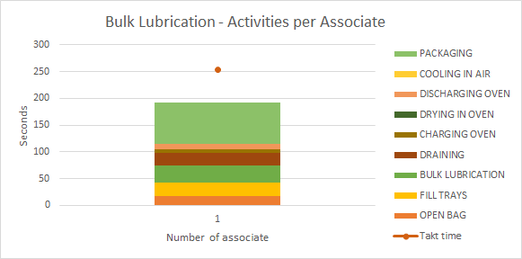
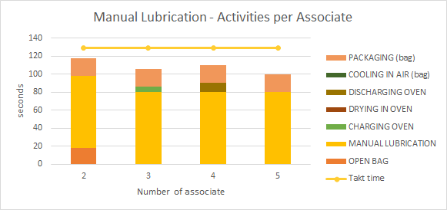
Line Balancing
Optimal Scenario: 1 associate in bulk and 4 associates in manual lubrication. The solution for ERCA Line is done in the hot tube for bulk.

Slide 35
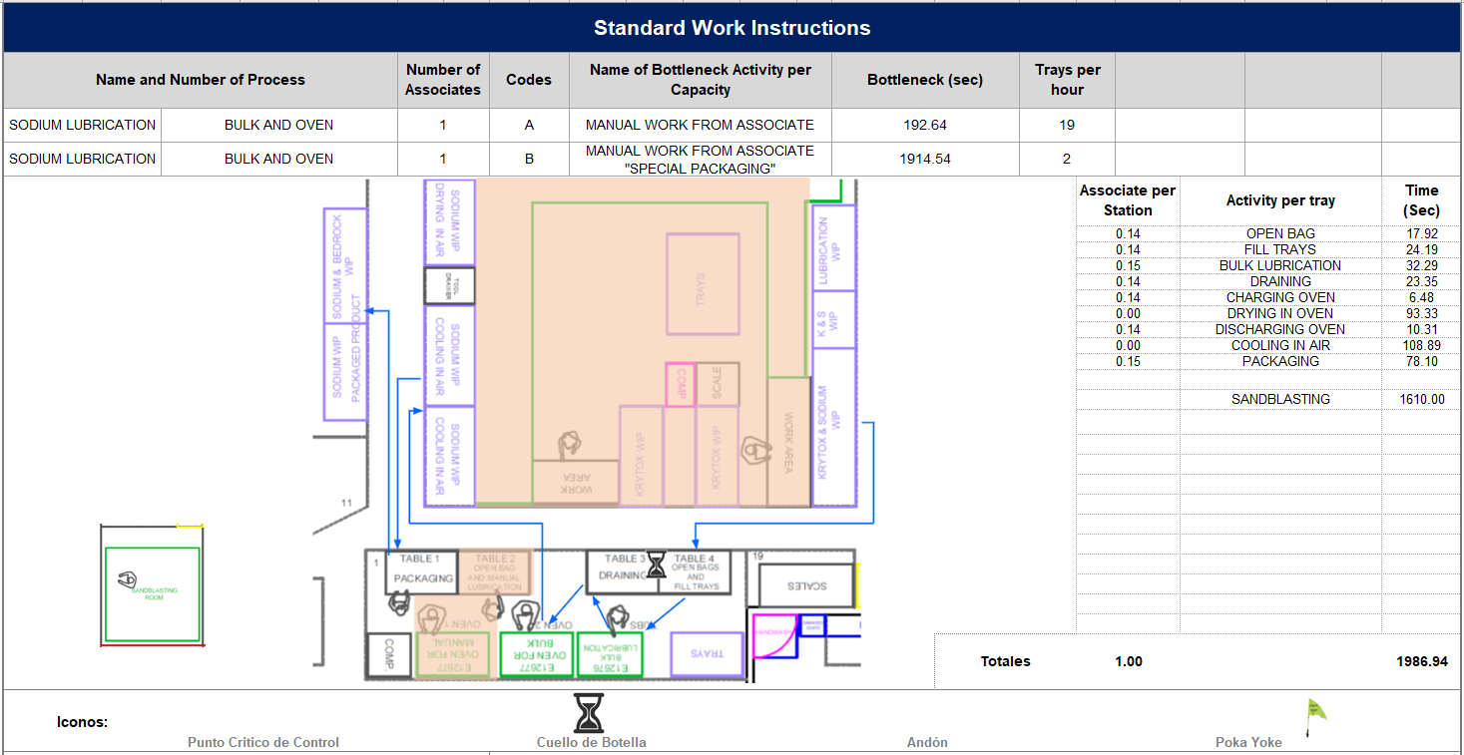
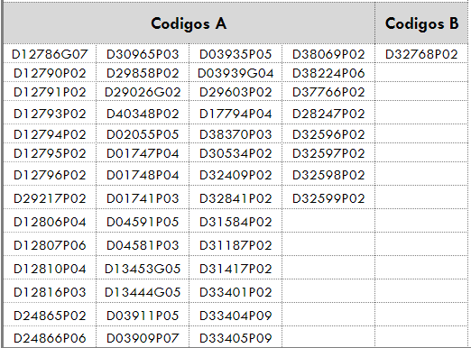
Proposed Standard Work for Sodium Lubrication

Slide 36
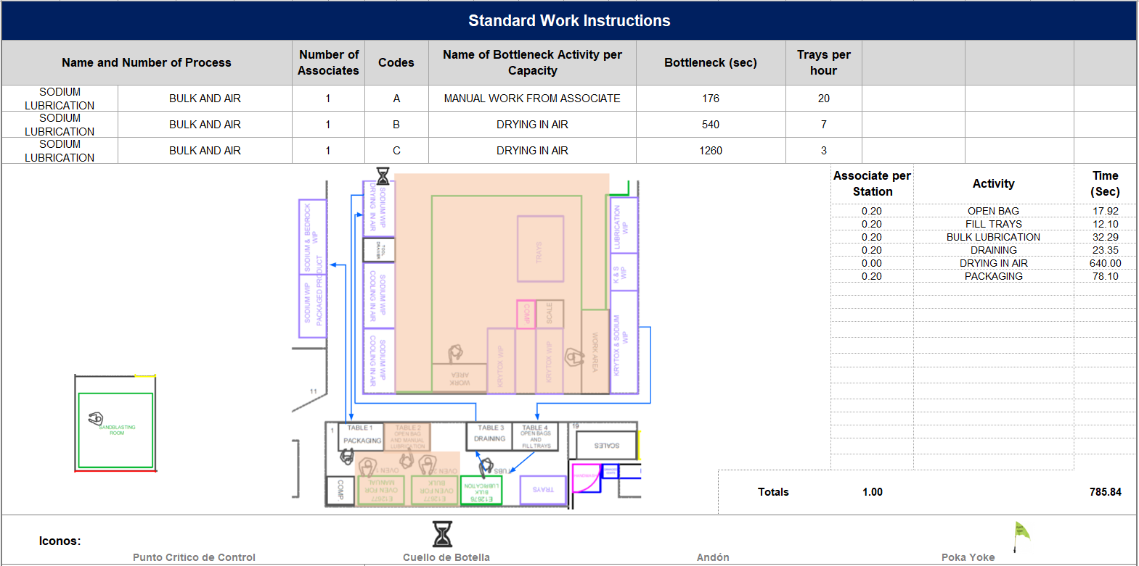
Proposed Standard Work for Sodium Lubrication

Slide 37
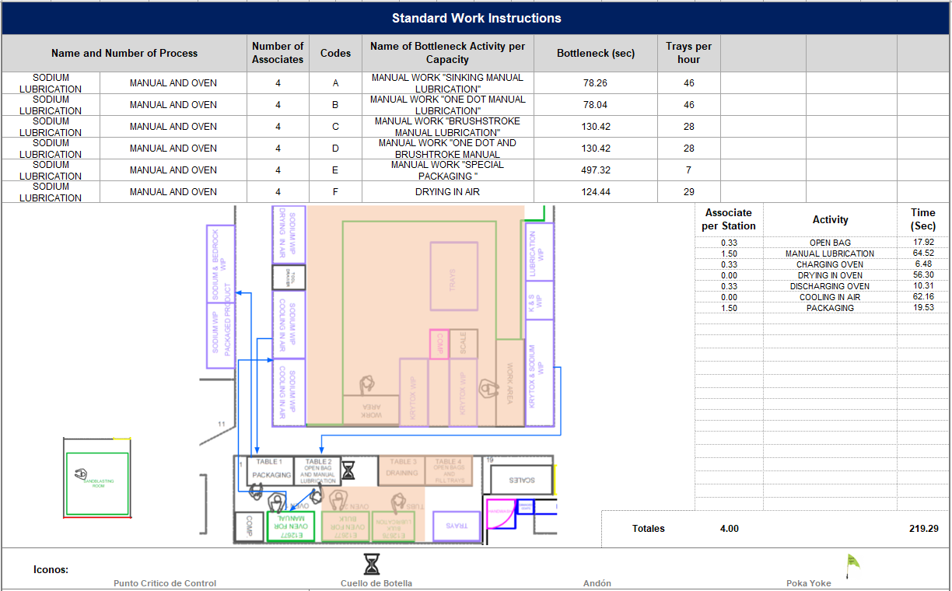
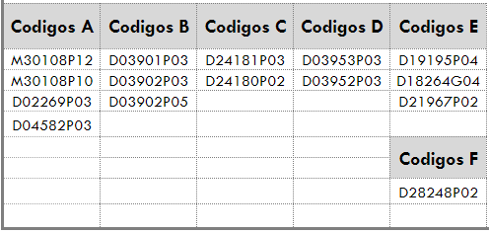
Proposed Standard Work for Sodium Lubrication

Slide 38
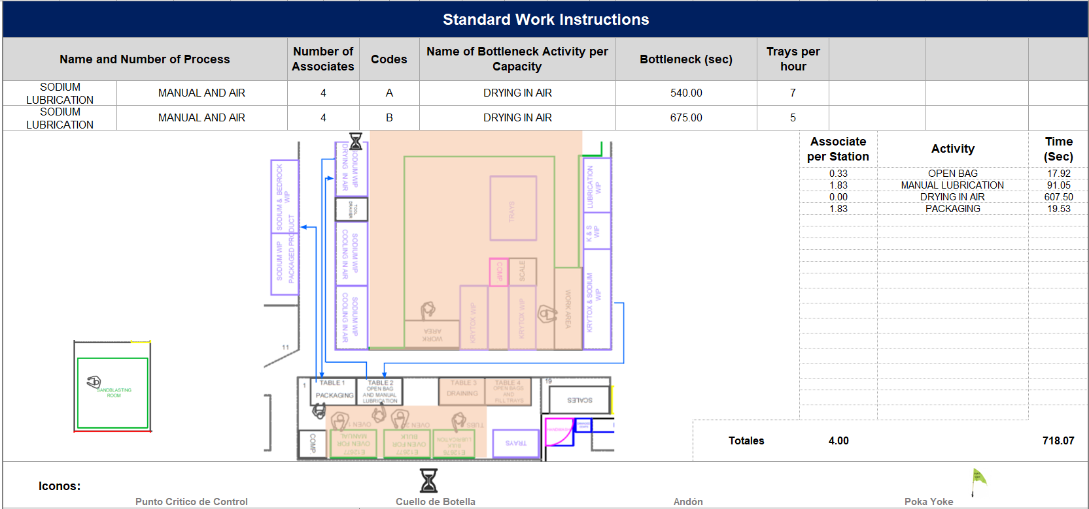
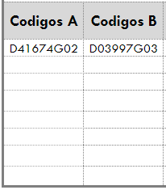
Proposed Standard Work for Sodium Lubrication

Slide 39
Improvements of Sodium Lubrication Area
Bulk Lubrication:
Reduction of overproduction (49%).
There is still and extra capacity during the day of 65 trays.
Manual Lubrication:
Increase production capacity (90%).
Increment of 214 trays per day
There is an extra capacity during the day of 38 trays.

Slide 40
Krytox Lubrication

Slide 41
Krytox Lubrication
6 sub-processes
4 are automated sub-processes
38 Running Products
2 Low Runner Products Codes
Work 1st shift only
Automated
Load of component
Washing
Lubrication
Drying
Oven
Packaging and labeling

Slide 42
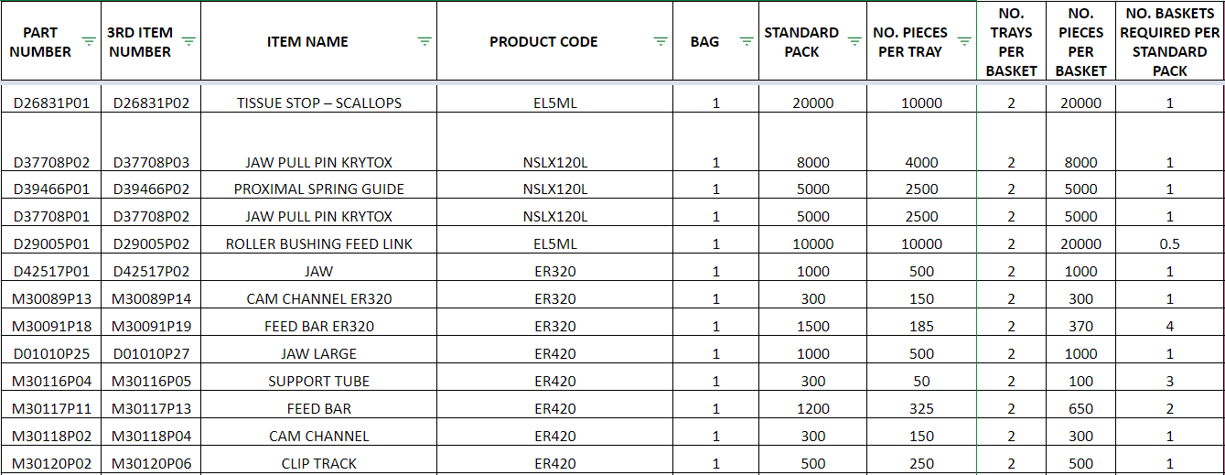
Krytox Lubrication: Product Family Matrix

Slide 43
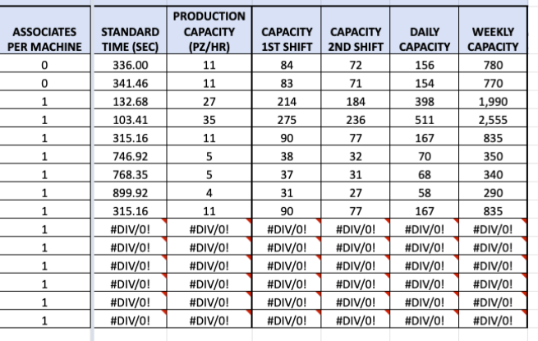
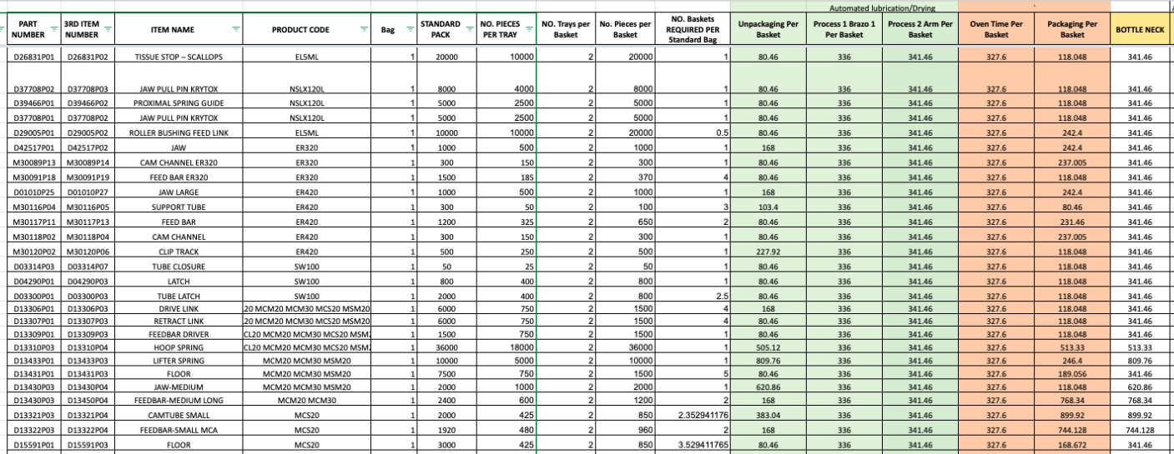
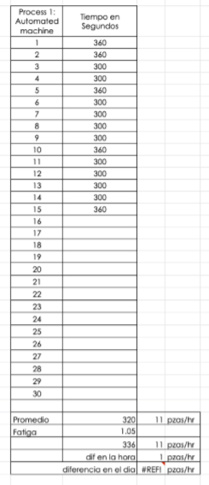
Time Study

Slide 44
Actual Standard Work for Krytox Lubrication

Slide 45
Calculating Takt time-Current Scenario
Current Scenario: 1 associate in Loading and 1 associate in Packaging/Labeling.

Slide 46
Line Balancing-Proposed Scenario
Optimal Scenario: 1 associate in loading/Labeling and 2 associates in Packaging.

Slide 47
Proposed Standard Work for Krytox Lubrication

Slide 48
Improvements
Produce under a 80-85% of Overall Equipment Effectiveness
Move the printer to increase capacity in Krytox area
Implement associates to work 7.9 hours
Allocate a new associate for 1.5 hours in packaging area

Slide 49
Improvements
Increment in capacity: 32 baskets; 62.75%
3,524 pieces per basket; 112,768 pieces of capacity increment
Counting there are small pieces that can fit up to 20,000 per basket

Slide 50
Implementation of Proposed Solutions

Slide 51
Implementing Proposed Solutions
Benefits:
Savings:
Headcount: 2 associates
Space: 121 ft²
Gain:
Capacity: +130,592 pieces per day; 44.76%.
Decoration Process: +918 pieces per day
Sodium Lubrication: +16,906 pieces per day
Krytox Lubrication: +112,768 pieces per day

Slide 52
Q&A
Thank You!

Slide 53
Technical References and Bibliography
Ana Claudia Dias, A. C. (2018). LEAN MANUFACTURING IN HEALTHCARE. A SYSTEMATIC REVIEW OF LITERATURE.
Ethicon: J&J Medical Devices. (2019, December 3). Retrieved from https://www.jnjmedicaldevices.com/en-US/companies/ethicon
Groover, Mikell P. (2005). Work Systems: The Methods, Measurement & Management of Work. Prentice Hall.
Johnson & Johnson SWOT Analysis. (2019). Johnson & Johnson SWOT Analysis, 1–7.
Kusiak, A. (2000). Computational Intelligence in Design and Manufacturing. John Wiley & Sons.
Lean Six Sigma Definition (2019). Takt Time. Retrieved from: http://www.leansixsigmadefinition.com/glossary/takt-time/
May George A. Kassir, M. M.-K. (2019). Computing Cutting Time in Turning Operation. Based on AutoCAD Drawings.
Nahmias, S. (2015). Production and operations analysis (7th ed.). McGraw-Hill/Irwin.
Niño, M. (2020, January). Lists of headcount and information of processes of OPEN Manufacturing Arez. (R. L. Carmen Almeraz, Rocio Lopez, Joshua Holguin)
Our Credo. (2018, December 14). Retrieved from https://www.jnj.com/credo/
Perez, I. (2020, January). Johnson & Johnson products annual demand. (R. L. Carmen Almeraz, Rocio Lopez, Joshua Holguin)
Tompkins, J. A. (2010). Facilities Planning (4th ed.) New York, NY: John Wiley & Sons.
Vorne Industries Inc. (2019). OEE Factors. Retrieved from https://www.oee.com/oee-factors.html
Vorne Industries Inc. (2019). What is Overall Equipment Efficiency?. Retrieved from https://www.oee.com/

