Slide 1
AI in the Classroom Setting Spring 2021 Ariadne Reveles Abdullah Alajmi Maribel Alva Miguelangel Castaño
IE 4466 Senior Design

Slide 2
Use Case Diagram

Slide 3
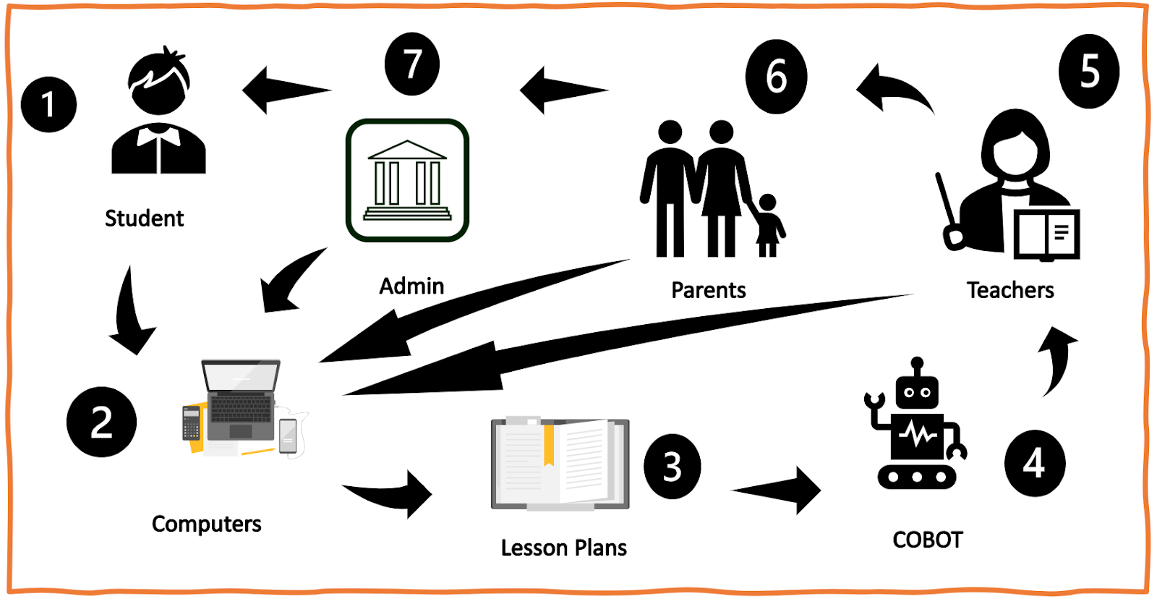
Concept of Operations
Students scan ID and log in
Computers record student's progress
Lesson plans are geared toward the needs of the classroom
Cobot's Role
Teacher's Role
Parents receive feedback
Administrator oversight

Slide 4
System Decomposition and Requirements
Notes:
1. Why is it important to be specific with requirements and not use vague terms and non-specific statements? It is important for requiremnts to be specific because they are less likely to be misunderstood. In addition, if requirements are clear and concise you are able to verify and validate that the stakeholders needs are being met. It conveys clear idea about your system and its elements. 2. How did the use cases and scenario description steps you used in your use cases help you develop good requirements? I think initially i had trouble creating my requirements. I was working backwards thinking of requirements and matching them to my subsystem or part. However, after reviewing the team that was creating COVID mask I believe I understood how to create a requirement correctly. I kepy in mind the idea "I want my subsytem to do this, so what does is need to do complete that action". For example, my cobot is going to address students questions and concerns. Therefore, my cobot needs to have a speaker and microphone in order to listen and orally respond to the students. 3. Explain the difference between verification and validation. The difference between verification and validation is verification focuses on the product meeting the requirements that were created whereas validation is concerned with if the product meets its intention or what it was created for. For instance, let us say someone is creating a candle. The requirements of the candle are that it be a floral smell with a floral design to match the smell. The verification for this candle is it must smell like a flower and that the label or the candle shows what flower it smells like. The validation for the candle would that the candle does what candles do such as the wick is able to burn and the aroma of the candle is able to be smelt. That is at least how I understand the difference between verification and validation.

Slide 5
Requirements Validation and Verification Plan
Requirement ID | Requirement | Requirement Validation | Verification Method |  |  |  | Verification Plan
 |  |  | I | A | T | D
1.1.1 | Student shall scan ID upon entering class | Students will be provided with ID badges that they will scan when entering class. | X |  |  |  | Attendance will be checked after ID is scanned using barcode scanner..
1.2.1 | Teacher shall scan ID upon entering building | Teacher will scan ID badges at front office. | X |  |  |  | Adminstrator will check-in teachers by scanning badge.
1.3.1 | Teachers shall schedule a meeting with a struggling students' parent(s) | When it is identified a student needs additional help parents will be emailed using a format where they can schedule a meeting that works with their schedule. | X |  |  |  | All meeting that should be scheduled with parents will be tracked to ensure meetings are taking place.
1.4.1 | Administrators must have access to student data such as individual progress scores developed by AI and teacher's lesson plans. | Administrators will have log-in credentials through computer system with the abaility to oversee all teacher and student content. | X |  |  |  | Administrator access can be checked to ensure full access to classes.
3.1.1 | Teacher shall have tasks for the class the day uploaded before the commencement of the class | Feedback of students and instructor's performance evaluation by system |  |  | X |  | Instructor's attendance and online tasks uploading for the attendees of course
3.1.2 | Instructor shall have to show his/her availability for the scheduled online classes with the students. | Comparison of Online meetings with the schedule of the those set for the whole course before the start of course |  | X |  |  | Students' feedback against or in favor of the instructor's availability for online classes
4.1.1 | Cobots shall have a speaker to orally respond to students and teachers | Cobot will have a speaker placed at the center of its system that voices its response so that students and teachers can hear it clearly. |  |  |  | X | Will demonstrate that when a student ask a question the cobot will answer accordingly through its speaker and the student will confirm they have understood the cobots response.
4.1.2 | Cobot shall have a microphone to listen and undertsand students questions or concerns | Cobot will have a micrphone placed at the center of its system next to the speaker that allows it to hear and unstand students clearly |  |  |  | X | Will demonstrate that when a student ask a question the cobot will answer accordingly through its speaker and the student will confirm their question has been answered satisfactorially
5.1.1 | Lesson plans shall be generated based on classroom progress measured by the average grade in each lesson. | Classroom progress will be constantly monitored by the computer system through grades on student assignments, test, and homework |  |  |  | X | Random generation of grades on random assignments, test, and homework will be uploaded into the computer system and a mock lesson plan will be generated.
5.1.2 | Lesson plans shall be implemented into the computers. | Lesson plans will be automatically be uploaded into the computers via a connected network system every day at 12am | X |  |  |  | A pre-made lesson plan will be uploaded into the network system and an IT member will verify the correct lesson plan has been uploaded.

Slide 6
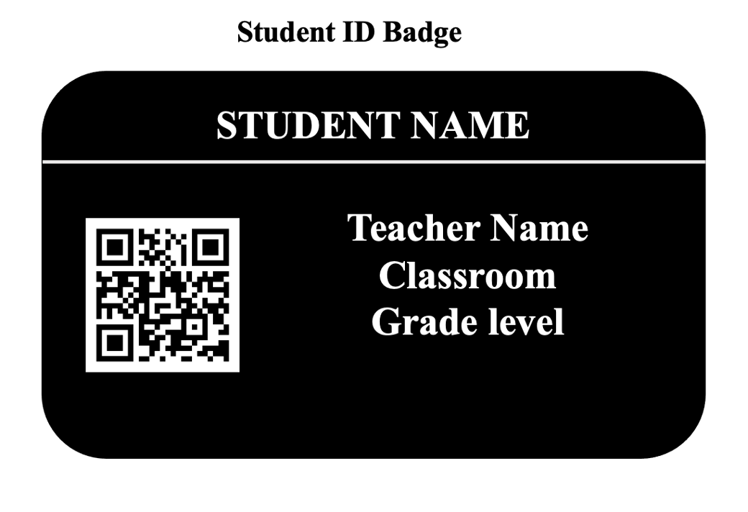
Subsystem and Part Design

Slide 7
Subsystem and Part Design
To: Parent Email
From: Teacher Email
Subject: Student Name Course Discussion
Good Morning Mr./Mrs Parent Name,
I wanted to inform you that Student Name has fallen behind his pears significantly in Course Subject. Specifically, he/she is struggling in Course Material. The metric by which we determine a student is falling behind is by comparing assignments grades relating to the subject. This includes but is not limited to test scores, quizzes, and our homework assignments. As you know our homework assignments are adaptative and reflect what course content material needs attention. We have been adapting Student Name's homework assignments but have seen no improvement. As a result. we would like for you to get involved in helping him/her. Below are a list of my prep days/hours please select which one works best for you so we can discuss this further. You will also be given the option to select an in-person or virtual meeting.
Best Regards,
Teacher Name
Teacher Prep Day 1
(Check Box) 30 Minute Duration Time Slot
(Check Box) 30 Minute Duration Time Slot
(Check Box) 30 Minute Duration Time Slot
(Check Box) Virtual Meeting (Check Box) In-Person Meeting

Slide 8
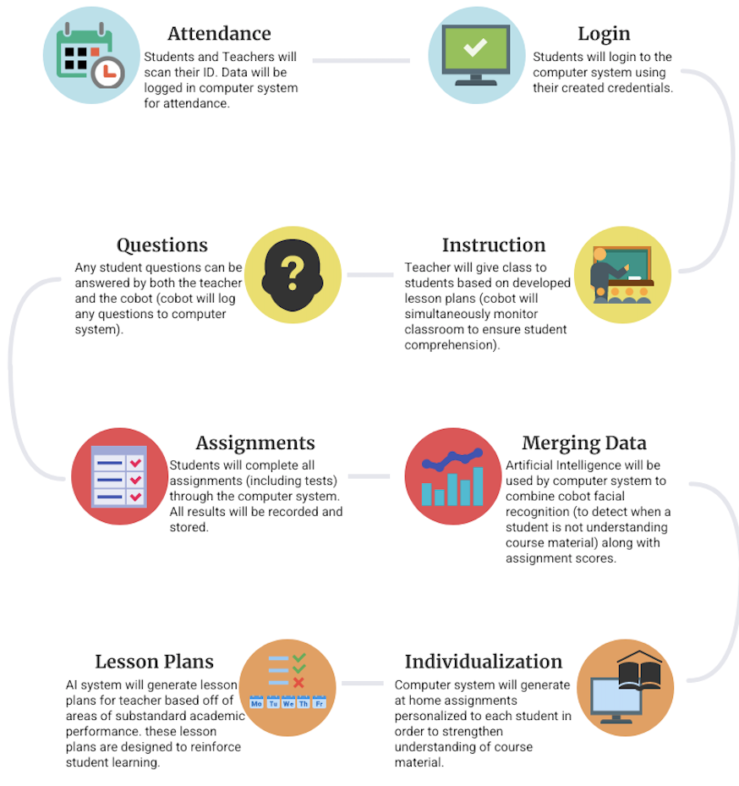
Recomposing Parts into Final System
Integration of parts
System Instruction Manual
All aspects accounted for

Slide 9
Validating Overall System
We asked ourselves "How will the system be used?"
Use Case Steps.
Researched similar ideas to ours.
Cobot = Letting Artificial Intelligence in Education Out of the Box (Timms).
Cobot makeup = technology that already exist today (Face ID, cameras, mics, monitors, etc.).
Feedback from users/stakeholders.
'Student' feedback': In public school and even in university we all have ID badges, some of us were too scared to ask a question in front of the entire class.
'Stakeholder' feedback: As someone who worked for a school system. My students' complaints were often about how they didn’t understand the material. However, when I challenged them to solve a problem the best way, they could I saw how they grasped information. I temporarily subbed for classroom and felt overwhelmed and out-numbered by the number of students I oversaw.

Slide 10
Questions?

