Slide 1
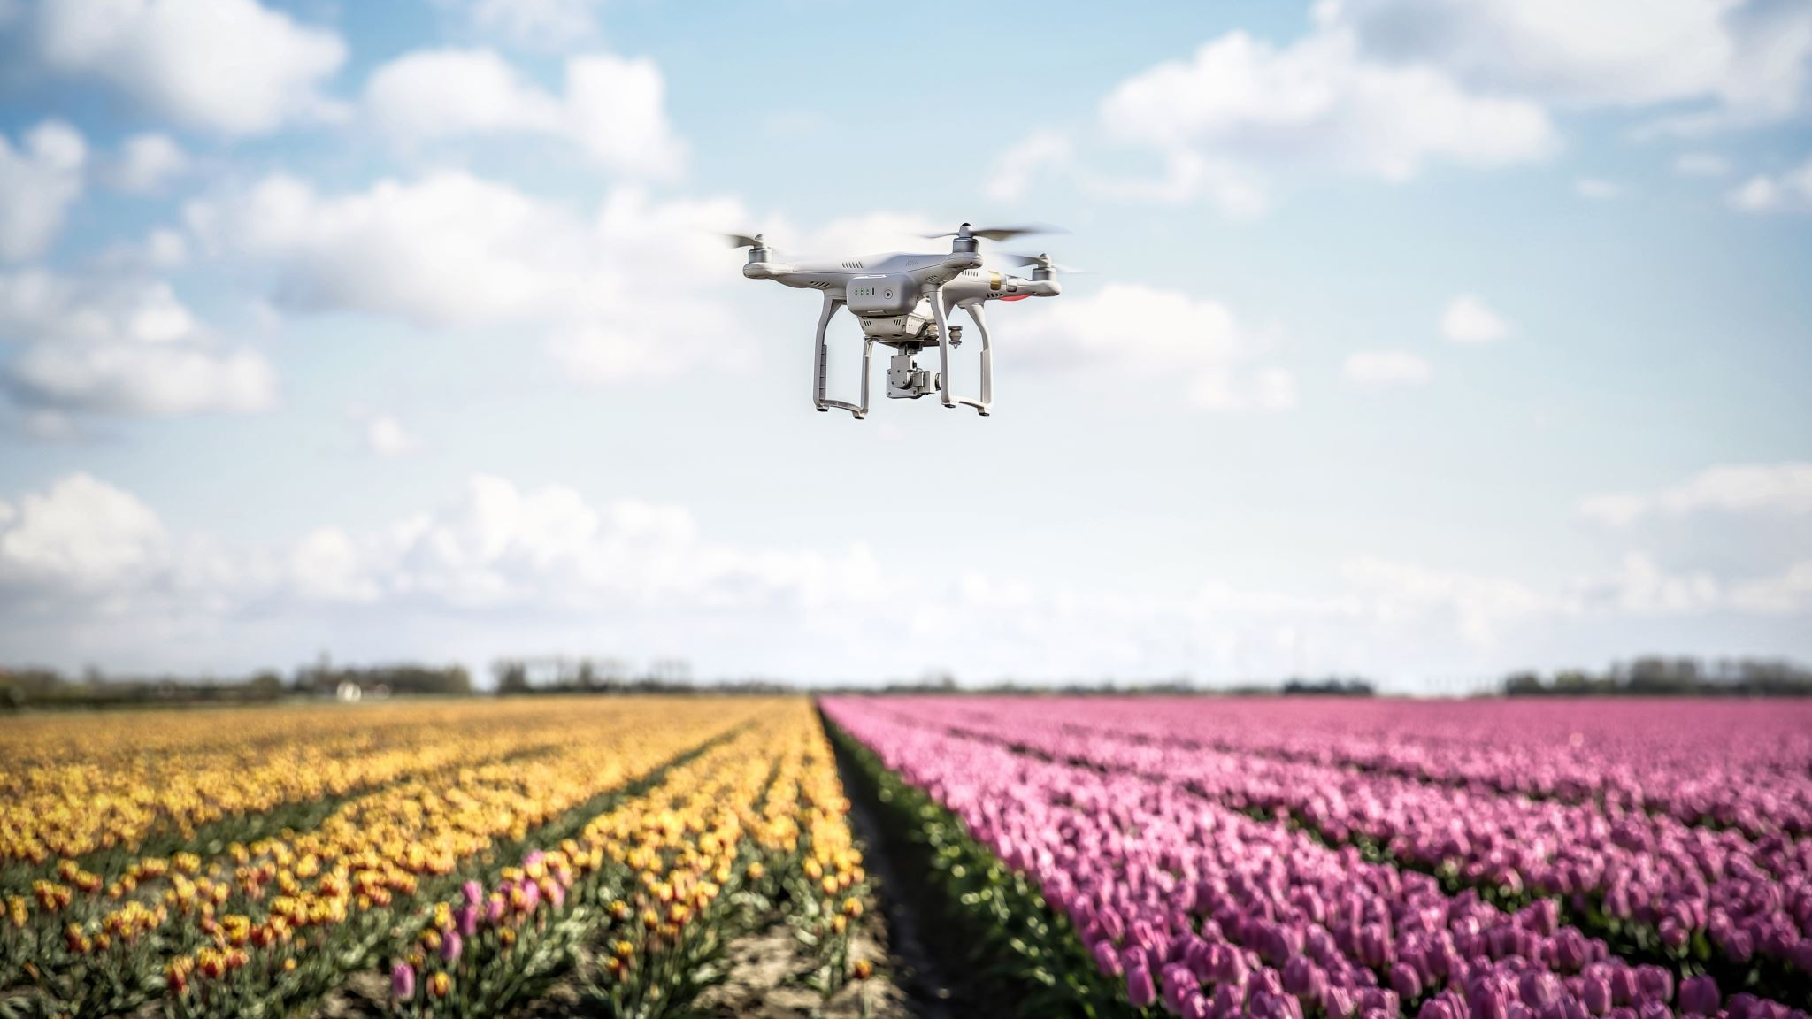
Drone Delivery
By Abdulmohsen Al-Mutairi

Slide 2
Abstract
The rise of drone technology has made drone delivery a reality for many businesses
This report aims to propose a new system that can improve the production and logistics process for drone delivery
The report outlines the needs and requirements of the customers, the design of the proposed system, the verification of the design, and the validation of the customer satisfaction with the proposed system

Slide 3
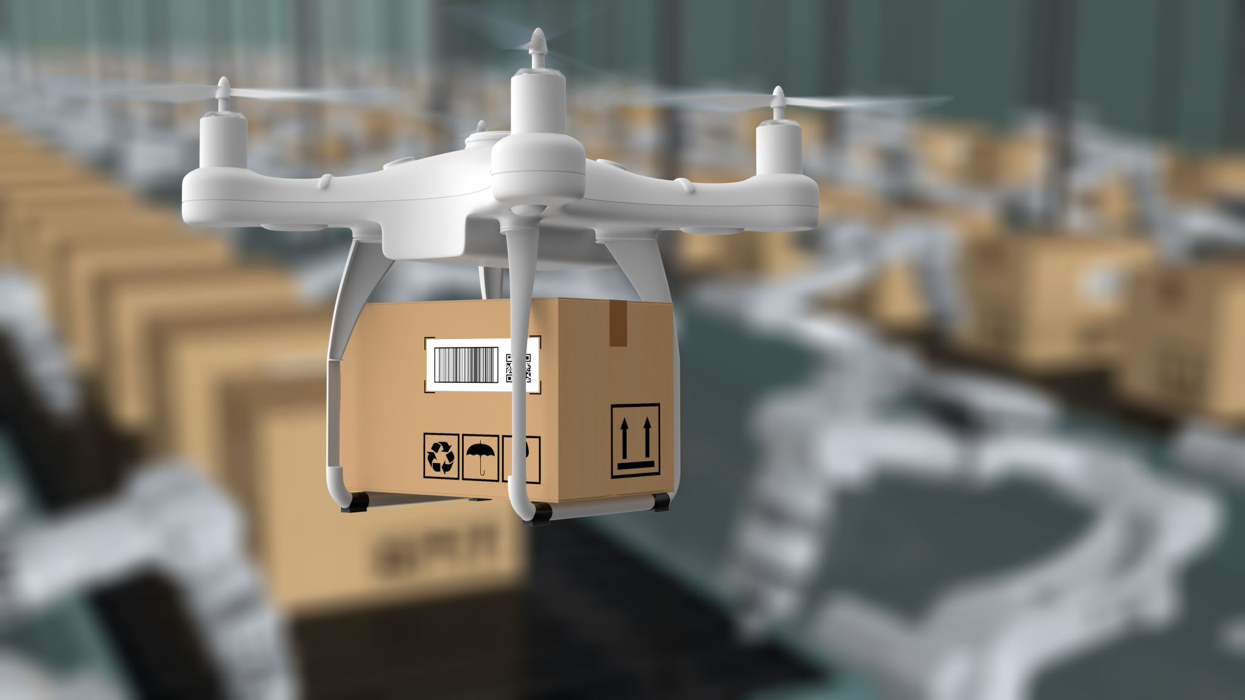
Introduction
Drone technology has rapidly advanced in recent years, leading to new possibilities for delivery services
Drone delivery is an efficient and fast way to transport products to customers, but it also comes with some challenges
The current production and logistics process for drone delivery is not as efficient and cost-effective as it could be

Slide 4
Who is your Customer, and their Needs & Requirements
The customer for this proposed system is any business that wants to use drone delivery for their products
The needs and requirements of the customers are

Slide 5
What system did you Design
The proposed system is a fully automated drone delivery system that uses a central hub to manage the entire production and logistics process
The system is designed to be efficient, cost-effective, safe, and secure

Slide 6
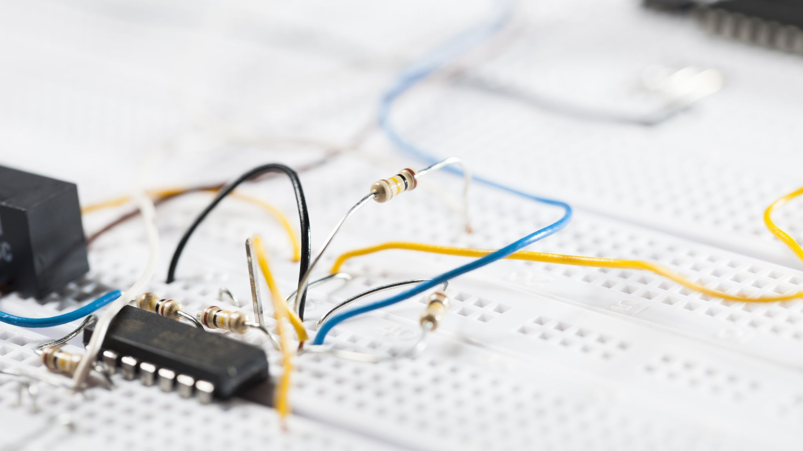
The system consists of four main components
System
The central Hub
The Drone
The charging Station
Software

Slide 7
Verification:
Increase Performance
Reduce Cost
Reduce Risk
Reduce Time

Slide 8
Validation: Is your Customer Satisfied with Efficiency & Effectiveness improvements?
The proposed system was tested with a small group of customers
The customers were asked to evaluate the efficiency and effectiveness ofthe proposed system in comparison to their previous delivery methods
The customers were satisfied with the improvements in efficiency and effectiveness and expressed interest in using the proposed system for their future deliveries

Slide 9
Calculation and Forecasts
The implementation of the proposed system will require an initial investment in hardware and software
However, the proposed system is expected to reduce the overall cost of the production and logistics process in the long run
The reduction in the cost of manual labor and the increased efficiency of the delivery process are expected to result in significant cost savings for the business

Slide 10
Forecast
Month | Number of Deliveries | Price per Delivery | Total Revenue
Jan | 500 | $50 | $25,000
Feb | 600 | $50 | $30,000
Mar | 700 | $50 | $35,000
Apr | 800 | $50 | $40,000
May | 900 | $50 | $45,000
Jun | 1000 | $50 | $50,000
Jul | 1100 | $50 | $55,000
Aug | 1200 | $50 | $60,000
Sep | 1300 | $50 | $65,000
Oct | 1400 | $50 | $70,000
Nov | 1500 | $50 | $75,000
Dec | 1600 | $50 | $80,000
Total | 13,500 |  | $650,000
Item | Cost | Revenue
Hardware (drones and charging stations) | $500,000
Software development and implementation | $200,000
Operational costs (maintenance, electricity, etc.) | $100,000
Total | $800,000 | $650,000
Year | Projected Revenue
2 | $1,000,000
3 | $1,500,000
4 | $2,000,000
5 | $2,500,000

Slide 11
Outcomes
Through the process of designing and implementing a drone delivery system to improve production and logistics processes, several important learning outcomes were achieved
The proposed system was designed to be efficient, cost-effective, safe, and secure while meeting the needs and requirements of customers who want to use drone delivery for their products
Third, the project provided an opportunity to function effectively on a team whose members together provide leadership, create a collaborative and inclusive environment, establish goals, plan tasks, and meet objectives

Slide 12
Outcomes
Overall, the project provided a valuable learning experience that developed important skills related to engineering design, effective communication, teamwork, and learning strategies

Slide 13
Conclusion
In conclusion, the proposed system is a fully automated drone delivery system that uses a central hub to manage the entire production and logistics process
The system is designed to be efficient, cost-effective, safe, and secure
The system has been designed to meet the needs and requirements of customers who want to use drone delivery for their products

Slide 14
Reference
Shariq, M., & Shahbaz, M. (2020). Drone-based delivery services: a review of current trends and future directions. Journal of Cleaner Production, 255, 120194.
Kamble , S., & Gunasekaran, A. (2019). Designing last-mile drone delivery network for sustainable urban logistics. Transportation Research Part D: Transport and Environment, 71, 46-61.
Leng , R., Liu, H., & Tan, W. (2021). Sustainable drone logistics for rural areas: A review of recent research trends and future directions. Journal of Cleaner Production, 296, 126554.
Ha, M. H., & Park, J. (2020). Sustainable urban logistics with drone delivery services: A case study of Seoul, South Korea. Sustainability, 12(16), 6573.

