Slide 1
Systemwide Title IX &
Sexual Misconduct Updates
Krista Anderson, Systemwide Title IX Coordinator
Faculty Advisory Council
January 31, 2020

Slide 2
Agenda
Title IX Overview
Federal Updates (DOE Title IX Regulations)
State Law Updates (SB 212 & HB 1735)
UT System Updates
  Systemwide Title IX Program
  UTS Model Policy on Sexual Misconduct
  Education & trainings systemwide

Slide 3

Title IX Overview

Slide 4
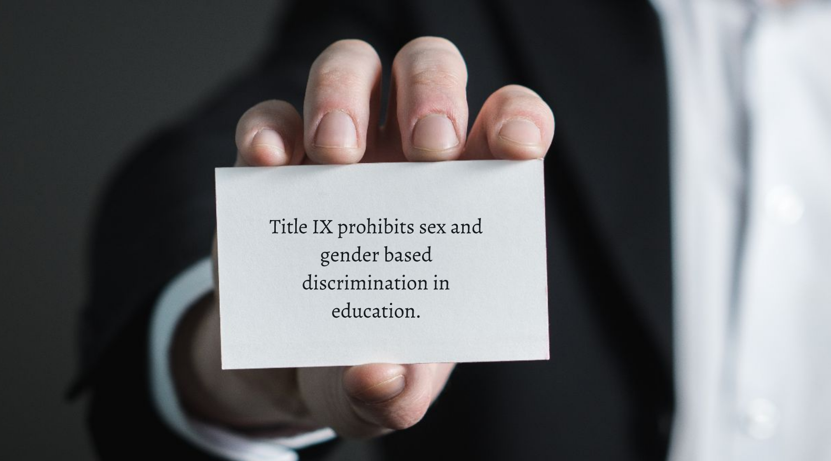
Title IX (1972)

Slide 5
Sexual Misconduct (Umbrella Term)
Can include:
Sexual Harassment
Sexual Exploitation
Sexual Violence, Sexual Assault
Dating and Domestic Violence (Interpersonal Violence)
Stalking
Other Inappropriate Sexual Conduct

Slide 6
Sexual Misconduct is a form of sex discrimination in educational programs, or employment settings…
When:
Quid Pro Quo: Submission to such conduct is a condition of a person’s educational status, employment, or participation in educational activities; or
Hostile Environment: Such conduct is unwelcome, undesirable, or offensive, and it is sufficiently severe or pervasive to deny or limit an individual’s ability to participate in or benefit from educational programs or an employee’s conditions of employment.

Slide 7

Federal Updates

Slide 8
DOE Title IX Regulations
Currently in the “final rule stage” with Office of Information & Regulatory Affairs (OIRA)
  This office is part of the Office of Management & Budget (OMB)
  Scheduled meetings currently through February 19, 2020
Anticipated release should be afterwards
Date of release TBD
Deadline for compliance TBD

Slide 9
DOE Title IX Regulations
The proposed regulations aim to address and describe the following:
  What constitutes sexual harassment for the purposes of rising to the level of a civil rights issue under Title IX;
  What triggers a school’s legal obligation to respond to incidents or allegations of sexual harassment; and
  How a school must respond once there is actual notice.

Slide 10
Major Changes Expected
Title IX Regulations
Narrower course & scope of Title IX
  Narrower definition for “sexual harassment”
  Requires “actual notice” from alleged victim/survivor (complainant) to the Title IX Coordinator/Deputy
  Applicable to educational programs & activities in the U.S.A. only
Reinforces the “deliberate indifference” standard
Allows for “preponderance” or “clear & convincing” evidence standard; all adjudication must use the same standard
Allows for informal resolutions & mediation
Notes:
Sexual harassment defined as actionable under Title IX to mean any of the following types of behavior:
A school employee conditioning an educational benefit or service upon a person’s participation in unwelcome sexual conduct (quid pro quo);
Unwelcome conduct on the basis of sex that is so severe, pervasive and objectively offensive that it effectively denies a person equal access to the school’s education program or activity (hostile environment); or
Sexual assault as defined in the Clery Act regulations
“Deliberate Indifference” Standard:
Stop the continuation of sexual harassment once known or should have known;
Prevent the reoccurrence of the sexual harassment once known or should have known; and
Remedy the effects of the sexual harassment

Slide 11
Major Changes Expected (Cont.)
Title IX Regulations
Eliminates the “single investigator” model, and requires a hearing with an independent hearing officer or panel
Requires cross-examination in hearings (by the advisors)
Requires institutions to provide an advisor to each party, if they have not selected one of choice
Requires live participation in the hearing for the participant’s statements, evidence, or documents to be considered in the decision of the hearing outcome
Questions on TIX Regs?

Slide 12

State Law Updates

Slide 13
SB 212 (January 1, 2020)
Employee Reporting Requirements
Requires all postsecondary institution employees to report information of sexual harassment, sexual assault, dating violence, and stalking, when involving:
  Students enrolled at the institution (at the time of alleged incident), alleged victims or respondents; or
  Employees at the institution (at the time of alleged incident), alleged victims or respondents

Slide 14
Confidential Employee Reporting Requirements
SB 212 (Cont.)
Requires all confidential employees to report type of incident only who receive information of sexual harassment, sexual assault, dating violence, and stalking, when involving:
  Students enrolled at the institution (at the time of alleged incident), alleged victims or respondents; or
  Employees at the institution (at the time of alleged incident), alleged victims or respondents
Notes:
Note: Under institutional policy, “responsible employee” reporting obligations include all alleged incidents reported/disclosed, regardless of time of alleged incident)

Slide 15
Who are Confidential Employees?
SB 212 (Cont.)
Employees that receive information confidentially, through privileged communications under law, such as healthcare & mental health care providers, other medical providers, or attorneys
Employees designated by the institution as a person that students may speak with confidentially concerning sexual harassment, sexual assault, dating violence, or stalking.

Slide 16
Examples of Confidential Employees?
SB 212 (Cont.)
Privileged communication under law:
Licensed counselors, psychologists
Doctors, physician assistants
Nurses, nurse assistants
Attorneys
Licensed social workers in a clinical or medical setting
Commonly designated “confidential” employees:
Victim Advocates (who work with students)
Student Ombuds
Notes:
Not applicable to being designated as “confidential”:
Faculty/Staff Ombuds
Victim Advocates (not licensed) working with faculty/staff

Slide 17
Immunities
SB 212 (Cont.)
A person acting in good faith who reports or assists in the investigation of a report received under this new law is immune from civil liability and from criminal liability* that might otherwise be imposed as a result of those actions.
* Similar to the student amnesty provisions in the Tex. Edu. Code

Slide 18
Employee Consequences
SB 212 (Cont.)
For employees who are “found responsible”*
for failing to report or falsely reporting,
employment must be terminated.
* Policy violation in accordance with the institution’s disciplinary procedure

Slide 19
Criminal Offense
SB 212 (Cont.)
Criminal offense for knowingly failing to report or with the intent to harm or deceive, knowingly falsely reporting to the institution:
  Class B misdemeanor
  Class A misdemeanor, if “intended to conceal the incident”

Slide 20
Administrative Reporting Requirements
SB 212 (Cont.)
Requires administrative reporting for all postsecondary institutions regarding reports of sexual harassment, sexual assault, dating violence, and stalking
Reporting Type | Timeline | To/From
Title IX Coordinator Report | At least 1x quarterly | TIXC → President (CEO)
Immediate Danger Notification | Immediately | TIXC → President (CEO)
CEO Report | At least 1x annually | President (CEO) → BOR

Slide 21
Administrative Reporting Requirements
SB 212 (Cont.)
Institutions must publish the CEO Report online annually; “during either the fall or spring semester”.
President (CEO) must annually certify to the THECB in October of each year that the institution is in substantial compliance of the administrative reporting requirements.
Questions on SB 212?
Notes:
Note: UT System is recommending the institutions publish in October when they certify compliance.

Slide 22
HB 1735 (August 1, 2020)
Institutional Policy Requirements
Institutions must have a policy on sexual harassment, sexual assault, dating violence, and stalking, including:
Definitions of prohibited conduct
Sanctions for policy violations
Importance of hospital treatment & evidence preservation ASAP
Right to report & receive prompt & equitable resolution
Protocol for reporting & responding
Interim measures
Right to report to law enforcement, to be assisted by the institution in reporting to police, or to decline reporting to police

Slide 23
Policy Access Requirements
HB 1735 (Cont.)
Institutions must provide access to the policy by:
Including in the institutional student and personnel handbooks
Creating & maintaining a webpage online solely dedicated to the policy & an accessible link on the institution’s homepage.

Slide 24
Orientation Requirements
HB 1735 (Cont.)
Institutions must have an orientation on the institution’s policy regarding sexual harassment, sexual assault, dating violence, and stalking.
Institutions must require entering freshmen or undergraduate transfer students to complete the orientation before or during the first semester of enrollment.
It can be administered online.

Slide 25
Prevention & Outreach Requirements
HB 1735 (Cont.)
Institutions must have a comprehensive prevention & outreach program, including:
Prevention strategies
Victim empowerment program
Primary prevention
Bystander intervention
Risk reduction
Information regarding reporting protocols, and Title IX Coordinator contact information, office location(s), phone, email, etc.

Slide 26
Disciplinary Process Requirements
HB 1735 (Cont.)
Institutions must provide both parties a prompt & equitable opportunity to present witnesses and other evidence relevant to the alleged policy violation.
Institutions must ensure that both parties have reasonable & equitable access to all evidence in the institution’s possession relevant to the alleged policy violation.
Institutions must take reasonable steps to protect & prohibit retaliation and harassment during the pendency of the disciplinary process.

Slide 27
Other Requirements
HB 1735 (Cont.)
Counseling options for both parties
Student course drops without penalty, when both parties are enrolled
Victim (complainant) right to request not to investigate an alleged incident that was reported to the institution
Student withdrawals or graduation pending disciplinary processes
Peace officer trauma-informed training
Memorandum of understanding with at least 1 local agency
Responsible employee & confidential employee requirements
Student advocates (optional, not required)

Slide 28
SB 212 & HB 1735 Training Materials
Texas Higher Education Coordinating Board
http://www.thecb.state.tx.us/institutional-resources-programs/title-ix-training/
Questions on New State Laws?

Slide 29

UT System Updates

Slide 30
Systemwide Title IX Program
UT Systemwide Title IX Coordinator: position established in 2019
Four pillars of the program:
  Regulatory Compliance
  Training & Education
  Communication
  Resources

Slide 31
UT System Model Policy on Sexual Misconduct
Updated October 1, 2019 to incorporate SB 212 & HB 1735 requirements. UT institutions are currently updating their respective policies to be in substantial compliance.
Expect to reconvene the systemwide policy working group after the DOE TIX Regulations are released & identify the areas of the policy that require revisions.
Available online:
https://www.utsystem.edu/documents/docs/general-documents/2019/ut-system-model-policy-sexual-misconduct

Slide 32
Highlights on Substantive Changes
UT System Model Policy on Sexual Misconduct
Revising the definition of “Responsible Employee” to apply to all employees
Including a definition of “Confidential Employee” & the requirement to report type of incident
Revising the section on “Immunity” to protect from disciplinary action employees & students who act in good faith when reporting

Slide 33
Highlights on Substantive Changes (Cont.)
UT System Model Policy on Sexual Misconduct
Adding the complainant’s right to request the university not to investigate
Including provisions to ensure reasonable & equitable access to all evidence relevant to the alleged violations in the university’s possession in the investigatory & disciplinary processes
Adding the state law provision of “failure to report” as an additional conduct violation of the policy; subject to disciplinary action, including termination

Slide 34
Education & Trainings Systemwide
Systemwide Title IX Annual Training (available annually)
SB 212/HB 1735 (available)
Prevention & Boundaries (available)
Crisis Management (available)
Title IX Advanced Training & Case Studies (in development)
NIH/NSF Reporting Obligations (in development)
Clery Workshops (exploring)
Youth Protection (exploring)

Slide 35
UT System Title IX Webpage
https://www.utsystem.edu/offices/systemwide-compliance/title-ix
Contact Information for all UT institutional Title IX Coordinators
Links to UT System Policies, Model Policies & Regent Rules on Sexual Misconduct

Slide 36

Q & A

Slide 37
Contact Information
Krista Anderson
Systemwide Title IX Coordinator
Office of Systemwide Compliance, UT System (Austin, TX)
Phone: 512-664-9050
Email: kranderson@utsystem.edu

