Slide 1
HISPANIC EQUITY REPORT
_________________
Independent Equity Committee
Prof. Alberto Martínez, Chair
Prof. Jorge Cañizares-Esguerra
Prof. Gloria González-López
Prof. Emilio Zamora
Prof. Martha Menchaca
Prof. Francisco Gonzalez-Lima
Prof. John Morán González
Prof. Fred Valdez, Jr.
The University of Texas at Austin
Notes:
1

Slide 2
 |  | All | Hispanics Percentage
Texas | Population | 28,304,596 | 11,082,299 39.1%
 | 18-24 year-olds | 2,883,788 | 1,285,222 44.6%
UT Austin | UT Austin undergraduates, Fall 2017 | 40,492 | 9,312 23.0%
 | T&TT faculty | 1,706 | 119 6.9%
 | Deans (incl. Vice, Assoc., Assistant) | 117 | 7 5.9%
Hispanics in Texas and our University, in 2017
Source: University of Texas at Austin, Statistical Handbook 2017-2018 (SHB17-18Complete.pdf), p. 7.
Also in IRRIS, Common Data Set IMA_PUB_CDS_2017-2018_Ay.pdf, p. 3.

Slide 3
Admission of First Year Students 2011-15
Source: https://www.texastribune.org/2016/06/23/race-and-admissions-ut-austin-last-five-years/

Slide 4
Admission of First Year Students 2011-15
Source: https://www.texastribune.org/2016/06/23/race-and-admissions-ut-austin-last-five-years/

Slide 5
Recommendation 1:
UT Austin should modify the Holistic Admissions process to enroll more qualified Hispanic and Black students.

Slide 6
 |  | All | Hispanic Women
Texas | Hispanic Population | 11,082,299 | ~ 5.6 Million
UT Austin
 | Deans (incl. Vice, Assoc., Assistant) | 130 | 0
January 2019: No Latina Deans

Slide 7
Recommendation 2:
Hispanic women should be appointed
as Deans, Associate Deans, Assistant Deans, and other high administrative roles.

Slide 8
Tenured and Tenure-Track Hispanics on Campus, July 2017
8 Schools and Colleges had merely two or fewer T&TT Hispanic faculty.
There were no T&TT Hispanics in Departments such as:
Communication Studies, Advertising and Public Relations; Nutritional Sciences; Human Development & Family Sciences; Business, Government and Society.

Slide 9
Source: Office of the Executive Vice President and Provost: Promotion and Tenure: “Ten Year Data,” 2010-2018

Slide 10
2010-18
Retention of Hispanic Assistant Professors
(irrespective of application to tenure)
yields an even more disturbing number:
only 40% remained at UT.

Slide 11
Recommendation 3:
More Hispanics should be hired as T-TT faculty.
Prioritize hiring Hispanics who are Tejanos, who originate from disadvantaged groups, and who labor to improve inclusion and advancement of Hispanic students.

Slide 12
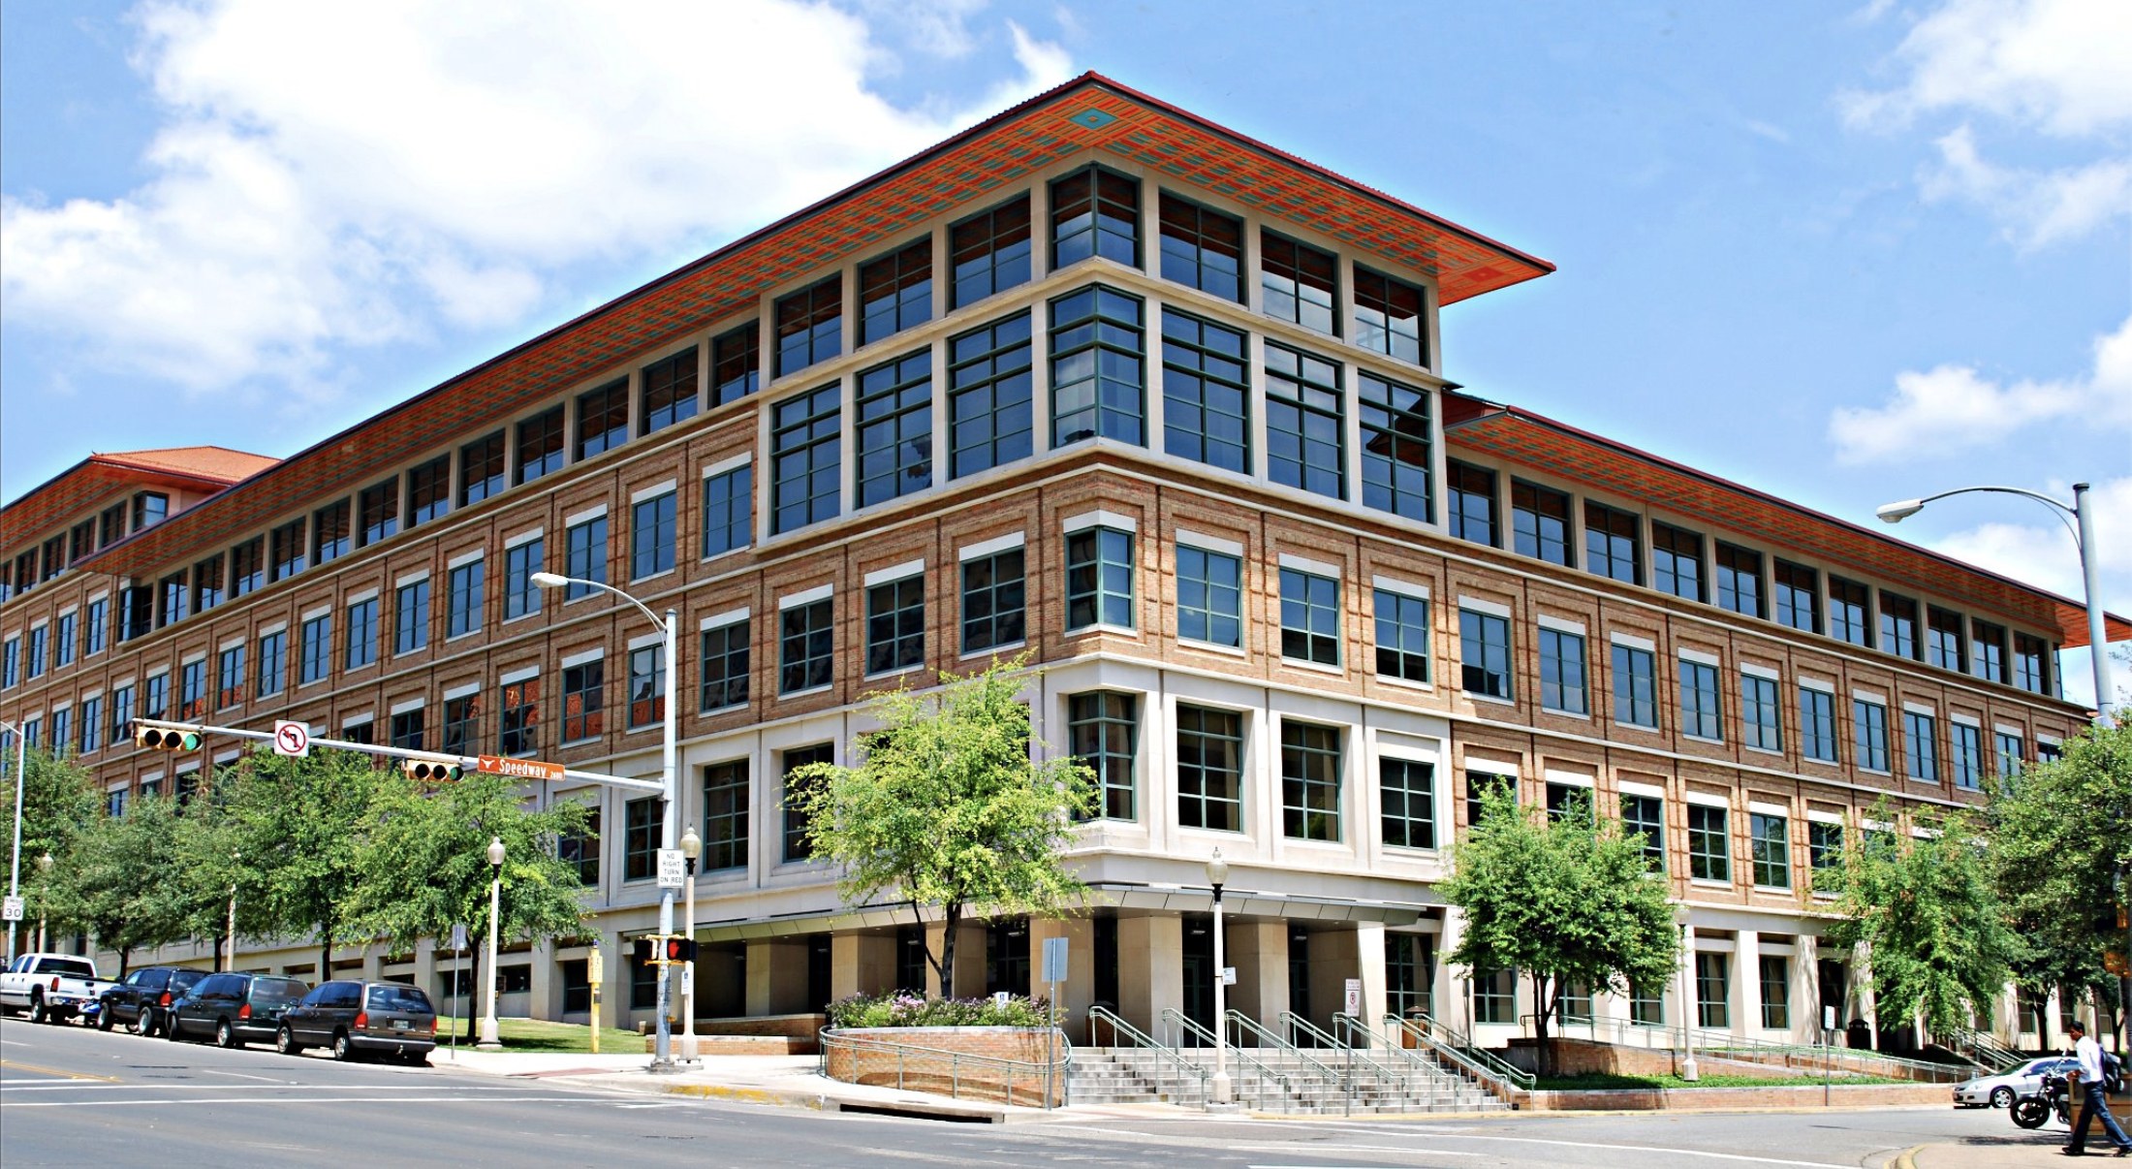
Department of Psychology = 93 Years

Slide 13
98 departments and units
yet only 6 Dept Chairs are Hispanic:
all in Liberal Arts, Education, and Fine Arts.

Slide 14
98 departments and units
yet only 6 Dept Chairs are Hispanic:
all in Liberal Arts, Education, and Fine Arts.
220 Centers and Institutes
yet only 8 Directors (3.6%) are Hispanic.
Presently no Hispanics at all head
Depts, Centers, or Institutes
in any branches of
Engineering, Medicine, Natural Sciences, Business, Architecture, Law, Public Affairs, Information, or Communication.

Slide 15
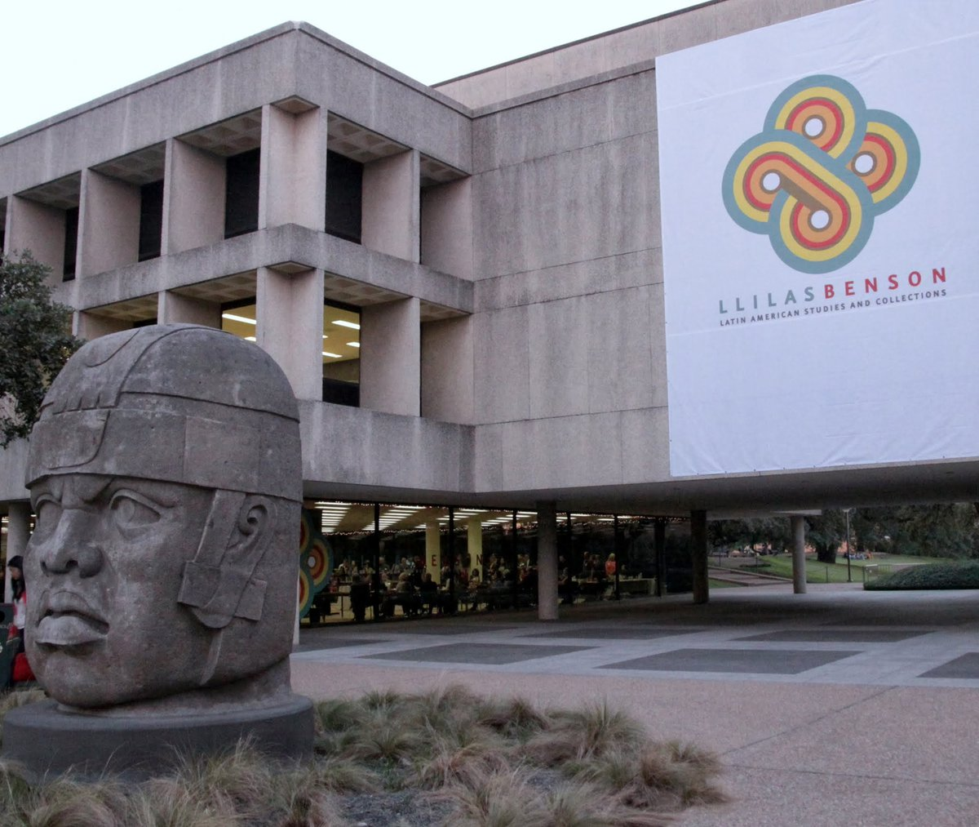
Institute of Latin American Studies = 80 Years

Slide 16
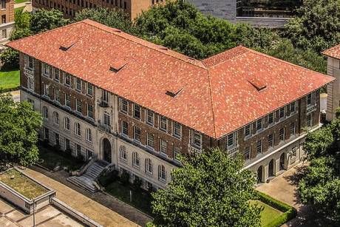
Department of History = 130 Years

Slide 17
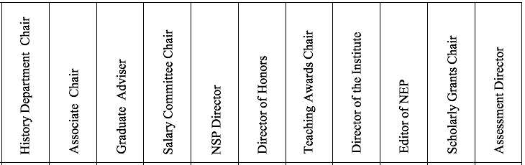
 | ss,3cr | ar,2cr | ar,2cr | or | 1cr | ar,1cr |  | ar,2cr | 2cr |  | ss,1cr
2003-04 | White | White | White | White | White | White | White
2004-05 | White | White | White | White | White | White | White
2005-06 | White | White | White | White | White | White | White
2006-07 | White | White | White | White | White | White | White
2007-08 | White | White | White | White | White | White | White | White
2008-09 | White | White | White | White | White | White | White | White
2009-10 | White | White | White | White | White | White | White | White
2010-11 | White | White | White | White | White | White | White | White | White
2011-12 | White | White | White | White | White | White | White | White | White
2012-13 | White | White | White | White | White | White | White | White | White | White
2013-14 | White | White | White | White | White | White | White | White | White | Asian
2014-15 | White | White | White | White | White | White | White | White | White | Asian
2015-16 | White | White | White | White | White | White | White | White | White | Asian | White
2016-17 | White | White | White | 2Ethn | White | White | White | White | White | Asian | White
2017-18 | White | White | White | White | White | White | White | White | White | White | White
2018-19 | White | White | White | White | White | White | White | White | White | White | White
2019-20 | White | White | White | White | White | White | White | White | White | Asian | Asian
Table 30. HISTORY Department, leadership positions, 2003-2020

Slide 18
Recommendation 4:
More Hispanics and people of color should be appointed to positions of departmental and university governance.
UT should establish rotation as a method of inclusion for campus-wide departmental and university governance.

Slide 19
Race/Ethnicity | Median salary in July 2017 | Median salary in July 2019
White | $63,461 | $68,962
Native Hawaiian/Pacific Islander | $62,127 | $62,500
Asian | $56,262 | $76,867
American Indian/Alaskan | $53,596 | $53,131
Two Or More Ethnicities/Races | $47,478 | $55,389
Black | $45,002 | $48,000
HISPANIC | $42,638 | $47,002
UT Austin Salaries by Race or Ethnicity
All Employees
Source: Data provided by UT Austin to The Texas Tribune; on 7/6/2017. Also, the 2018-19 data is available at: https://salaries.texastribune.org/university-of-texas-at-austin/

Slide 20
 | Hispanic Full Professors
2016-17 Total Annual Compensation Compared to White Faculty Excluding administrators. | – $25,342

Slide 21
 | Hispanic Full Professors
2016-17 Total Annual Compensation Compared to White Faculty Excluding administrators. | – $25,342
2018-19 Nine-Month Base Salaries Compared to White Faculty. Excluding endowments. Disaggregated by departments and excluding administrators, directors and dept. chairs. | – $21,880

Slide 22
We analyzed 90 faculty c.v. including 27% of Hispanic full Professors
77% were near the bottom of their pay scales, yet 54% were Top Ten most published.

Slide 23
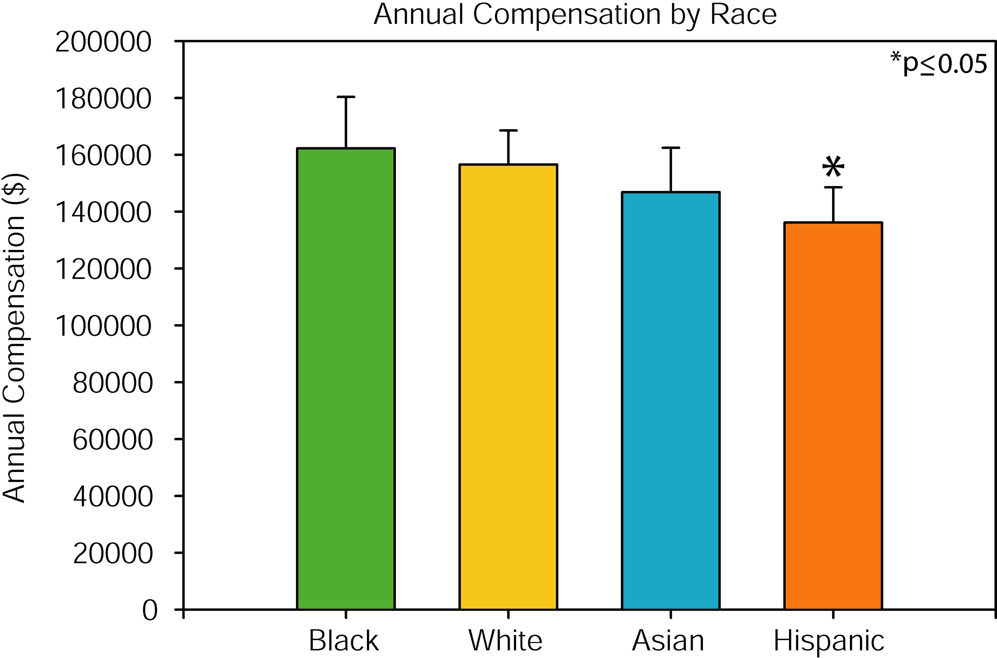
We analyzed 90 faculty c.v. including 27% of Hispanic full Professors
77% were near the bottom of their pay scales, yet 54% were Top Ten most published.
We analyzed covariance with one-tailed hypothesis testing, adjusted for covariates of gender, years employed, and publications, which showed that the mean compensation of Hispanic faculty was statistically significantly lower than the mean compensation of White faculty.
We found a near zero correlation between the compensation and publications of Hispanic faculty, contrary to White, Black, Asian faculty.

Slide 24
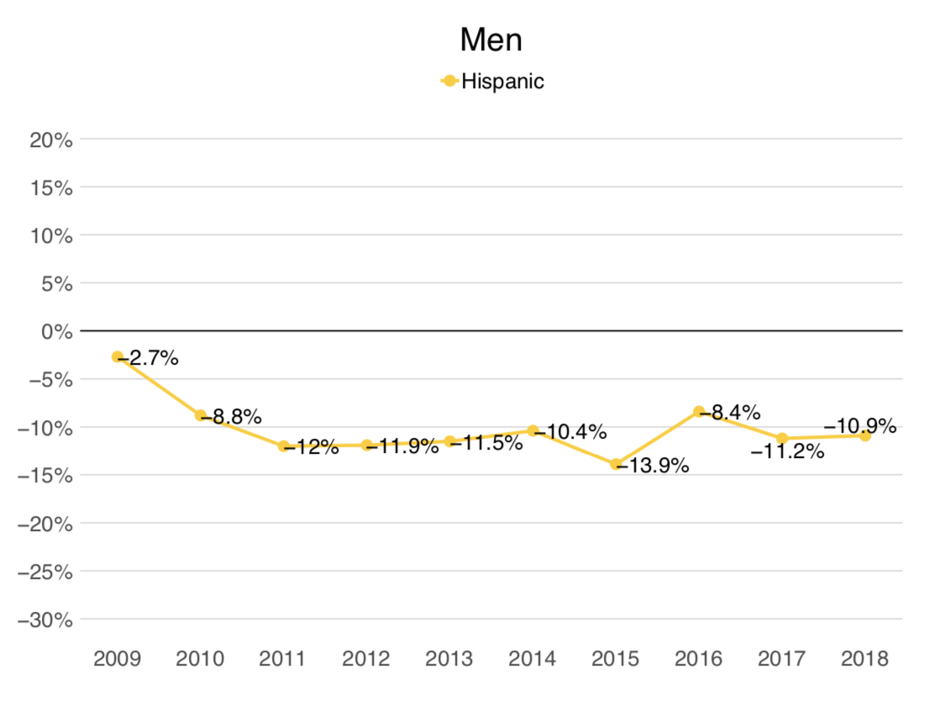
Chart by UT IRRS, 2019; provided to the Mexican American Legislative Caucus
CAMPUS-WIDE AVERAGE
NINE-MONTH BASE SALARIES
OF FULL PROFESSORS
MALES
Full Professors, White Males
Full Professors, Hispanic Males

Slide 25
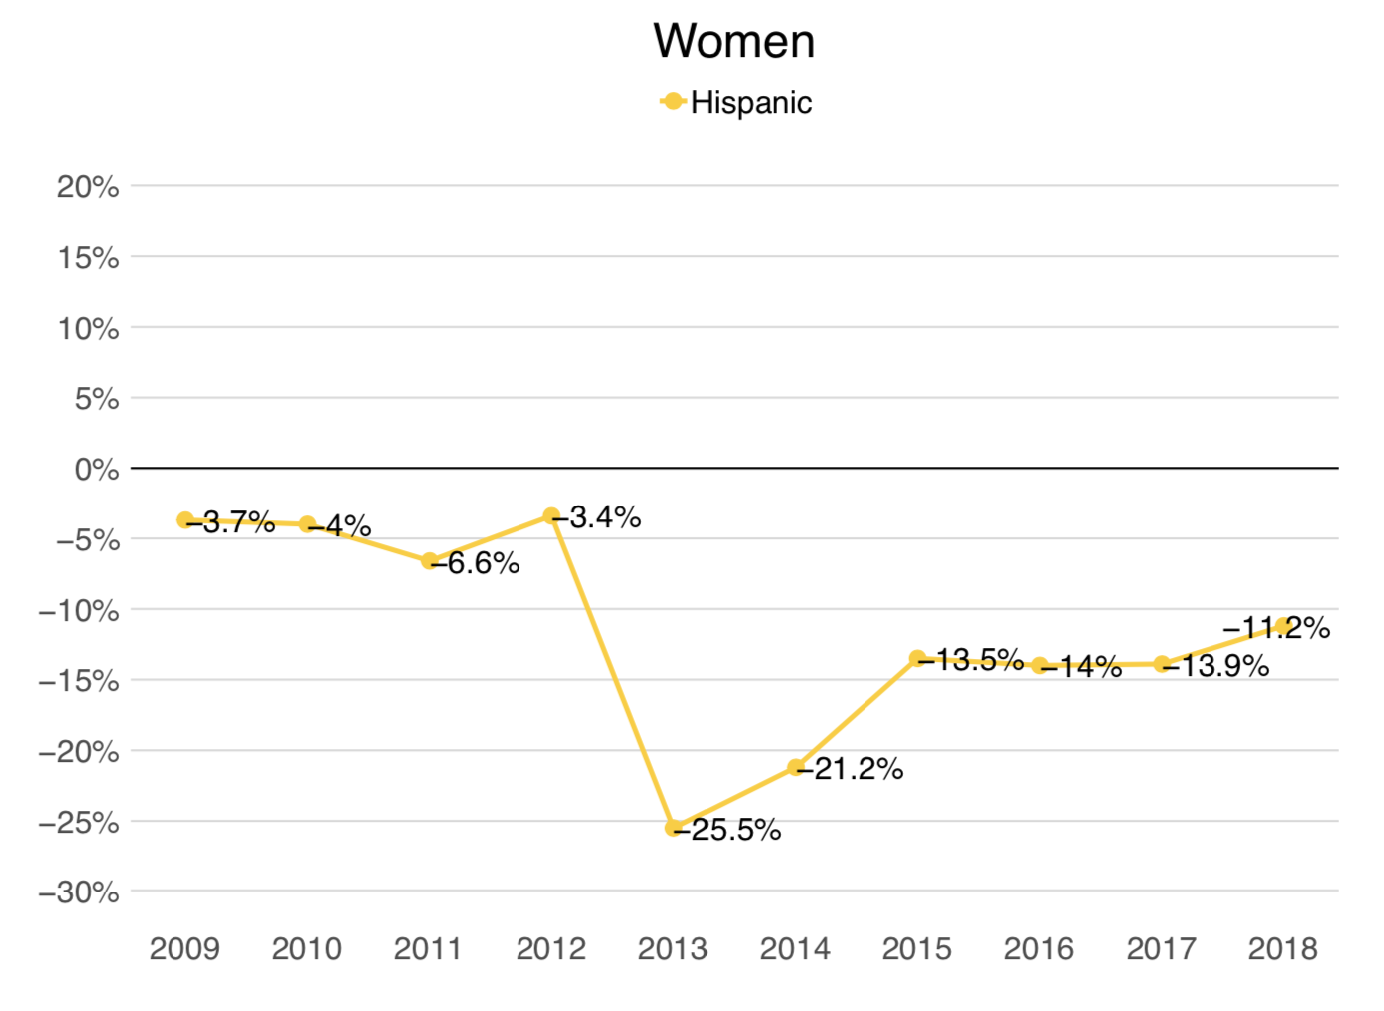
Chart by UT IRRS, 2019; provided to the Mexican American Legislative Caucus
CAMPUS-WIDE AVERAGE
NINE-MONTH BASE SALARIES
OF FULL PROFESSORS
FEMALES
Full Professors, White Females
Full Professors, Hispanic Female

Slide 26
Recommendation 5:
We request an annual investment of $2.3 Million to achieve
equity compensation for Hispanic faculty relative to White faculty.

Slide 27
In 2019, the College of Liberal Arts cut $4.9 Million from its academic programs:

Slide 28
In 2019, the College of Liberal Arts cut $4.9 Million from its academic programs:
$1.3 Million were cut from Latino Studies
(25.4% of the cuts)
1. Latino Research Institute
2. Center for Mexican American Studies
3. Dept. Mexican Am. & Latina/o Studies
59
other
Depts,
Centers,
Institutes

Slide 29
Recommendation:
The UT System should review
equity for minorities who are faculty, including Non-TT Faculty,
not only regarding compensation
but also especially inclusion in leadership.

Slide 31
HISPANIC EQUITY REPORT,
October 8, 2019
The Daily Texan Apr.18, 2019
Texas Ed Equity Oct.11, 2019
The Daily Texan Oct.22, 2019
Austin American-Statesman Oct.23, 2019
MSN.com Oct.23, 2019
Austin News Briefs Oct.24, 2019
Inside Higher Ed Oct.30, 2019
*Austin American-Statesman Nov. 3, 2019
HeraldDemocrat.com Nov. 3, 2019
Glen Rose Reporter Nov. 3, 2019
Alice Echo News Journal Nov. 3, 2019
Brownwood Bulletin Nov. 3, 2019
Nueces County Record Star Nov. 3, 2019
Van Alstyne Leader Nov. 3, 2019
Waxahachie TX Daily Light Nov. 3, 2019
Stephenville Empire-Tribune Nov. 3, 2019
Austin American-Statesman Nov.13, 2019
Historia Chicana Newsletter Nov.15, 2019
Telemundo Nov.22, 2019
CBS Austin Nov.22, 2019
Univision Nov.22, 2019
Texas Ed Equity Nov.24, 2019
NBC News Nov.25, 2019
Latin Post Nov.25, 2019
The Daily Texan Nov.25,2019
San Antonio Current Nov.25, 2019
DNYUZ Nov.25, 2019
Diverse Issues in Higher Ed Nov.26, 2019
Medium Nov.27, 2019
Project Pulso Dec.23, 2019
Houston Chronicle Jan. 5, 2020
Agencia EFE (SPAIN) Jan. 9, 2020
Yahoo! Jan. 9, 2020
Impacto Latino (NY) Jan. 9, 2020
Alianza News (Miami) Jan. 9, 2020
NonProfit Quarterly Jan. 9, 2020
Be Latina Jan.10, 2020
*Houston Chronicle Jan.22, 2020

Slide 32
HISPANIC EQUITY REPORT
_________________
Independent Equity Committee
Prof. Alberto Martínez, Chair
Prof. Jorge Cañizares-Esguerra
Prof. Gloria González-López
Prof. Emilio Zamora
Prof. Martha Menchaca
Prof. Francisco Gonzalez-Lima
Prof. John Morán González
Prof. Fred Valdez, Jr.
University of Texas at Austin
Notes:
32

