Slide 1
Commitment to Faculty
Initiatives and Goals
Improve Communication
Responsive to Feedback
Campus Training/Information Sessions – Campus Edge Travel Sessions
UTEP & Southwest Airlines Virtual Travel Forum
9/17/2020, 2:00pm – 3:00pm
9/23/2020, 2:00pm – 3:00pm
Travel Management Contact Information
Rene Rayon, Director – rener@utep.edu
Antonio Romero, Assistant Director – anromero@utep.edu

Slide 2
Travel & COVID-19
Notices/Reminders:
Helpful Links:
Follow University policies and guidelines
Review travel restrictions/airline policies
Request International Oversight Committee (IOC) approval, if required
Apply “Unused” Tickets
Report to COVIDaction@utep.edu
Center for Disease Control Prevention
Safety Guidelines and Travel Warnings
Department of State
Country Travel Warnings
UTEP EH&S Department
UTEP Protocols and Guidelines
International Air Transport Association
Travel and Entry Restrictions
** Standard travel operation resumed 9/1/2020 **

Slide 3
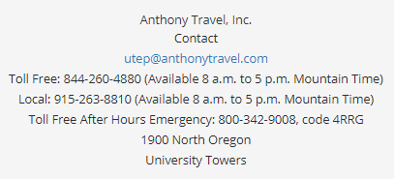
Contracted Agencies
Airfare
Vehicle Rentals
Onsite Travel Agent and After Hours Service
Contracted Discounts
Direct Bill
International SOS Registration Included
Online Booking Tool (Concur)
Insurance Coverage Included
Contracted Discounts
Direct Bill
One-way Rentals Available
Online Booking Tool (Concur)
** Travelers must use contracted agencies for business travel **

