Slide 1



How to Fill Out Your 104-R
UTEP ARMY ROTC
Fightin’ Miner Battallion
Simon Hernandez
Recruiting Operations Officer
shernandez6@utep.edu

Slide 2
What is the 104=R?
The 104-R form is an academic planner that lays out all the classes required for you to graduate. You will also lay out all the classes needed for you to complete the ROTC curriculum. Keep in mind that this form is subject to change any semester of your time in college.
Key topics:
Personal information
What information is needed to input classes.
How to properly look at your degree plan.
The ROTC courses that you need to take.

Slide 3
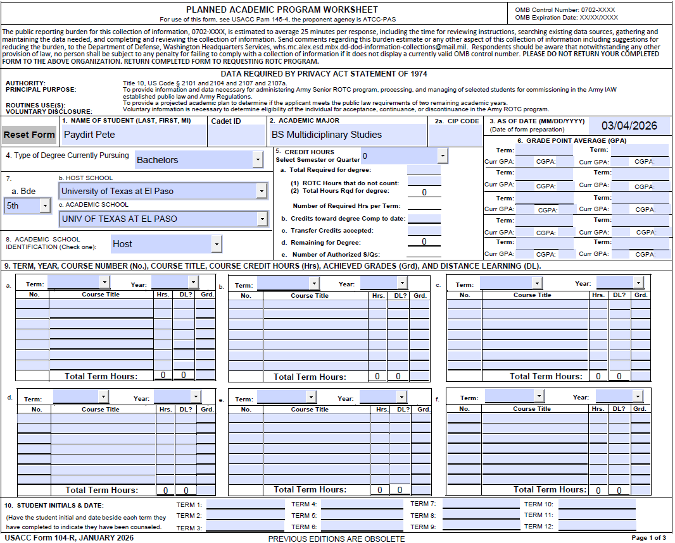
PAGE 1 OF 3
Instructions:
1. In all CAPS – LAST, FIRST , MI.
1A. Cadet ID: Can be provided by your Military Instructor
2. Your academic major , BE SURE TO ADD: B.S., B.A. OR MASTER
2a. CIP CODE: ELX
3. Todays date
4. Type of Degree Currently Pursuing
5. Select Appropriate Term Type and Degree plan
6. Input Term (Fall 2025, Spring 2025,etc.)
Term GPA and Cumulative GPA.
7. 7A. BDE (5th)
7B. University of Texas at El Paso
7C. UNI OF TEXAS AT EL PASO
8. Academic School ID: HOST
The MSSC needs everything filled out correctly in order for the form to be completed, especially what is high lighted in red.

Slide 4
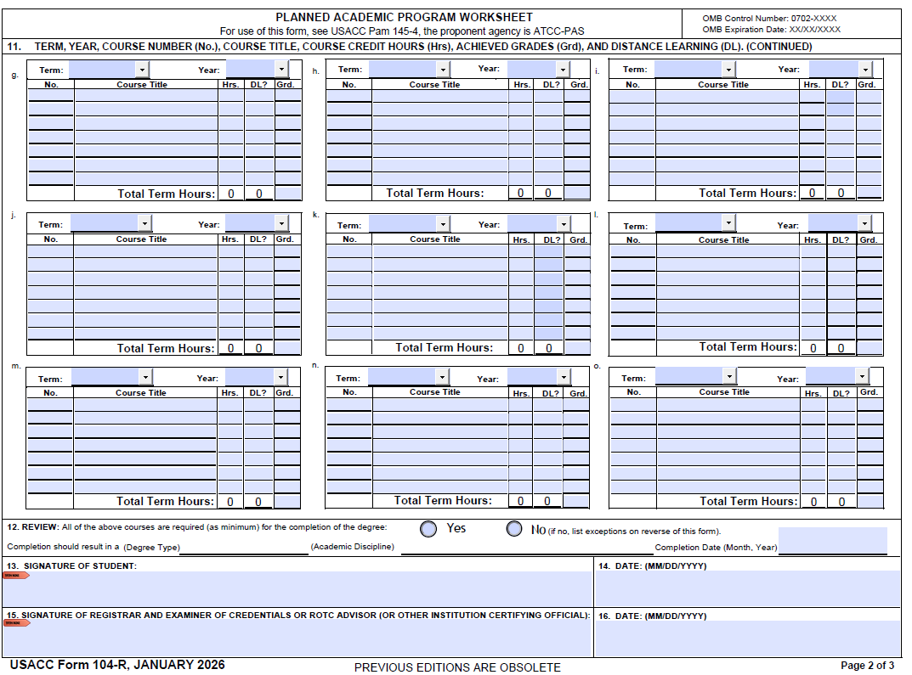
PAGE 2 OF 3
9. Mark YES , completion should result in ( Your degree SAME AS IN BLOCK 2 ON PAGE 2) Then insert the month and year you will graduate
10.-12 Signatures must be current and match page 3 dates.

Slide 5
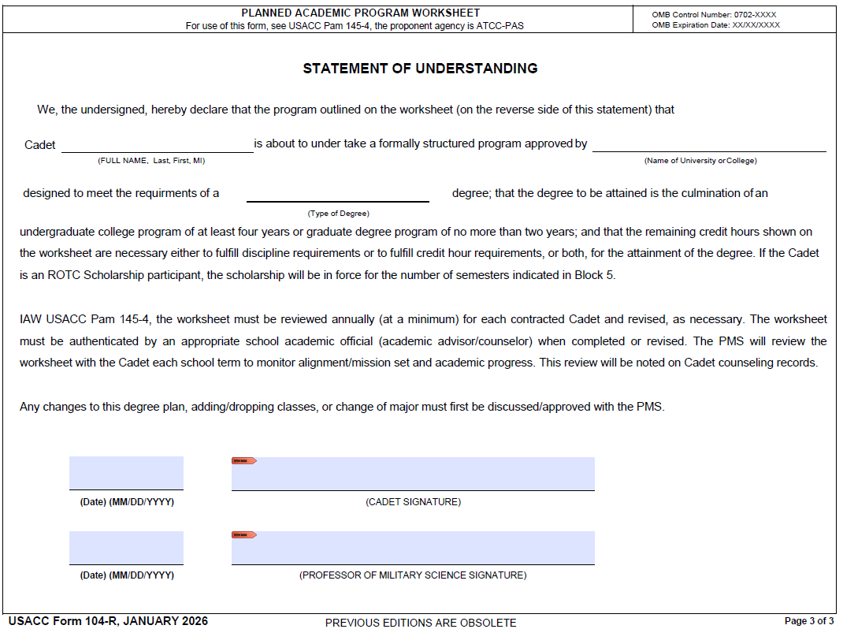
PAGE 3 OF 3
AGAIN BE SURE TO CORRECTLY IN PUT YOUR DEGREE AND SIGNATURES MUST

Slide 6
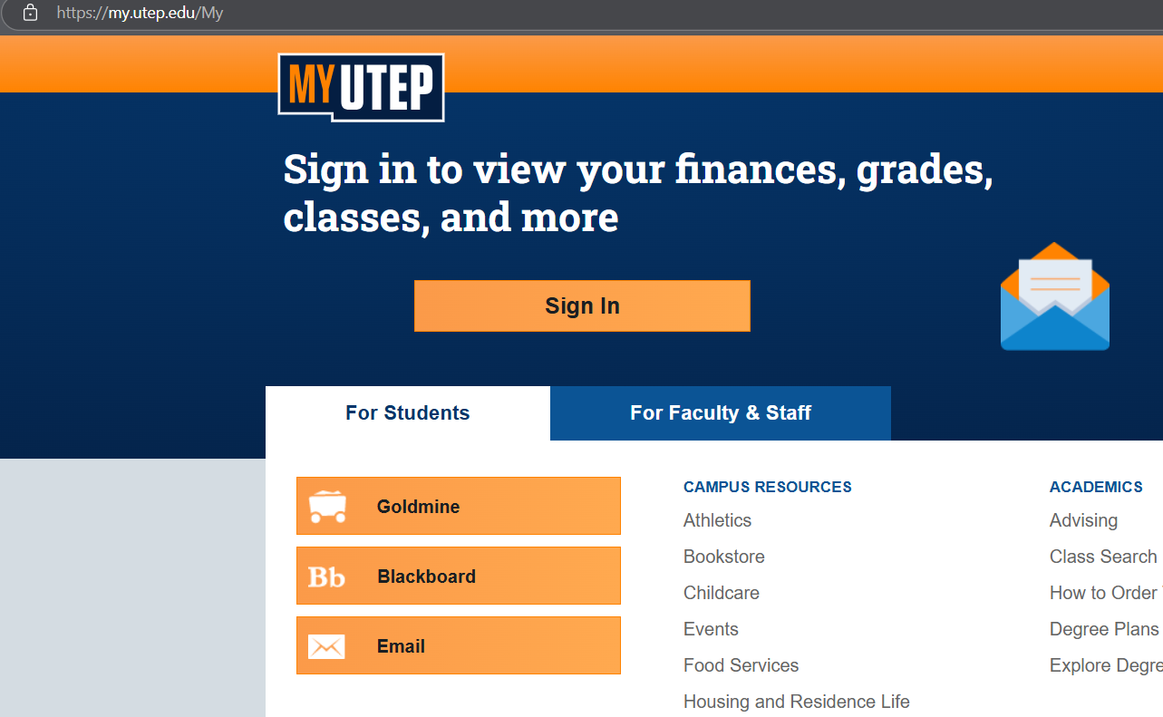
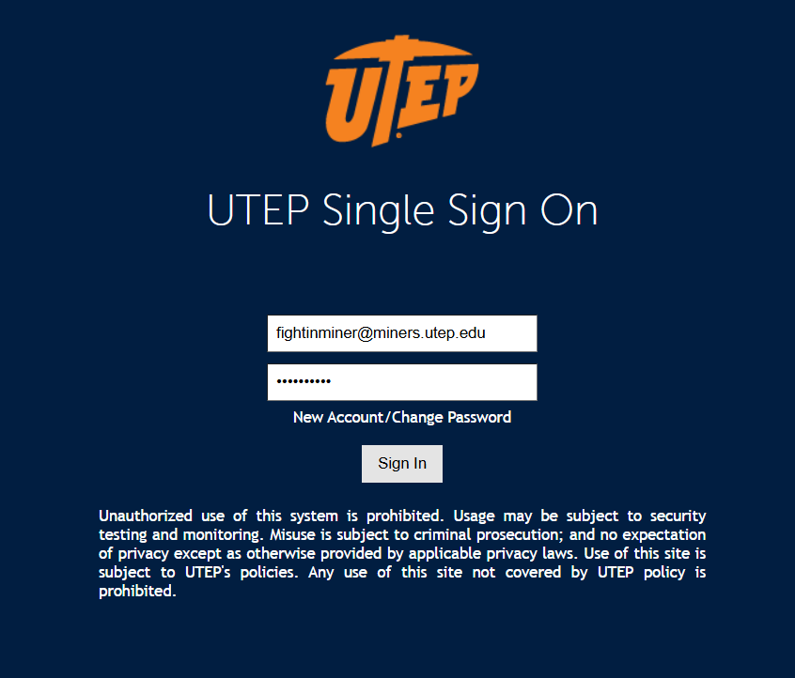
How To Input Class Into 104-R
The first TERM should be your current or first semester (if freshman) that includes classes that you have already registered for .
The next steps will show you how to access your detail schedule in order to correctly fill out the form.
Go to your UTEP account (my.utep.edu) and log into your GoldMine through the main page

Slide 7
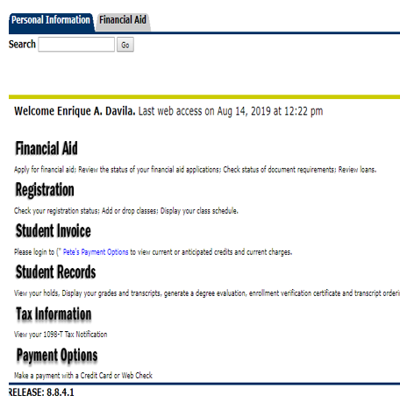
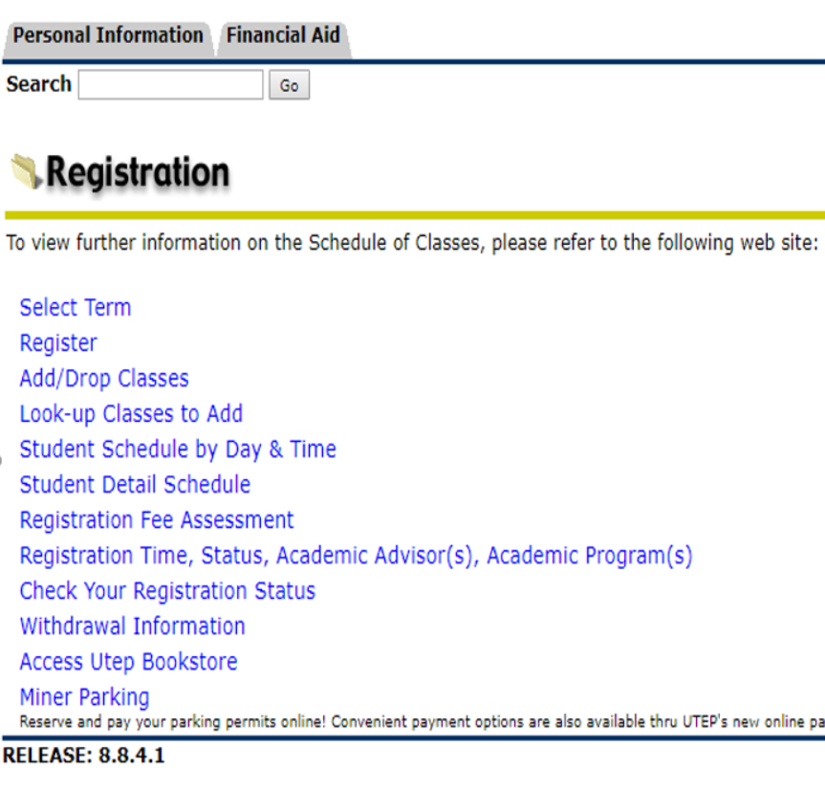
NEXT STEPS
3.
2.

Slide 8
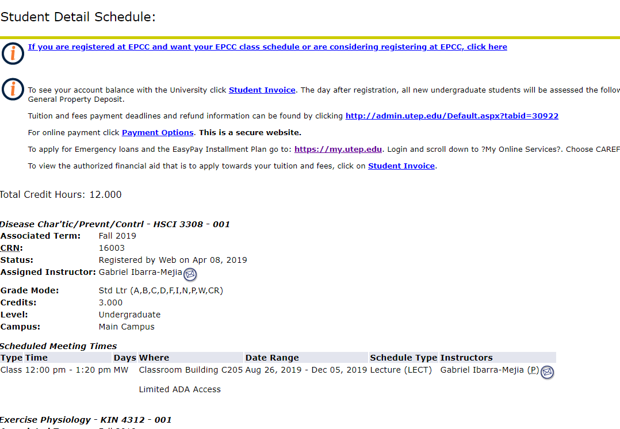
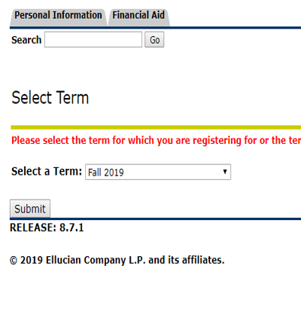
NEXT STEPS
This page will include the details to all your classes you have registered for your current/upcoming semester.
Semester we want
4.

Slide 9
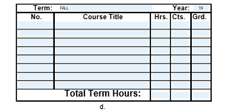
Filling In the Course Information
Find the first block that looks like the one below and insert for Term: Fall , Year : 19
Split your screen to have the webpage with your detail class schedule visible.

Slide 10
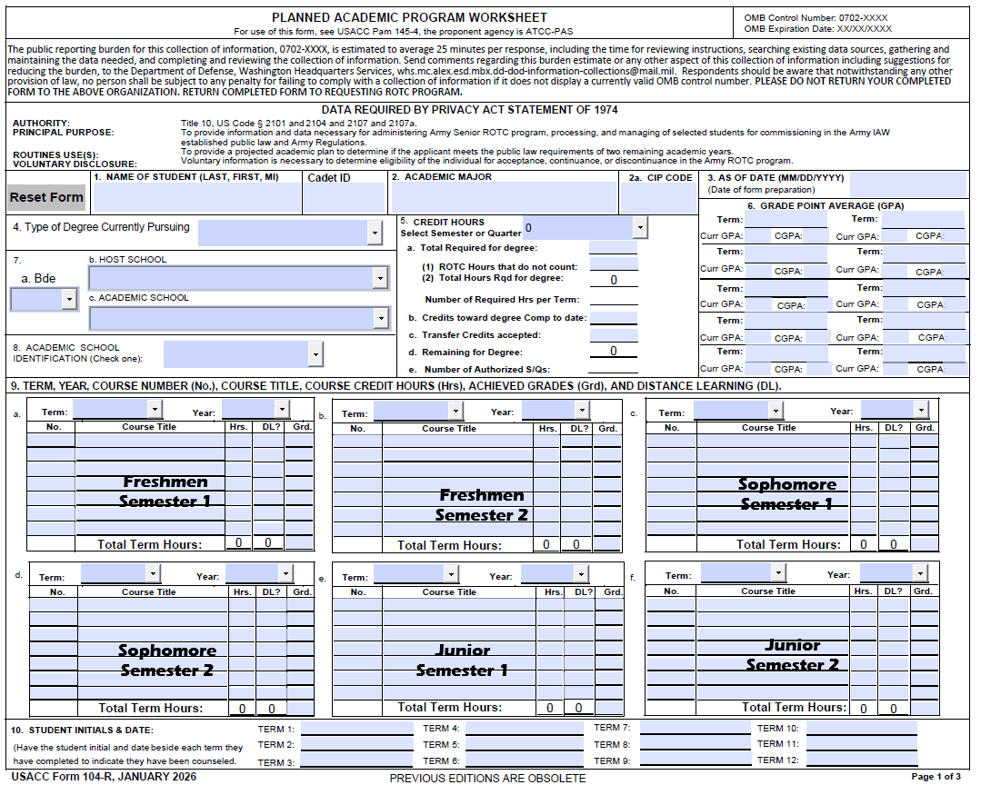
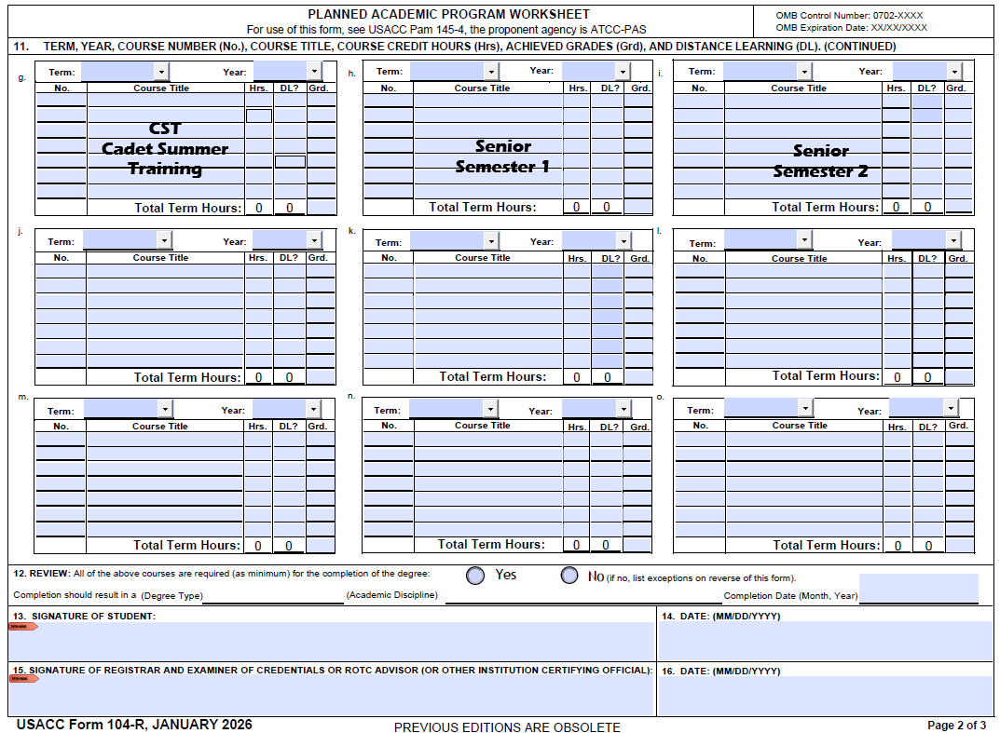
A traditional freshman student will have 8 semesters in order to finish their Bachelors degree in four years
A Sophomore will have 6 semesters left
A junior will have 4 semesters left
This can vary on your major and the amount of credits you have that count towards your degree.

Slide 11
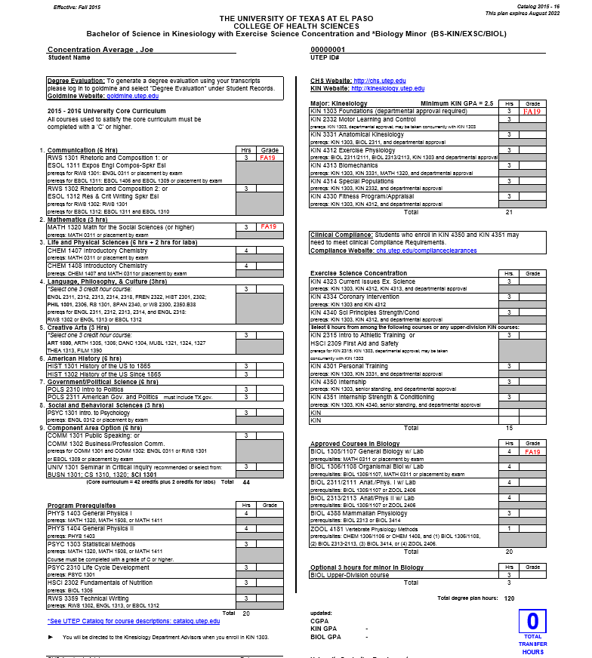
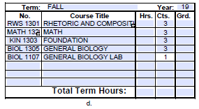
The degree plan on this page will be our example to fill out a semester block. This can be used instead of using your Gold Mine account.
If you need to generate a degree plan, you can use the following link in with UTEP to help generate your degree plan.
Degree Plans - The University of Texas at El Paso
Degree Plans - The University of Texas at El Paso
To figure the amount of credit hour per class look at the second number in the catalog number and that will tell you how many credit hours the class is.

Slide 12
Things to keep in mind:
Most major classes have prerequisite classes that must be met prior to registering for them.
This form is subject to change due to some classes are only offered one time of the year, class may have already reached its max number of students or the class conflicts with the Military Science courses and classes were taken in the summer or mini-mesters.
The summer between your junior and senior year will be designated for Advanced Camp.
When reviewing with your advisor, ensure that it matches the degree plan with the correct year group/ catalog year.
Make it a habit to consistently check up with your advisor, to make sure that you are still on track to graduate. (Recommended at least once a semester).

Slide 13
What Military Science Courses do you need to take?
Military Science Course
Freshmen Year
• MS1104 Intro to the Army (FALL)
• MS1104 Intro to the Army Lab
• MS1105 Foundations of Leadership (SPRING)
• MS1105 Foundations of Leadership Lab
Sophomore Year
• MS2201 Leadership and Ethics (FALL)
• MS2201 Leadership and Ethics Lab
• MS2203 Army Doctrine& Decision Making (SPRING)
• MS2203 Army Doctrine& Decision Making Lab
Junior Year
• MS3304 Training Management (FALL)
• MS3304 Training Management Lab
• MS3305 Applied Leadership (SPRING)
• MS3305 Applied Leadership Lab
MS 3401. Summer Field Training (SUMMER)
Only after your Junior Year
Based on your Degree Plan if credit is needed
Senior Year
• MS4401 The Army Officer (FALL)
• MS4401 The Army Officer Lab
• MS4402 Company Grade Leadership (SPRING)
• MS4402 Company Grade Leadership Lab
MS 3313. U.S. Military History
Only needed 1 Semester Registration
PE 1157. Military Conditioning
Only needed 1 Semester Registration
MS1104/1105 and MS 2201/2203 may be replaced by attendance of Basic Training/Prior Service/Approval, based on the amount of years of schooling is done.
A college student who is in their junior year, with approval from PMS, skips freshman and sophomore Military Science classes.

Slide 14
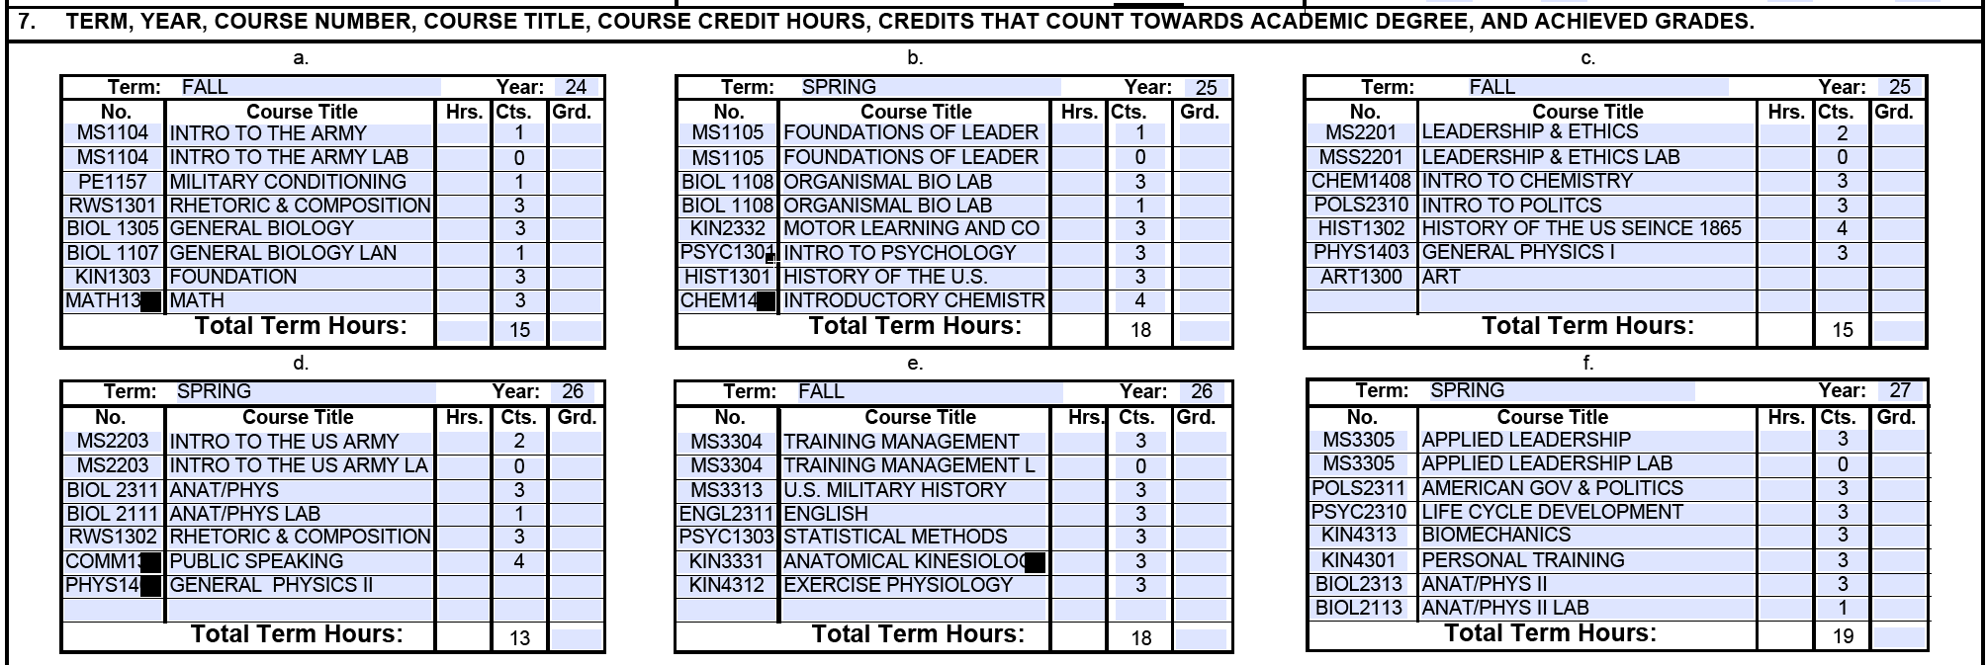
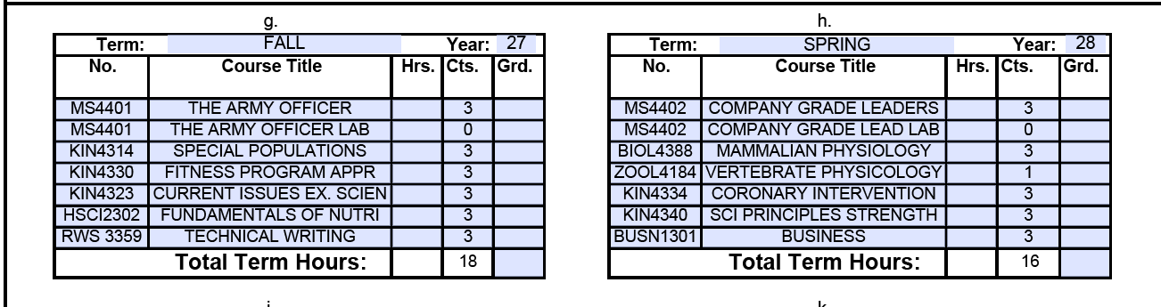
Plan out all the 8 Semesters using your degree plans and include the Military Science courses that are needed for each semester. (In orange)

Slide 15


UTEP ARMY ROTC RECRUITING OPERATIONS OFFICER
THE UNIVERSITY OF TEXAS AT EL PASO
MILITARY SCIENCE DEPARTMENT
SIMON HERNANDEZ
SHERNANDEZ6@UTEP.EDU
MILITARY SCIENCE BUILDING
251 GLORY ROAD,
EL PASO, TEXAS, 79902

