Slide 1
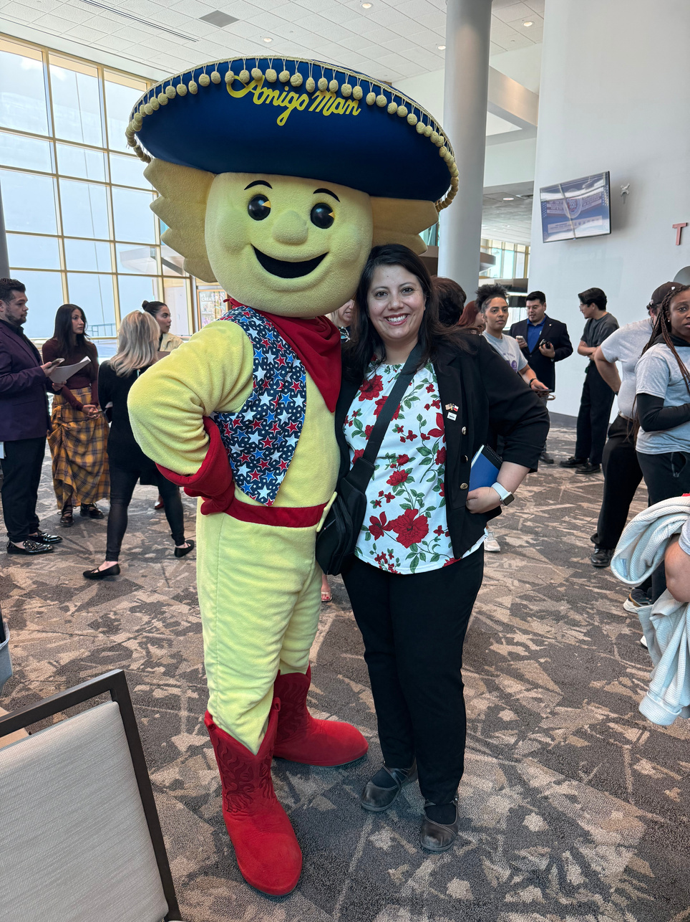
UTEP Volunteer Project
Elizabeth Macias
COMMUNITY SERVICE ADVOCATE

Slide 2
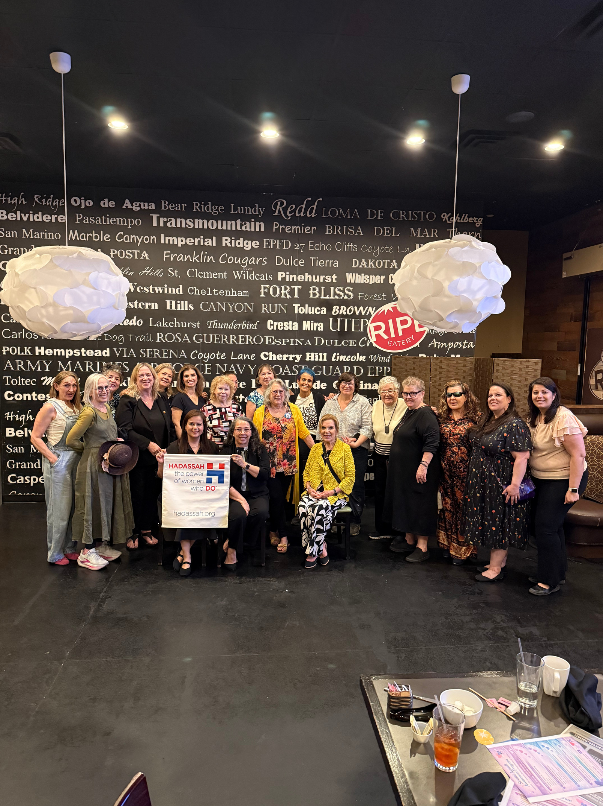
Volunteering and Leadership
A Journey of Empowerment through Community Service and Collaboration
This presentation reflects on my transformative experiences volunteering with various nonprofits and on the impact of empowered women in community service.
Through collaboration with local nonprofits, I have learned valuable lessons in leadership, creativity, and the importance of visibility, ultimately strengthening our El Paso community.

Slide 3
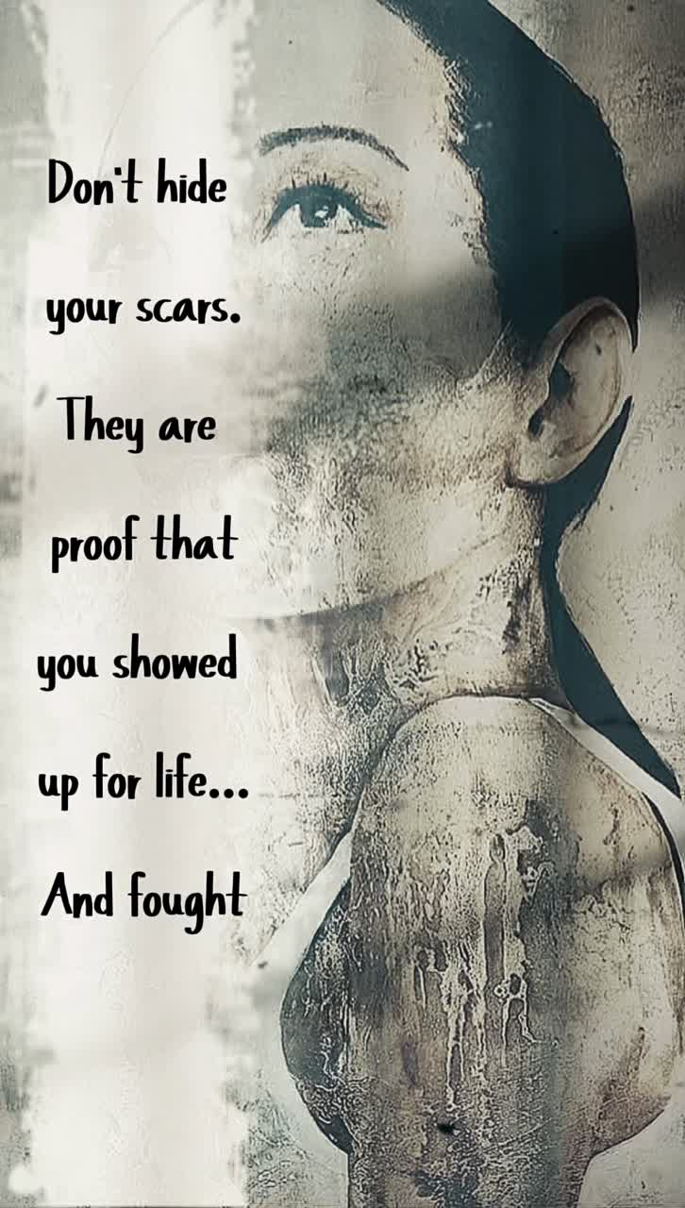
Hadassah:
Desert Mountain Region
Empowered Leadership
Hadassah is a national, women-led organization founded in 1912 that focuses on advocacy, health, education, and leadership. It supports community programs and global health initiatives while empowering women to lead and serve. Hadassah Desert Mountain continues this mission locally through events, awareness efforts, and community engagement.
The Dine & Discuss event created an important conversation around how to support survivors of sexual assault and domestic violence through awareness, resources, and empathy. It provided attendees with meaningful information and left the audience feeling heard, seen, and empowered.

Slide 4
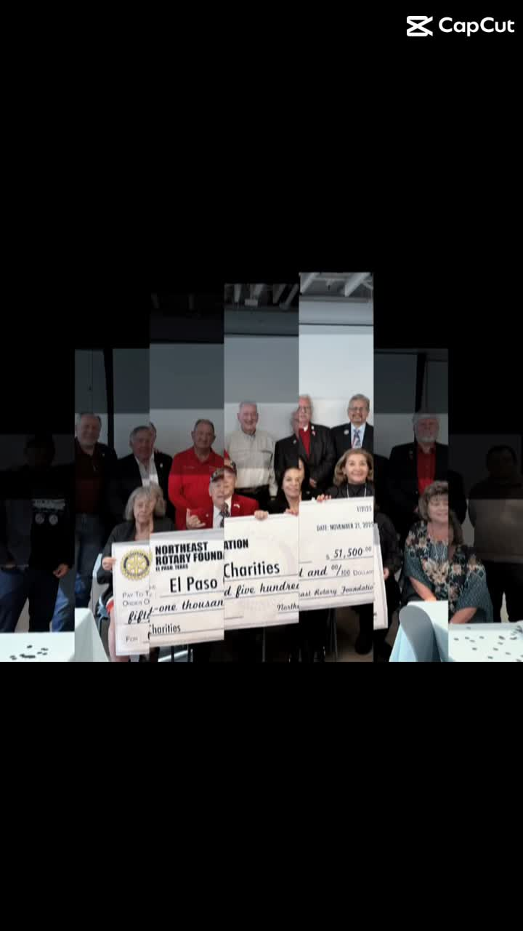
Northeast El Paso Rotary Club
United for Good
The Northeast El Paso Rotary Club is part of Rotary International, a worldwide service organization dedicated to helping communities. With the motto “Service Above Self,” the club supports El Paso through service projects, scholarships, outreach, and volunteer efforts.
This year our theme was “United for Good”.

Slide 5
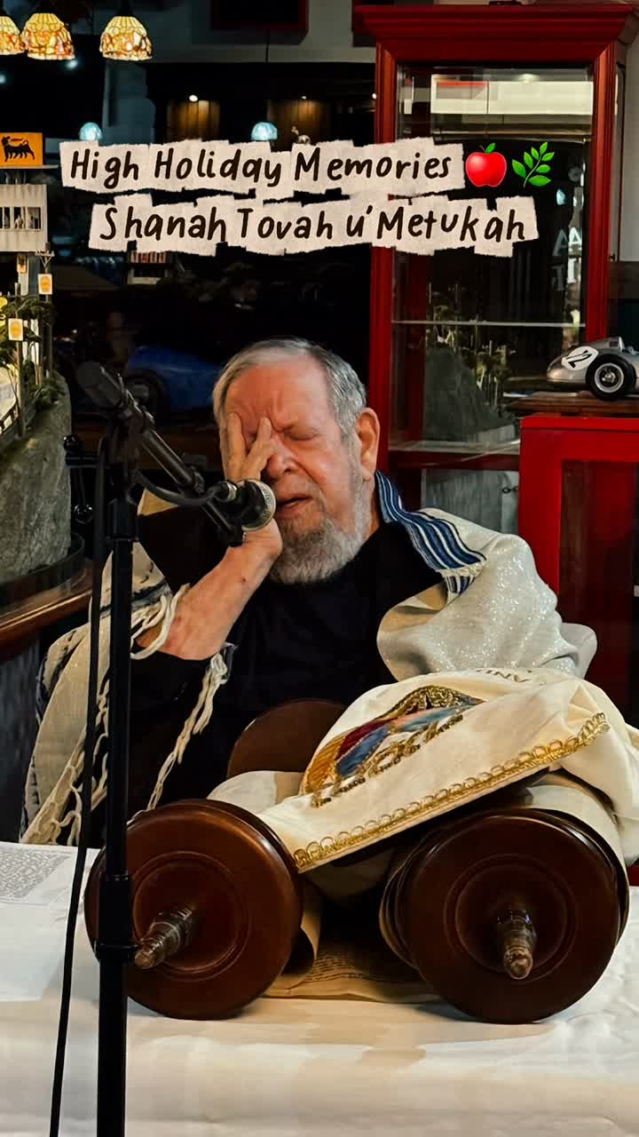
Anusim Center:
Celebrating Community and Identity
Preserving Heritage
The Anusim Center and Synagogue is a community centered on faith, identity, history, and belonging. Its mission is important because it helps preserve Jewish heritage while creating a welcoming space for community, learning, and meaningful connection.

Slide 6
Creative Growth, Reflection, and Gratitude
  Learned to use new tools such as CapCut to make my videos and storytelling more polished and professional
  Used photography to capture moments, memories, and the human side of service in the community
  Realized that each person brings light and helps make El Paso better, even through small actions
  Strengthened my efficiency, communication, leadership, and sense of purpose through volunteering
  Gained a deeper appreciation for mentors, community leaders, and the opportunity to help others feel seen

Slide 7
Final Reflection
  I enjoyed working with others and seeing firsthand the impact that the work we do as volunteers has on others.
  The least enjoyment was not having more time to help like I want to. Volunteering is not easy, especially if you work full-time and go to school.
  I learned that I need to be more open to what I need and when I need things. When creating a flyer or helping I would rather have the information way in advance than it piling up last minute.
  I still volunteer for these nonprofits; it's what makes me part of my community. I want to be more vocal about my needs and make sure I don’t stretch my time thin.

Slide 8
"Service is the heart of community"
I am grateful to be surrounded by strong leaders and empowered women who continue to mentor, guide, and inspire me through service.
Hadassah Desert Mountain
  Susie Schechner — President and Mentor
  Audrey Lavi — Past President and Mentor
  Gail Slater — Invited me to Hadassah and welcomed me to the team and Mentor
Northeast El Paso Rotary Club
  Arvis Jones — Past President and Mentor
Anusim Center and Synagogue
  Blanca Carrasco — Past President, and Mentor
  Rabbi Leon — My Rabbi and Mentor
  Iran Brown — Vice President and Mentor
  Sarah Williams — President and Mentor
And many more

