Slide 1
School of Nursing
Phase 1

Slide 2
Spring 2021 Phase 2
Ranking Timeline
Date | Process
Monday, November 16, 2020 | Ranking takes place in the a.m. Selection e-mails will be sent in the p.m. Refrain from calling or e-mailing so that we complete the ranking in a timely manner.
Monday, November 30, 2020 | Registration deadline at 5:00 p.m. CBC Information Form deadline at 5:00 p.m.
Tuesday, January 19, 2021 | Spring semester begins.
The Spring 2021 Phase 2 application is currently open and will close Wednesday, September 30, 2020.
Applications can be found in utep.edu/nursing then click on the Applications and Deadlines link on the left hand side.

Slide 3
Phase 2 Ranking Criteria
Criterion 1 | Pre-professional Courses (PPC) GPA Highest grade will be used for calculating PPC GPA
Criterion 2 | Overall GPA (minimum GPA to apply is 3.00)
Criterion 3 | TEAS Test (minimum score of 62%) Ensure that your TEAS score is up to date Your TEAS score is valid for 2 years—check your ATI account for your test date(s)

Slide 4

Additional Requirements to Apply to Phase 2
Due date: Monday, October 30, 2020
Proof of health insurance
  Must cover ER visits anywhere in El Paso, TX
  Discount health care programs are not valid
    Not insurance
    Provides members with discounts for health care services
Transfer credit
  Any missing required courses from Phase 1 must be transferred to UTEP by October 30th.
  Applicant will be ineligible to rank if courses are not transferred by the deadline.
Do not worry about these requirements until you are selected to Phase 2.
  Titers (An antibody titer is a laboratory test that measures how many antibodies are in a blood sample. The level of antibodies helps determine a person’s immunity level.)
  Criminal background check

Slide 5
Overall GPA
Minimum overall GPA to apply to Phase 2 is 3.00.
This applies to UTEP students and transfer students.
We will check the student’s previous institution’s overall GPA if the student is transferring to UTEP Phase 1 complete.
The overall GPA must be at 3.00 or better at the time of ranking.
  Ranking will take place Monday, November 16, 2020.
  If student’s overall GPA is below 3.00; student may opt to apply for a future semester when their overall GPA has improved to 3.00.
If the student is accepted on a conditional basis, we will check their overall GPA after final grades post.
  Student will be dropped from the Phase 2 courses if their overall GPA drops below 3.00 after final grades post.

Slide 6

TEAS Information
Deadline: October 31, 2020
Registration instructions: https://www.utep.edu/student-affairs/testing/tests/teas-distance-testng.html
UTEP is listed as U of TX El Paso
Achieve a total score of 62% or better
A passing TEAS score is valid for 2 years
There is a 30 day waiting period between attempts
TEAS test may be attempted up to 3 times within a 12 month cycle
Please enter your student ID number when registering for the test
Select this test option: TEAS at ATI (an online remote proctored exam)
    ATI will remote proctor the exam
    Testing is every Wednesday and Friday
    Capacity of 75 students per session

Slide 7
Academic Holds/UTEP Admissions
Spring 2021 window opens Monday, October 5, 2020
Contact the Office of Admissions
  If you have been out of UTEP for more than a year
  If you will be pursuing your second Bachelor’s degree
  Deadline to clear your inactive status with the University is Friday, November 13, 2020.
Clear holds from other departments
  Check your Goldmine account to view any holds starting Monday, October 5, 2020.
  Transfer Orientation
    If you are currently transferring from another institution.
    Contact the Office of New Student Orientation at orientation@utep.edu to sign up.
  Take care of financial holds with Student Business Services
  Complete the new student virtual orientation modules
    Communityofcare.utep.edu/faqs OR DOS@utep.edu
Contact the Graduate School and the Office of Admissions if you are currently pursuing your Master’s or Ph.D. Degree at UTEP.
  The DEADLINE to clear the above holds is Friday, November 13, 2020.

Slide 8
Phase 2 Selection Process
Full Admission/Conditional Acceptance
Ranking date: Monday, November 16, 2020
Acceptance e-mail with registration instructions will be sent out in the afternoon.
Students will be selected into Phase 2 with either full admission or conditional acceptance.
Full admission acceptance
  Phase 1 complete
  Competitive Pre-professional courses GPA
  Meeting the overall GPA of 3.00 or better and ATI TEAS total score of 62% or better
Conditional acceptance
  Student is in the process of completing Phase 1 in the fall 2020 semester at UTEP.
  Competitive Pre-professional courses GPA
  Meeting the overall GPA of 3.00 or better and ATI TEAS total score of 62% or better.
  Students will be dropped from Phase 2 courses if they fail or withdraw from Phase 1 requirements.

Slide 9
Phase 2 Expectations
If selected:
Must e-mail the CBC form to Assistant Dean at Myrna@utep.edu by Monday, November 30, 2020.
Must complete titers by a deadline set by the Clinical Compliance Coordinator.
Expected to read all information given to you from faculty or other nursing officials.
Passing a nursing course is 75 or better.
The Phase 2 semester is full-time so working a full-time job might interfere with your success in all three courses.
Discuss with instructors any issues affecting your performance in class.
Be PROACTIVE.

Slide 10
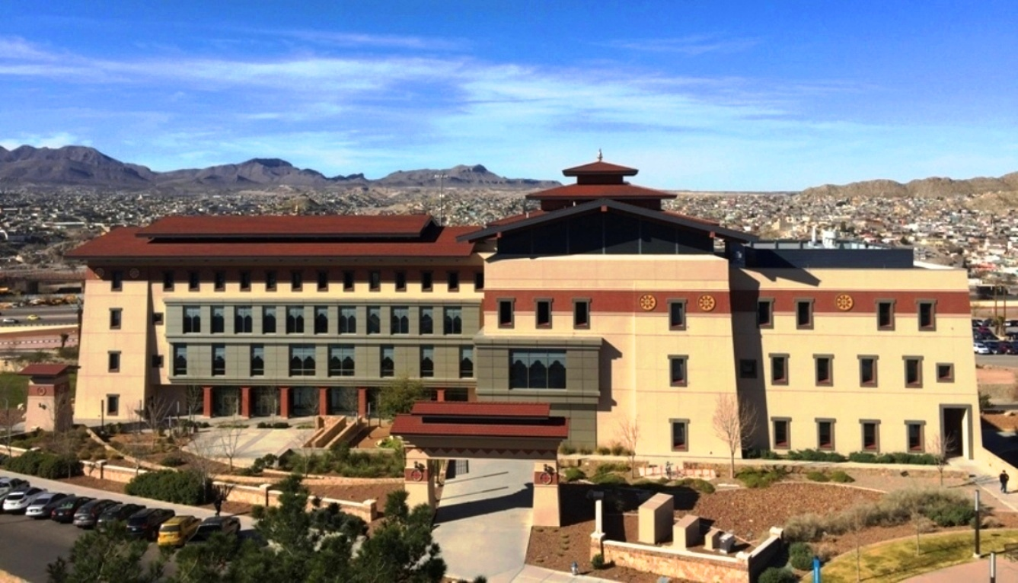
QUESTIONS ???
HAVE A SUCCESSFUL SEMESTER!

