Slide 1
Office of Research and Sponsored Projects
CITI
Export Compliance Registration Instructions for the Collaborative Institutional Training Initiative

Slide 2
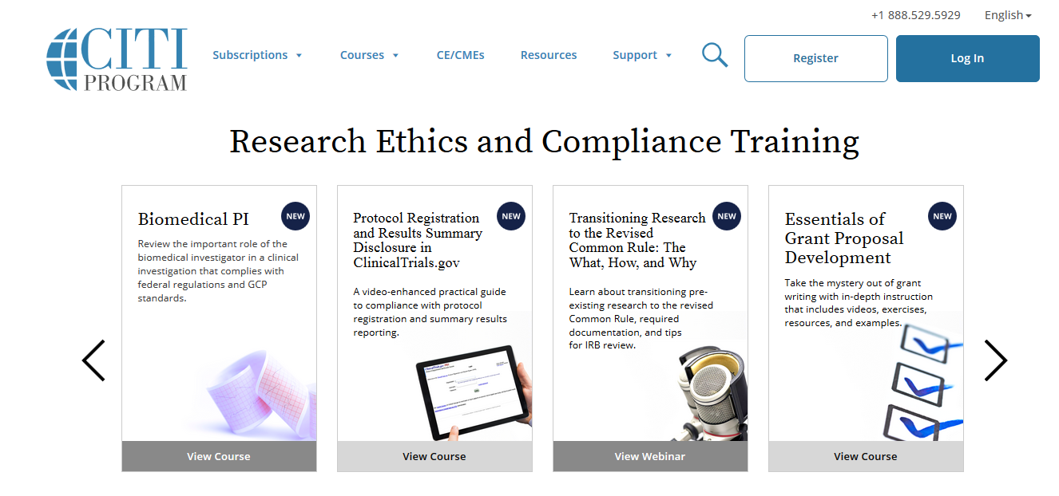
CITI Registration Instructions
Login/ New User Registration
New users click here to register
Go to the CITI Website: http://www.citiprogram.org
Existing users and or returning users log in here
NOTE: This is a 3rd party website and cannot be accessed with your miners login

Slide 3
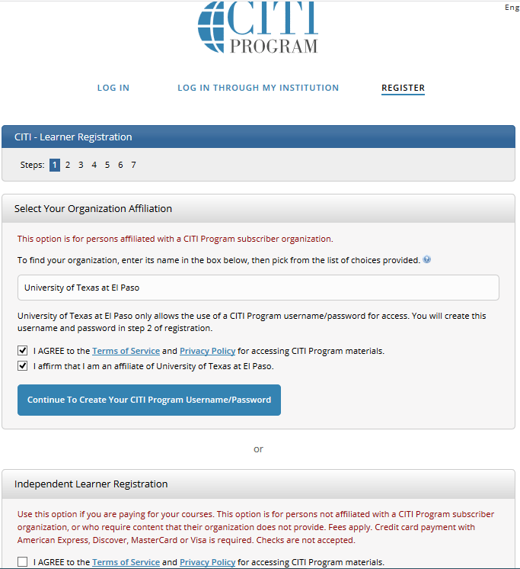
STEP 1
LOGIN/ NEW USER REGISTRATION
For new users, please complete the registration steps (1-7) to complete your profile/account set-up on the CITI Website.
Please enter “University of Texas at El Paso” in the search box. All active organizations are listed.
Next, Click on “ Continue to create your CITI Program Username/Password” at bottom.

Slide 4
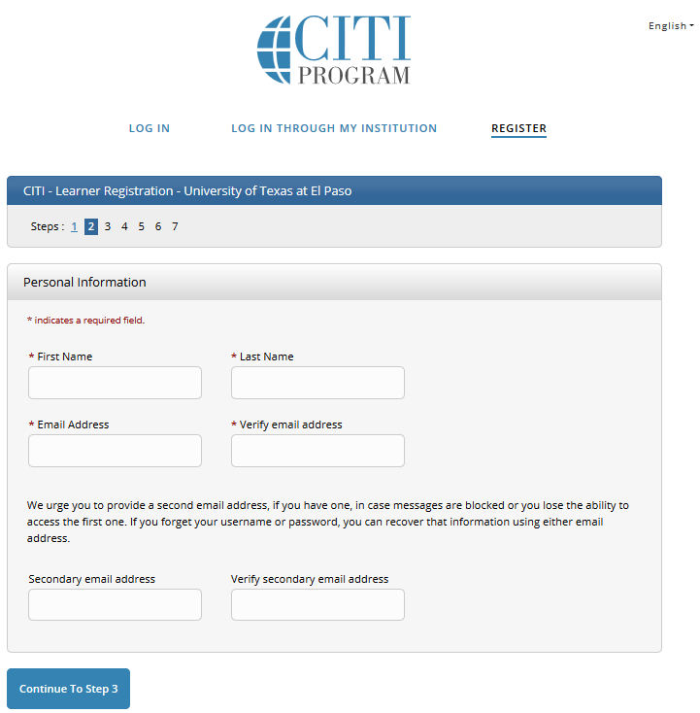
LOGIN/ NEW USER REGISTRATION
STEP 2
Please enter first name, last name and email information.
Next, click on “Continue to Step 3”
Note: Please use your UTEP email as your log-in email address
NOTE: We do encourage entering a secondary email address. It will assist in the recovery of your account if you forget your username/ password and no longer have access to your primary email address.

Slide 5
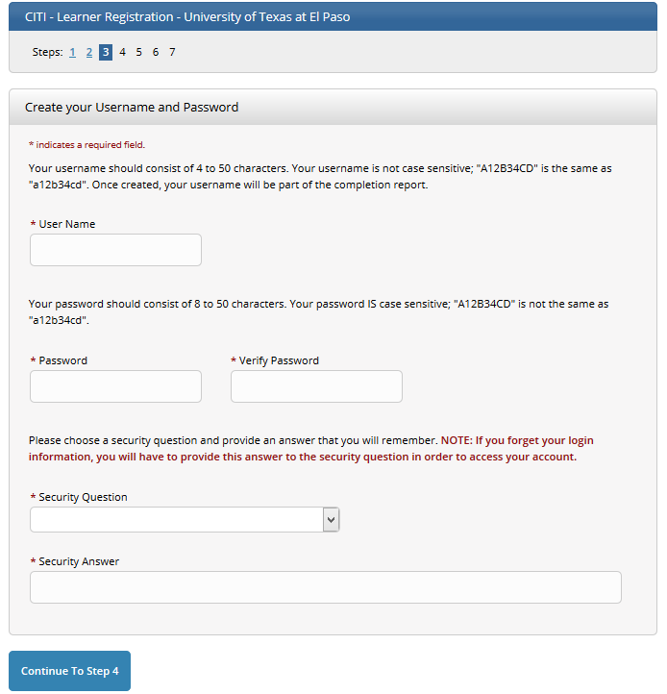
LOGIN/ NEW USER REGISTRATION
STEP 3
Please create a memorable username and password for ease of returning to this training site.
Choose your desired security question and answer.
Next, Click “Continue to Step 4”

Slide 6
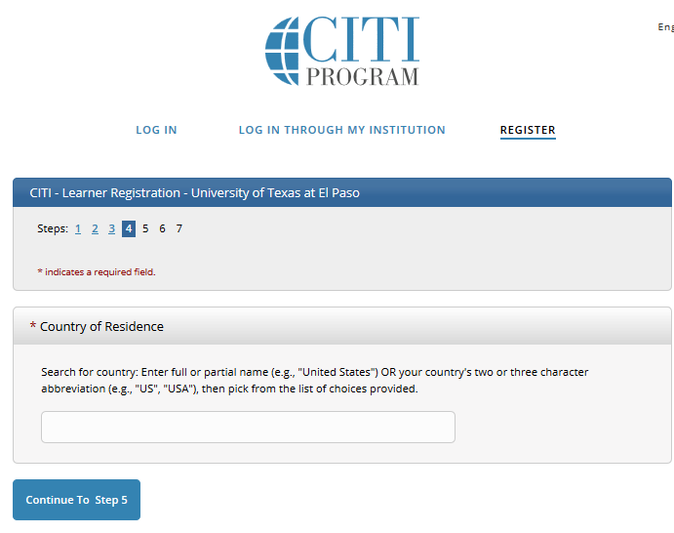
LOGIN/ NEW USER REGISTRATION
STEP 4
Select your country of residence.
Next, click “Continue to Step 5”

Slide 7
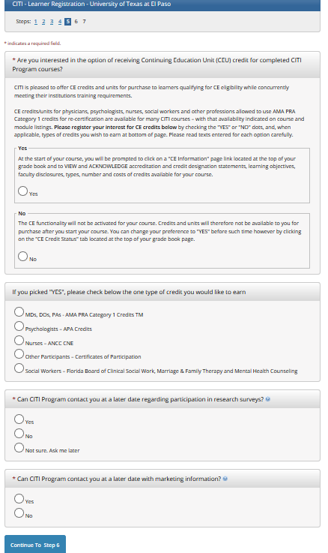
LOGIN/ NEW USER REGISTRATION
STEP 5
Click on the desired Continuing Education Unit (CEU) credit options, if interested in receiving credits. This is not required for Export Compliance training. Click “No”, if not interested in CEU credits.
Answer CITI survey questions.
Click “Continue to Step 6”

Slide 8
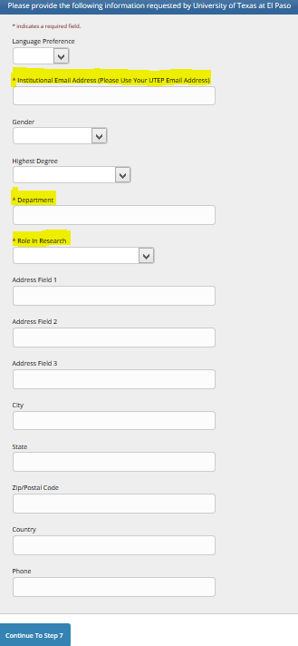
LOGIN/ NEW USER REGISTRATION
STEP 6
Please fill-out the required information pertaining to UTEP.
Note: Please use your UTEP E-mail for the “Institutional email address”.
Click on “Continue to Step 7” below.

Slide 9
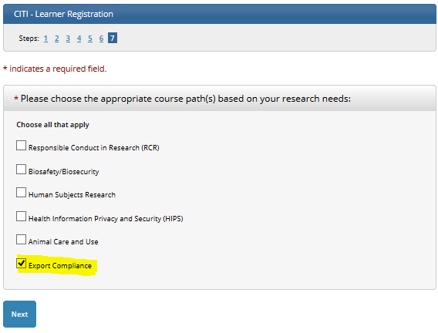
LOGIN/ NEW USER REGISTRATION
STEP 7
Please select “Export Compliance” checkbox and click “Next”

Slide 10
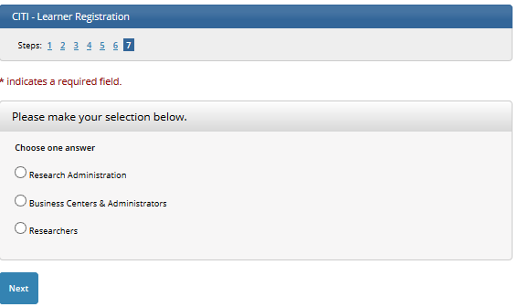
Please make your selection below and click “Next”

Slide 11
Click on “Finalize Registration”

