Slide 1

Research Administration
Life Cycle of a Grant
Notes:
Add the 3 teams in bullets

Slide 2
Office of Sponsored Projects
Pre-Award
Contracts and Agreements
Post-Award
Notes:
Add the 3 teams in bullets

Slide 3




Office of Sponsored Projects
Pillars and Functions
Pre-Award
Contracts and Agreements
Post-Award
Supports faculty by facilitating the preparation, review, and submission of funding applications
Facilitate and execute research agreements
in support of the university’s research mission
Assist faculty in award stewardship, compliance, management and closeout
Key Initiatives:
Research Agreement Review & Negotiation
Contract Execution & Institutional Approvals
Subaward Issuance & Oversight
Compliance, Risk & Institutional Protection
Confidentiality, Data & Material Agreements (NDA, MOU, DUA, MTA) & Faculty Support
CLM Administration, Templates, Guidance & Agreement Repository
Key Initiatives:
Compliant Submissions
Sponsor, System, and Administrative
guidance
Budget Development and Support
Regulatory and Policy Compliance
Key Initiatives:
Award Setup
Management and Oversight
Regulatory and Policy Compliance
Award Lifecycle Management
Award Closeout

Slide 4

Office of Sponsored Projects
Notice of Intent (NOI) *Off campus? Connect to VPN first
Every proposal must start with an NOI initiated by the PI
A designated Pre-Award RA is assigned upon NOI submission
Proposal Timelines
PI submits NOI at least 12 weeks prior to sponsor deadline (complex proposals)
PI submits NOI at least 4 weeks prior to sponsor deadline (standard proposals)
PI provides complete proposal to designated Pre-Award RA 5 business days before sponsor deadline. This includes budget, budget justification, cost share commitments, required resources, subawards, disclosures.
Scientific narrative may be a draft, but ready for compliance review.
On time submissions receive a full OSP review
Submissions under 5 days: limited review only (budget input/accuracy & system/validation error check)
Subcontracts
Handles both incoming subcontracts (UTEP as a subrecipient) and outgoing subcontracts (UTEP as lead with subrecipient)
All subcontract proposals require an NOI and follow standard proposal submission processes
Sponsor Review
Review sponsor requirements and provide PI proposal checklists
Budget and Cost Share
Develop, review, and provide feedback of sponsor and cost share budgets
Dean approval required for all cost share budgets/commitments prior to proposal submission
Cost share included only when required by the sponsor
Provide guidance on allowable/unallowable costs (sponsor and institutional limits, e.g. participant expenses, UTEP student stipends)
Compliance and Approvals
Coordinate administrative reviews and institutional processes (e.g. transmittal)
Proposal Submission
Submit funding applications as UTEP’s Authorized Organizational Representative
Helpful resources
Roles and Responsibilities Matrix
Frequently Asked Questions (FAQ)
Pre-Award
Supports faculty by facilitating the preparation, review, and submission of funding applications while ensuring sponsor requirements and institutional compliance.
Key Initiatives:
Compliant Submissions
Sponsor, System, and Administrative Guidance
Budget Development and Support
Regulatory and Policy Compliance
utep.edu/research/office-of-sponsored-projects/services/pre-award.html

Slide 5
Contracts and Agreements
Strategic Consultation & Agreement Planning
We collaborate with colleges and departments early to identify agreement needs, including non-sponsored research agreements requiring institutional signature, assess risk, and determine the appropriate contract structure for your project or partnership.
Faculty should first contact their college or department CLM point of contact (POC) for assistance in initiating agreements.
Agreement Review, Negotiation & Compliance Support
We review externally drafted agreements and develop or apply approved institutional templates in the CLM system to ensure alignment with UT System policies, state regulations, and sponsor requirements, while coordinating and supporting engagement with external parties during negotiation to clarify terms, resolve issues, and protect institutional interests while maintaining a customer service-based approach.
Subcontract Development, Management & Oversight
We support the full lifecycle of subcontract agreements (when UTEP issues subcontracts to outside entities). We facilitate subcontract setup, monitor compliance and performance, and ensure timely execution, reporting, and closeout in accordance with contractual and regulatory standards.
Execution & Compliance Support
We facilitate routing, approvals, and execution of all agreements requiring institutional signatures
Repository Management
We maintain the official CLM system repository for all executed Research & Innovation agreements.
Facilitate and execute research agreements
in alignment with the University’s research mission
Key Initiatives:
Research Agreement Review & Negotiation
Contract Execution & Institutional Approvals
Subcontract Issuance & Oversight
Compliance, Risk & Institutional Protection
Confidentiality, Data & Material Agreements (NDA, MOU, DUA, MTA) & Faculty Support
CLM Administration, Templates, Guidance & Agreement Repository
Funded research agreements are managed through the Office of Sponsored Projects and are initiated by the assigned Research Administrator.
utep.edu/research/office-of-sponsored-projects/services/contracts-and-agreements.html

Slide 6

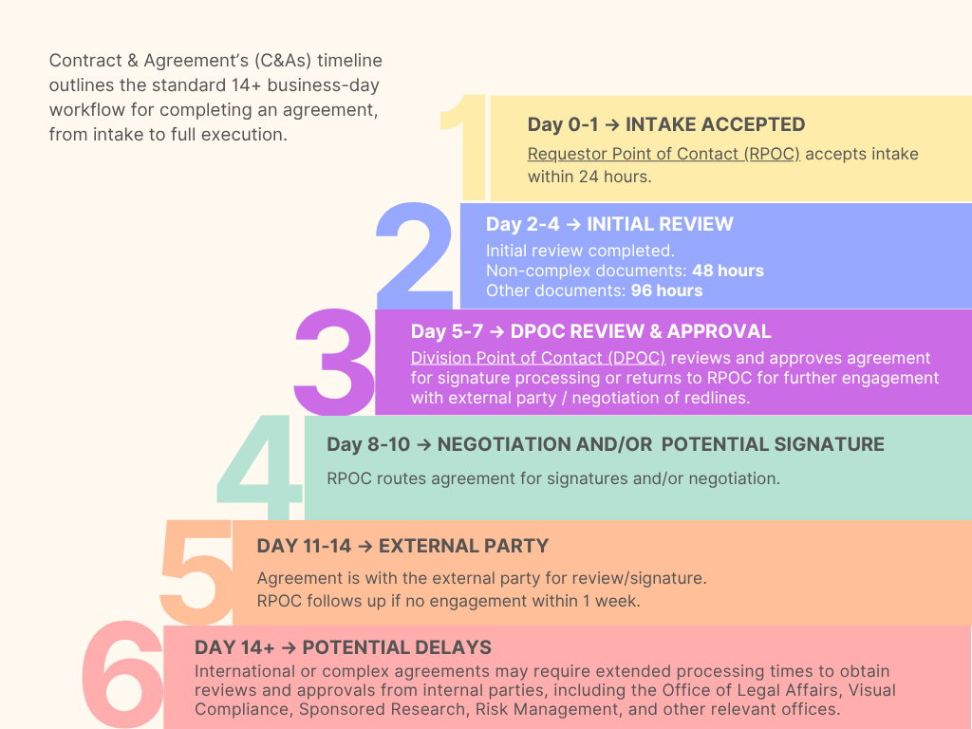
Contracts and Agreements

Slide 7
Post-Award
Award setup
Creation and review of Notice of Award (NOA) documentation to accurately capture new award details.
NOA meetings offered to new faculty and upon request, with participation from OSP and GMA and department personnel.
NOAs will be distributed to PIs, Co-PIs, Department Admins, CAOs, etc.
Management, and Oversight
The R&I Dashboard is new award management system replacing Project Information Center (PIC).
The PI has primary responsibility for managing the award, in collaboration with the department, and for completing all required progress reports.
Regulatory and policy compliance
Ensure adherence to sponsor terms and conditions, institutional policies, and applicable regulations throughout the life of the award.
UTEP Research Protections will review Federal awards subject to compliance.
Awards could be subject to security training requirements, CUI or EC policies.
Assist faculty in award stewardship, compliance, management and closeout
Key Initiatives:
Award setup
Management and Oversight
Regulatory and Policy Compliance
Award Lifecycle Management
Award Closeout
utep.edu/research/office-of-sponsored-projects/services/post-award.htm

Slide 8
Post-Award
Award lifecycle management
Provide ongoing oversight and coordination of award activities, including sponsor approvals and modifications.
OSP Post Award will assist with:
-Additional Allocations
-Budget Revisions
-Change of PI or Co-PI
-No Cost Extensions
-Internal NCEs or Pre-Award Allocations
-Change in Scope of work
-Others Post-Award actions as needed
Closeout requirements
Track and ensure timely and compliant award closeout.
Standard Closeout reporting requirements include:
-Final technical reports
-Final financial reports
-Final Invoice
-Property reports
-Inventory reports
Assist faculty in award stewardship, compliance, management and closeout
Key Initiatives:
Award setup
Management and Oversight
Regulatory and Policy Compliance
Award Lifecycle Management
Award Closeout
utep.edu/research/office-of-sponsored-projects/services/post-award.htm

Slide 9
Office of Sponsored Projects
Small Dollar Awards
Definition:
External funding, typically under $15,000, with limited administrative, reporting, or compliance requirements.
Criteria:
-The award is small in amount. (less than 15,000)
-The sponsor does not require formal financial reporting, detailed documentation, or compliance oversight that would require OSP or other R&I offices review and approval.
Requirements:
A University cost center may be established under the requesting department or college with the approval of the Budget Office and relevant department or college.
The department or college assumes full fiscal and administrative responsibility, including expenditure tracking, billing and communication with the sponsor.
OSP and GMA will not manage or oversee the account but may provide procedural guidance in conjunction with other relevant parties at the University.
Policy link:
https://www.utep.edu/research/office-of-sponsored-projects/policies/admin-small-dollar-awards.html
State Appropriation Funding
Awards funded with State Appropriations funds are not managed by OSP. Instead, they are administered by the Budget Office and set up as a cost center.
Assist faculty in award stewardship, compliance, management and closeout
Key Initiatives:
Award setup
Management and Oversight
Regulatory and Policy Compliance
Award Lifecycle Management
Award Closeout
utep.edu/research/office-of-sponsored-projects/services/post-award.htm

Slide 10
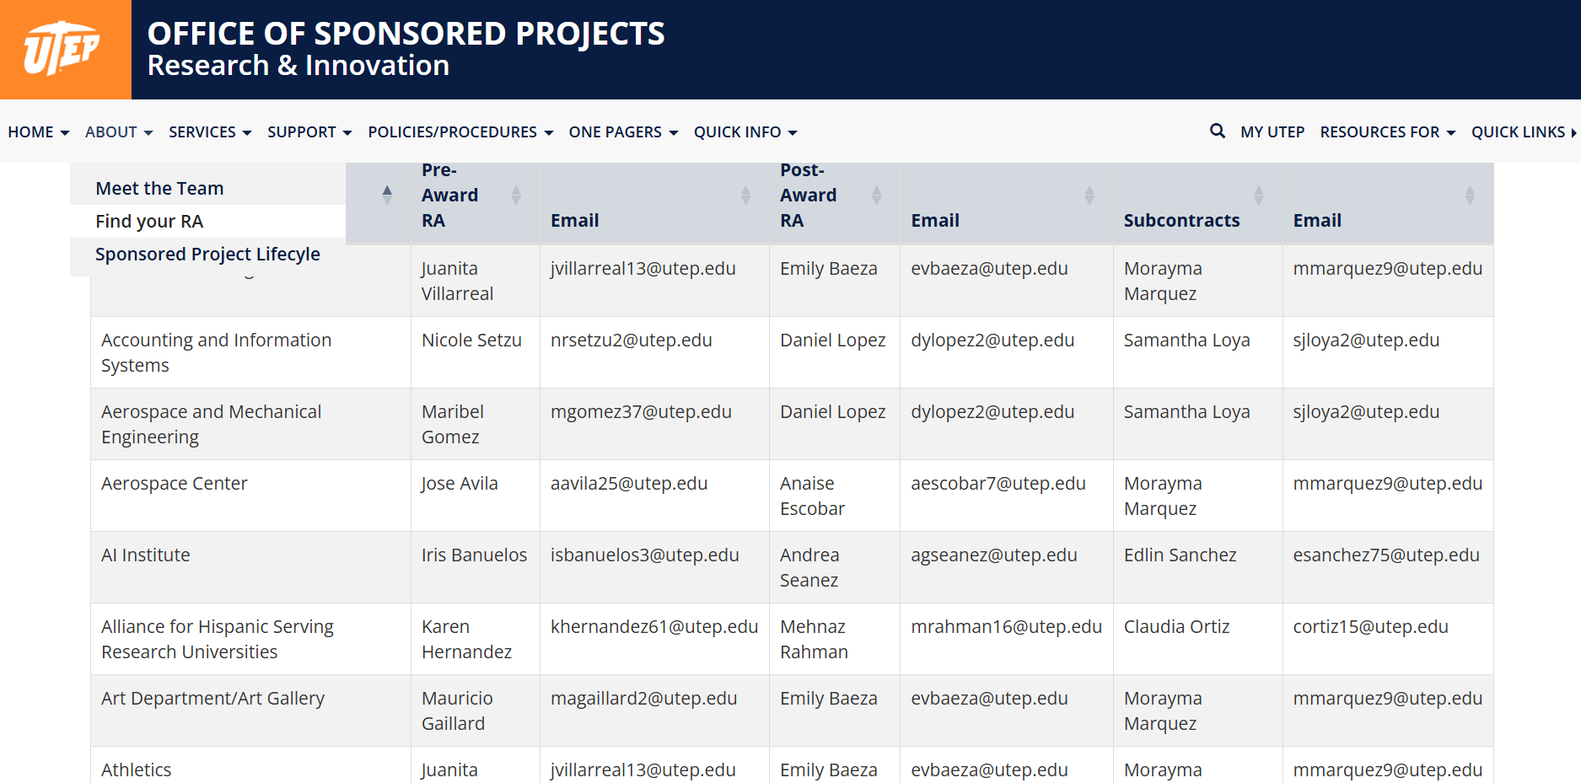
Find your RA
utep.edu/research/office-of-sponsored-projects/

Slide 11
Contact Information
OSP@utep.edu
agreements@utep.edu
Please contact us if you need training or assistance
We are here to help!
utep.edu/research/office-of-sponsored-projects/

Slide 12
Grant Management Accounting
Grants Accounting
Support Center
Cash Management
Notes:
Add the 3 teams in bullets

Slide 13
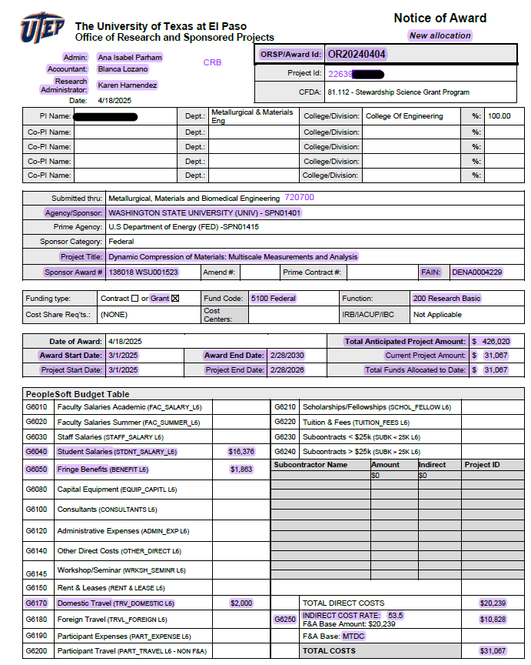
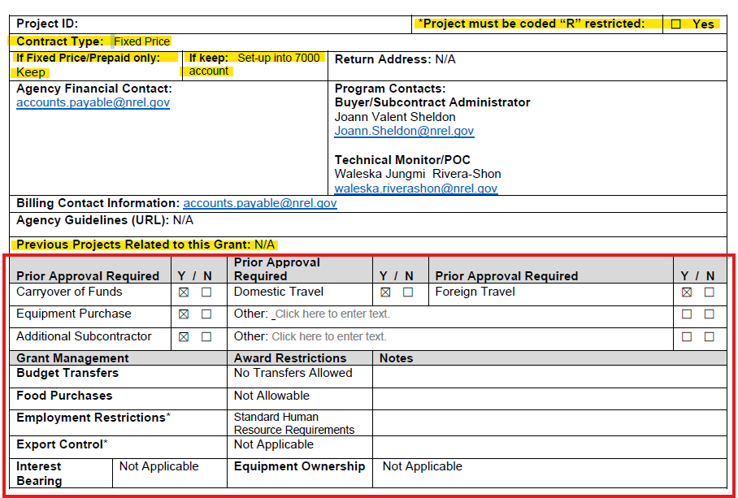
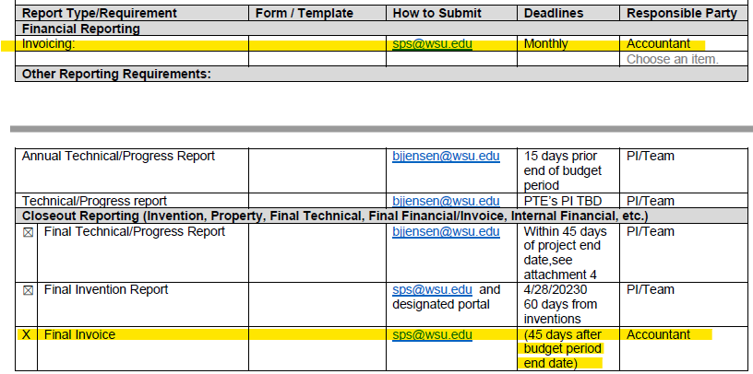
Grants Accounting
New Award Set Up
All information from contract/agreement SHOULD match information on NOA

Slide 14
Grants Accounting
NCEs / Additional Allocations / Carryover Requests
NCEs/Additional Allocations
No-Cost Extensions (NCEs)
Add/adjust funding within an award
Requires review of carryover type (automatic vs. non-automatic)
Dates are updated in the system to match sponsor-approved period
Additional Allocations
Extend project end date without additional funding
Allow time to complete work and spend remaining funds
Require sponsor approval and system date update
Carryovers:
AUTOMATIC
A second allocation is received
Prior-year funds retained
Same project ID used.
NOT AUTOMATIC
A second allocation is received
Agency will determine if prior-year funds can be retained
A different project ID is used to keep both allocations separately.

Slide 15
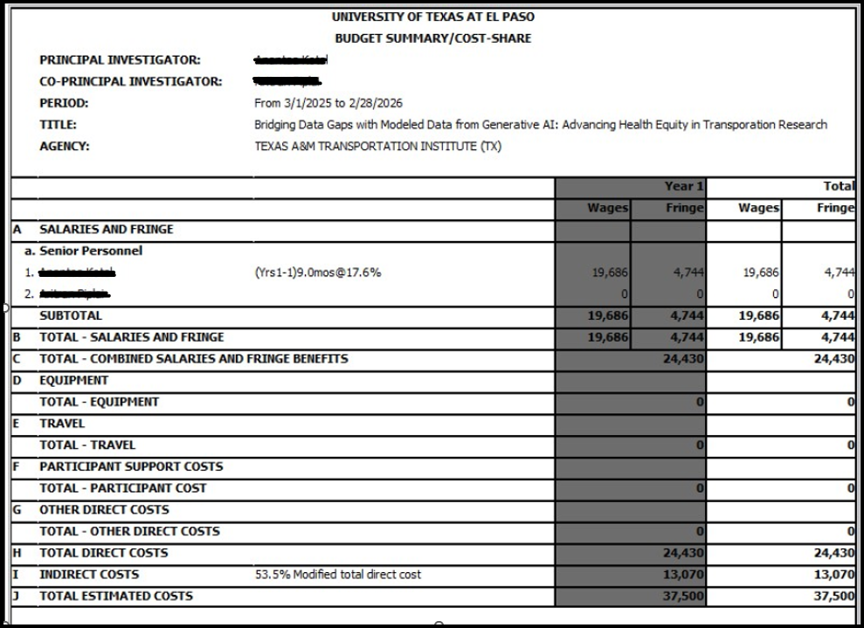
Grants Accounting
Cost Share
Commitment made by the Institution to fund the portion of project cost not funded by the sponsoring agency.
May be for direct and/or indirect costs
May consist of Institutional Funds or Funds from other outside sources (third-party agreements).
Mandatory (Required by the sponsor, included in the proposal and approved in the budget)
Must be tracked
May require reporting
NOTE: per policy, VOLUNTARY cost share is discouraged.
https://www.utep.edu/research/office-of-sponsored-projects/policies/cost-share-policy.html

Slide 16
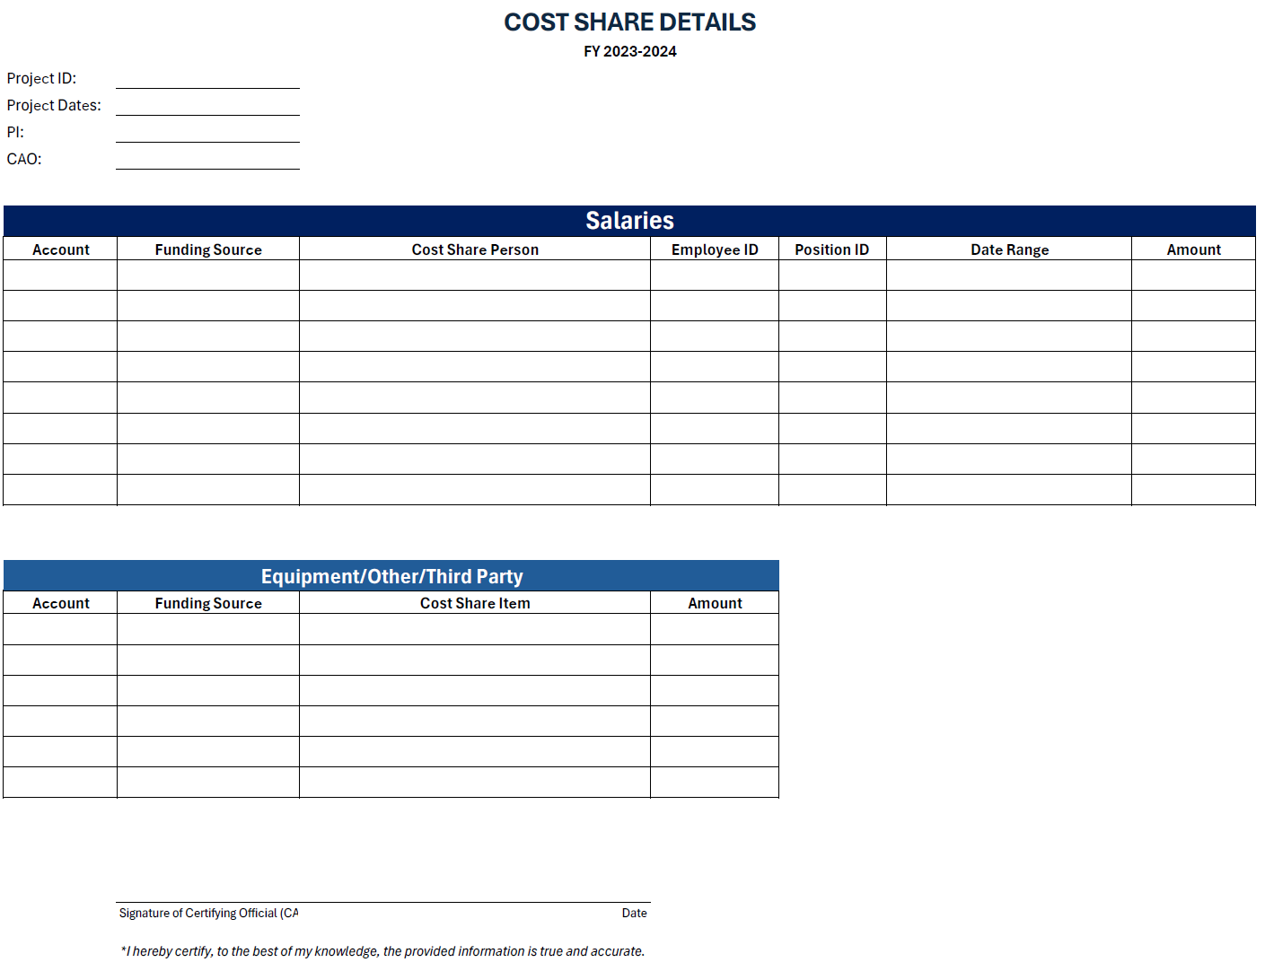
Grants Accounting
Cost Share: Expectations of GMA and Department
GMA
Track and Document Cost Share throughout the process.
Set up initial Cost Share meetings with department personnel and Pre/Post Award RAs.
Send complete information to budget office for review and approval of the new Cost Share Cost Center (CSCC).
Populate the CSCC budget under the Project.
Appoint designated personnel to the new CSCC
Maintain continuous communication with department about Cost Share Status
Report Cost Share to sponsoring agency as requested.
Report Cost Share progress to Colleges Deans and CAOs every quarter.
Ensure all expenses are fully spent by the project’s deadline and project cost share requirements are met.
Department/PI/CAO
At proposal stage provide
Dean Approval
Funding Sources
Budget by Fiscal Year
Names of personnel being cost shared
Once set up
Spend balance according to plan – balance not met by end of FY will need to be made up the next FY.
Review and approve monthly reconciliations
Ensure project cost share requirements are met
Notes:
Add the mandatory meetings and add pre and post RA

Slide 17
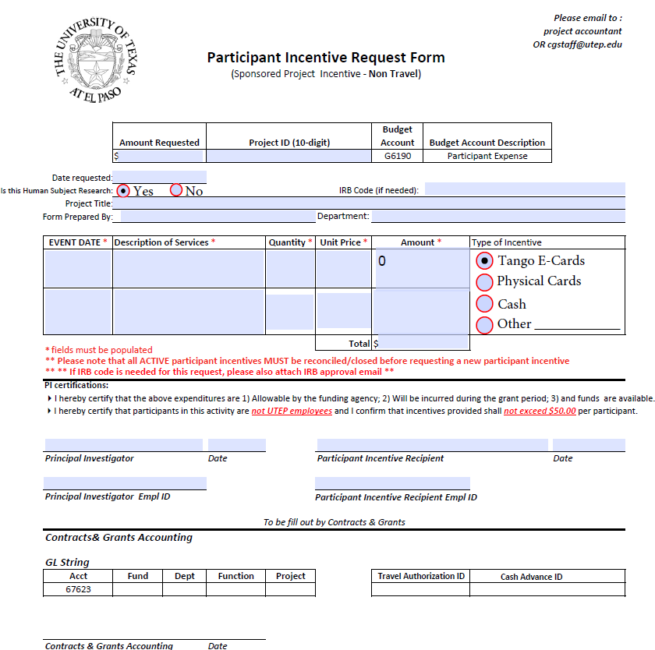
Grants Accounting
Participant Incentives/Cash Advances
Process is used to provide funds as research incentives in the form of cash or gift cards following the University policies.
Department is to request, complete and return the form to GMA accountant, including PI approval and IRB protocol when needed
Track all transactions disbursed from each cash advance and submit final documentation to GMA.
TANGO – e-Gift Cards
GMA creates the Tango accounts
GMA requests invoice from Tango and process payment via Non-PO Voucher.
Once payment has been processed, funds are added to the Tango account.
GMA notifies department and they start using the funds.
The Department provides the final participant log once completed.
GMA processes any refunds and final expense to project.
NOTE: A new cash advance will not be approved if existing advance has not been fully reconciled.
https://www.utep.edu/hoop/section-7/ch-12.html

Slide 18
Support Center
eForms
Reviewed by the SC
  Appointment Request (APT)
  Transfer (TRF)
  Job Attribute Change (JAC)
  Position Funding Change
  Additional Pay (ADP)
  SEARs (now submitted through PAC as of 5/1/2026)
Key Items we review
Justification/Allowability
Employee name
Standard Hrs/Wk
Salary
Job Code/Title (Research positions are only allowed under Fund Code 200 - Research)
Proposed Funding Section
Funding start and end date
Project
Distribution percentage
Amounts

Slide 19
Support Center
Over 90 Days Retroactive Requests
Requests involving salary expenses dated back more than 90 days from the original payment date must have prior approval from our Director.
Each request must include a detailed justification explaining:
  Why the appointment or transaction was not processed within 90 days
  Any delays in getting things approved or submitted
  Steps taken to prevent recurrence
These requests are submitted to our office through the CGSC@utep.edu email account.
Once reviewed for completeness, they are forwarded to the Director for final approval.
Request should never be sent directly to the Director.
https://www.utep.edu/hoop/section-7/ch-11.html
https://www.utep.edu/research/office-of-sponsored-projects/policies/cost-transfers-for-sponsored-projects.html

Slide 20
Support Center
SNOAs – Student Notice of Awards
Scholarship
Tuition Support
Doctoral RA Remission (Tuition Remission)
Key Items we review
sufficient project funding is available
award dates align with the project period
student's employment status
all institutional and sponsor regulations are met.
Other Financial Assistance (stipend payments to UTEP students) effective as of 5/1/2026
For stipend payments made to UTEP students, these must be submitted using the Scholarship type.
In the comments section of the form, it is important to include all required details. This includes clearly indicating that the SNOA is a stipend, the frequency of the payment, the amount, the name of the recipient or recipients, and the benefit to the grant. All relevant supporting information should also be included, along with the account that will be charged.
*Although the process has transitioned to SNOAs, it is important to note that the budgetary account used for these payments remains G6205.
https://www.utep.edu/hoop/section-7/ch-15.html

Slide 21
Support Center
Expense Reports - travel and non-travel
Travel:
Travel authorization
Airfare
Itemized lodging receipts
Transportation receipts
Meals (Meals actuals or per diem)
Rental car receipt
Supplies/Materials purchased for travel
Conference registration
Mileage
Non-Travel:
  Food purchases (Entertainment Expense form and itemized receipt, account is used correctly)
  Materials/Supplies (reimbursements need justification as to why they were not purchased through Miner Mall)
  Controlled property/items (we check the purchase cost of the item)
  Controlled equipment (coded correctly using the correct expense account)
  Computer equipment controlled
  Computer Equip. & Parts Expensed
  SC sends a monthly report to AP detailing ER's related to materials purchases.
  SC sends a monthly report to AP identifying ER's with expense dates exceeding 90 days.
Notes:
Add screen shot of people soft’s expense report

Slide 22
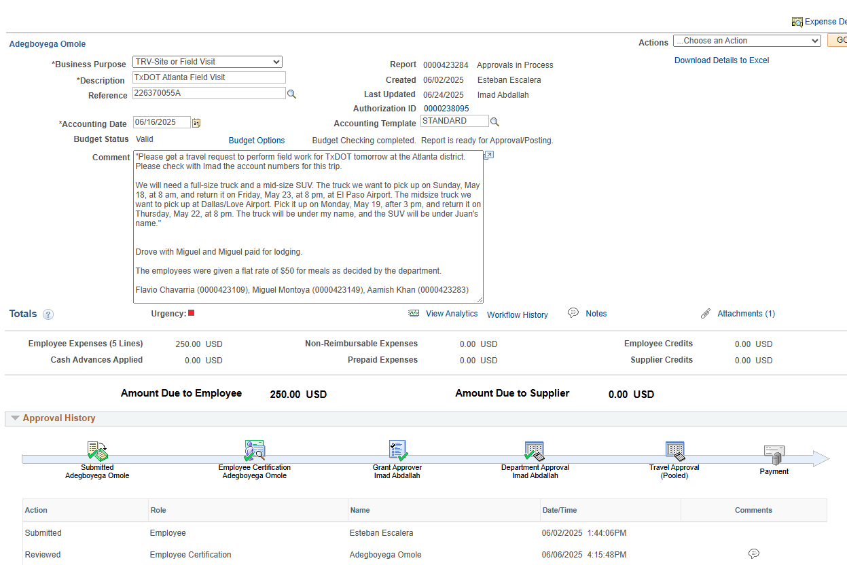
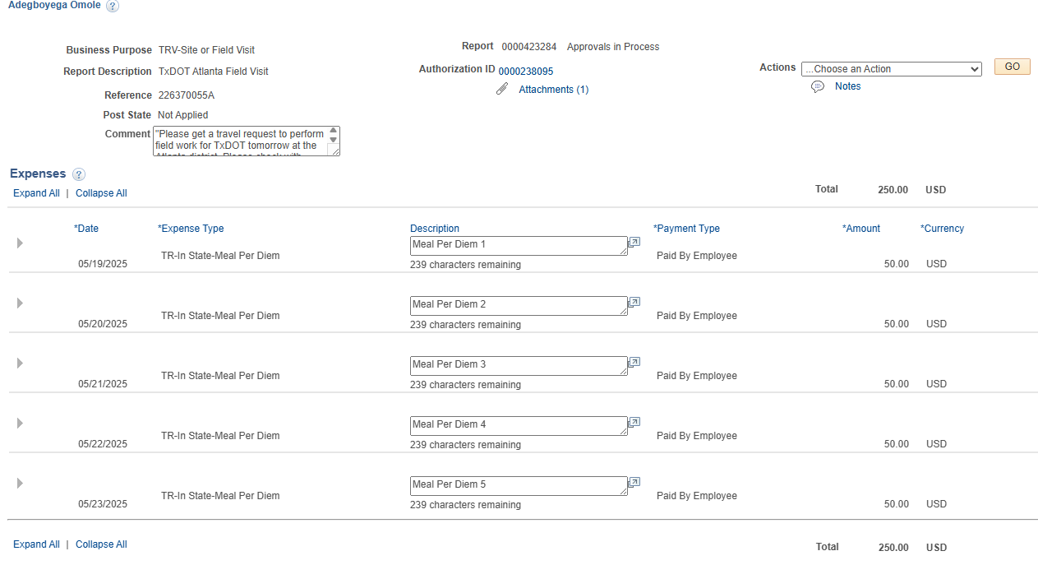
Support Center
Expense Report Example
TA Linked to ER
Attachments
Name
Amount Due
Benefit to the grant/Additional Details
Expense Lines

Slide 23

Support Center
Vouchers
We review vouchers submitted in PeopleSoft to ensure compliance and accuracy before processing payments. The most common type of vouchers we receive are:
Vendor Payments
APS (consultants)
Stipends (non UTEP students)
Subcontracts payments – GMA processed
Key Items we review
Item | Review Criteria
Invoice Number | Must match exactly between PeopleSoft and the physical invoice. Confirms the correct invoice is being paid.
Total Amount | Must match the invoice’s total to prevent over/underpayment.
Attachments | All supporting documentation must be included (invoices, memos, emails, etc.).
Comments | Project Admin must justify how the expense supports the grant. Include relevant info (e.g., why MinerMall wasn't used). Missing info requires follow-up.
Expense Account | Must be an appropriate expense account (6-series only): Not allowed: 4-series (revenue), 5-series (salary), 7-series (F&A), 8-series (equipment). Always verify every distribution line.
Project | Must list the correct grant being charged.
Address | Vendor address in PeopleSoft must match the invoice.
Schedule Due | Confirm appropriate payment scheduling.
Late Charges | Grants do not pay late fees. This field must be left blank.

Slide 24
Support Center
Authorization of Professional Services (APS forms)
For individual consultants who will provide consulting or specialized services to the grant.
An APS form is required for payments over $250.
For payments under $250, an invoice is required
  must include the date services were provided
  a description of the services provided
  the amount to be paid
APS forms cannot be used for active employees; an Additional Pay form must be processed with Payroll for employees.
Key Items we review
Item | Review Details
APS Form | Must be completely filled out Approval certified signatures
Attachments | Consultant’s CV or resume Invoice (includes date, services provided, amount)
Address Match | Consultant’s invoice address must match with what’s in the voucher’s payment tab.
Allowability | Verify expense is allowable per grant terms and if they have available budget.
Visual Compliance Check | Perform a compliance search to ensure the consultant is not restricted or flagged.
Final Routing | Once approved, route the completed package to Payroll for processing through email.
Coming Soon: Electronic Form
Notes:
ADD COPY OF APS FORM

Slide 25
Support Center
IDT’s (Interdepartmental Transfers)
Starting 9/1/2025, IDT’s being charged on grants should be reviewed by the support center.
An Interdepartmental Transfer (IDT) is the process of charging an expense to the project once a service has been provided.
Process Overview:
IDT requests are submitted to the CGSC email (cgsc@utep.edu).
Requests are reviewed by the CGSC office for accuracy and completeness.
Once all required information is verified, approvals are obtained, and cost allocations are confirmed, the IDT is processed in PeopleSoft.
Examples:
SODEXO Food Services, LARC Services, Xerox Postage, REAS Charges
Key Items we review
PI Approval
Invoice for services
Grant period dates
Allowability of the expense
Available budget
Appropriate expense account classification

Slide 26
Support Center
Purchase Requisitions (Miner Mall)
Starting 9/1/2025, PR’s are reviewed by the Support Center.
Our office reviews purchase requisitions submitted through Miner Mall when the funding source is a sponsored project.
Key Items we review
Grant period dates
Benefit and relevance to the project
Allowability of the expense
Available budget
Appropriate expense account classification

Slide 27
Most Common Expense Accounts (Purchase Requisitions)
Expense Account | Budget Account | Description
60104 | G6100 | Other Professional Services
60106 | G6100 | Consultant Services – Other
60103 | G6140 | Information Technology Services
60373 | G6140 | Freight/Delivery Service
67616 | G6140 | Freight/Delivery Service
63001 | G6140 | Consumables
63004 | G6140 | Food for Research
63005 | G6140 | Chemicals and Gases
63204 | G6140 | Supplies/Materials – Agriculture, Construction, and Hardware
67606 | G6140 | Fees and Other Charges
67620 | G6140 | Fees and Other Charges MISC
63103 | G6140 | Furnishings & Equip Expensed
63142 | G6140 | Computer Equip & Parts Exp'd
63162 | G6140 | Furnishings & Equip Controlled
63163 | G6140 | Computer Equip Controlled

Slide 28
Grants Accounting
Budget Transfers and Expense Transfers
BUDGET TRANSFERS
(Moving funds between categories)
  Initiated by the department, approved by PI.
  If transfer restrictions exist, the request may be denied.
  Restricted transfers may require agency approval.
  Transfers between different projects require OSP approval. Transfer is processed internally between OSP and GMA.
EXPENSE TRANSFERS
(Reclassification of posted expenses)
  Initiated by the department and approved by PI.
  Requires review for allowability and available funding.
  Should be processed within 90 days of original posting.
  Must comply with University policy requirements: https://www.utep.edu/research/office-of-sponsored-projects/policies/cost-transfers-for-sponsored-projects.html
Must look for restrictions:
-10% Restriction of total award amount
-Cannot transfer out of certain category
-No transfers allowed
Restrictions:
Expense transfers over 90+ days may not be processed
GMA Budget Transfer Form
GMA Expense Transfer Form
Notes:
Make notes about the restrictions about budget transfers
90 days restrictions for expense transfers

Slide 29
Grants Accounting
Sahara Reconciliation Reminders
Process is owned by Office of Vice President for Business Affairs (VPBA)- VPBA Account Reconciliation Review
“The one-to-one match of a department’s supporting documentation to actual charges against the Department’s Cost Centers and Projects. This ensures that expenditures are properly authorized and charged to the correct account and identifies any discrepancies or errors that need to be resolved.”
GMA will be sending reminder emails for projects that have one or more months pending either
Pending Reconciliation - Administrators
Pending Approval – PI
Goal is to have 100% completion
Tools
Video tutorial that take less than 15 minutes to complete https://utep.questionpro.com/t/AUN6HZ0UDV
SAHARA Training Documents
PeopleSoft Training Calendar to register for a training session.
Policies
https://www.utep.edu/hoop/section-7/ch-5.html
https://www.utsystem.edu/board-of-regents/policy-library/policies/uts1421-policy-annual-financial-report

Slide 30
Cash Management
What we Do
Billing team – processes, reviews and submits invoices based on agency requirements.
Accounts Receivable team- Receives and collects all items pending to be paid by sponsoring agencies
Assist with maintaining financial integrity, sponsor compliance, and recover funds the university fronts.
Notes:
Add visual – copy of invoice

Slide 31
Cash Management
Internal Key Collaborations
Office of
Sponsored
Projects
(OSP)
Grants
Accounting
Team
Department
& PI
Support Center
Team
Billing specifications on NOA
Agency required documentation for final closeout
Provide financial reports needed for payments
Handle budget adjustments and transfers
Primary source for backup documentation and technical requests from sponsoring agency
Ensures expenses meet agency guidelines for approval
Notes:
ADD F&A Process – wait to end month process – agregar cuando es cuando corre los quarterly months

Slide 32
Cash Management
Billing Overview
Types of sponsored contracts
Billing cycles
Types of invoices
Form 1034/1035
(Regular Invoices)
Generic invoices
(Invoices with logo)
SF-270
(Standard Federal Form)
Manual Invoices
Based on templates received
from agencies
LOC reports
On Demand
Monthly
Quarterly
CRB
(Cost Reimbursable)
Fixed
LOC
(Letter of Credit)
Year Quarters
Q1: Jan – Mar
Q2: Apr – Jun
Q3: Jul – Sep
Q4: Oct – Dec
State Quarters
Q1: Sep – Nov
Q2: Dec – Feb
Q3: Mar – May
Q4: Jun – Aug

Slide 33
Cash Management
Accounts Receivables
Download bank transactions daily/ deposit checks
Identify Payments- we determine if any of the payments received correspond with invoices outstanding for sponsored projects.
  General Accounting
  Institutional Advancement
  OSP
  Other
Complete and submit
  W-9 form
  Bank Information requests.
  Supplier registration
Review and process refunds to sponsors.

Slide 34
Cash Management
Accounts Receivables Cont.
Run an aging report monthly (typically the 6th) to track and manage outstanding invoice balances.
Identify any delinquent invoices in categories (Current, 31-60, 61-90, 91-120, 121-180, 181-365, Over 1 Year).
Prioritizes collection efforts: Once invoices hit their net term (typically 30 days), we begin sending follow-ups to the agency. Collection actions are escalated as invoices become overdue.
Unpaid balances due to unmet deliverables must be covered by department.
ESCALATION PROCESS
Attempt to follow up with the agency on a weekly basis.
If no response is given after the 2nd follow up, we attempt other contacts and begin doing follow ups by both email and phone.
After the 3rd attempt if we still do not receive response, we will begin including the PI, RA, and GA manager to request assistance to recover the payment.

Slide 35
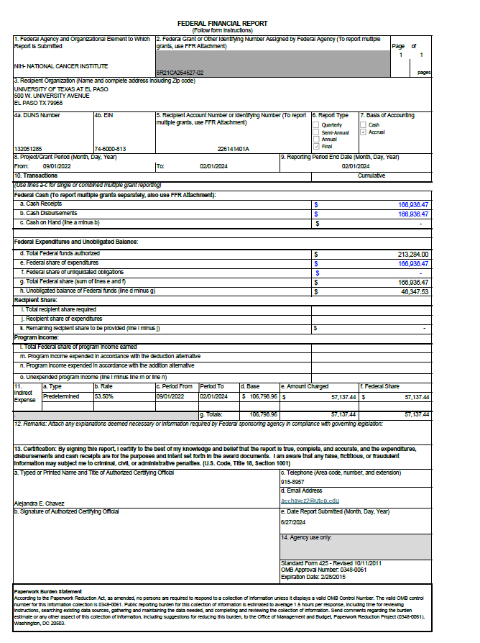
Grants Accounting
Financial Reports
Submission of reports is based on agency requirements,
Ex. Quarterly, semi-annual, annual etc.
Payments
Expenses
Budget
Encumbrances
Cost Share
Program Income
Indirect Costs (F&A)
Types of Reports
SF-425
SF-428
ED – 524B
Internal Financial
Expenditure Report
Agency Templates
Reporting websites
  PMS
  CPRIT
  Proposal Central
  Grants Solutions
  Sandia Supplier
  Just Grants
  NIFA
  Meta
  eBrap
  IPP Collector
  ASAP
Notes:
Add ejemplo de SF428 AND SF425 - y todas las reporting websites

Slide 36
Grants Accounting
Residual Projects
Unspent funds paid by the sponsoring agency up front and not required to be returned at the end of grant.
Send email notification to PI informing about remaining balance
A new residual project will be created in PS with a 2267XXXXXA
PI should notify OSP with intent to utilize remaining balance by providing a spending plan and justification
Residual Policy: https://www.utep.edu/research/office-of-sponsored-projects/policies/financial-disposition-funds.html

Slide 37
Grants Accounting
Project Closeouts
Department/PI Expectations
you have 30 days after project end date
  Clear encumbrances
  Clear overdrafts if any
  Finalize expenses (submit and review)
Complete any required program reports
Ensure all financial activity is accurate and fully reconciled
Timely action is critical to avoid delays and compliance issues.
GMA Expectations
Review expenses for compliance.
Prepare and submit final invoice.
Ensure payments have been received.
Submit final financial report or closeout requirements.

Slide 38
Resources for Post Award Accounting
Handbook of Operating Procedures
https://www.utep.edu/hoop/
Research Administration Website
https://www.utep.edu/research/administration/
Research Administration Policies/Procedures
https://www.utep.edu/research/office-of-sponsored-projects/policies/
Grants Accounting – cgstaff@utep.edu
Support Center – cgsc@utep.edu
Cash Management – gma-cashmgmt@utep.edu

Slide 39


