Slide 1

B.S.-Ecology and Evolutionary Biology Planning Template
Biology
Chemistry
Core Curriculum
MATH 1411
BIOL 1305-1107
CHEM 1305-1105
GEOL 1211-1111
BIOL 1306-1108
CHEM 1306-1106
ESCI 1301
BIOL 3193
RWS 1301
BIOL 3320
RWS 1302
BIOL 3321
LD Major Electives
HIST 1301
BIOL 3316-3117
HIST 1302
Language, Phil, & Culture
LD elective 4 HR
POLS 2310
UD Major Elective #1
LD Elective 4 HR
POLS 2311
Social & Behavioral Science
UD Elective #1
Creative Arts
Major Electives
Component Area Option
UD Major Elective #2
UD elective 3 HR
Component Area Option
UD Elective #2
UD Elective 4 HR
LD/UD Elective 2HR
Other Major Requirements Choose 1
Field of Study
UD Elective 3HR
STAT 2480
UD Elective 3HR
MATH 1312
UD Elective 3HR
UD Elective 4HR
Information
LD/UD Elective 3HR
UD: Upper Division: Course # begins with a 3 or 4
LD: Lower division: Course # begins with a 1 or 2
LD/UD Elective 3HR
LD/UD Elective 3HR
LD/UD Elective 2HR

Slide 2




BIOL 3342 - Plants & People
BIOL 3360 - Quantative Methods in Ecology
BIOL 3417 - Plant Ecology
BIOL 3427 - Desert Ecology
BIOL 4195 - Advan Methods in Biology
BIOL 4198 - Special Problems
BIOL 4225 - Field Biology
BIOL 4298 - Special Problems
BIOL 4315 - Population Genetics
BIOL 4324 - Genetic, Env & Evol - Animal Behavior
BIOL 4325 - Field Biology
BIOL 4326 - Bioarcheology
BIOL 4327 - Animal Ecology
BIOL 4370 - Hist/Phil Biology
BIOL 4395 - Developmental Neurobiology
BIOL 4395 - Topics in Biology (can only be taken twice)
BIOL 4398 - Special Problems
BIOL 4428 - Environm Stressor in Ecosyst
BIOL 4466 - Ecosyst Ecology
BOT 3330 - Comparative Plant Morphology
BOT 3437 - Plant Diversity & Systematics
MICR 3328 - Microorganisms in Ecosystems
ZOOL 3468 - Entomology
ZOOL 4155 - Vertebr Paleontology Techniques
ZOOL 4157 - Advan Vertebr Paleontology Tech
ZOOL 4354 - Paleozoic and Mesozoic Vertebr Paleontology
ZOOL 4356 - Cenozoic Vertebr Paleontology
ZOOL 4476 - Fish, Amphibians & Reptiles
ZOOL 4478 - Birds & Mammals
LD Major Elective
Select Two
BOT 2410 - General Botany
ZOOL 2406 - Vertebrate Zoolgy
ZOOL 2466 - Invertebrate Zoology
UD Major Elective #1
Select One
BIOL 3342 - Plants and People
BIOL 3417 - Plants Ecology
BOT 3437 - Plant Diversity & Systematics
BIOL 4428 - Global Change Ecology
BIOL 4466 - Ecosystem Ecology
BIOL 4351 - Spatial Ecology
BIOL 4360 - Aquatic Ecology
BIOL 3330 - Histology
BIOL 3375 - Forensic Pathobiology
BIOL 4195 - Advan. Methods in Biology
BIOL 4198 - Special Problems
BIOL 4298 - Special Problems
BIOL 4319 - G Protein-Coupled Receptor
BIOL 4320 - Endocrinology
BIOL 4321 - Developmental Biology
BIOL 4330 - Cancer Biology
BIOL 4370 - History/Phil Biology
BIOL 4389 - Developmental Neurobiology
BIOL 4395 - Topics in Biology (can only be taken twice)
BIOL 4398 - Special Problems
UD Major Elective #2
Select One
BIOL 4324 - Genetics,Env & Evol - Anim Beh
BIOL 4327 - Animal Ecology
ZOOL 4476 - Fish, Amphibians, and Reptiles
ZOOL 4478 - Birds and Mammals
BIOL 4315 - Population Genetics
ZOOL 3468 - Entomology
CBCH 3316 - Membrane Biology (FA)
CBCH 4414 - Cellular Biochem (SP)
CBCH 4310 - Techn in Molecular Biochem (FA)
CBCH 4320 - Advan Topics in Molecular Biochem. (SP)
MICR 3144 - Pathogenic Micro Lab (SP)
MICR 3343 - Pathogenic Micro (SP)
MICR 3146 - Microbial Physio Lab (FA)
MICR 3345 - Microbial Physio (FA)
MICR 3449 - Prokaryotic Molecular Genetics (SP)
MICR 4154 - Immunology Lab (FA)
MICR 4353 - Immunology (FA)
MICR 4329 - Epidemiology (FA)
MICR 4351 - General Virology (FA)
MICR 4355 - Medical Mycology
ZOOL 3464 - Medical Parasitology
ZOOL 4384 - Neurobiology
Field of Study
ANY course in CHEM, ESCI, GEOG, GEOP, GEOL, BIOL, BOT, MICR, or ZOOL
(BIOL 1103, 1104, 1203, 1303, 1304, and MICR 2330 are not allowed)

Slide 3
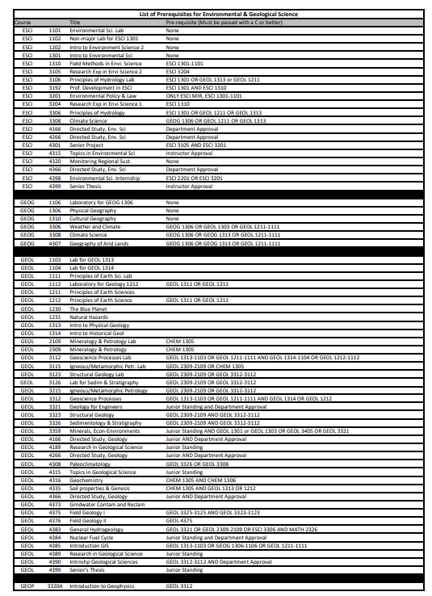
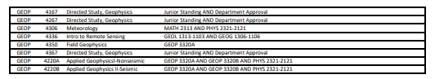
ESCI, GEOL, GEOG, GEOP courses and their pre-requisites
potential courses for
Field of Study

Slide 4

Core Curriculum options

Slide 5

Core Curriculum Options

Slide 6

Core Curriculum Options

Slide 7

Core Curriculum Options

Slide 8
Core Curriculum Options

Slide 9
UTEP College of Science: Bachelor of Science Degree Plans
UNIVERSITY CORE CURRICULUM¹
A maximum of 66 hours may be transferred from two-year institutions to UTEP degree programs
COURSE NAME UTEP EPCC COURSE NAME
A General Education
6 Government/Political Science (6 credits)²
UTEP
EPCC
1 Communication (6 credits) Introduction to Politics
POLS 2310 &
POLS 2311
GOVT 2305 &
GOVT 2306
Rhetoric & Composition I RWS 1301
ENGL 1301
American Government & Politics
Rhetoric & Composition II RWS 1302
ENGL 1302
Rhetoric, Composition, & Communication RWS 1601
no equivalent
7 Social and Behavioral Sciences (3 credits) - choose 1 course
Expository English Composition for Speakers of ESL ESOL 1311
no equivalent
Origins of Humanity ANTH 1301
ANTH 2346
Expository English Composition for Speakers of ESL ESOL 1312
no equivalent
World Cultures
ANTH 1302
ANTH 2351
Written and Oral Communication COMM 1611
no equivalent
Cultural Geography ANTH 1310
GEOG 1302
Writing about Literature ENGL 1313
no equivalent
Introduction to Human Language
ANTH 2320
no equivalent
2 American History (6 credits) - must take both
Asian American Studies ASIA 2300
no equivalent
History of the U.S. to 1865
HIST 1301
HIST 1301
Economics for Engineers and Scientists
CE 2326
no equivalent
History of the U.S. since 1865 HIST 1302
HIST 1302
Intro to Chicano Studies CHIC 2311
no equivalent
Interpersonal Communication
COMM 2350
no equivalent
Mass Media and Society COMM 2372
COMM 1307
3 Language, Philosophy, & Culture (3 credits) - choose 1 course
Language in Culture & Society ANTH 2325
Principles of Macroeconomics
ECON 2303
ECON 2301
Intro to African American Studies AFST 2300
Latina/o Pressence in the U.S. CHIC 2302
no equivalent
Principles of Microeconomics ECON 2304
ECON 2302
no equivalent
Inroduction to Educational Pyschology EDPC 1301
no equivalent
English Literature I (to 1700's) ENGL 2311
no equivalent
Action Research in Classrooms
EDU 1342
no equivalent
English Literature II (1700's - Modern) ENGL 2312
ENGL 2322
Introduction to Human Language ENGL 2320
no equivalent
Inroduction to American Fiction ENGL 2313
ENGL 2323
Cultural Geography
GEOG 1310
GEOG 1302
Inroduction to American Drama ENGL 2314
ENGL 2342
Leadership in Action
LEAD 2300
no equivalent
Introduction to American Poetry ENGL 2318
ENGL 2343
Introduction to Human Language
LING 2320
no equivalent
Language in Culture & Society ENGL 2325
no equivalent
Language Inside and Out: Select Topics
LING 2340
no equivalent
Making of the Other Americas FREN 2322
no equivalent
Introduction to Pyschology
PSYC 1301
PSYC 2301
World History to 1500 HIST 2301
no equivalent
Introduction to Sociology
SOCI 1301
SOCI 1301
World History since 1500 HIST 2302
HIST 2321
Cultural Geography
SOCI 1310
GEOG 1302
Language in Culture & Society LING 2325
HIST 2322
8 Creative Arts (3 credits) - choose 1 course
Introduction to Philosophy PHIL 1301
PHIL 1301
Art Appreciation
ART 1300
ARTS 1301
Introduction to Ethics PHIL 2306
PHIL 2306
History of Art I (Pre-Renaissance Art History)
ARTH 1305
ARTS 1303
Introduction to Religious Studies RS 1301
no equivalent
History of Art II (Renaissance & Modern Art History)
ARTH 1306
ARTS 1304
Seeing & Naming: Conversations SPAN 2340
no equivalent
Introduction to Dance
DANC 1304
DANC 2303
Introduction to Women's Studies WS 2300
no equivalent
Chicana/o Fine Arts Appreciation
CHIC 1311
HUMA 1311
Global Feminisms WS 2350
no equivalent
Introduction to Art of Motion Picture
FILM 1390
DRAM 2366
4 Mathematics (PreCalculus plus 7 or 8 additional credits) Designated Core
Introduction to Music History
MUSL 1321
MUSI 1307
Music Appreciation
MUSL 1324
MUSI 1306
PreCalculus
MATH 1508 or
MATH 1309 + 1310
MATH 1314 + 2412
Jazz to Rock
MUSL 1327
MUSI 1310
Calculus I
MATH 1411
MATH 2413
Introduction to Theater
THEA 1313
DRAM 1310
AND choose one of the following:
Music, Culture, and Society MUSL 2321
no equivalent
Calculus II
MATH 1312
MATH 2314
9 Component Area Option (6 credits) - choose 2 courses
Statistical Methods STAT 2480 no equivalent
Introduction to Global Business
BUSN 1301
BUSI 1301
5 Life and Physical Sciences (8 credits) - choose 1 sequence (varies by degree) "Designated
Public Speaking COMM 1301
SPCH 1315
Non-Calculus-Based Physics:
Business/Professional Communication COMM 1302
SPCH 1321
General Physics PHYS 1403
PHYS 1301-1101
Intro-Computational Thinking
CS 1310
no equivalent
General Physics II PHYS 1404
PHYS 1302-1102
Computer Programming Sci/Eng CS 1320
COSC 1301
Calculus-Based Physics:
Scientific Inquiry
SCI 1301
no equivalent
Physics I (Introd. Mechanics) PHYS 2320-2120
PHYS 2325-2125
Seminar/Critical Inquiry UNIV 1301
EDUC 1300
Physics II (Introd. Electromagnetism) PHYS 2321-2121
PHYS 2326-2126
Eng Innovation and Leadership
EL 1301
no equivalent
Geology
Engineering Design Experience
ENGR 1302
no equivalent
Principles of Earth Sciences I GEOL 1211/1111
GEOL 1301
Applied Engineering Analysis
ENGR 1303
no equivalent
Principles of Earth Sciences II GEOL 1211/1112
GEOL 1302
Inquiry in Math and Science
SCI 1301
no equivalent
Comm. Var. Across the Lifespan
SPLP 1312
no equivalent
Geology
IMPRORTANT
1 | Course substitutions are not allowed in the Core Curriculum
However, courses used towards a core curriculum at other institutions can be used towards our "core" but must be approved through "corearticulation@utep.edu"
Introduction to Physical Geology GEOL 1313/11103
GEOL 1303/1103
Introduction to Historical Geology GEOL 1314/1104
GEOL 1304/1104
Chemistry
CHEM 1311/1111
General Chemistry I CHEM 1305/1105
General Chemistry II CHEM 1306/1106
CHEM 1312/1112

Slide 10
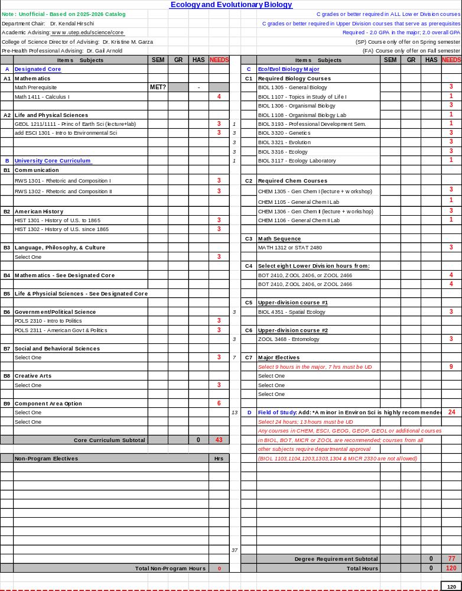

Slide 11
EXAMPLES OF CAREERS IN ECOLOGY & EVOLUTIONARY BIOLOGY
Wildlife Biologist/Manager: Studies animals and their ecosystems to manage populations. | Conservation Biologist: Works to protect species and habitats from extinction. | Environmental Consultant: Assesses ecological impacts of projects for private industry. | Park Ranger/Manager: Manages natural resources in state and national parks. | Wetlands Scientist/Delineator: Maps and studies wetlands for regulatory compliance. | Forestry Technician/Manager: Manages Forest ecosystems and resources. | Marine Biologist: Studies marine organisms and ecosystems.
Botanist/Plant Ecologist: Studies plant communities and ecology. | Invasive Species Specialist: Monitors and controls non-native species. | Population Geneticist: Analyzes genetic variation within populations. | Bioinformatician: Uses computational tools to analyze large biological data sets, particularly in evolution. | Systematist/Taxonomist: Studies the diversification of life and relationships among organisms. | Molecular Ecologist: Uses molecular genetic techniques to address ecological questions. | Paleobiologist/Paleontologist: Studies evolutionary biology through the fossil record.
Zoo Curator/Educator: Manages captive animal populations and educates the public. | Science Writer/Communicator: Communicates scientific findings to the public. | Museum Curator/Technician: Manages biological collections. | Agricultural Scientist/Geneticist: Applies evolutionary principles to improve crops or livestock. | Biology Teacher/Professor: Teaches at the high school or university level.
Some careers may require advanced degrees, professional school or certifications *

