Slide 1

B.S. Environmental Science- Geology Concentration
Environmental Science Courses
Geology Concentration
Core Curriculum
MATH 1411
ESCI 1301-1101
GEOL 1313-1103
CHEM 1305-1105
ESCI 1310 (Spring)
GEOL 1314-1104
CHEM 1306-1106
ESCI 3204 (Fall)
RWS 1301
ESCI 3105 (Spring)
GEOL 2309-2109 (Fall)
RWS 1302
ESCI 3201 (Spring)
HIST 1301
ESCI 3192 (Fall)
GEOL 3312-3112 (Fall)
HIST 1302
Language, Phil, & Culture
ESCI 4320 (Fall)
GEOL 3323-3123 (Fall)
POLS 2310
ESCI 4301 (Spring)
POLS 2311
ESCI 4398
GEOL 3326-3126 (Fall)
STAT 2480
Social & Behavioral Science
GEOL 4375 (Dec)
Creative Arts
GEOL 4376 (May)
Component Area Option
Physics Sequence
GEOL 4385 or 4336
Component Area Option
PHYS 2320-2120
PHYS 2230
Math Sequence
Electives
MATH 1312
UD Elective 3HR
UD Elective 3HR
UD or LD Elective 1HR
Information
UD: Upper Division: Course # begins with a 3 or 4
LD: Lower division: Course # begins with a 1 or 2

Slide 2
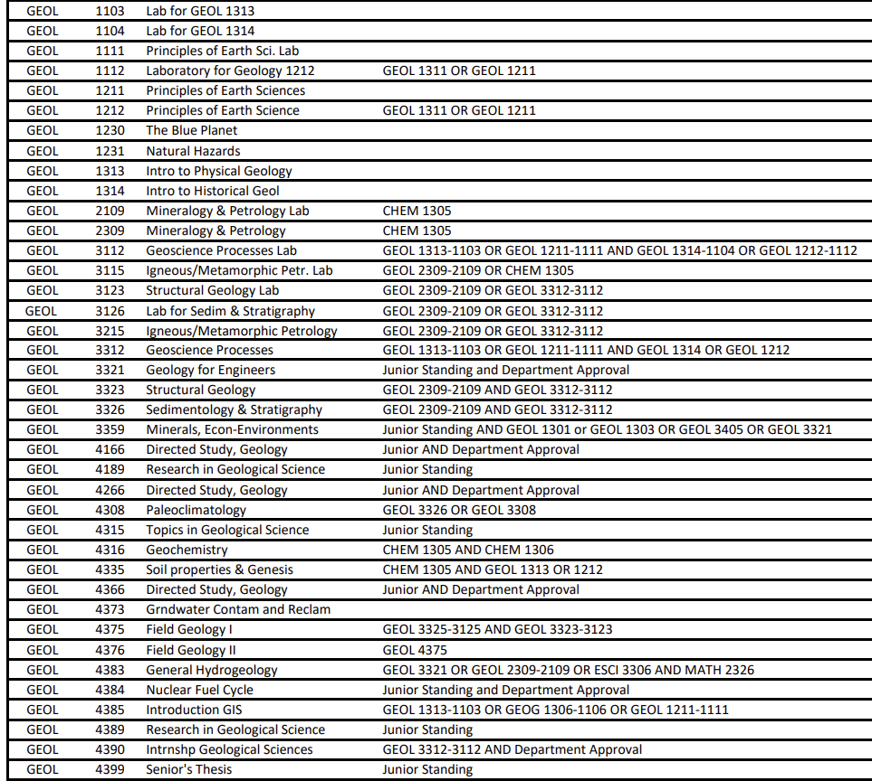
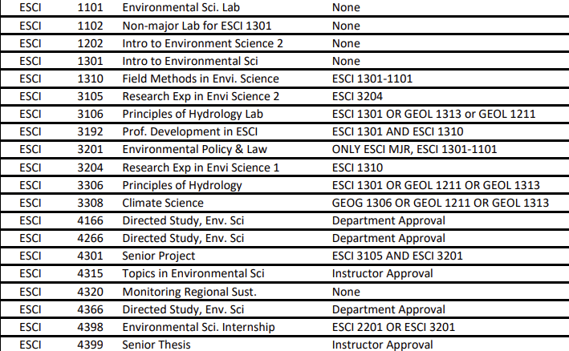
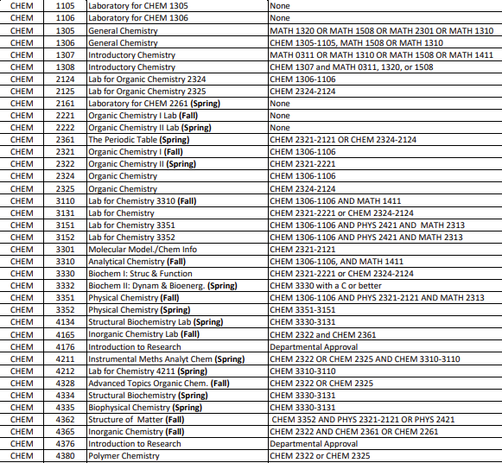
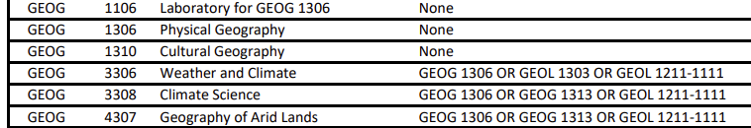
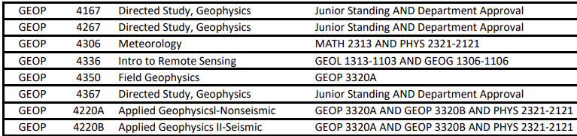
Electives
Upper or Lower Division in ESCI, GEOL, GEOP, GEOG, or CHEM

Slide 3

Core Curriculum options

Slide 4

Core Curriculum Options

Slide 5

Core Curriculum Options

Slide 6

Core Curriculum Options

Slide 7
UTEP College of Science: Bachelor of Science Degree Plans
UNIVERSITY CORE CURRICULUM¹
A maximum of 66 hours may be transferred from two-year institutions to UTEP degree programs
COURSE NAME UTEP EPCC COURSE NAME
A General Education
6 Government/Political Science (6 credits)²
UTEP
EPCC
1 Communication (6 credits) Introduction to Politics
POLS 2310 &
POLS 2311
GOVT 2305 &
GOVT 2306
Rhetoric & Composition I RWS 1301
ENGL 1301
American Government & Politics
Rhetoric & Composition II RWS 1302
ENGL 1302
Rhetoric, Composition, & Communication RWS 1601
no equivalent
7 Social and Behavioral Sciences (3 credits) - choose 1 course
Expository English Composition for Speakers of ESL ESOL 1311
no equivalent
Origins of Humanity ANTH 1301
ANTH 2346
Expository English Composition for Speakers of ESL ESOL 1312
no equivalent
World Cultures
ANTH 1302
ANTH 2351
Written and Oral Communication COMM 1611
no equivalent
Cultural Geography ANTH 1310
GEOG 1302
Writing about Literature ENGL 1313
no equivalent
Introduction to Human Language
ANTH 2320
no equivalent
2 American History (6 credits) - must take both
Asian American Studies ASIA 2300
no equivalent
History of the U.S. to 1865
HIST 1301
HIST 1301
Economics for Engineers and Scientists
CE 2326
no equivalent
History of the U.S. since 1865 HIST 1302
HIST 1302
Intro to Chicano Studies CHIC 2311
no equivalent
Interpersonal Communication
COMM 2350
no equivalent
Mass Media and Society COMM 2372
COMM 1307
3 Language, Philosophy, & Culture (3 credits) - choose 1 course
Language in Culture & Society ANTH 2325
Principles of Macroeconomics
ECON 2303
ECON 2301
Intro to African American Studies AFST 2300
Latina/o Pressence in the U.S. CHIC 2302
no equivalent
Principles of Microeconomics ECON 2304
ECON 2302
no equivalent
Inroduction to Educational Pyschology EDPC 1301
no equivalent
English Literature I (to 1700's) ENGL 2311
no equivalent
Action Research in Classrooms
EDU 1342
no equivalent
English Literature II (1700's - Modern) ENGL 2312
ENGL 2322
Introduction to Human Language ENGL 2320
no equivalent
Inroduction to American Fiction ENGL 2313
ENGL 2323
Cultural Geography
GEOG 1310
GEOG 1302
Inroduction to American Drama ENGL 2314
ENGL 2342
Leadership in Action
LEAD 2300
no equivalent
Introduction to American Poetry ENGL 2318
ENGL 2343
Introduction to Human Language
LING 2320
no equivalent
Language in Culture & Society ENGL 2325
no equivalent
Language Inside and Out: Select Topics
LING 2340
no equivalent
Making of the Other Americas FREN 2322
no equivalent
Introduction to Pyschology
PSYC 1301
PSYC 2301
World History to 1500 HIST 2301
no equivalent
Introduction to Sociology
SOCI 1301
SOCI 1301
World History since 1500 HIST 2302
HIST 2321
Cultural Geography
SOCI 1310
GEOG 1302
Language in Culture & Society LING 2325
HIST 2322
8 Creative Arts (3 credits) - choose 1 course
Introduction to Philosophy PHIL 1301
PHIL 1301
Art Appreciation
ART 1300
ARTS 1301
Introduction to Ethics PHIL 2306
PHIL 2306
History of Art I (Pre-Renaissance Art History)
ARTH 1305
ARTS 1303
Introduction to Religious Studies RS 1301
no equivalent
History of Art II (Renaissance & Modern Art History)
ARTH 1306
ARTS 1304
Seeing & Naming: Conversations SPAN 2340
no equivalent
Introduction to Dance
DANC 1304
DANC 2303
Introduction to Women's Studies WS 2300
no equivalent
Chicana/o Fine Arts Appreciation
CHIC 1311
HUMA 1311
Global Feminisms WS 2350
no equivalent
Introduction to Art of Motion Picture
FILM 1390
DRAM 2366
4 Mathematics (PreCalculus plus 7 or 8 additional credits) Designated Core
Introduction to Music History
MUSL 1321
MUSI 1307
Music Appreciation
MUSL 1324
MUSI 1306
PreCalculus
MATH 1508 or
MATH 1309 + 1310
MATH 1314 + 2412
Jazz to Rock
MUSL 1327
MUSI 1310
Calculus I
MATH 1411
MATH 2413
Introduction to Theater
THEA 1313
DRAM 1310
AND choose one of the following:
Music, Culture, and Society MUSL 2321
no equivalent
Calculus II
MATH 1312
MATH 2314
9 Component Area Option (6 credits) - choose 2 courses
Statistical Methods STAT 2480 no equivalent
Introduction to Global Business
BUSN 1301
BUSI 1301
5 Life and Physical Sciences (8 credits) - choose 1 sequence (varies by degree) "Designated
Public Speaking COMM 1301
SPCH 1315
Non-Calculus-Based Physics:
Business/Professional Communication COMM 1302
SPCH 1321
General Physics PHYS 1403
PHYS 1301-1101
Intro-Computational Thinking
CS 1310
no equivalent
General Physics II PHYS 1404
PHYS 1302-1102
Computer Programming Sci/Eng CS 1320
COSC 1301
Calculus-Based Physics:
Scientific Inquiry
SCI 1301
no equivalent
Physics I (Introd. Mechanics) PHYS 2320-2120
PHYS 2325-2125
Seminar/Critical Inquiry UNIV 1301
EDUC 1300
Physics II (Introd. Electromagnetism) PHYS 2321-2121
PHYS 2326-2126
Eng Innovation and Leadership
EL 1301
no equivalent
Geology
Engineering Design Experience
ENGR 1302
no equivalent
Principles of Earth Sciences I GEOL 1211/1111
GEOL 1301
Applied Engineering Analysis
ENGR 1303
no equivalent
Principles of Earth Sciences II GEOL 1211/1112
GEOL 1302
Inquiry in Math and Science
SCI 1301
no equivalent
Comm. Var. Across the Lifespan
SPLP 1312
no equivalent
Geology
IMPRORTANT
1 | Course substitutions are not allowed in the Core Curriculum
However, courses used towards a core curriculum at other institutions can be used towards our "core" but must be approved through "corearticulation@utep.edu"
Introduction to Physical Geology GEOL 1313/11103
GEOL 1303/1103
Introduction to Historical Geology GEOL 1314/1104
GEOL 1304/1104
Chemistry
CHEM 1311/1111
General Chemistry I CHEM 1305/1105
General Chemistry II CHEM 1306/1106
CHEM 1312/1112

Slide 8
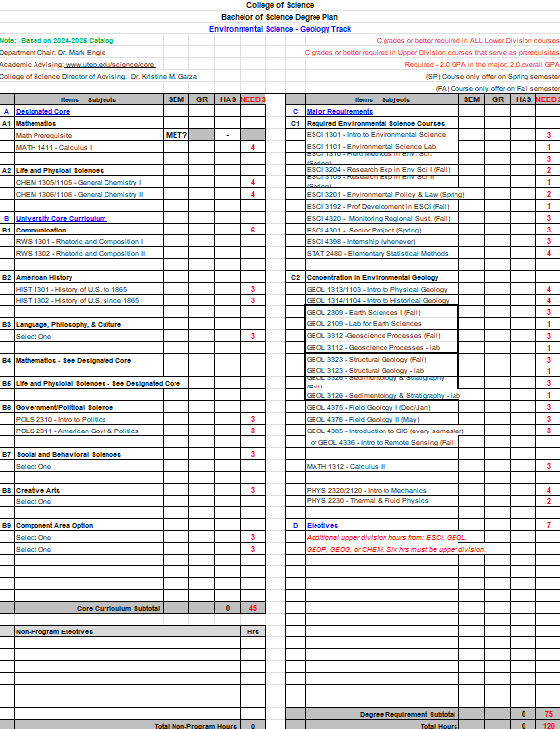

Slide 9
EXAMPLES OF CAREERS IN ENVIRONMENTAL SCIENCE
Environmental Scientist: Studies environmental problems, analyzes data, and provides solutions. | Wildlife Biologist/Zoologist: Studies animal behavior, population dynamics, and ecosystem interactions. | Hydrologist: Analyzes water quality and quantity, focusing on groundwater and surface water issues. | Microbiologist: Researches microorganisms' effects on the environment. | Geoscientist: Researches the Earth’s physical composition and natural resources.
Natural Resource Manager: Oversees land, forest, or park resources to ensure sustainability. | Environmental Policy Analyst: Researches and advises on environmental legislation. | Urban/Land Use Planner: Develops plans for land use to maximize sustainability. | Environmental Technician: Monitors environmental health, collects data, and tests for pollution. | Conservationist/Forester: Manages land quality in parks and forests.
Air Quality Manager/Analyst: Collects data to improve air quality and ensure compliance. | Waste Water Manager: Manages water treatment and recycling processes. | Environmental Consultant: Advises companies and governments on regulation compliance and sustainability. | Fish and Game Warden: Protects wildlife and enforces hunting/fishing regulations. | Environmental Engineer: Designs solutions for pollution control, waste treatment, and site remediation.
Some careers may require advanced degrees, professional school or certifications *

