Slide 1


B.S. Geological Sciences- Geoscience Concentration
Geology Courses
Geoscience Concentration
Core Curriculum
MATH 1411
GEOL 1313-1103
GEOL 1101
CHEM 1305-1105
GEOL 1314-1104
GEOL 1101
CHEM 1306-1106
GEOL 2358
RWS 1301
GEOL 2309-2109 (Fall)
GEOL 1101
RWS 1302
GEOL 1101
HIST 1301
GEOL 3312-3112 (Fall)
GEOL 3215-3115 (Spring)
HIST 1302
Language, Phil, & Culture
GEOL 3323-3123 (Fall)
POLS 2310
POLS 2311
Math & Physics Sequence
GEOL 3323-3126 (Fall)
Social & Behavioral Science
GEOL 3359
Creative Arts
MATH 1312
GEOL 4375 (Dec)
Component Area Option
PHYS 2320-2120
GEOL 4376 (May)
PHYS 2321/2121
GEOL 3192 (Spring)
Component Area Option
Or
PHYS 2210 (Fall)
PHYS 2230 (Spring)
Major Electives
UD Elective 3HR
UD Elective 3HR
General Electives
UD Elective 3HR
UD Elective 3 HR
LD or UD Elective 3HR
Information
LD or UD Elective 3HR
LD or UD Elective 2HR
UD: Upper Division: Course # begins with a 3 or 4
LD: Lower division: Course # begins with a 1 or 2

Slide 2

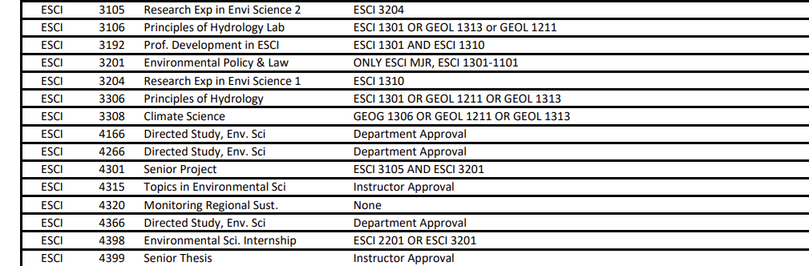
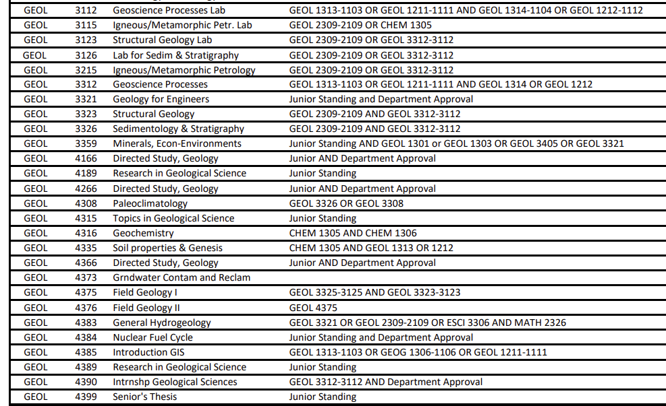
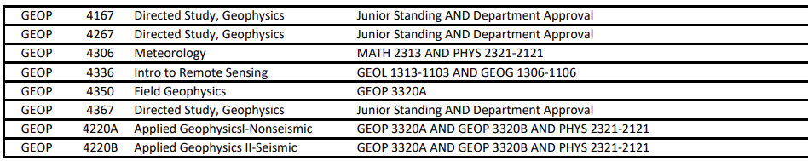
Major Electives
Any Subject at All
Upper Division in ESCI, GEOL, GEOP or GEOG

Slide 3

Core Curriculum options

Slide 4

Core Curriculum Options

Slide 5

Core Curriculum Options

Slide 6

Core Curriculum Options

Slide 7
EPCC Transfer Course Articulation Chart
UTEP College of Science: Bachelor of Science Degree Plan
BIOLOGICAL SCIENCES - Biomedical Concentration UNIVERSITY CORE CURRICULUM for this MAJOR
A maximum of 66 hours may be transferred from two-year institutions to UTEP degree programs
 | COURSE NAME | UTEP | EPCC |  |  | COURSE NAME | UTEP | EPCC
A | General Education
 | (Minimum "C" grades required) |  |  |  | 6 | American History (6 credits) - must take both
 |  |  |  |  |  | History of the U.S. to 1865 | HIST 1301 | HIST 1301
1 | Communication (6 credits) |  |  |  |  | History of the U.S. since 1865 | HIST 1302 | HIST 1302
 | Rhetoric & Composition I | RWS 1301 | ENGL 1301
 | Rhetoric & Composition II | RWS 1302 | ENGL 1302 |  | 7 | Government/Political Science (6 credits)**
 | Rhetoric, Composition, & Communication | RWS 1601 | no equivalent |  |  | Introduction to Politics | POLS 2310 | GOVT 2305
 | Expository English Composition for Speakers of ESL | ESOL 1311 | no equivalent |  |  | American Government & Politics | POLS 2311 | GOVT 2306
 | Expository English Composition for Speakers of ESL | ESOL 1312 | no equivalent
 | Written and Oral Communication | COMM 1611 | no equivalent |  | 8 | Social and Behavioral Sciences (3 credits) - choose 1 course
 |  |  |  |  |  | Intro to Physical Anthropology & Archaelology | ANTH 1301 | ANTH 2346
2 | Mathematics (PreCalculus plus 7 or 8 additional credits) |  |  |  |  | Intro to Social & Cultural Anthropology | ANTH 1302 | ANTH 2351
 | PreCalculus | MATH 1508 | MATH 1314 & 2413 |  |  | Cultural Geography | ANTH 1310 | no equivalent
 | Calculus I | MATH 1411 | MATH 2412 |  |  | Introduction to Linguistics | ANTH 2320 | no equivalent
 | AND choose one of the following: |  |  |  |  | Economics for Engineers and Scientists | CE 2326 | no equivalent
 | Calculus II | MATH 1312 | 2314 |  |  | Interpersonal Communication | COMM 2350 | no equivalent
 | Statistical Methods | STAT 2480 | no equivalent |  |  | Mass Media and Society | COMM 2372 | COMM 1307
 |  |  |  |  |  | Principles of Macroeconomics | ECON 2303 | ECON 2301
3 | Life and Physical Sciences (8 credits) - choose 1 sequence |  |  |  |  | Principles of Microeconomics | ECON 2304 | ECON 2301
 | Physics for non-majors: |  |  |  |  | Inroduction to Educational Pyschology | EDPC 1301 | no equivalent
 | General Physis | PHYS 1403 | PHYS 1301-1101 |  |  | Action Research in Classrooms | EDU 1342 | no equivalent
 | General Physics II | PHYS 1404 | PHYS 1302-1102 |  |  | Introduction to Linguistics | ENGL 2320 | no equivalent
 | Physics for majors: |  |  |  |  | Cultural Geography | GEOG 1310 | no equivalent
 | Physics I (Introd. Mechanics) | PHYS 2420 | PHYS 2325-2125 |  |  | An Introduction to Linguistics | LING 2320 | no equivalent
 | Physics II (Waves & Fields) | PHYS 2421 | PHYS 2326-2126 |  |  | Language Inside and Out: Select Topics | LING 2340 | no equivalent
 |  |  |  |  |  | Introduction to Pyschology | PSYC 1301 | PSYC 2301
4 | Language, Philosophy, & Culture (3 credits) - choose 1 course |  |  |  |  | Introduction to Sociology | SOCI 1301 | SOCI 1301
 | English Literature (to 1700's) | ENGL 2311 | ENGL 2322 |  |  | Cultural Geography | SOCI 1310 | no equivalent
 | English Literature (1700's - Modern) | ENGL 2312 | ENGL 2323
 | Inro to American Fiction | ENGL 2313 | ENGL 2324 |  | 9 | Component Area Option (6 credits) - choose 2 courses
 | Inroduction to American Drama | ENGL 2314 | ENGL 2343 |  |  | Introduction to Global Business | BUSN 1301 | no equivalent
 | Introduction to American Poetry | ENGL 2318 | no equivalent |  |  | Public Speaking | COMM 1301 | SPCH 1315
 | World History to 1500 | HIST 2301 | HIST 2321 |  |  | Business/Professional Communication | COMM 1302 | SPCH 1321
 | World History since 1500 | HIST 2302 | HIST 2322 |  |  | Intro-Computational Thinking | CS 1310 | no equivalent
 | Introduction to Philosophy | PHIL 1301 | PHIL 1301 |  |  | Computer Programming Sci/Eng | CS 1320 | no equivalent
 | Introduction to Ethics | PHIL 2306 | PHIL 2306 |  |  | Scientific Inquiry | SCI 1301 | no equivalent
 | Making of the Other Americas | FREN 2322 | no equivalent |  |  | Seminar/Critical Inquiry | UNIV 1301 | EDUC 1300
 | Introduction to Religious Studies | RS 1301 | no equivalent
 | Seeing & Naming: Conversations | SPAN 2340 | no equivalent
 | Introduction to Women's Studies | WS 2300 | no equivalent
 | Global Feminisms | WS 2350 | no equivalent
5 | Creative Arts (3 credits) - choose 1 course
 | Art Appreciation | ART 1300 | ARTS 1301
 | History of Art I (Pre-Renaissance Art History) | ARTH 1305 | ARTS 1303
 | History of Art II (Renaissance & Modern Art History) | ARTH 1306 | ARTS 1304
 | Dance Appreciation | DANC 1304 | DANC 2303
 | Introduction to Art of Motion/Film | FILM 1390 | DRAM 2366
 | Introduction to Music History | MUSL 1321 | MUSI 1307
 | Music Appreciation | MUSL 1324 | MUSI 1306
 | Jazz to Rock | MUSL 1327 | MUSI 1310
 | Introduction to Theater | THEA 1313 | DRAM 1310
IMPORTANT
It is recommended that both Political Science courses be completed at EPCC then transferred to UTEP or both be completed at UTEP.
All courses used to satisfy the core curriculum must be completed with a
grade of "C" or better. This also applies to courses transferred from
No substitutions will be allowed in the Core Curriculum.
revised 9-20-16 KMG

Slide 8
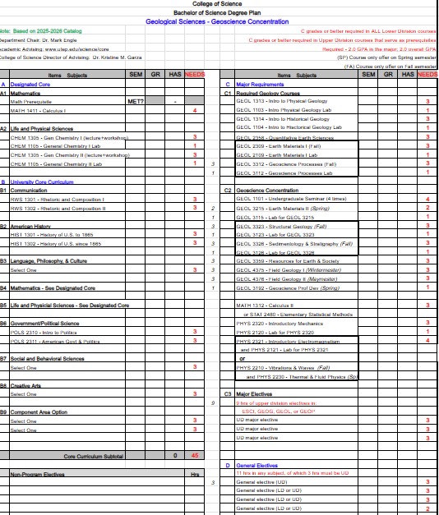

Slide 9
EXAMPLES OF CAREERS IN GEOLOGICAL SCIENCE
Hydrogeologist: Studies the distribution, movement, and quality of groundwater | Mining/Exploration Geologist: Searches for and analyzes mineral deposits for economic extraction | Petroleum Geologist: Explores for, evaluates, and aids in the extraction of oil and natural gas | Engineering Geologist: Assesses geological factors affecting engineering structures like dams, bridges, and tunnels | Environmental Geologist/Scientist: Identifies and mitigates pollution and environmental hazards, often working on remediation | Geochemist: Analyzes the chemical composition of rocks, soils, and water to locate resources or map contamination
Paleontologist: Studies fossils to understand prehistoric life and ecosystems | Seismologist: Analyzes earthquakes and seismic waves to assess hazard risks | Volcanologist: Studies volcanoes and volcanic activity to predict eruptions | Sedimentologist: Studies sediment deposits and sedimentary rocks to reconstruct past environments | Geomorphologist: Analyzes landforms and the processes that shape Earth's surface | Mineralogist: Analyzes the composition and structure of minerals
GIS Specialist/Technician: Uses Geographic Information Systems to map and model geological data | Natural Hazards Specialist: Predicts and plans for disasters like landslides, floods, and volcanic eruptions | Marine Geologist/Oceanographer: Explores the geology of the ocean floor and coastal areas | Planetary Geologist: Studies the geology of planets and moons other than Earth | Geophysicist: Uses physical principles (seismic, gravitational, magnetic) to study Earth's structure, often for energy exploration
Some careers may require advanced degrees, professional school or certifications *

