Slide 1
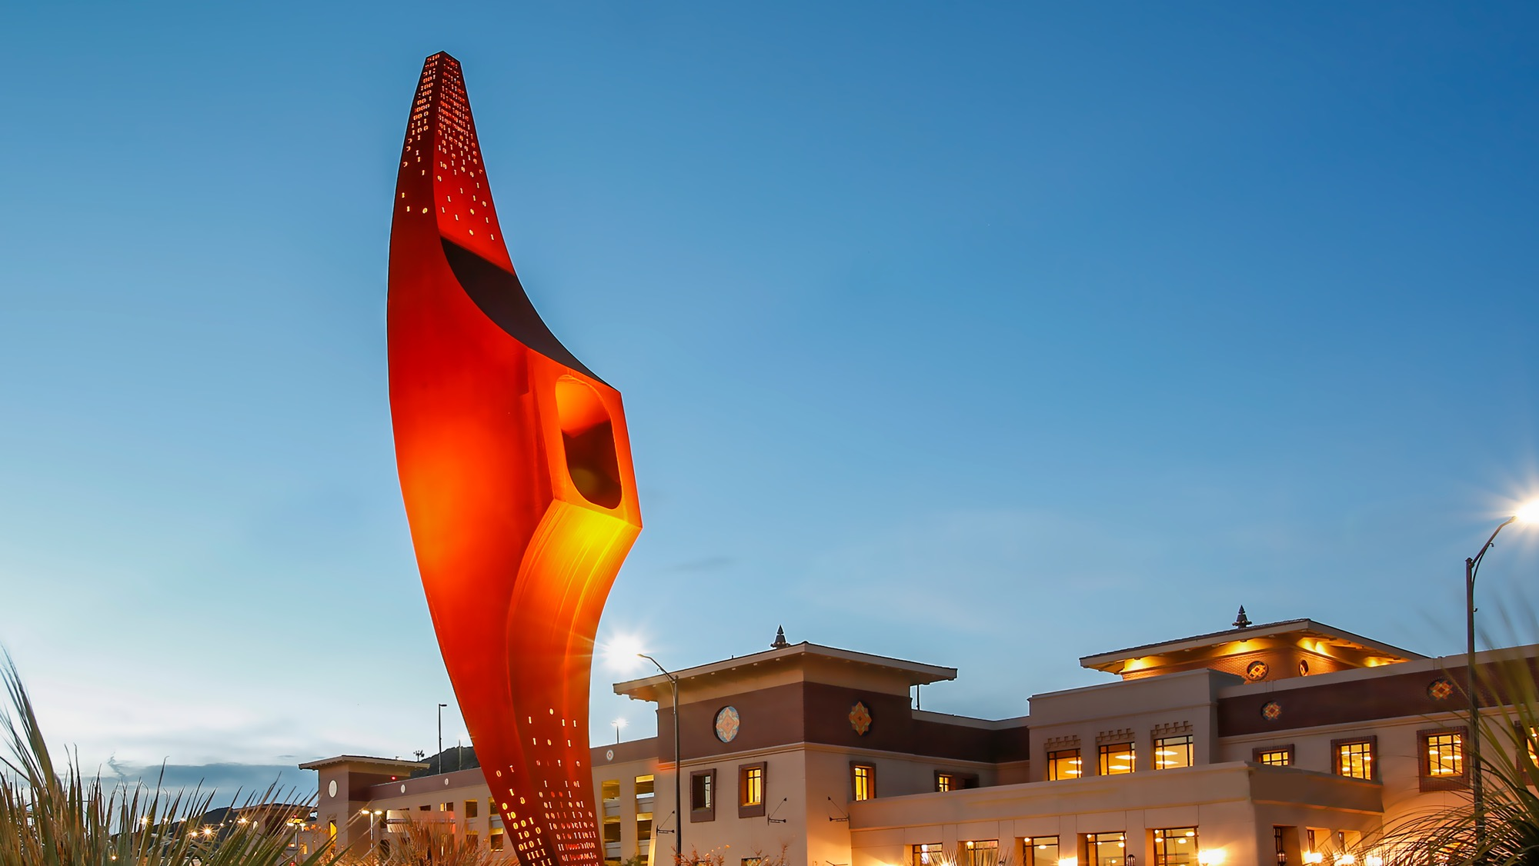
THE UNIVERSITY OF TEXAS AT EL PASO
AMERICA’S LEADING
HISPANIC-SERVING
UNIVERSITY
2030 STRATEGIC PLAN

Slide 2
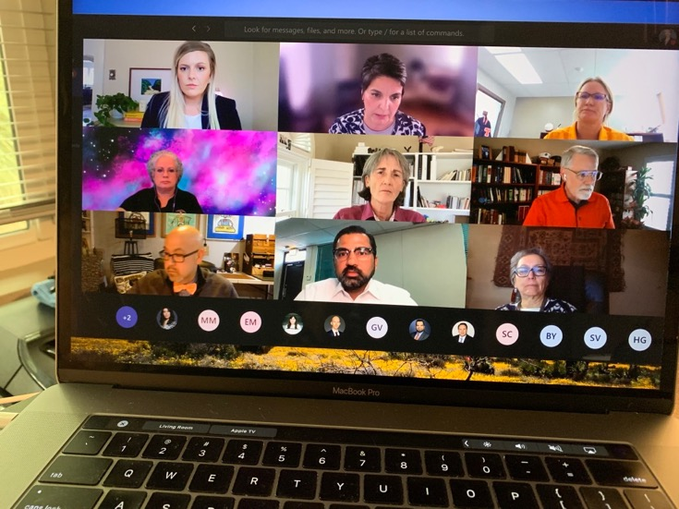
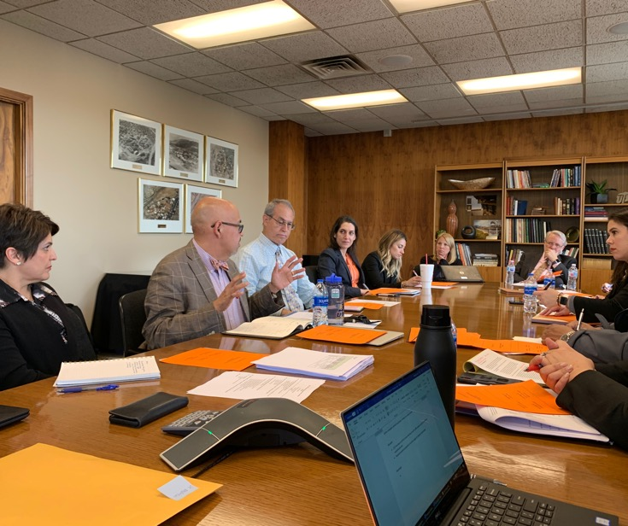
THANK YOU!!!
Envision alternative futures
Analyze
initiatives
Categorize initiatives into key mission areas
Identify strategic advantages
Develop goals and initiatives
Refine drafts and seek input
Notes:
In January 2020, UTEP started a strategic planning process that began with envisioning alternative futures, each rooted in elements of UTEP’s history and proven successes. With these futures as a foundation for creative exploration, a 21-member advisory committee comprised of faculty and staff representatives from across the University worked to identify current and possible initiatives that could be scaled to help the University more fully achieve its mission.
The team analyzed over 73 initiatives for impact and ability to scale – and then categorized them within four key mission areas: teaching and learning, research, community impact and leadership.
Through discussion and analysis of initiatives, the committee then identified unique strengths that not only define who we are as an institution, but that also give us clear advantages for where we want to be in 10 years: our place, our people, our culture of care and our engagement with partners.
With these strengths and advantages guiding the process, a core team from the advisory committee worked to bridge recommendations from the larger group with input from campus leadership and from faculty and staff colleagues throughout the campus community.
Drafts were shared formally and informally and, as ideas were refined with college, school, and research leaders, department heads and Cabinet members, the value of the plan was deepened by the process of collective planning.

Slide 3
MISSION
UTEP is a comprehensive public research university that is increasing access to excellent higher education. We advance discovery of public value and positively impact the health, culture, education and economy of the community we serve.
Notes:
Regions of the world that choose to educate their people will thrive in the 21st century. Those that do not will be left behind.
Over the last year, UTEP has undertaken a strategic planning process that caused us to evaluate carefully our inherent strengths and the needs of the community we serve.
With this strategic plan, we have reaffirmed and embraced who we are – America’s Leading Hispanic-Serving University. That is more than a description; it is a responsibility.
Ten years from now, when we reflect on this decade of UTEP’s history, it is my hope that this strategic plan will have been an important tool that helped us to focus our work and guide the way.
To start the process, we looked at our mission.

Slide 4
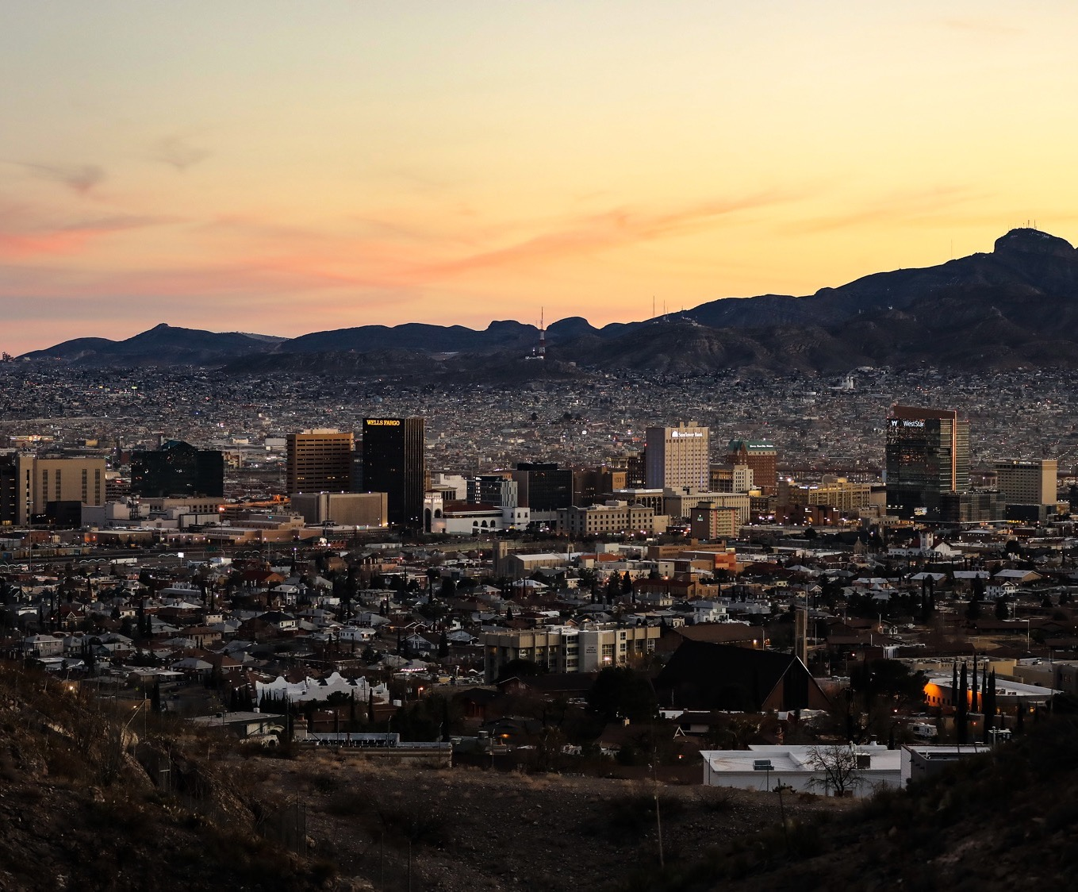
STRATEGIC ADVANTAGES
LEVERAGE
OUR
PLACE
4
Notes:
Region of 3 states and 2 countries along an international border
Gateway to opportunity and a trade route for >400 years
5th largest manufacturing region in North America
Largest military installation in the U.S.

Slide 5
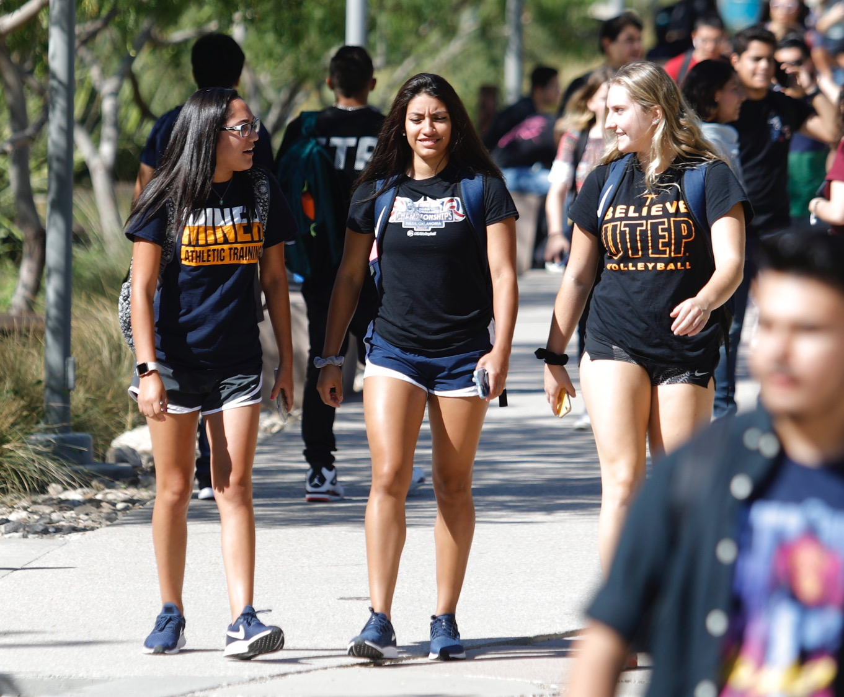
STRATEGIC ADVANTAGES
BUILD UPON
THE UNIQUE
DIVERSITY
OF OUR
PEOPLE
5
Notes:
One of the largest bilingual, binational, multicultural communities in the Western Hemisphere
We thrive in fluid, blended traditions of a border and trading community
College-going culture values education as a pathway to opportunity
Workforce is second-most educated in Texas, after Austin

Slide 6
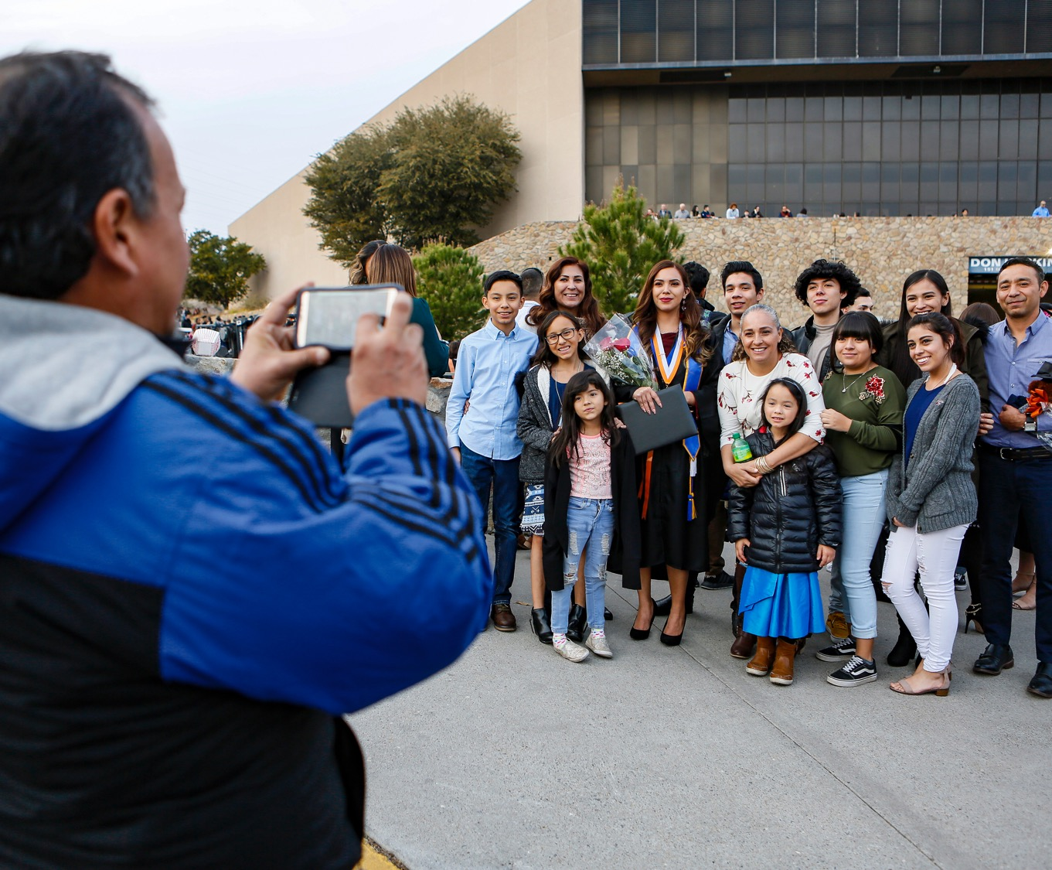
STRATEGIC ADVANTAGES
REINFORCE
OUR
CULTURE
OF CARE
6
Notes:
Culture of care and belonging for traditionally underrepresented students
The only open-access, top tier university in America with retention rates that exceed those at selective universities
Meet our students where they are, believe in their potential and help them succeed
Generous, family-oriented, close-knit community shaped by traditions and customs of more than 4 centuries

Slide 7
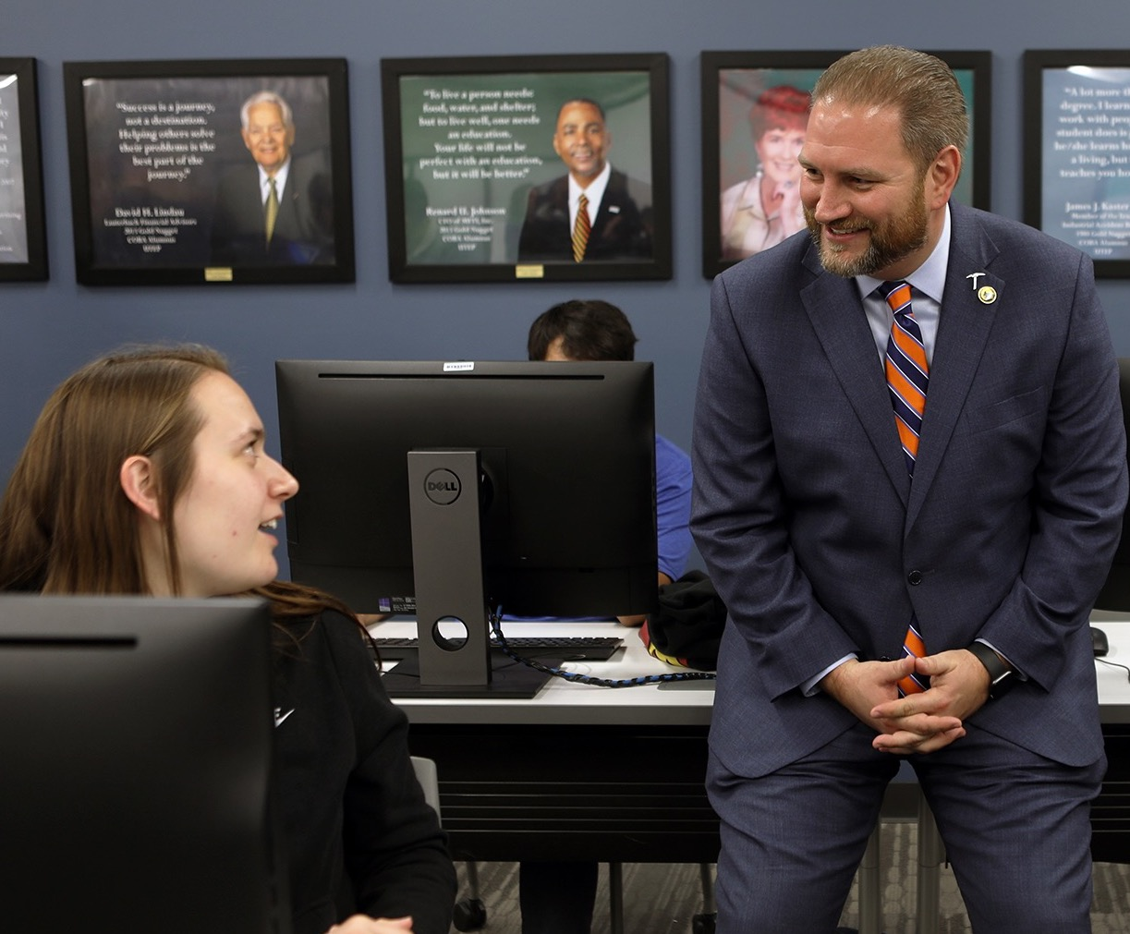
STRATEGIC ADVANTAGES
STRENGTHEN
OUR
ENGAGEMENT
AND BUILD
STRONG
PARTNERSHIPS
7
Notes:
Strong alignment among public school districts, El Paso Community College and the University
One of the best research universities for connecting students with the community
Potential to enhance hands-on learning through internships, co-ops, community-based service learning, undergraduate research, etc.
Build partnerships with other educational partners and research sponsors

Slide 8
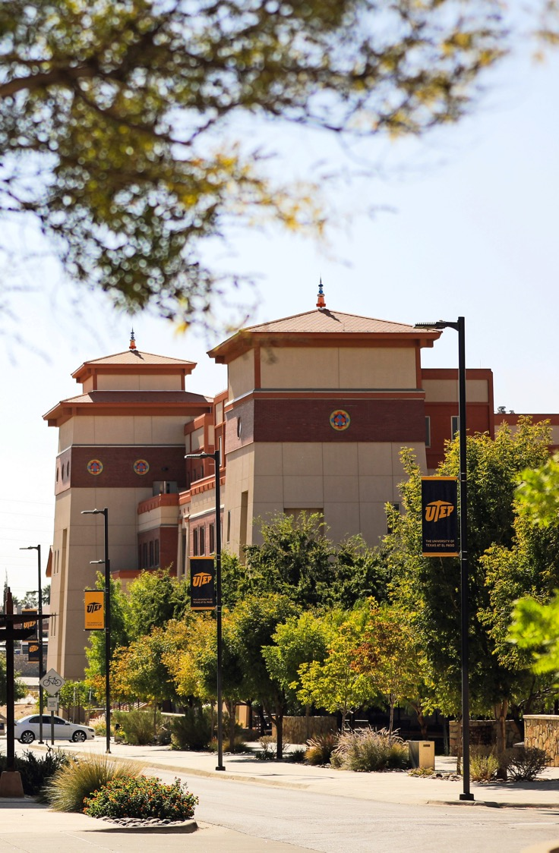
DEVELOPING GOALS
- Teaching, Learning and the Student Experience
- Advance Discovery
- Community Impact and Public Service
- Shape the Future of Higher Education
Notes:
Four goals tied to core areas within UTEP’s mission:
Teaching, Learning and the Student Experience
Advance Discovery
Community Impact and Public Service
Shape the Future of Higher Education
Goals look ahead to 2030
Goals are achievable with focused effort
Each goal has three initiatives
Goals are the “what,” initiatives are the “how”

Slide 9
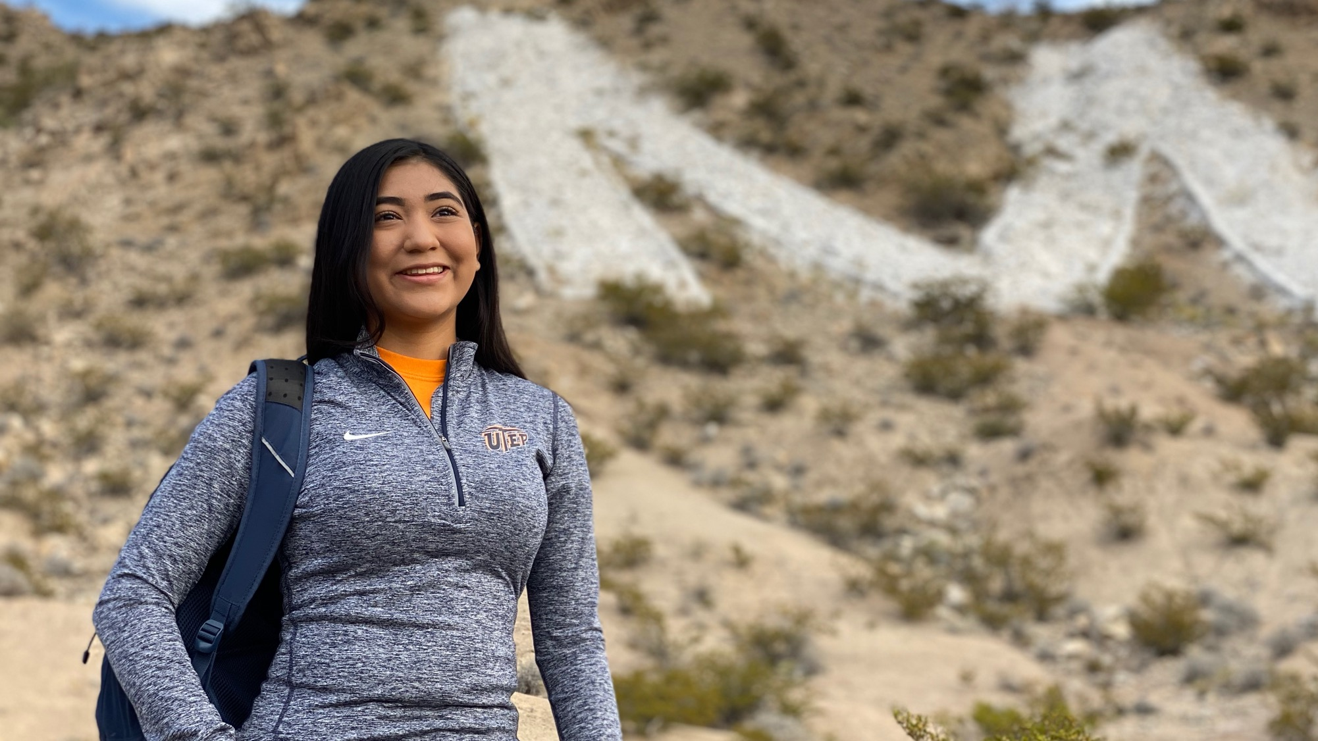
STRATEGIC GOALS
GOAL 1
Teaching, Learning And The Student Experience
Provide students an excellent and engaged education in an inclusive university that builds on student strengths and demonstrates a culture of care.

Slide 10
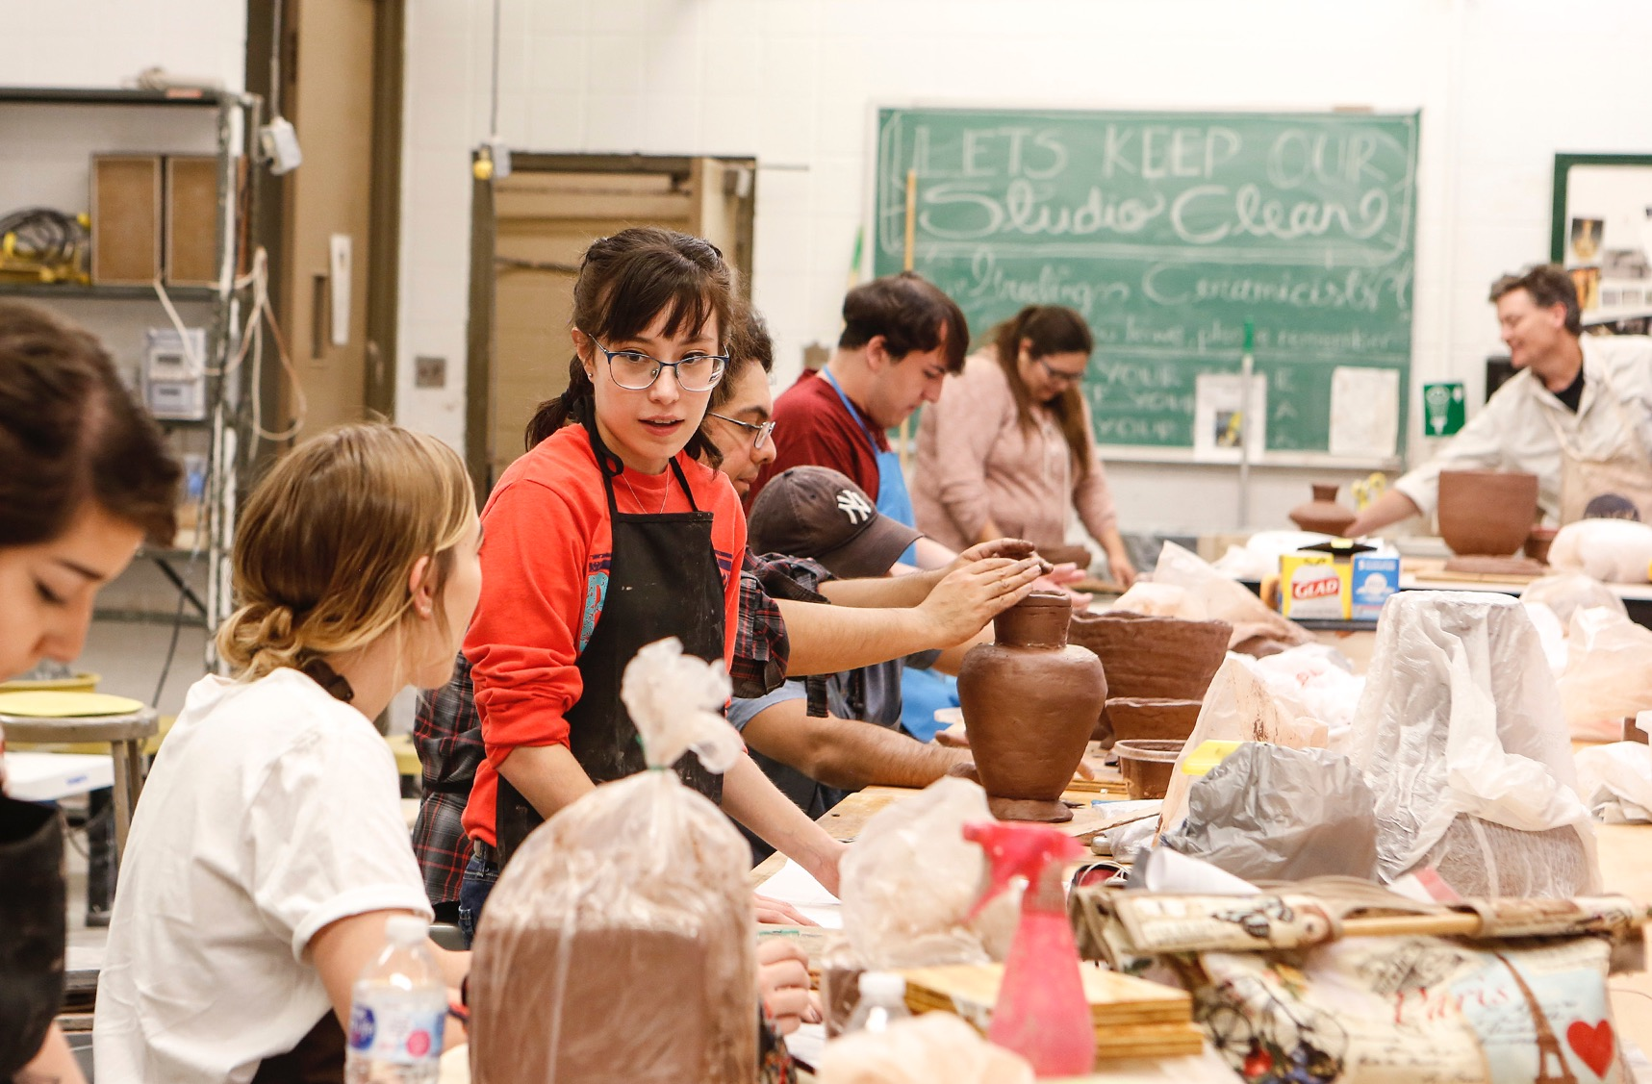
STRATEGIC GOALS
Initiatives
GOAL 1
New enrollment strategy
Enhance on-campus living
Prioritize scholarships
Redesign core for engaged learning
Transfer student alignment
Internships & Co-ops
10

Slide 11
STRATEGIC GOALS
MEASURING SUCCESS
Teaching, Learning And The Student Experience
- Degrees Awarded
- Enrollment
- Retention Rate
- Student Participation in High-Impact Programs
11

Slide 12
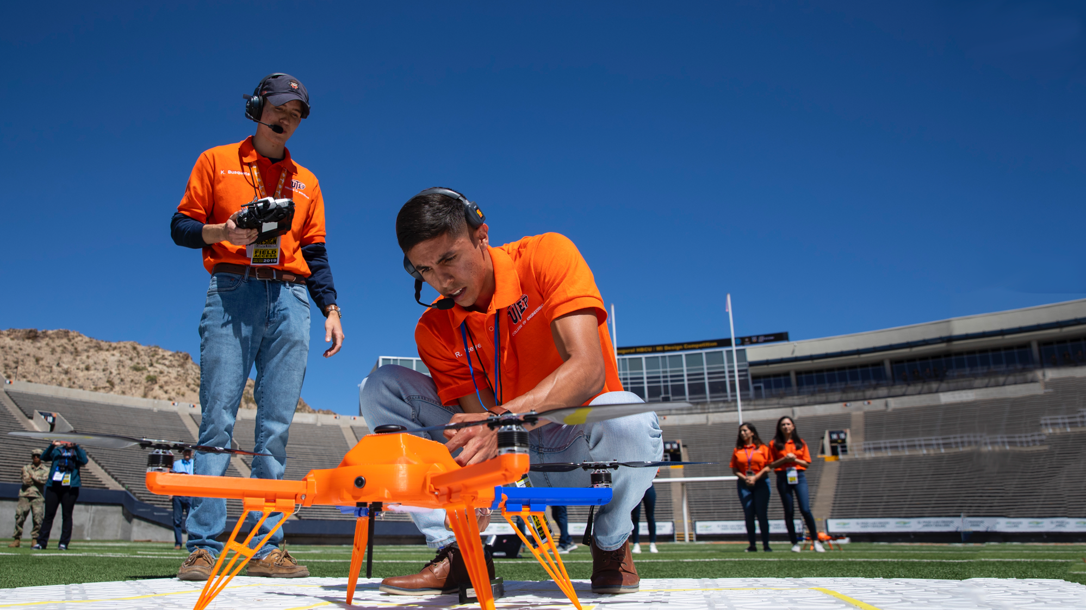
STRATEGIC GOALS
GOAL 2
Advance Discovery
Advance research, scholarship and artistic expression with emphasis on areas of current and emerging strength.

Slide 13
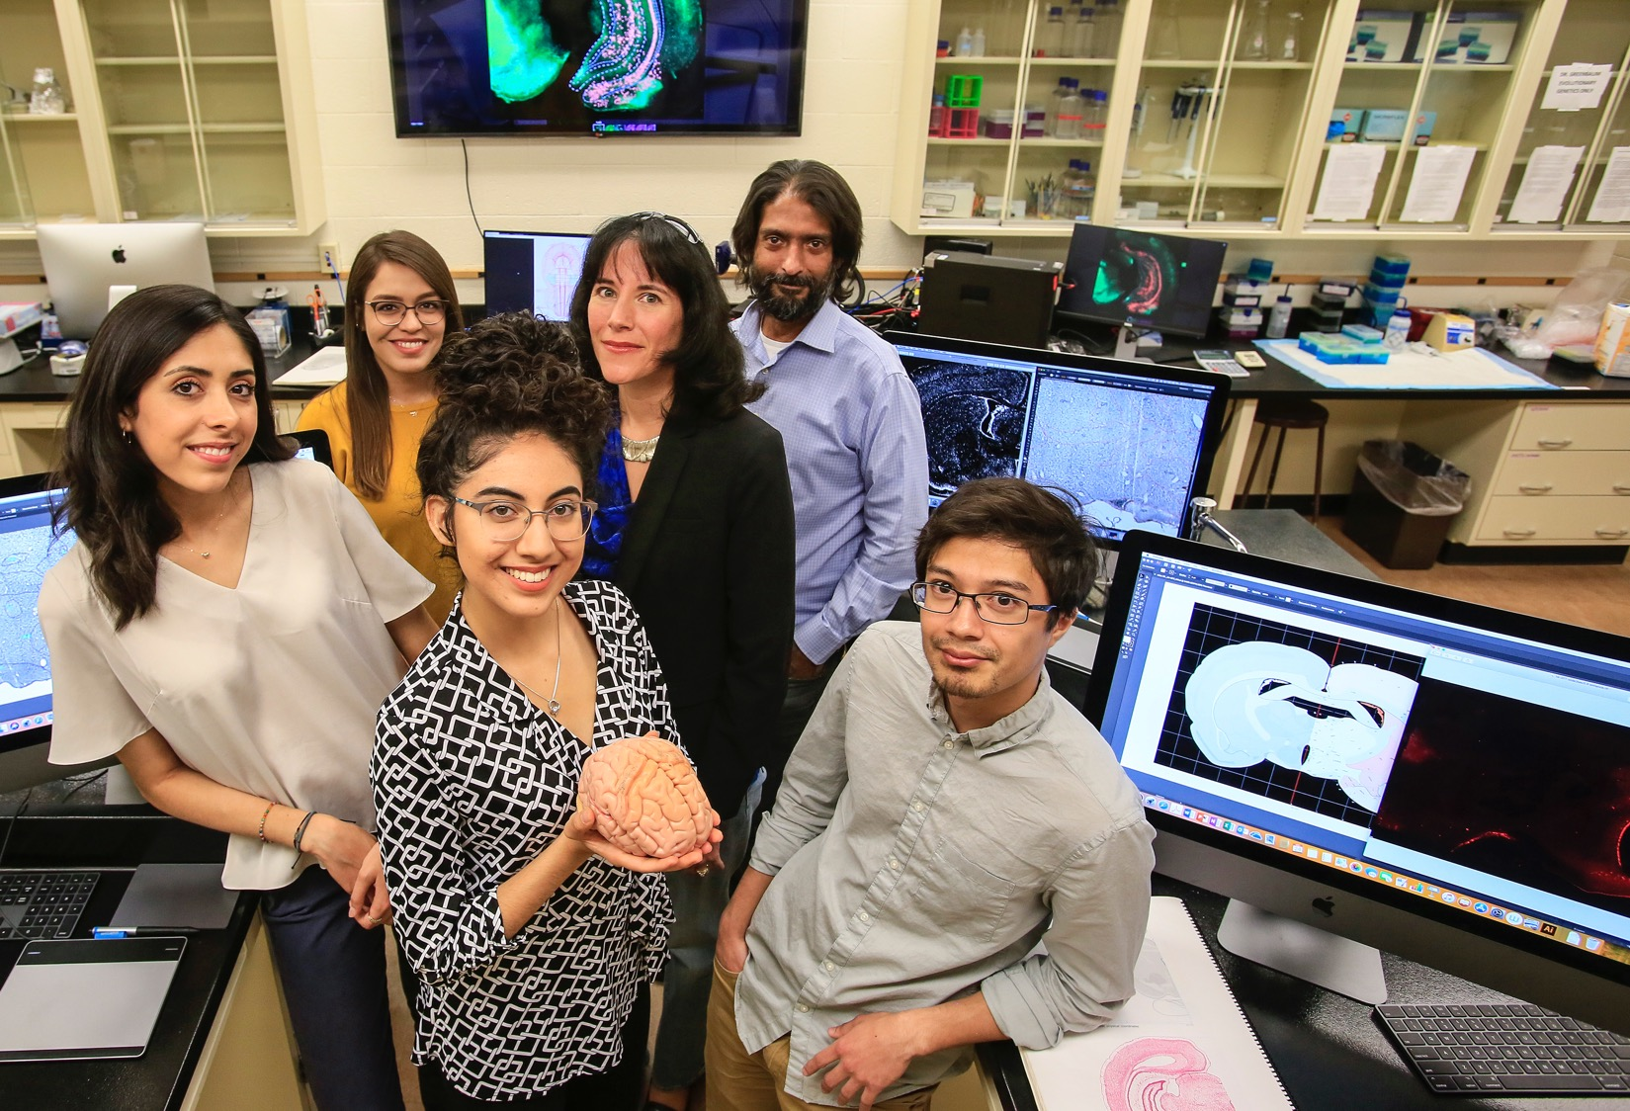
STRATEGIC GOALS
GOAL 2
Initiatives
Broad support for scholarship by all tenured and tenure track faculty
Focus on areas of strength to build federally funded research
Expand Ph.D. programs and increase support
13

Slide 14
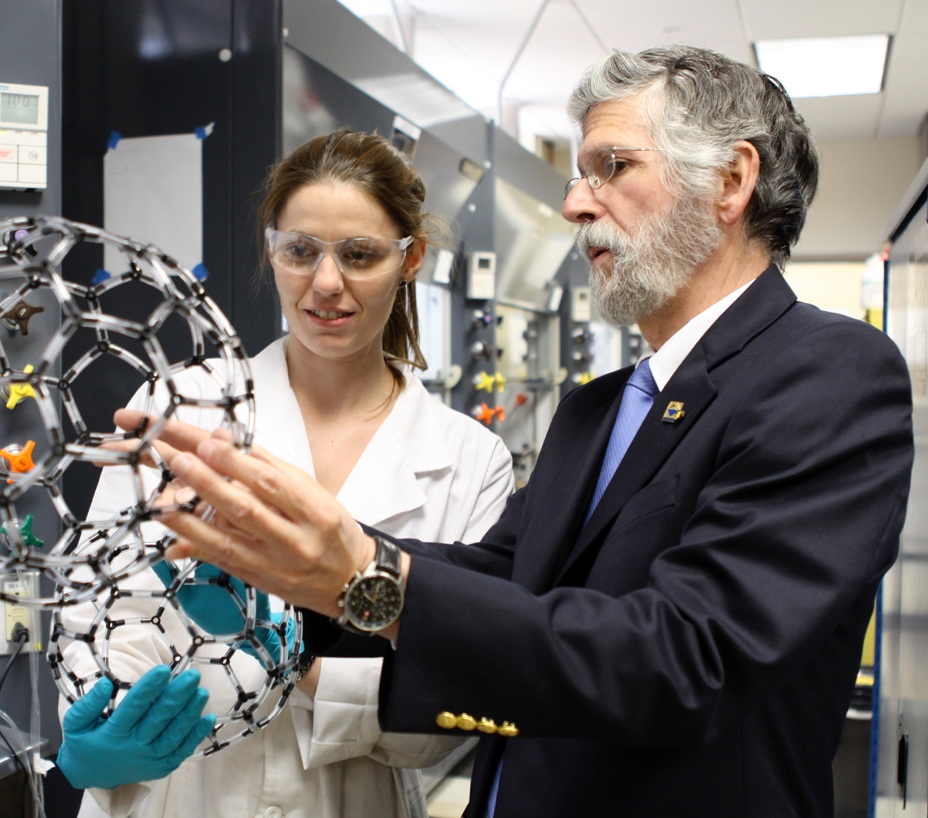
STRATEGIC GOALS
MEASURING SUCCESS
Advance Discovery
- Research Expenditures
- Scholarly Publications
- Creative Activities, Exhibitions, and Performances
- Doctoral Degrees Awarded
- Patents
14

Slide 15
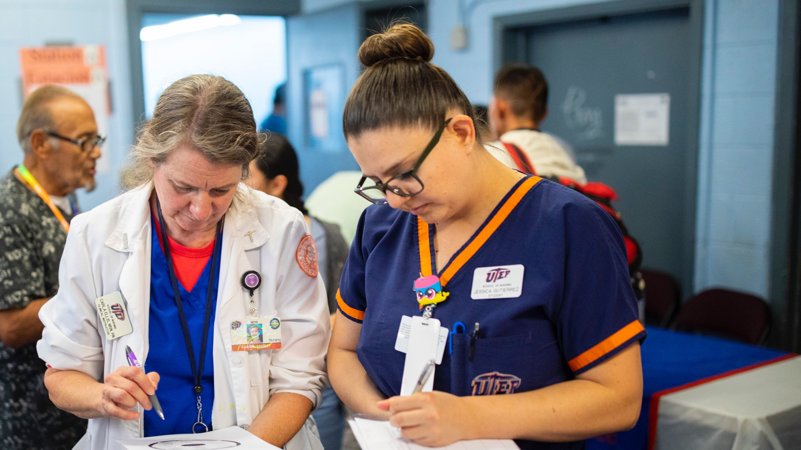
STRATEGIC GOALS
GOAL 3
Community Impact And Public Service
Foster well-being in our community so that we all live healthier, more prosperous, and culturally enriched lives.

Slide 16
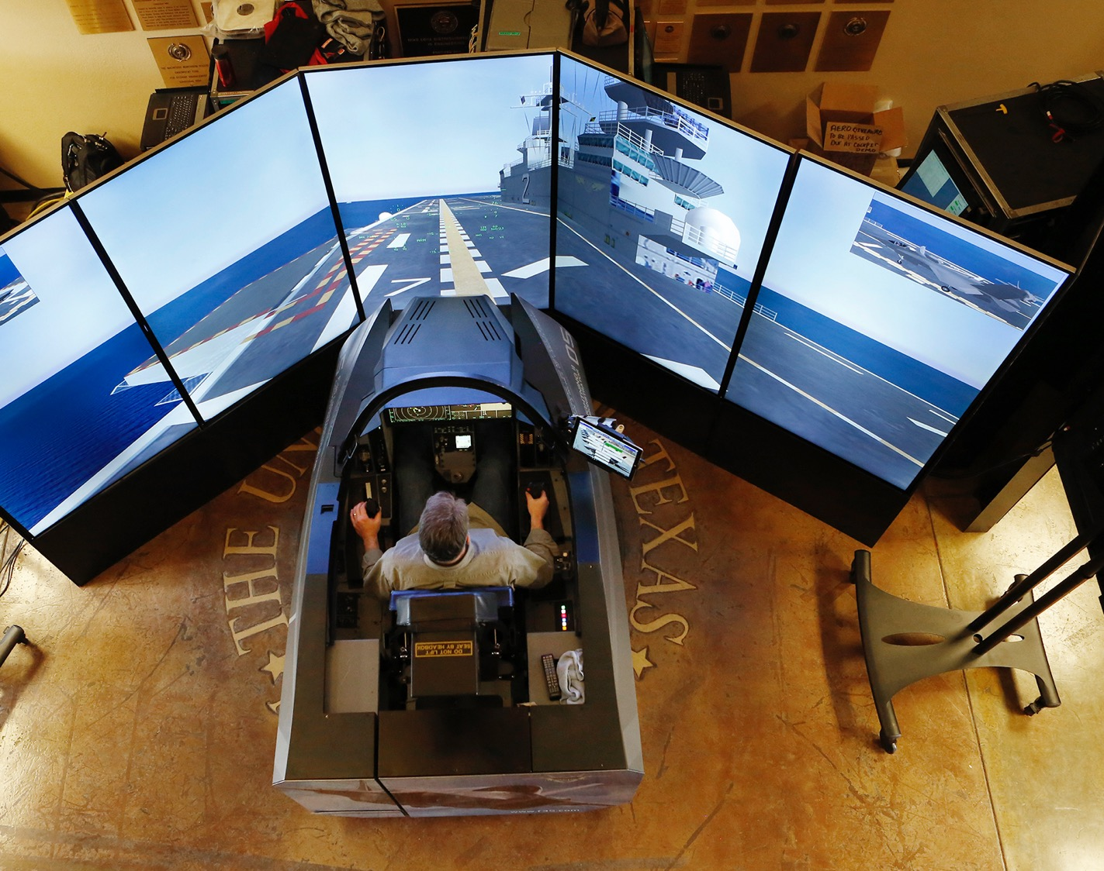
STRATEGIC GOALS
GOAL 3
Initiatives
Increase events
High quality intercollegiate athletics
Develop KTEP to tell the story of our region
Establish Business Engagement Center
Deepen health care partnerships
16

Slide 17
STRATEGIC GOALS
MEASURING SUCCESS
Community Impact And Public Service
- Education Level in the El Paso Region
- Workforce Productivity in the El Paso Region
- Health of Residents in the El Paso Region
- Community Participation in UTEP Events
17

Slide 18
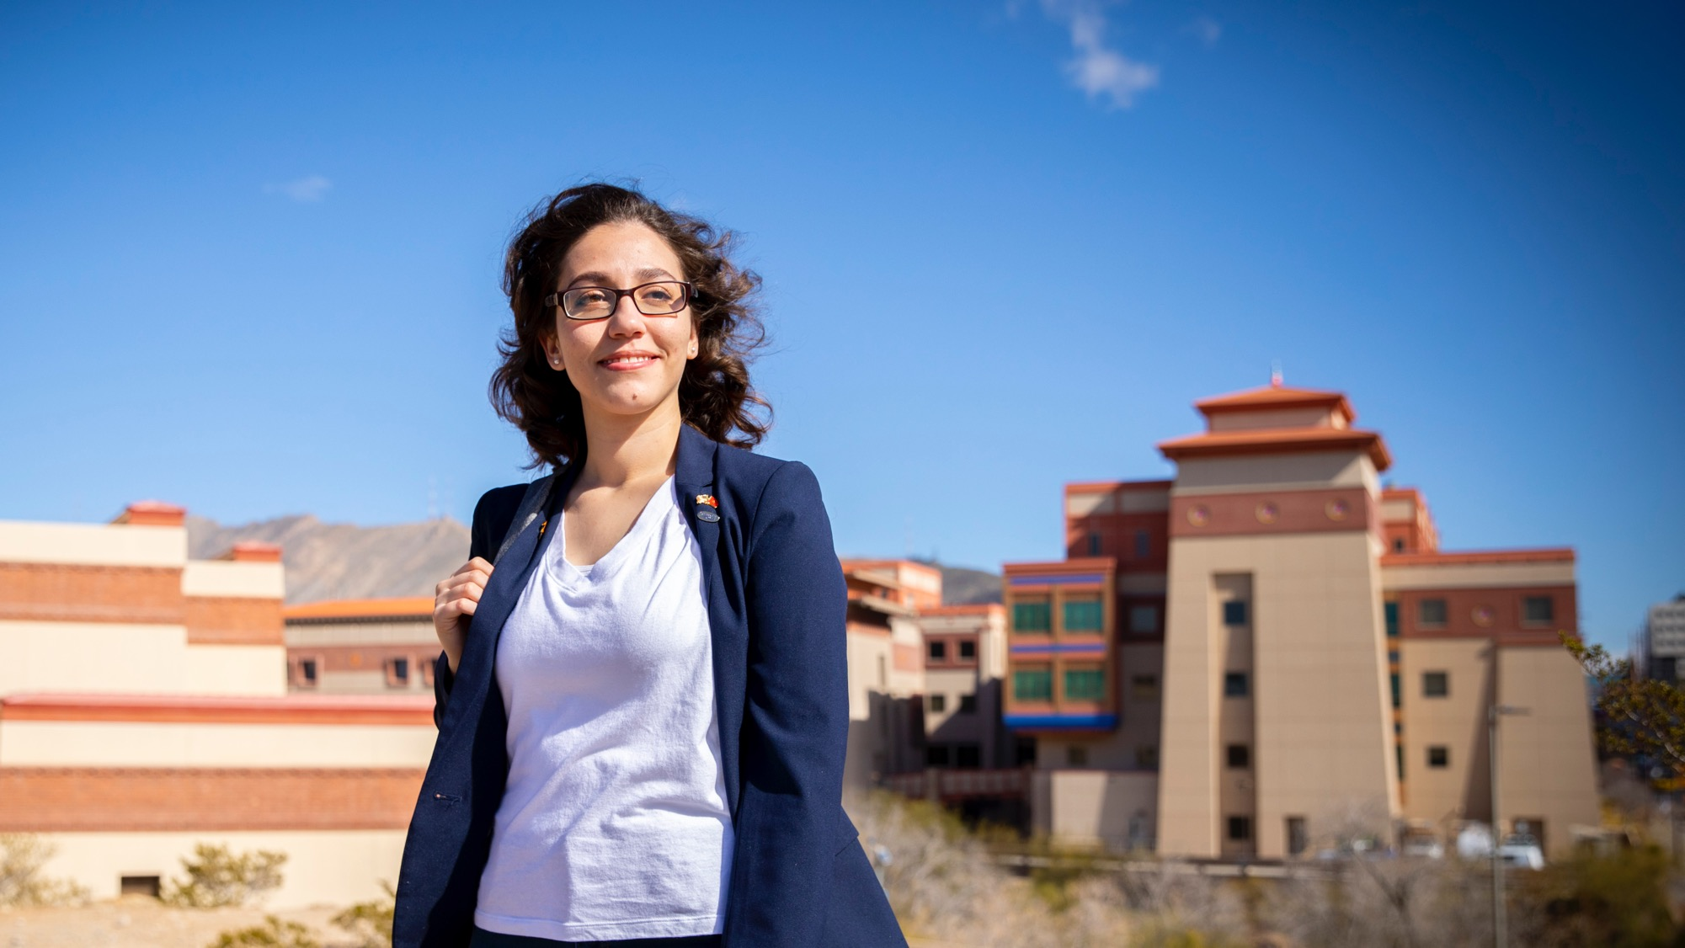
STRATEGIC GOALS
GOAL 4
Shape The Future Of Higher Education
Positively impact American higher education as the exemplary Hispanic-serving research university.

Slide 19
STRATEGIC GOALS
GOAL 4
Initiatives
Center for the Study of Hispanic Education
Re-establish UTEP University Press as a digital only publisher to focus on minority-serving universities
Train administrators
National leader in bilingualism
19

Slide 20
STRATEGIC GOALS
MEASURING SUCCESS
Shape The Future Of Higher Education
- UTEP Representation on National Boards, Agencies, Commissions and Committees
- UTEP Scholarly Activities Related to Hispanic-Serving Institutions
- National Recognition for UTEP
20

Slide 21
WHAT’S NEXT
Spread the Word
Presentations to each unit on campus through April
Distribution of plan to external stakeholders
Presentations to partners and community groups
Implementation
Implementation of initiatives

Slide 22
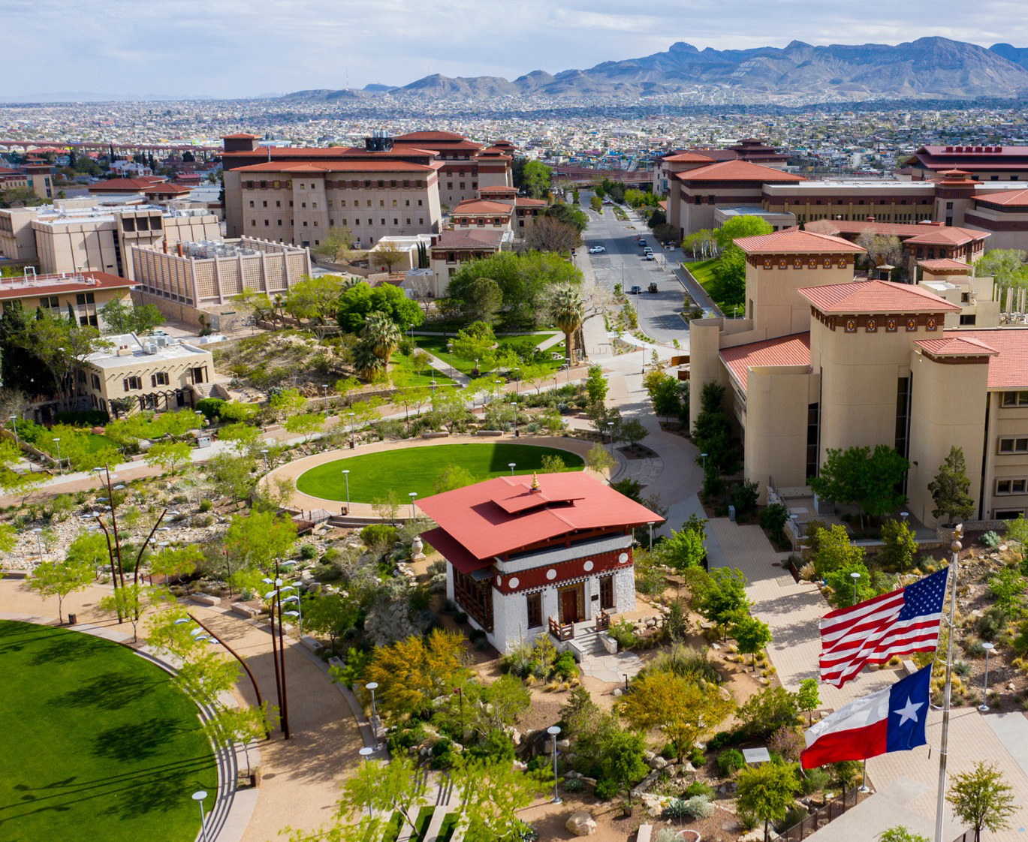
Learn More
utep.edu/strategic-plan
22

