Slide 1
iClicker Student Sign-up Instructions

Slide 2
Quick Tips when Using iClicker:
Students can either connect to the UTEPSECURE Wi-Fi when they are on campus or use their mobile data (if available) to participate in class.
Use the one that provides better service in the classroom where class is conducted
For optimal performance, students should close all other apps or windows that may be running on their device
If a student’s device freezes, they will need to restart it.
Students need to use the email address that is associated with their Blackboard profile when creating their accounts. Students who have used iClicker in the past do not need to create a new account.
iClicker automatically gives all new students a 14 day free trial. As long as students have selected UTEP as their institution, they will not have to renew their subscription after the 14 day trial is over. Students will still be able to participate and add additional UTEP courses.
Students: DO NOT create more than one iClicker student account! You will only receive credit from a single account. You can edit your account information in your iClicker student profile if needed. Your iClicker student account will work for multiple courses.

Slide 3
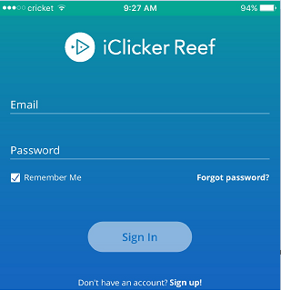
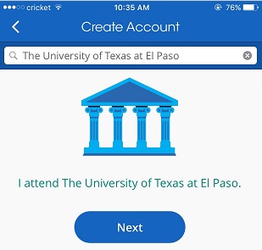
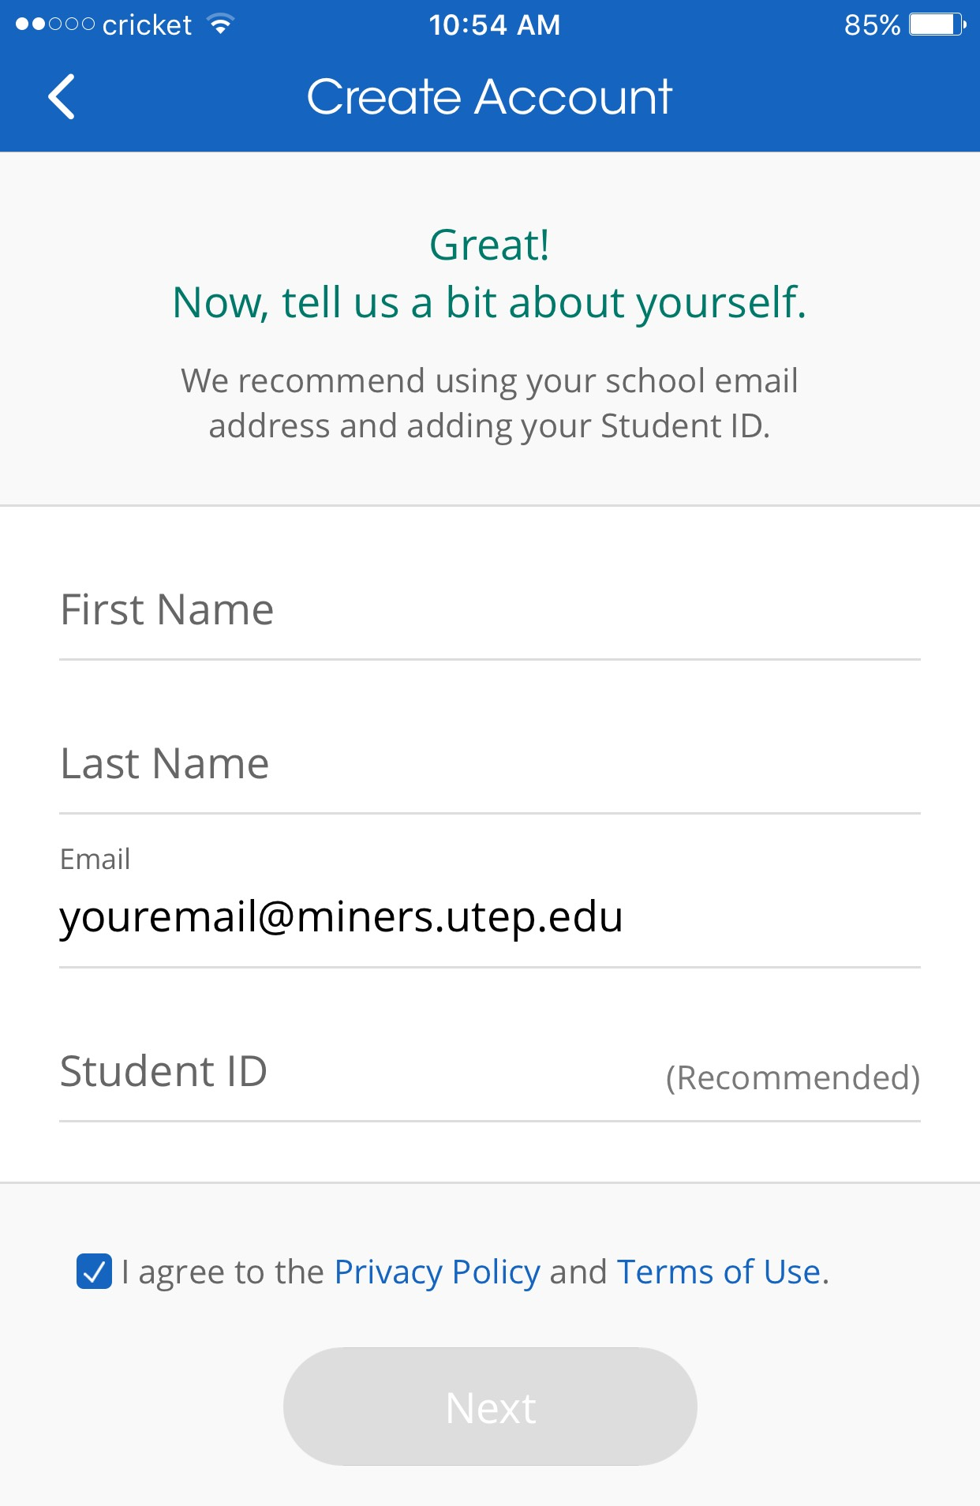
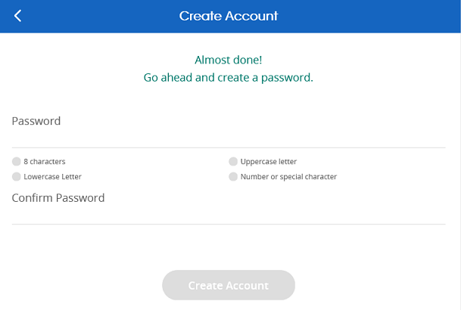
1
Using any web browser, go to https://student.iclicker.com/#/login or using your smart phone, download the iClicker Student app from the App Store or Google Play.
2
Create an iClicker Student Account
Note: If you already have an existing account skip this part and go to “Add a Course” slide
1. Click on the Sign up option to create an account.
2. Search your institution:
Institution: UTEP (University of Texas at El Paso)
Complete the form with the following information:
Enter your First and Last Name
Email: use the email address associated with your Blackboard profile
Student ID: use your 800# or 880#
Check “I agree to the Policy”
Click on “Next”
4. Create your password (must meet all credentials listed) on the line that says “Password” then confirm the password you just created.
Click on Create Account.
3
4

Slide 4
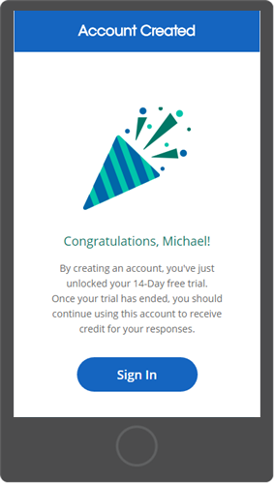
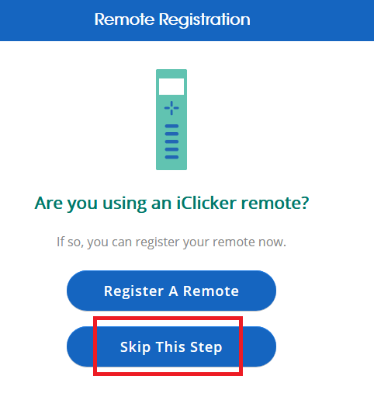
Now that you have created your account, sign in to the iClicker Student app
When asked to register a remote device, choose “Skip This Step”

Slide 5
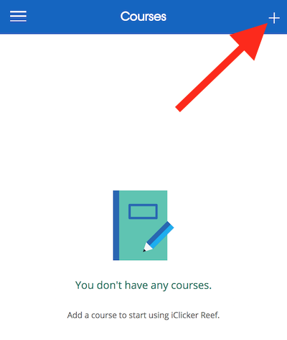
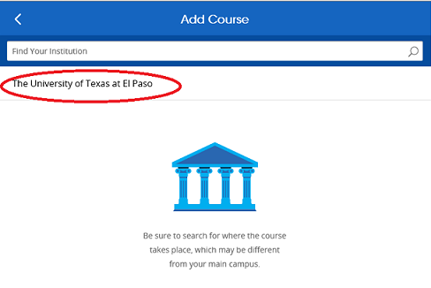
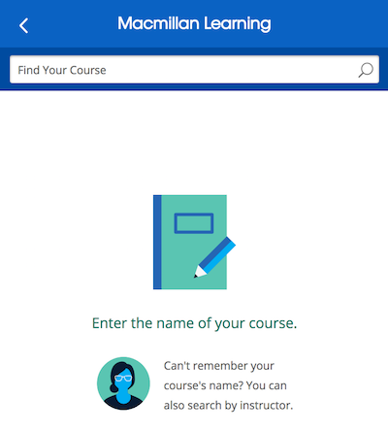
Add A Course to Your Account
1 Click the + button and find your instructor’s course using the following information:
Find your Institution: Select The University of Texas at El Paso
Find your Course: Type your instructors last name in the box
This will give you a list of their iClicker courses. If you see more than one course listed, choose the course that applies to you. If unsure then ask your instructor which course it should be.

Slide 6
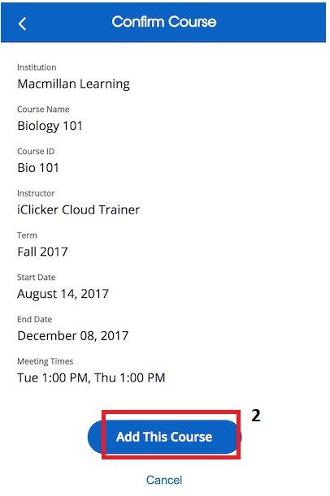
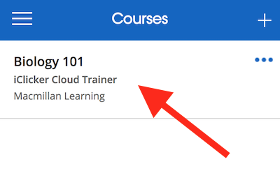
Then press “Add this course”
The course will now appear in your Courses list whenever you log into your iClicker Student account. When it’s time to participate in class, select the course and wait for your instructor to begin.

Slide 7
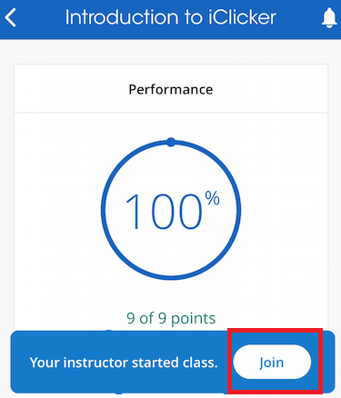
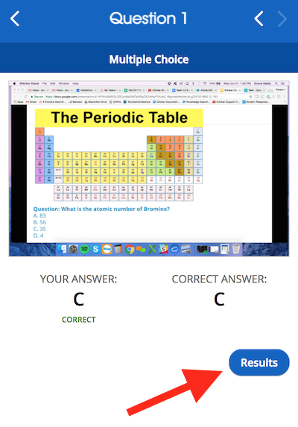
How to Participate in Class
1. When a session is active, the Join Session button will appear on the course screen. Click this button to join the session.
2. Once you’re connected to the session, your screen will
automatically update to allow you to answer questions
whenever polling starts. You will receive an image of
the instructor’s screen (if enabled by instructor).
3. If questions are graded, you
will receive correct/incorrect
feedback.

Slide 8
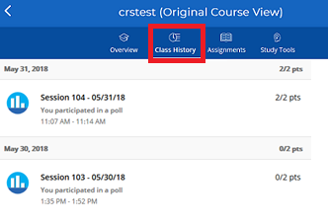
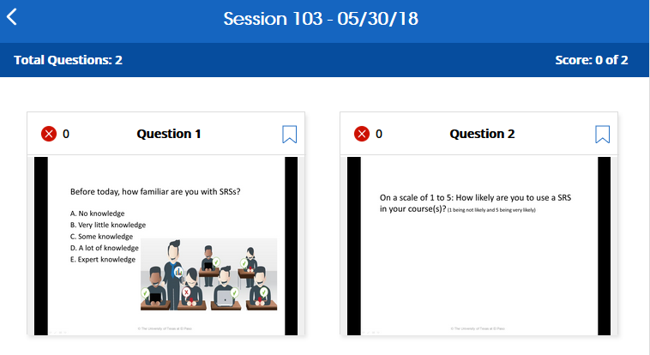
Class History and Session Results
Class History tab allows you to view all your course participation, organized by date. You will see the points you earned over the total possible points for each session. If your instructor has chosen to share screenshots then you can review past questions to study material after class.
Simply tap on a session to select it and tap a question to view the details.
NOTE: Because iClicker data is stored to the cloud, you can access your session history from anywhere using a web browser, iOS app or the Android App.

Slide 9
iClicker Technical Support
Please contact UTEP Technology Support at
915-747-4357 (HELP), to open a service request
Or
If on campus, come to the Library room 300 (Technology Support Center) for assistance.

