Slide 1
Miner Mall
Shopper and Creator Training
Revised Nov. 19, 2013

Slide 2
Agenda
Procure to Pay Process
Purchasing Thresholds
Miner Mall live-site Demonstration
Purchasing Information
HUB
Procurement Card Program
Contract Administration
PeopleSoft

Slide 3
Purchase-to-Payment Processes
Miner Mall is the university’s system of record for the procurement of goods and services. The majority of purchase-to-payment processes will be conducted in Miner Mall
Cart
Purchase Requisition
Purchase Order
Shopping
Hosted Catalog
Punchout Catalog
Forms & Spec. Request
Enabled Contracts
PR Creator
Enters accounts, chart field and shipping.
Approval(s)
Dept $
Optional EH&S, IT, Other
.
Purchasing
Review Non-Catalog items
High Dollar
Contracts
Supplier
Receives PO
Acknowledges
Fulfills Goods / Services
Receiving
Invoice Entry
Matching
Payment Status
Central Rec.
Unpacking
Quality Checking
Delivery
Desktop delivery to requestor
Invoice
PO Invoice
Non-PO Invoice
Direct Voucher
Approval
Non-PO Invoice Dept $ approval
3-way Match
Payment
PeopleSoft voucher payment
Check or ACH to Supplier

Slide 4
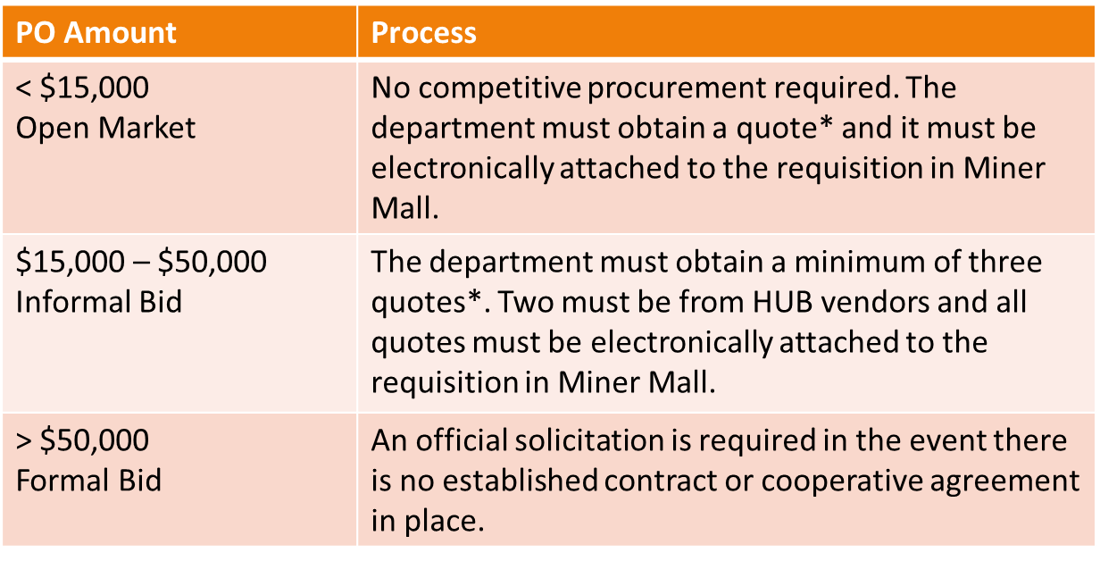
Dollar Thresholds
*Quotes must be valid (not expired).
* When soliciting quotes from multiple vendors, specifications must match

Slide 5
What will you learn today?
Sign On
Set Up Profile
E-mail Notification Preferences
Creating a Cart
Non-Catalog Order
Freight, Shipping, Delivery and/or Handling Charges
Non-Catalog Checkout
Check-Out
Accounting Codes
Commodity Codes
Attachments and Notes
Ordering Chemical/Hazardous Materials (HAZMAT)
Requesting a New Supplier
Process a Change Order
Alternate Ship-to Address
Document Search
Invoices

Slide 6
Sign On – my.utep.edu
Miner Mall

Slide 7
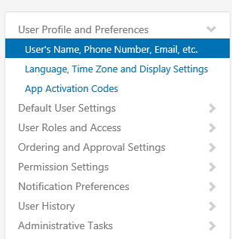
Set Up Profile
Click on your name
Click on Language, Time …

Slide 8
Set Up Profile
Update your Information & save

Slide 9
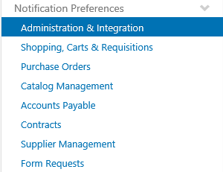
E-mail Notification Preferences
Click Notification Preferences
Click Edit to select your notification preferences
Notes:
Important that creators click on the question mark to understand what each notification is for. Approvers and creators should select Cart Assigned Notice. Creators should then select PR Workflow complete / PO created so they are sent a notification once their requisition is final approved.

Slide 10
Creating a Cart
Home Page
Click on a displayed catalog, form, or create a
Non-Catalog order.

Slide 11
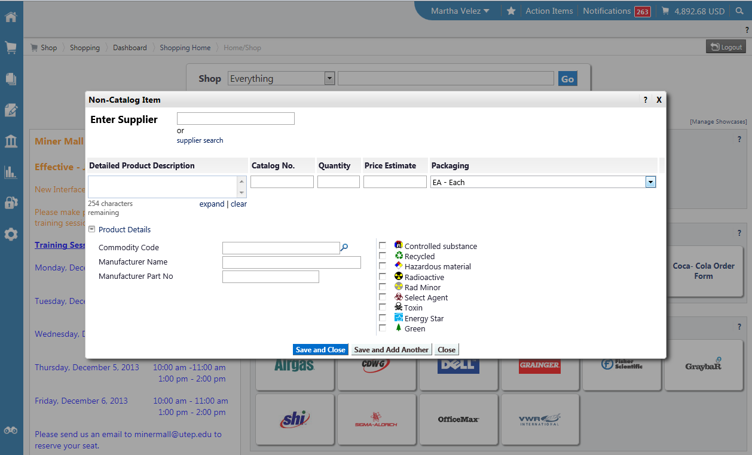
Non-Catalog Order
Supplier Search
Options
Notes:
Non-catalog orders should always have a valid quote attached to the requisition.

Slide 12
Freight/Shipping/Delivery and/or Handling Charges
Freight, Shipping, Delivery and/or Handling Charges
If the vendor has not provided you an amount, please enter an estimated line item charge.
Commodity Code
Notes:
Freight charges should be included when requesting a quote from a vendor. If not, then include an estimate. Unless the vendor has indicated there will be no charges for shipping or freight, do not assume it will be free.

Slide 13
Non-Catalog Checkout
After Saving, you will be Returned to your Home Page and your Cart will be Displayed in the Upper Right Corner

Slide 14
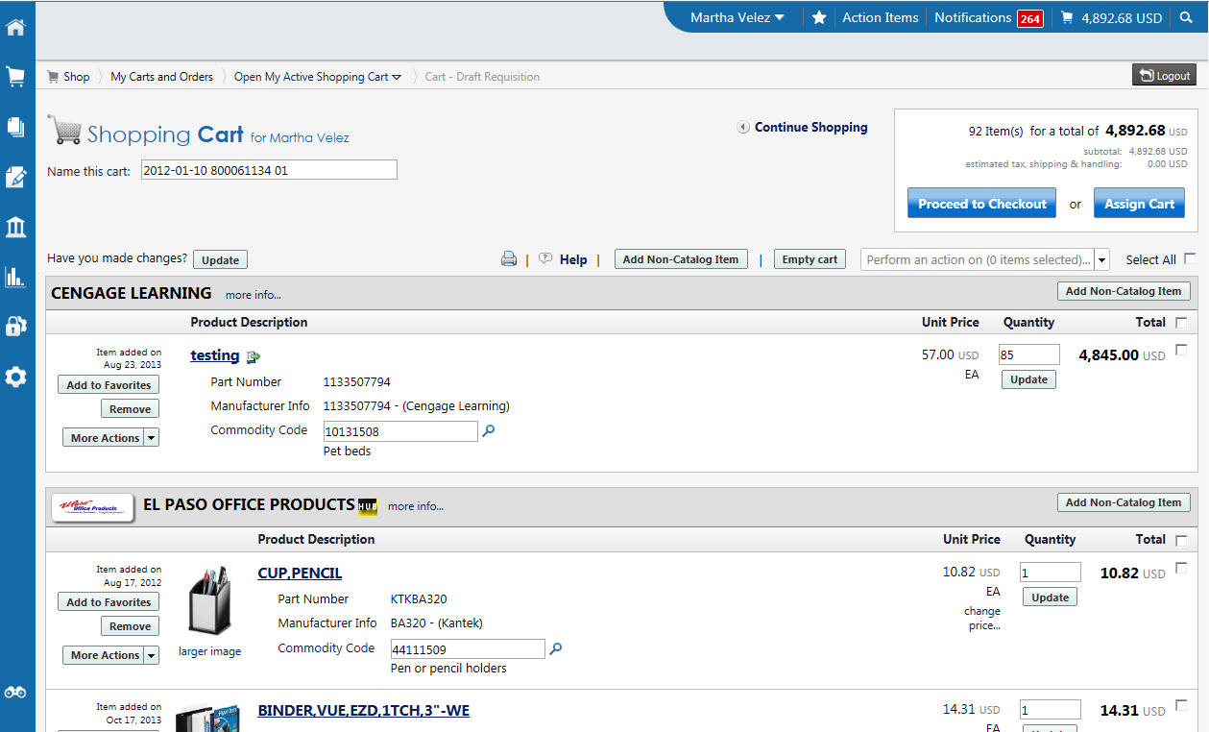
Shopping Cart
Cart Name
Update
Proceed to Checkout or Assign Cart
Commodity Code
Notes:
Cart names can be modified to help you easily identify a purchase during workflow approval or simply for recordkeeping. If any changes are made in the shopping cart, be sure to click Update so that the changes are applied. Shoppers will only see the option to Assign Cart while creators will see both Proceed to Checkout and the Assign Cart option.

Slide 15
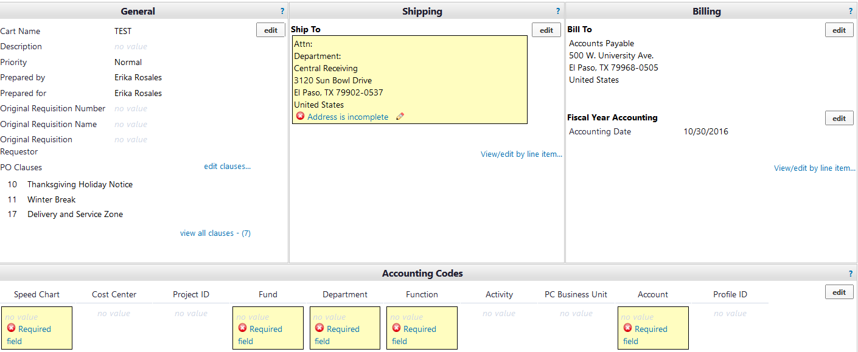
Check-Out
Incomplete items
Notes:
After selecting to check-out, the breadcrumbs will indicate what areas need to be addressed before your cart can be submitted. Select edit to update the information.

Slide 16
Update Accounting Codes
Identify the Speed Chart (Cost Center or Project number)
Click “Select from Values” link and choose from the account values provided.
Notes:
If you know the number, enter the cost center or project number in the Speed Chart field and then recalculate/validate values. Remaining fields, with the exception of the account, will auto-populate. You can also select from your profile values or from all values. Creators will have access for both options but shoppers will only see the Select from profile values option
Next search for and add the account number (object code). Save.

Slide 17
Split an Accounting Code
Click Edit
Line level splits
Click the Add Split option
Click the drop-down arrow. Enter the desired percentages or the dollar amount to be distributed.
Notes:
Accounting code splits should preferably be done at the line level of a requisition document.

Slide 18
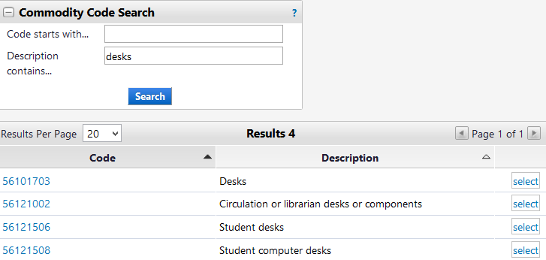
Commodity Codes
Search by description
Code associated to the PO line.
Notes:
Commodity codes are required to be associated to each PO line. Catalog orders will have the commodity code already generated. Non-catalog orders will require the user to select the correct code.

Slide 19
Attachments and Notes
Add a Note
Add Attachment
Internal Notes can be used to reference anything that may be of significance to you such as a project name or location. These are only visible to UTEP end-users.
External notes are used to send a short text to the vendor. This may be a quote number, instructions, or a reference. These notes are sent to the Supplier.
Notes:
At the requisition level, quotes, contracts, and other documentation can be attached to requisition via Internal Notes and Attachments. Documents must be saved to your desktop in a PDF format in order to load them. Once a requisition becomes a PO, documents can only be uploaded via a comment. Be sure to always click Save when adding an attachment or note.

Slide 20
Ordering Chemicals/Hazardous Materials (HAZMAT)
Notes:
Hazardous materials ordered via a Miner Mall hosted or punch-out vendor will have the items flagged as required. Non-catalog orders containing any item considered HAZARDOUS, will require the end-user to mark the appropriate category if necessary. Items marked here will route to our EH&S safety team for review.

Slide 21
Requesting a New Supplier
New Supplier Request Form
Supplier Name
Supplier Address
Supplier Phone no.
Supplier e-mail

Slide 22
Process a Change Order/Cancel or Close an Order
Change Order Request
Canceling a purchase order
Canceling a line item on purchase order
Closing a purchase order to relieve an open encumbrance
Correcting an error

Slide 23
Alternate Ship-to Address
Alternate Ship to Request Form
Live animal and Cadavers
Hazardous chemicals
Off Campus research
Construction Job Sites
Notes:
Only Purchasing has the authority to modify ship-to locations. Never call a vendor to request an item ship to an alternate address without Purchasing office approval and a modification to the PO.

Slide 24
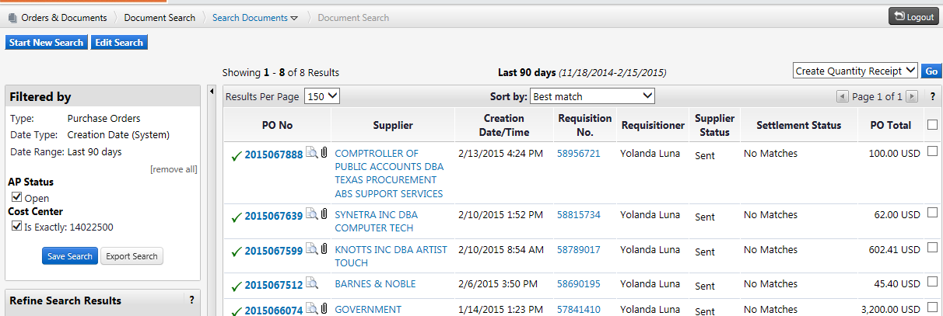
Document Search
Document types
Export results
Notes:
Document Search can be used to create customized reports on various documents by user, department, vendor, cost center and projects, dollar amount, and other custom fields. Reports can be exported in an Excel format.

Slide 25
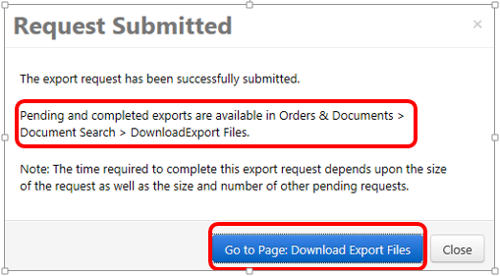
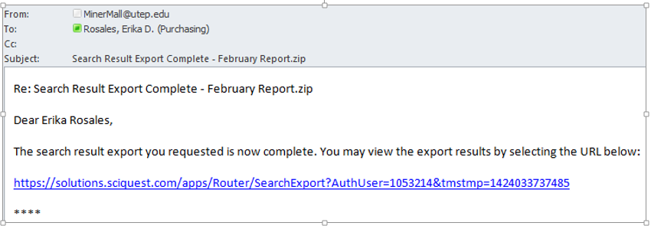
Document Search
Notification e-mail
Notes:
Once an export is generated, the end-user will be notified via Outlook. When opening your file it will be in CSV format and will need to be converted and save in an Excel format.

Slide 26
Invoices
Invoices should always be forwarded to the Accounts Payable office as indicated in the address on the PO.
Invoices received at the departments should be forwarded to the Accounts Payable department immediately.
Upload invoices to your Miner Mall PO via a comment and address it to billing@utep.edu.

Slide 27
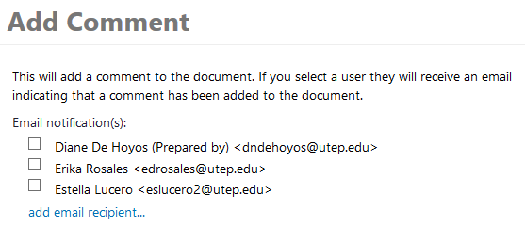
Uploading an Invoice
Then Add Comments
Click on Comments
Who the comment will be addressed to.
Search for the Accounts Payable user
Notes:
Invoices should be loaded to your PO document but must be saved to your desktop as a PDF. It is important that when adding a comment with an invoice. that the comment is addressed to Accounts Payable otherwise, they will be unaware that you have uploaded an invoice for payment.

Slide 28
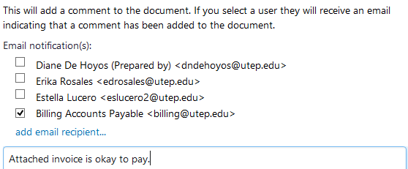
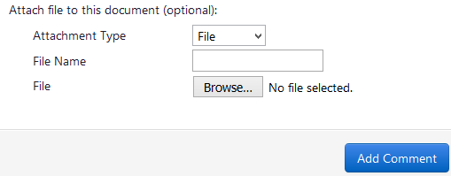
Uploading an Invoice
Add your comment
Browse for your invoice file, select it. and then Add Comment.
Notes:
When uploading the invoice be sure the correct recipients have a checkbox by their names. Indicate the invoice is okay to pay, upload your invoice, then select Add Comment. Accounts Payable will receive a notification. *IMPORTANT THAT THE COMMENT BE ADDRESSED TO ACCOUNTS PAYABLE* Comments can also be used internally to communicate with other departments.

Slide 29
UTEP HUB PROGRAM
The goal of the HUB Program is to promote participation of HUB businesses in procurement and contracting opportunities with UTEP.
HUBs include:
Minority-owned businesses
Woman-owned businesses
Service-Disabled Veteran - owned businesses
Departments should make a sincere, good-faith effort to purchase from HUB vendors whenever possible.
Contact your Purchasing office Buyer or the HUB Program Administrator for any HUB related questions or inquiries.

Slide 30
Procurement Card Program
The ProCard Program is designed to give departments a quick and efficient way in which to make small dollar purchases.
The ProCard is a Citibank MasterCard and is issued to an individual employee for UTEP business purchases only.
For more information regarding the procard, please visit the Purchasing and General Services website http://admin.utep.edu/purchasing

Slide 31
WHO CAN SIGN CONTRACTS ON BEHALF OF THE UNIVERSITY ?
The university President has signature authority for all contracts. This approval has also been delegated to the VPBA and Purchasing Office.
Department Chairs, Deans, Directors or administrative staff may not sign contracts on behalf of the University.
Any purchasing contracts requiring an official University signature should be forwarded to the Purchasing office for review.

Slide 32
Contract Administration and Compliance
The Purchasing office includes a team of Contract Administrators responsible for;
Reviewing and executing standard contract documents
Reviewing and negotiating contracts
Monitoring the status of contracts
Monitoring scope of work performance in contracts
Advising departments of contractual rights and obligations
Assisting in the resolution of contract disputes

Slide 33
PeopleSoft
PeopleSoft is the universities ERP system of record.
The system handles all transactions for Finance (FMS) and HR (HCM)
Finance (Payroll, A/P, Receivables, Billing, Budget)
HR (Benefits, Time & Labor, Recruiting, Hiring)
For more information regarding PeopleSoft, visit the website at www.peoplesoft.utep.edu

Slide 34
For More Information
Miner Mall website www.minermall.utep.edu
Purchasing and General Services website http://admin.utep.edu/purchasing
HR webpage for registration for Miner Mall and Pro Card Training: http://admin.utep.edu/hr , click on Training and Development link
Contact the Purchasing Office at 915-747-5601.

Slide 35
Questions

